Slide 1

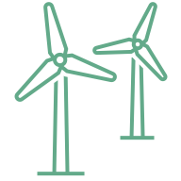

Wind Energy Education HUB
Renewable energy workshop

Slide 2
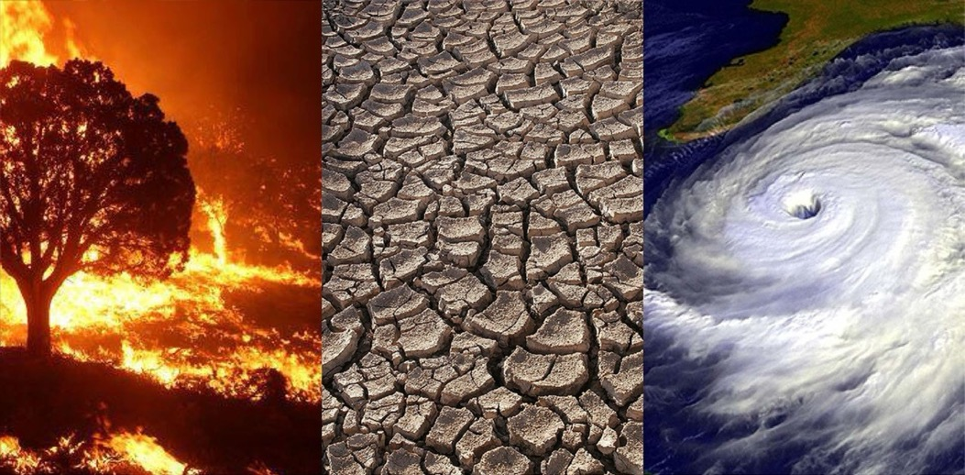
Source: https://science.nasa.gov/climate-change/effects/ (January 23rd, 2026)

Slide 3
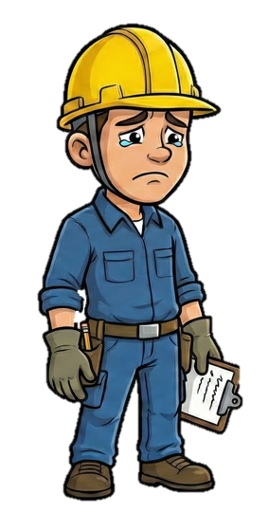
Get to know Walter
Climate change really is a problem… We need a plan to save the climate! Let’s call it the “Wind Mission.” If we follow these steps, we can do it together!
Walter is worried:
He sees a lot about climate change in the news and doesn't want to just stand by and watch, he wants to help. He is looking for an energy source that never runs out and doesn't pollute the air.

Slide 4
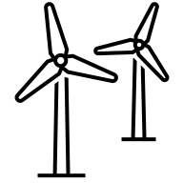
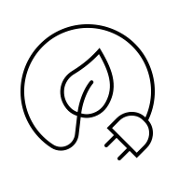


At the end of the session you’ll be able to
know the basics of energy, wind energy and where you can find the windiest places.
know how to measure wind and understand how wind can do work.
create an airfoil and connect it to the principle of Bernoulli.
use the wind turbine kit and try out which configurations generate the most energy and which is therefore the best way to build a wind turbine in real life.
Notes:
https://i.pinimg.com/originals/36/32/ea/3632ea56e4415244eb44fd078674ae1c.jpg
https://th.bing.com/th/id/OIP.iGsyHNGh0JOFRnQa8SUstgAAAA?rs=1&pid=ImgDetMain
https://wonderfulengineering.com/wp-content/uploads/2014/09/wind-turbine-pictures-2.jpg

Slide 5
Our session’s agenda
01
02
03
04
Wind basics
Measuring and working with wind
Learn about energy, wind energy and the wind atlas.
Learn how to measure wind and understand how it can work.
Airfoils
Experiments with a wind turbine
Learn about airfoils, their shape, and how this helps explain wind blade movement.
Familiarize yourself with the wind turbine kit and try out different configurations.

Slide 6
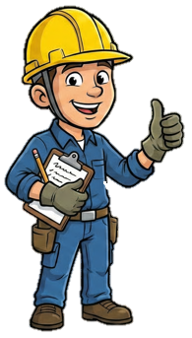
01
Wind basics
What actually drives the world? This should be good inspiration for a sustainable energy source.
Learn about energy, wind energy and the wind atlas.

Slide 7
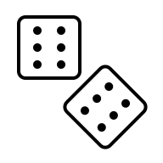

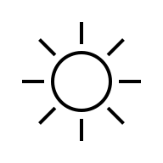
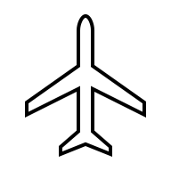

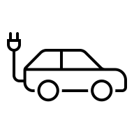
Energy
What comes to your mind when you hear the word "energy"?
Task 1: Let‘s create an energy word chain! Open your worksheet on page 10.
Be creative!
Biomass
Battery
Oven
Light bulb
Electricity
Power
Notes:
Form 2 groups from the class.
Someone starts with the first letter of their last name and says an energy-related word, such as an energy source, an energy-using device, or any energy term.
Look at the examples:
M: Microwave
S: Solar panel
T: Turbine
Go around the circle; everyone takes a turn. The last letter of the previous word becomes the first letter of the next energy word.
The game ends when no one can find a new energy word.

Slide 8
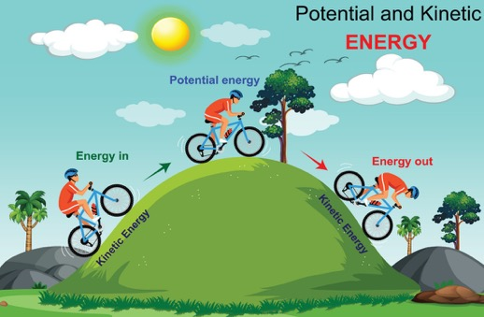
Energy
Energy is what makes things move and change.
It is the power to do work, which means it allows objects and living things to move, act, or make something happen.
Energy comes in two main types:
Kinetic energy: Energy of moving things (like a bike speeding down a hill),
Potential energy: Stored energy (like a bike resting at the top of a hill).

Slide 9


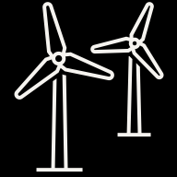
Energy
I'm crossing out coal and oil. It's like my pocket money - eventually it'll be gone. We need something that keeps coming back like a boomerang.
Non-renewable energy
Comes from sources that can be exhausted over time.
These are finite and will eventually run out.
Renewable energy
Comes from natural sources that are constantly replenished.
These sources can be used indefinitely without depleting them.
VS.
Task 2: Let's test your knowledge! Open your worksheet on page 12.
Notes:
Form a group of 2–4 people.
Look at the pictures on the next side and decide, which of them are renewable energy sources and which of them are non-renewable / conservative energy sources! Tick the right box.
Think about: do you know how they all are named?
Try it on your own first, then discuss it in your group.

Slide 10
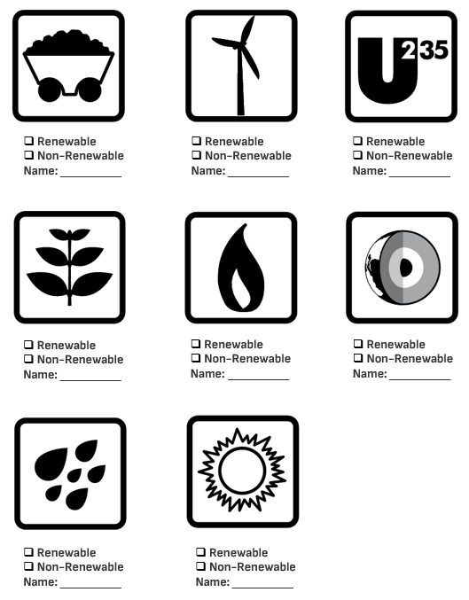
Energy
Coal
Wind
Uranium
Biomass
Natural Gas
Geothermal
Hydropower
Solar
Notes:
Solution

Slide 11
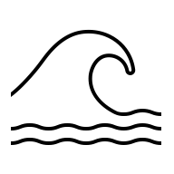
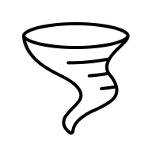

How wind is created
Wind creation
(during the day)
Sea
Above the sea, the air is cooler.
Cool air sinks and moves toward the land.
→ This is wind.
Land
The land becomes warmer.
Warm air rises above the land.
The warm air cools as it rises.
The cooled air flows back toward the sea.
Cooling of the air
Cool air
sinks
Warm air
rises
Sea
Land
Wind
Notes:
Page 13

Slide 12
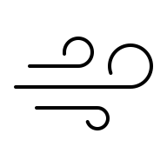
How wind energy is created
Energy
Energy is what makes things move or do work.
It is the power that allows things to move, change, or make something happen.
Wind
Wind is moving air in the atmosphere.
It happens when the air heats up differently in different places and moves around.
Wind Energy
Wind energy is the energy created by the movement of the wind.
Wind turbines use this movement to make electricity that we can use in our daily lives.
Have you ever seen a wind turbine in real life?
Notes:
Page 13

Slide 13
Windy places
Windy places mostly have one or more of these characteristics in common:
High elevation
Temperature differences
Pressure differences
Flat, open spaces
Attention: How strongly the wind blows varies greatly on a regional scale.
I want to set up my first wind turbine. But where? In the city? Or better on a mountain?

Slide 14
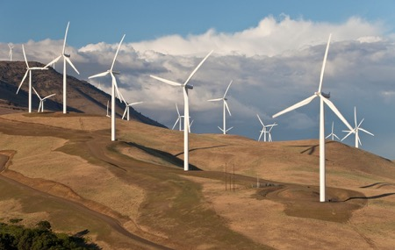
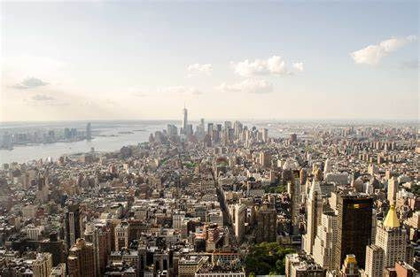
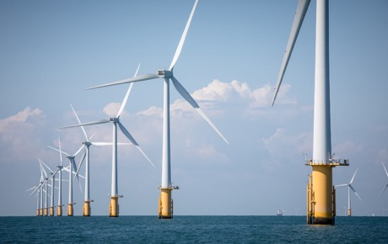
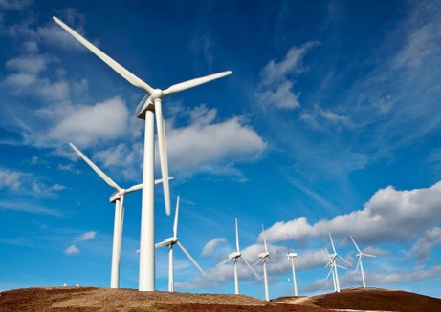
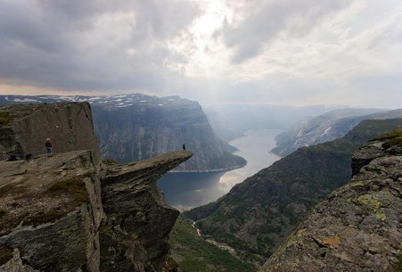
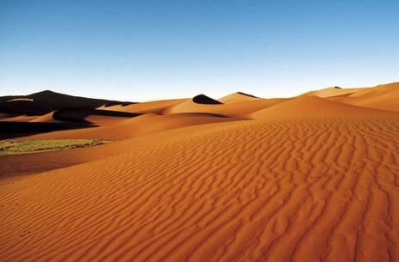
Wind in cities, mountains, oceans, and deserts
Notes:
Sources: https://th.bing.com/th/id/R.cf01ae7779af262b63783b832d25c043?rik=6aXtW9gO1e90gQ&riu=http%3a%2f%2fcdn.ebaumsworld.com%2fmediaFiles%2fpicture%2f2146605%2f82592521.jpg&ehk=vTWLGpMZKGWYhT1EzorJhPh%2fMQpkOcBfGjl12DqmhYc%3d&risl=&pid=ImgRaw&r=0
https://pixnio.com/free-images/2017/10/27/2017-10-27-06-36-32.jpg
https://www.jacana.de/assets/data/_resampled/CroppedImage14001000-Bild27138.jpg
Copyright: © Will Rose / Greenpeace

Slide 15





Wind level in different locations
Task 1: It’s time for a challenge! Open your workbook on page 14.
High places
GOOD LOCATIONS
(very windy)
Closed spaces
and low areas
Coasts and offshore (oceans, seas)
wind turbines
BAD LOCATIONS
(hardly any wind)
Open areas
Task 2: Choose one place and explain why it is windy or not, using the hints on page 15.
Notes:
→ Look at your worksheet on page 14 and complete the allocation of good and bad wind locations!
Match these places according to how windy they are.
Places with strong winds are good for producing energy,
while places with little wind are not.
Additional question for the quick ones:
Explain why a certain area is good and what makes a certain area bad

Slide 16
Wind level in different locations
Task 1: It’s time for a challenge! Open your workbook on page 14.
Behind my neighbor's tall house, my little hand-held windmill barely turns. So, wind doesn't like obstacles. I need a ‘clear path’.
High places
GOOD LOCATIONS
(very windy)
Closed spaces
and low areas
Coasts and offshore (oceans, seas)
wind turbines
BAD LOCATIONS
(hardly any wind)
Open areas
Task 2: Choose one place and explain why it is windy or not, using the hints on page 15.
Notes:
Showing solution

Slide 17

Wind speed: high places vs. low places
The wind speed increases with height.
There is less friction from obstacles such as trees, buildings and the ground.
More movement means more wind.
Wind locations in high places are GOOD.
Examples: mountains, hills, exposed sites, plateaus
Wind locations in low places are BAD.
Examples: valleys, river valleys, basins, low-lying areas
Notes:
Let me explain you the differences.

Slide 18
Wind speed: open spaces vs. closed spaces
The wind speed is higher in open spaces.
There are fewer obstacles (like buildings or trees), so the air can move freely.
The wind speed is lower in closed or built-up spaces.
Buildings and structures create friction and block the airflow, slowing wind.
Wind locations in open spaces are GOOD.
Examples: deserts, open plains, coasts, riverbanks, oceans
Wind locations in closed spaces are BAD.
Examples: areas with buildings, areas with many trees, narrow streets, valleys

Slide 19

Wind turbines: onshore vs. offshore
There aren't any trees in the way! But it must be really difficult to build in water.
Onshore wind turbines | Offshore wind turbines
Location
build on land (plains, hills, mountains) | built in the sea or ocean
Energy production
more variable winds lower energy output | stronger, steadier winds higher energy output
Costs
cheaper to build and maintain | more expensive due to marine foundations and undersea cables
Notes:
Fragen: Which ones are in the picture onshore and offshore wind turbines?
Sources: https://www.nationalgrid.com/stories/energy-explained/onshore-vs-offshore-wind-energy
https://www.nationalgrid.com/stories/energy-explained/what-offshore-wind-power

Slide 20




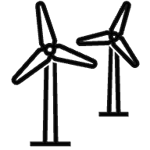
What is the global wind atlas?
I don't want guesswork, I want data! Fortunately, there is something like a treasure map for wind: the Wind Atlas.
The wind atlas shows wind conditions in a specific region.
It provides information about:
wind speed
wind direction
energy potential (power density)
It is based on weather data and models that predict long-term wind patterns.
It helps to plan and decide where wind turbines should be built.
Notes:
Icons von: https://de.freepik.com/search?format=search&iconType=standard&last_filter=query&last_value=region&query=region&type=icon

Slide 21
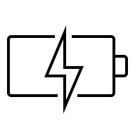
What the global wind atlas shows
Power density (W/m²)
shows how much energy the wind can produce
measures energy available per square meter
higher W/m² = more potential energy for electricity
Wind speed (m/s)
shows fast the wind blows
measured in meters per second
higher m/s = more energy for wind turbines
This helps understand the wind energy potential of different places.

Slide 22
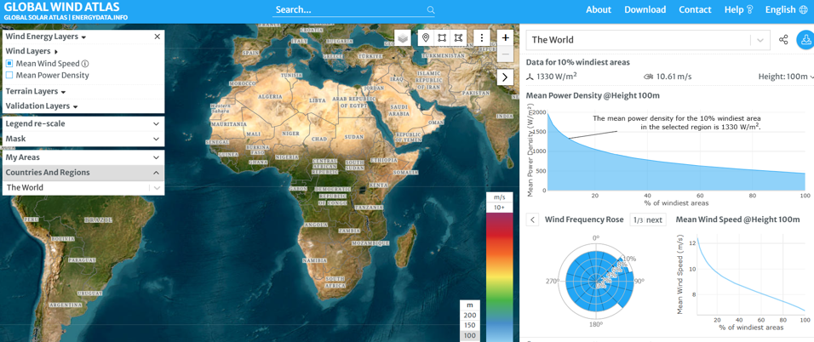

Global wind atlas in practice
Task 1: Let’s try it out! Open your worksheet on page 17.
https://globalwindatlas.info/en/
Notes:
Split the class into groups of 4–5 students.​
Visit the website below (you can use the QR code).​
Select “Countries And Regions” on the left-hand side and choose two countries that differ in climate or location – Ghana and Germany – and one more of your choice.​
On the right-hand side, make sure the height is set to 100 m.​
Compare the countries by their average power density (W/m²) and wind speed (m/s). ​
​
​

Slide 23
Global wind atlas in practice
Task 2: Interpret the numbers from Ghana and Germany at an altitude of 100 metres!
Open your worksheet on page 18.
Country​ | Power density (W/m²)​ | Wind speed (m/s)​
Ghana​ | 184​ | 5.7​
Germany ​ | ​595 | ​8.45
Other country​ | Your example | ​Your example
Power density: Germany > Ghana
Wind speed: Germany > Ghana
Conclusion:
Germany is better suited
for wind energy production.
Remember:
Higher power density = better conditions for wind turbines
Higher wind speeds = more energy
Notes:
What is your result from your comparison in Task 1?​
What does it tell you about the country’s potential for generating wind energy?​
Solution:
Germany has higher power density than Ghana, meaning it can generate more wind energy.​
Germany also has faster wind speeds, which increases energy output.​
Conclusion: Germany is better suited for wind energy production due to these favourable conditions.​
BUT: This is just a comparison; Ghana still has great potential to generate wind energy!
Ghana still has good wind potential in several coastal and elevated regions, especially with modern wind turbines.
​
​
​

Slide 24

Various perspectives on wind energy
With the wind atlas, I've found the perfect spot! Now I can build my wind turbine right away.
But wait! There's a farmer who's worried about his fields. And a president who needs electricity for the city.
Technology alone isn't enough. We have to talk to people.
Notes:
​Hier seht ihr die Ergebnisse aus dem Global Wind Atlas! Und wie können wir die interpretieren? (Aufgabe 2)
Deutschland hat im Vergleich zu Ghana eine höhere Leistungsdichte – also mehr Energie pro Quadratmeter – und auch eine höhere durchschnittliche Windgeschwindigkeit.
Das bedeutet: Deutschland eignet sich besser für die Erzeugung von Windenergie, weil dort stärkere und gleichmäßigere Winde wehen.
Aber Achtung: Das heißt nicht, dass Ghana kein Potenzial hat!
Ghana hat gutes Windpotenzial, besonders in Küstenregionen oder erhöhten Lagen.
Mit moderner Windtechnik kann dort ebenfalls viel Energie erzeugt werden.
Was lernen wir daraus?
Auch wenn ein Land auf den ersten Blick bessere Bedingungen hat, lohnt sich ein genauer Blick auf regionale Unterschiede und technische Möglichkeiten.
​
​
​

Slide 25


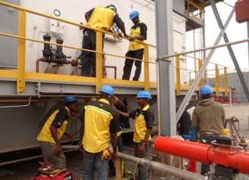

Why perspectives matter
Task: Last challenge for this chapter! Open your worksheet on page 20.
Local farmer Government official Engineer Student
Scenario:
“A new wind farm is planned near a coastal village. It will provide electricity for nearby towns but may also affect the local community and environment.”
Notes:
Split the class into groups of 4–5 students.​
Each group represents a person who might be affected by a wind energy project and receives one of the following roles:​
Local farmer: Worried about land use and noise from turbines.​
Government official: Focused on promoting renewable energy.​
Engineer: Explains how wind turbines work and key technical challenges.​
Student: Curious about how wind energy affects jobs, the environment, and future opportunities.​
Environmentalist (optional): Advocates for clean energy and nature care.​​
Write down arguments for your role below and discuss them afterwards.​
The goal is to discuss the benefits and challenges of wind energy ​while considering all perspectives!​
Who do you want to be?
Finally explaining:
Wind energy has advantages and disadvantages.​​
It can produce clean electricity, but it also affects landscapes, nature, and local communities.​
Different groups care about different things.​
​Some think about jobs or money, others about nature, technology, or daily life.​
There is no single “right” answer.​​
Good decisions often need balance – between energy needs, environmental protection, and local interests.​
Sources:
https://th.bing.com/th/id/R.165e40ad2e8015844434d94b97bbddc2?rik=sqfzrM4lRhQIyw&pid=ImgRaw&r=0
https://ghanaembassy.at/wp-content/uploads/2021/02/president.jpg
https://www.jnpengineeringgh.com/wp-content/uploads/2016/01/Electrical-instrumentation-works-on-the-turbine-and-pipeline-1144x858.jpg
https://th.bing.com/th/id/R.ced053f2c812ca086332d36d151b3b99?rik=AHxeHtUSoU9x6g&riu=http%3a%2f%2fsites.psu.edu%2fafr110%2fwp-content%2fuploads%2fsites%2f14793%2f2014%2f12%2fImage-3-.jpg&ehk=npu%2bvD8vpZRqF4VRGTW%2bMcFo6uvLGCRrMmTf%2fZAHCe8%3d&risl=&pid=ImgRaw&r=0

Slide 26
02
Measuring and working with wind
Before I can build a real wind turbine, I want to learn by making prototypes first!
Learn about wind speed, power and their impact on energy generation.

Slide 27
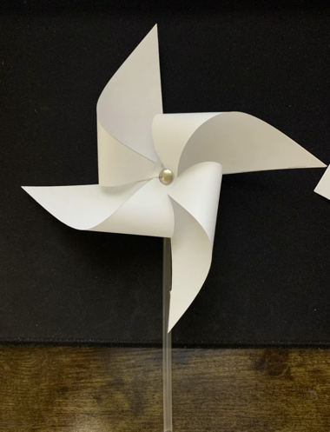


Wind rose
Experiment
Let’s try to make your own paper wind rose!
Open your workbook on page 24.
Question: How is wind speed measured by using it?
Bonus Question: In what unit can the wind speed be measured?
There’s also a video guide that can be followed.
Notes:
https://www.youtube.com/watch?v=HN0GxOQMzME&t=25s

Slide 28
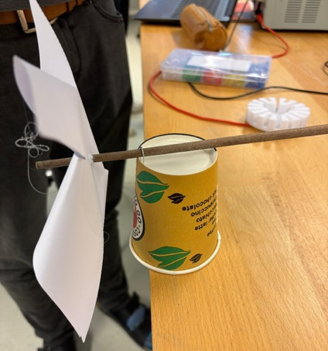
Let’s use your wind rose to measure the wind speed!
Open your worksheet on page 27 for instruction.
Measuring wind speed
Experiment
Task 1–3: Let’s write down your observations!
Open your worksheet on page 28.

Slide 29
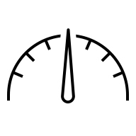
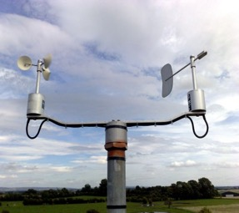
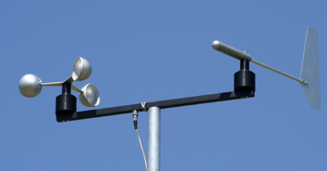
Measuring wind speed
Wind Speed is how fast the air is moving.
    Faster wind speeds mean more energy is available for generating power.
Anemometers are tools to measure wind speed by counting rotations.
Wind Vanes are tools to find a wind direction
Anemometer
    Wind measurement is the process of determining the wind speed:
It helps engineers to choose the best locations for turbines and other uses.
Wind vane
Notes:
Faster wind generates more power The energy a wind turbine produces depends on the cube of the wind speed. For example, doubling the wind speed increases energy production by 8 times!
Consistent wind is key Turbines require steady winds to perform effectively
Why do we measure wind speed?
Energy Potential: Wind turbines work best in areas with strong, steady winds.
Example: Offshore wind farms benefit from consistent sea breezes.
Turbulence and Height: Wind is stronger and steadier at higher altitudes because it faces less resistance from obstacles like buildings or trees.
Did you know? Wind turbines are often taller than 100 meters to catch higher winds!
Safety: Measuring wind helps predict extreme weather conditions, ensuring turbines can be safely shut down during storms.

Slide 30
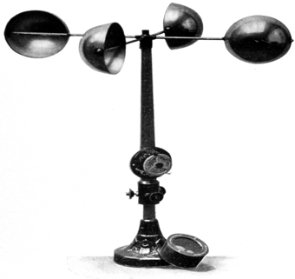
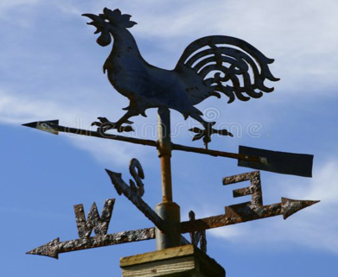
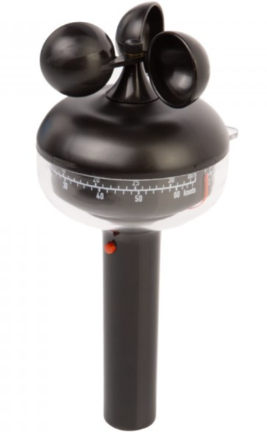
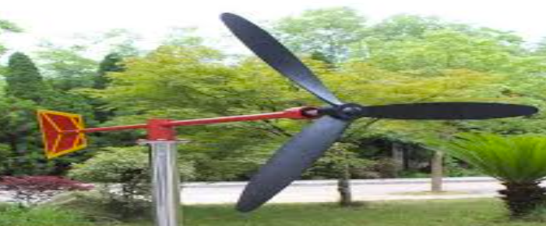
Different kinds of anemometer

Slide 31

Measuring wind speed
Let’s talk together about wind speed.
Form groups of 3–4 students and discuss the following questions.
After 3 minutes, we will share your ideas with the class.
What would happen if wind turbines were installed in a place with very little or irregular wind?
Could they produce enough electricity to supply homes, schools, or hospitals?
How would you measure wind speed at school or at home?
Is estimating sufficient, or do you need a measuring device?
Notes:
After letting the students discuss for a while, some texts for the teachers: We’ve seen that faster and consistent winds are critical for wind energy generation. But how do we know which areas have the right conditions? Scientists can’t just guess – they need accurate data. Tools like anemometers help measure wind speed and provide essential information. Without accurate data, it’s impossible to identify the best locations for wind farms and ensure they produce enough energy efficiently. For example, imagine trying to power an entire city with turbines placed in low-wind areas. Without these measurements, it would lead to wasted resources and failed projects. Fun fact: The world’s largest wind farms are located in places where scientists used anemometers to study wind speeds for years before starting construction.

Slide 32
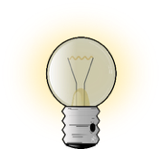
Measuring wind speed
Task: Form groups of 3–4 students and discuss the following questions.
After 3 minutes, we will share your ideas with the class.
Is it difficult to measure wind speed?
Looking back at the experiment:
Did the wind vane rotate smoothly, or did it stop repeatedly?
What could make measuring wind speed more difficult?

Slide 33
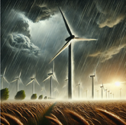
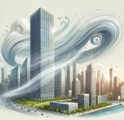
Different factors for changes of wind speed
Storms:
Height:
Unpredictable increase and changes in wind speed and direction
Turbines: Damages or safety shut down
more energy: wind turbine on high areas
less energy: wind turbine near the ground
Turbulences:
Locality:
irregular, swirling wind patterns
caused by: obstacles, changing wind direction, temperature differences
Differences in: open spaces, forests, cities and coastlines
Notes:
Wind speed is not constant; it fluctuates over time due to variations in atmospheric pressure, temperature, and obstacles in its path.
Example: The wind near a building can suddenly increase or decrease depending on how it flows around the structure.
Wind is generally stronger and more consistent at higher altitudes because there are fewer obstacles (like trees and buildings) causing friction.
Example: A wind turbine on a tall tower captures more energy than one closer to the ground.
Wind speeds increase unpredictably, and directions can change rapidly.
This makes it challenging to maintain steady power generation from wind turbines.
Impact on turbines:
Strong gusts can damage turbine blades or structures if not designed to withstand high winds.
Turbines often have mechanisms to shut down during storms for safety.
Obstacles: Buildings, trees, and hills disrupt smooth wind flow.
Changing Wind Directions: When wind changes direction quickly, it creates chaotic patterns.
Temperature Differences: Uneven heating of the Earth's surface can create pockets of rising or falling air, adding to turbulence.
Question to think about:
This is due to turbulence created as the wind splits and swirls around the structure. Similarly, turbulence near wind turbines can reduce their efficiency by disrupting the steady flow of wind.

Slide 34
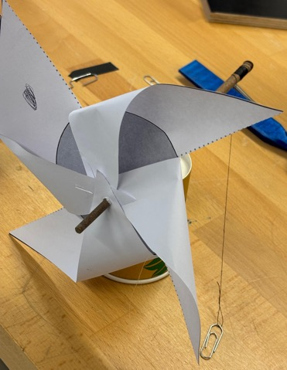
Wind can do work
Experiment
Let’s try out how wind energy can lift weights! Open your worksheet on page 30.
Task 1–4: Let’s write down your observations and transfer it to real-world situation! Open your worksheet on pages 30–31.
Here we will use the wind rose that we have built in our previous experiment.
Notes:
Additional question for the quick ones:
Can the turbine lift heavier weights with stronger wind?
Note: Answering only yes or no for the second question is enough. We will soon discuss more on this topic.

Slide 35
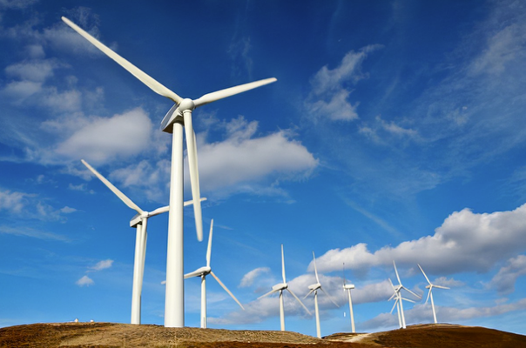
Harnessing wind to do work
What does it mean to harness wind?
Capturing wind's energy and converting it into useful work.
Work happens when force moves an object over a distance:
For wind turbines, the wind applies force to blades, causing them to spin and generate energy.
Bonus question:
Do you know any examples of wind doing work?

Slide 36
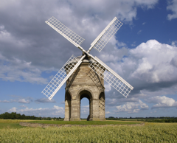
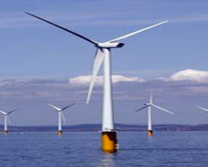
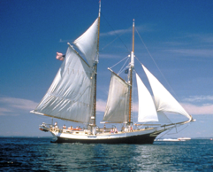
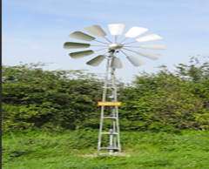
Real life example of wind doing work
Windmills
Wind turbines
used historically to grind grain or pump water
generate electricity for homes, schools, and industries
Sailboats
Wind-powered waterpumps
wind pushes sails to move boats forward
used in farming to bring water to crops
Notes:
Windmills: Windmills:
Historically, windmills were one of the earliest uses of wind energy.
They were primarily used to grind grain into flour or pump water for irrigation.
Windmills are still seen in many rural and agricultural settings, symbolizing a time when wind was a vital part of daily life.
Wind turbines: Modern wind turbines convert wind energy into electrical energy.These turbines are essential in producing renewable energy for homes, schools, and industries.Offshore wind turbines, like the ones shown in the image, take advantage of strong and consistent winds over oceans.
Sailboats: Sailboats are another example of wind doing work in transportation.Wind fills the sails, propelling the boat forward and enabling travel and trade long before engines were developed.Even today, sailboats are used for recreation and eco-friendly transportation.
Wind-powered water pumps: These pumps are commonly used in farming to draw water from wells or bring water to crops.They are particularly useful in remote areas where electrical access is limited.This application demonstrates how wind energy can directly benefit small-scale, localized needs.

Slide 37
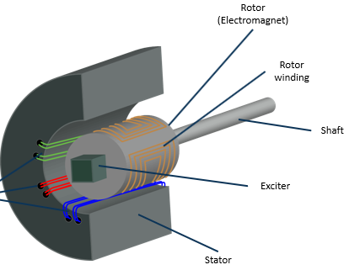
Wind can be used to spin a generator
A generator converts mechanical energy (motion) into electrical energy (electromagnetic induction).
Important components of a generator:
Rotor: The rotating part of the generator (usually contains the magnets), which is connected to the drive shaft (e.g., a turbine).
Stator: The stationary part that contains the induction coils (copper windings).
Magnetic field: Change in magnetic flux induces electrical voltage in the coils.
Electromagnetic induction: The rotation of the rotor causes a changing magnetic field in the coils. This induces voltage; when the circuit is closed, current flows.
Notes:
Start by asking the class, "Have you ever heard of a generator?" Then explain:
A generator is a machine that takes mechanical energy (like motion) and turns it into electrical energy.
This process powers most of the devices and equipment we use in our daily lives.
Explain Key Components:
Rotor: Highlight that this is the rotating part connected to the turbine shaft. The wind turns this part when the blades move.
Stator: The stationary part of the generator. It contains the wires or coils where electricity is produced.
Magnetic Field: Mention that the magnetic field is essential for creating the force that generates electricity inside the stator.
Explain How It Works:
A generator works using a principle called electromagnetic induction.
This means when a wire coil moves through a magnetic field, it produces an electric current.

Slide 38
Process of using a generator and energy transformation
Step 1: Wind turns the turbine blades.
Kinetic Energy
Step 2: The rotating blades spin a shaft connected to the rotor.
Mechanical Energy
Step 3: The rotor moves inside the stator, creating an electric current using electromagnetic induction.
Electrical Energy
Work output of capturing wind can also be tasks like lifting weights, pumping water, or generating electricity.
Generators are not sources of energy. They transform energy that is already available (like wind or motion).
Notes:
Explain How It Works:
A generator works using a principle called electromagnetic induction.
This means when a wire coil moves through a magnetic field, it produces an electric current.
Reinforce that generators rely on external energy sources (like wind or motion) to produce electricity; they don’t create energy on their own.

Slide 39
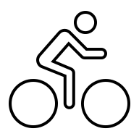
Wind turbine speed problem
Extra Task:
Imagine trying to generate electricity with a slow-spinning bicycle wheel.
If we tried to connect this wheel to a generator to create electricity, would it be able to produce enough energy?
Connect this question to wind turbines and slower blade rotation?
Answer:
Generators need a high rotational speed to efficiently produce electricity.
Slower spinning may not create enough mechanical energy to convert into electricity.
Therefore, the speed of the wind turbine’s blades is crucial for producing electricity.

Slide 40
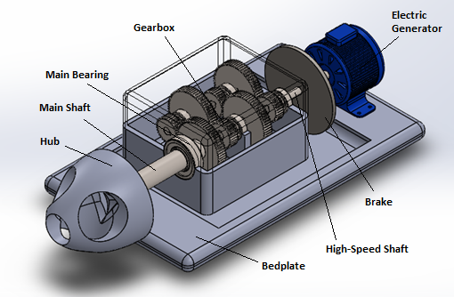
Turbines need a gearbox
A gearbox is a mechanical system combining different gears:
→ To increase or decrease rotational speed.
→ To adjust torque (force) as needed for a specific task.
→ Commonly used: in cars, bicycles, industrial machines, and wind turbines
Input gear: Receives energy from the source (e.g., wind turbine blades).
Output gear: Transfers adjusted speed and torque to the next system (e.g., generator).
Gear ratio: Determines how much the speed or torque is increased or decreased.
High gear ratio: Increases speed, reduces torque.
Low gear ratio: Reduces speed, increases torque.
Notes:
Example: In bicycles, pedaling a smaller gear at the front and a larger gear at the back makes it easier to climb a hill (more torque, less speed). Conversely, a larger gear at the front and a smaller gear at the back increases speed on flat surfaces (more speed, less torque).

Slide 41
Turbines need a gearbox
A gearbox is a mechanical device combining different gears:
→ To increase or decrease rotational speed.
→ To adjust torque (force) as needed for a specific task.
→ Commonly used: in cars, bicycles, industrial machines, and wind turbines
Example: In bicycles, pedaling a smaller gear at the front and a larger gear at the back makes it easier to climb a hill (more torque, less speed).
Conversely, a larger gear at the front and a smaller gear at the back increases speed on flat surfaces (more speed, less torque).
Notes:
Example: In bicycles, pedaling a smaller gear at the front and a larger gear at the back makes it easier to climb a hill (more torque, less speed). Conversely, a larger gear at the front and a smaller gear at the back increases speed on flat surfaces (more speed, less torque).

Slide 42
Gearboxes solve the wind speed problem
Problem:
slowly blade rotation of wind turbine
generators need high-speed rotation to produce electricity
Process in simple steps:
Low-speed input: slow input shaft trough slow blade rotation
Gearbox adjustment: increasing rotational speed with a high gear ratio
High-speed output: enough speed of output shaft can drive the generator and produces energy
Solution:
connecting low-speed turbine shaft to high-speed generator shaft
increasing rotational speed of the shaft
making it compatible with the generator’s requirements
Task 1–3: Let’s start a short quiz on generators and gearboxes! Open your worksheet on pages 33–34.

Slide 43

03
Airfoils
My first wind turbine with flat boards doesn't work very well. There are so many seagulls here on the beach. Why do they glide so well? Let's take a closer look at their wings.
Learn about airfoils and the bernoullik principle.

Slide 44
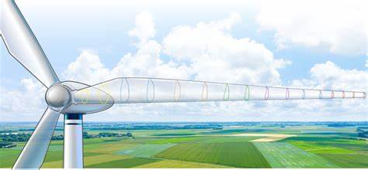
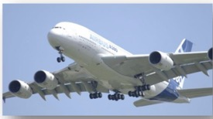
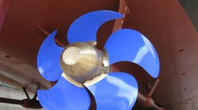



Airfoils
Airfoils are specially shaped structures, like wings or blades:
designed to generate lift or reduce drag when air flows over them
Drag is the resistance caused by air pushing against blades:
when fluid is a gas-like air: it is called aerodynamic drag or air resistance
Airfoils are crucial parts of many products of contemporary technology:
Notes:
Sources Pictures:
Airfoils, Where the Turbine Meets the Wind | Department of Energy
Air crafts, sail boats, ship propellers, helicopter, racing cars and wind turbines

Slide 45

Learning about airfoils
Experiment
Let’s try to make an airfoil!
Open your worksheet on pages 37–38.
Task 1–4:Let’s write down your observations and try to find key influences for turbine performance!
Open your worksheet on page 39.

Slide 46

Making flow visible
Experiment
We make airflow visible!
Open your workbook on page 40.
Aufgaben 1–2: Write down your observations!
What do the observations of the threads show about
the flow behavior of air and the relationship between
airflow and lift?
Open your worksheet on page 41.
Reflective question: Airfoils on page 42
Notes:
Es zeigt Auftrieb von Flügel, dass Bewegung reinkommt, obwohl es stationär ist.
Das Rotorblatt wird nach oben gezogen.

Slide 47
Task 4: Identifying key influences on turbine performance
Wind speed
faster wind means more power
Blade shape
curved blades, like airplane wings, work best
Factors
Blade size
longer blades catch more wind
Machine parts
clean, well-working parts make more power
Height
taller turbines reach stronger winds
Wind consistency
steady winds are better than gusty ones
Notes:
Sources Pictures:
Animation: How Wind Turbines Work

Slide 48

The magic behind an airfoil
Did you know? This is also the principle of an airplane!
The airfoil lifts, when you blow on top of it!
The airfoil lifts because of the pressure difference(Bernoulli Principle):
air flows over them, the pressure on top is lower than at the bottom, creating lift
lift causes the blades to rotate
wind energy → mechanical energy
essential to produce energy in a generator
Bernoulli Principle helps to capture more wind thereby, maximizes efficiency of wind turbines
→ The blade of a wind turbine should have this specific shape
Notes:
Sources Pictures:
Animation: How Wind Turbines Work

Slide 49

04
Experiments with a wind turbine
Now I know more about wind turbine design, but I think we can still optimize it!
Learn about how wind and blade design affect wind turbine performance.

Slide 50

Direction of wind
Short Excursus to measure power of wind turbines:
a multimeter is used to measure voltage
voltage directly reflects how much electrical energy is produced (pages 47-48)
Wind direction tells us where the wind is coming from:
flows from one to another direction (like a river)
Task 1 : Find the right wind direction!
Open your worksheet on page 49.
Notes:
Source: https://th.bing.com/th/id/OIP.dzhxLSfosp7s2vYOYskNAwAAAA?rs=1&pid=ImgDetMain
To see the difference in the direction of wind, we are measuring the power output of the wind turbine in the following experiments. Therefore, we are using a multimeter to measure power, or to be more precise the voltage of the wind turbine (see worksheet on page 38 onwards).
Why do we use voltage instead of power to measure the output of the wind turbine?
Power = is the energy produced or consumed over time, typically measured in watts (W)
Voltage = acts like the "pressure" in an electrical circuit, indicating how strongly electricity is pushed through wires.
→ When a wind turbine generates more power, the voltage usually increases.
This relationship makes voltage a reliable way to estimate power output.

Slide 51



Direction of wind
Notes:
Source: https://th.bing.com/th/id/OIP.dzhxLSfosp7s2vYOYskNAwAAAA?rs=1&pid=ImgDetMain
To see the difference in the direction of wind, we are measuring the power output of the wind turbine in the following experiments. Therefore, we are using a multimeter to measure power, or to be more precise the voltage of the wind turbine (see worksheet on page 38 onwards).
Why do we use voltage instead of power to measure the output of the wind turbine?
Power = is the energy produced or consumed over time, typically measured in watts (W)
Voltage = acts like the "pressure" in an electrical circuit, indicating how strongly electricity is pushed through wires.
→ When a wind turbine generates more power, the voltage usually increases.
This relationship makes voltage a reliable way to estimate power output.

Slide 52

Direction of wind
Task 2: What do they all have in common?
Finding: Direct wind has more power!
Experiment
Let’s measure the power of different angles! Open your worksheet on pages 51–52 .
Task 3-4:Let’s write down your observations! Open your worksheet on page 53.
Notes:
Source: https://thumbs.dreamstime.com/z/image-windy-day-trees-cloud-blowing-wind-cartoon-windy-day-trees-cloud-blowing-wind-110475663.jpg
Imagine you are running against the wind. It feels harder than running with the wind pushing you from behind. That’s the power of direct wind.

Slide 53


Angle of attack
The angle of attack describes the angle between the blade and the wind:
Adjusting this angle can optimize how much energy is captured
Task 1: Partner work: Which part of a wind turbine is
important to find the right angle?
Open your worksheet on page 54.

Slide 54

The usage of a tail fin
The tail fin works by using the force of the wind itself
wind hitting tail fin from the side a turning force is created and the turbine rotates
→reducing drag on tail fin to face direct wind again
you can simulate this with a flag
Experiment
tail fin in use = vertically oriented
tail fin "not usable" = horizontally oriented
Let’s use a tail fin!
Open your worksheet on page 55.
Task 1–3:Let’s write down your observations and give your opinion!
Open your worksheet on page 56.
After that test your knowledge and open your worksheet on page 58.
Notes:
Why does this happen?
Imagine you are standing outside holding
a large flag in a strong wind. If you rotate
your body sideways to the wind, the flag will flap and resist you.
However, if you turn such that the flag faces directly the wind, it straightens out smoothly

Slide 55

Changing blade pitch
Blade pitch is the angle between the plane of rotation of the wind turbine and the blade itself:
Adjusting this angle can optimize how much energy is captured
If the blade is too angled, we face power drops.
Experiment
Let’s change blade pitches!
Open your worksheet on page 59.
Task 1: Let’s write down your observations!
Open your worksheet on page 60.
Notes:
Source: https://th.bing.com/th/id/OIP.bR1Vsk264RbyCOG4OTaauQHaFj?rs=1&pid=ImgDetMain

Slide 56

Changing blade length
Blade lengths affect how much wind is captured by the wind turbine:
Longer blades usually provide more power.
However, it does not necessarily mean larger blades always provide the highest power.
Experiment
Let’s try out different blade lengths!
Open your worksheet on page 62.
Task 1–2:Let’s write down your observations!
Open your worksheet on page 63.
Notes:
Source: https://th.bing.com/th/id/OIP.bR1Vsk264RbyCOG4OTaauQHaFj?rs=1&pid=ImgDetMain

Slide 57
Influence of heavy blades
Higher inertia ➔ harder, to start spinning needs stronger wind to start
Lower voltage ➔ spins slower, especially at low wind speeds
Reduced electricity ➔ more energy needed to overcome inertia
More stable ➔ better handling of strong winds
Definition: Inertia
= resistance to changes in motion
Heavy objects: more inertia
                ➔ more force needed to start or stop
                Example: heavy blades need more force to overcome drag
Notes:
Sources Pictures:
Animation: How Wind Turbines Work
Discussion:
Think about the following question individually:
Is there a minimum speed (cut-in speed) needed to start spinning the blades?
If the wind is strong enough, light blades spin quickly, and heavy blades spin slower.
If the wind is not strong enough, then the blades would not spin at all.
So, yes there is a minimum speed needed to start spinning the blades.
To overcome drag/resistance, there is a minimum speed to start the blades spinning.

Slide 58

Influence of heavy blades
Your turn:
Which needs more force to move:
the table or the notebook?
Good to know about rotor blade weight:
                Heavier blades store more momentum but require higher wind speeds to start.
                Lighter blades spin faster and are efficient in low wind speeds but may lack stability.
Notes:
Sources Pictures:
Animation: How Wind Turbines Work
Discussion:
Think about the following question individually:
Is there a minimum speed (cut-in speed) needed to start spinning the blades?
If the wind is strong enough, light blades spin quickly, and heavy blades spin slower.
If the wind is not strong enough, then the blades would not spin at all.
So, yes there is a minimum speed needed to start spinning the blades.
To overcome drag/resistance, there is a minimum speed to start the blades spinning.

Slide 59


Real-world application of rotor blade weight
The weight of the rotor blade influences where wind turbines can be installed (e.g., in regions with strong or weak wind conditions).
Onshore wind turbine:
lightweight rotor blades
Offshore wind turbine:
heavy rotor blades

Slide 60

Changing number of blades
Experiment: Let’s try out different numbers of blades!
Open your worksheet on page 65.
Tasks 1–4: Write down your observations,
think about the stability when blades increase, as well as their advantages
& disadvantages!
Open your worksheet on page 66–67.

Slide 61


Impact of blade numbers
Less blades are…
…less efficient at capturing energy.
…faster to start spinning blades.
More blades are…
…more efficient at capturing energy.
…reduced at rotational speed & have an increased drag.
Notes:
Blades are one of the most critical components of wind turbines, and the number of blades directly impacts their performance. More blades can capture more wind energy but often reduce rotational speed due to the drag they create. Conversely, fewer blades can start spinning faster, making them suitable for low-wind areas, but they capture less energy overall.
Engineers aim to find the perfect balance between efficiency, stability, and cost. While you might think more blades are always better, they can increase manufacturing costs and structural complexity. This is why the majority of modern wind turbines are designed with three blades, as this configuration maximizes efficiency and stability while minimizing cost and structural stress.

Slide 62
Finding the balance
4
1
3
I now feel ready to build a wind farm. But we still have a few decisions to make together:
How many rotor blades would be ideal, also in terms of costs?
Should we build in the bird sanctuary where there is a lot of wind, or where there is less wind?
2
5
6

Slide 63





Finding the balance
1–2
4+
Fewer blades
More blades
Lower cost
Higher cost
Faster spin
Higher drag
Less stability
More stability
Notes:
To conclude, what we’ve learned today is that designing wind turbines is a complex balancing act. Blade weight and number are interconnected. Lighter blades might spin faster in low winds, but heavier blades are more stable and store more energy once moving. Similarly, fewer blades can reduce costs and allow faster startup. With very few blades, the turbine doesn’t rotate smoothly.
Ultimately, there’s no one-size-fits-all approach. Engineers have to assess environmental conditions, such as wind speed, along with economic factors, like cost, to make the best decisions. What’s critical to remember is that every decision in turbine design links back to the goal of optimizing performance for specific situations.

Slide 64

Three blades on a turbine
Practicability
Fewer blades reduce stability.
More blades increase cost & weight
without major efficiency gains.
Balance
Three blades create symmetry, reducing vibrations & mechanical stress.
Efficiency
They balance energy capture
& drag, leading to reliable
power generation.
Video:
design trade-offs
Key takeaway
Wind turbine design is about optimization.
Engineers balance efficiency, stability, & cost to meet specific conditions.
→ This is why three blades are the most common design choice.
Notes:
Three blades are commonly used because they optimize the turbine's performance. Symmetry reduces vibrations, making the structure more stable and durable. This balance also allows turbines to achieve high efficiency without the drawbacks of excessive drag or unnecessary weight. Engineers consistently find this configuration to be the sweet spot for performance and cost-effectiveness.
YouTube-Link: Why do (most) Wind Turbines have 3 blades? - YouTube

Slide 65

The Wake Effect (Wind Farm Effect)
The wake effect describes what happens when several wind turbines are placed one behind another in the wind.
A wind turbine removes kinetic energy from the wind.
Behind the turbine, the wind becomes slower and more turbulent.
Wind turbines that stand in the wind shadow therefore produce less electrical energy.
For this reason, the distance and arrangement of wind turbines in wind farms are very important.
Experiment
Investigate how wind shadows affect the performance of wind turbines.
Open your workbook on pages 69–70.

Slide 66



Discussion: Your turn!
Imagine that wind energy should provide a large share of our electricity:
Is wind energy a reliable source of energy?
What problems occur when there is little or no wind?
What does fluctuation mean in relation to wind energy?
What solutions are possible (e.g. combination with other technologies)?
Procedure: The class is divided into 3–4 groups. Each group looks at the question from one perspective (e.g. technology, environment, economy, everyday life).
Activity Rules:
  15 minutes of group preparation
  2 minutes presentation per group
  Followed by a class discussion
  Joint conclusion: Is wind energy reliable?

Slide 67



Why is wind a great energy source?
Renewable and clean
Wind will never run out, and it doesn’t pollute the environment
Widely available
Found almost everywhere, especially on open fields, coasts, and mountains.
Cost-effective
Once a turbine is installed, wind energy is free to use.

Slide 68



Real life example of wind doing work
Cost efficiency
Adaption to environment
fewer blades → lower manufacturing costs and less material
balance between cost and energy output ensures profitabily
coastal areas with high winds: heavier blades for stability
low-wind regions: lighter blades for faster startup
Sustainability
Technological Innovations
lightweight, durable materials like carbon fiber reduce environmental impact
maximized efficiency reduces the number of turbines needed
Advanced materials and designs optimize blade weight and shape.
Wind turbines tailored for offshore and onshore applications.
Notes:
Windmills: Windmills:
Historically, windmills were one of the earliest uses of wind energy.
They were primarily used to grind grain into flour or pump water for irrigation.
Windmills are still seen in many rural and agricultural settings, symbolizing a time when wind was a vital part of daily life.
Wind turbines: Modern wind turbines convert wind energy into electrical energy.These turbines are essential in producing renewable energy for homes, schools, and industries.Offshore wind turbines, like the ones shown in the image, take advantage of strong and consistent winds over oceans.
Sailboats: Sailboats are another example of wind doing work in transportation.Wind fills the sails, propelling the boat forward and enabling travel and trade long before engines were developed.Even today, sailboats are used for recreation and eco-friendly transportation.
Wind-powered water pumps: These pumps are commonly used in farming to draw water from wells or bring water to crops.They are particularly useful in remote areas where electrical access is limited.This application demonstrates how wind energy can directly benefit small-scale, localized needs.

Slide 69

Maximizing power point (MPP)
MPP is the point where a wind turbine generates the highest possible power output:
under given wind conditions
key factors: wind speed, blade angle and rotor speed
Importance:
→maximizing energy capture
→avoids energy loss (underutilization or overloading)
To realize MPP:
Dynamic adjustments:
Blade pitch control: adjusts the angle of the blades to optimize energy capture based on wind speed
Yaw control: rotates the turbine to face the wind direction for maximum efficiency.
Technology:
Sensors monitor wind speed, direction, and rotor performance in real-time
advanced algorithms compute adjustments
Notes:
The Maximum Power Point (MPP) is the sweet spot where a wind turbine extracts the most energy from the wind. It depends on critical parameters like wind speed, blade angle, and rotor speed. Just like a car engine has an optimal RPM for fuel efficiency, wind turbines have an optimal operating condition that varies with the wind. Reaching this point ensures efficient energy generation without overloading the system.
An example for mpp
Offshore wind farms like Hornsea 2 use advanced control systems for real-time MPP optimization.

Slide 70

Challenges of MPP in wind energy
MPP is unique for wind:
High variability of wind speed compared to solar radiation
Complex aerodynamics like turbulence and changing wind direction for wind turbines
power curve of a wind turbine is nonlinear
→ harder to determine the exact MPP
Key challenges:
Dynamic wind conditions
constant changes in wind speed make real-time adjustments crucial
Mechanical constraints
rapid changes to achieve MPP cause wear and tear on turbine components
Grid integration matching variable wind energy with grid demand is technically challenging
Cost
advanced MPP systems add complexity and increase the cost of wind energy systems
Notes:
Unlike solar energy, where irradiance changes relatively predictably, wind energy systems deal with rapidly changing wind speeds and directions. This makes tracking the Maximum Power Point more complex.

Slide 71

How engineers address these challenges
use advanced algorithms for dynamic MPP tracking
optimize turbine design to handle mechanical stress
hybrid systems (e.g., combining wind and solar) to stabilize energy output
Task 1–5: Let’s test your knowledge on chapter 4!
Open your worksheet on page 73–75.
Bonus: crossword puzzle on page 77.
Notes:
Engineers use advanced control systems to adapt to these conditions in real time, but this increases the cost and complexity of wind energy projects. Additionally, grid integration remains a key challenge, as wind energy output often doesn't match demand patterns.

Slide 72

Gut gemacht!
You’ve made it.
What can you take away from today?
Wind energy is not a perfect solution.
It requires consideration for nature & people.
But it is clean, renewable, & a key part
of the energy transition.
You can be proud of yourself.
For today, we’ve done our part.

