Slide 1


Hydro Energy Education HUB

Slide 2
Introduction
Welcome to the World of Hydropower!
Picture yourself utilizing the power of water. Hydropower achieves this by using turbines to
harness water’s energy to produce electricity. As a renewable and eco-friendly energy source,
hydropower offers a sustainable way to meet electricity demands. In this workbook, you’ll
uncover the fascinating workings of hydropower, examine its manifold benefits, and evaluate
its role in revolutionizing the future of energy.
Why Study Hydropower?
With the challenges of global warming and finite fossil fuel resources, hydropower plays a
crucial role in producing renewable energy. Hence, hydropower is considered a sustainable
technology that reduces greenhouse gas emissions and promotes an eco-friendly way of
living. Additionally, understanding hydropower in more depth allows us to answer questions
like how it can be used to protect aquatic ecosystems, and how it offers a reliable energy
supply, unlike some other renewable energy sources. All in all, you'll gain essential knowledge
and skills that contribute to energy security, sustainability, and the future of our planet
What Will You Learn?
In this workbook, you'll be taken along on an exciting journey through fascinating theory paired
with hands-on science and experiments of hydropower. Here are some of the key topics we’ll
cover:
Hydropower Basics: Learn what hydro energy is, where it can be found and how it can be harnessed effectively in various environments.
Discover how a water wheel works, understand its mechanics and explore techniques to optimize its efficiency.
Dive into the world of modern turbines and how they revolutionize the harnessing of water’s energy.
Gain in-depth knowledge about water behavior and learn how cutting-edge turbines are designed to manage and maximize energy from water streams.
Comparison of Renewable Energies: Examine the three most important renewable energy sources and how they differ in energy production capabilities.
Understand these critical concepts of Base Load vs. Peak Load and explore strategies to manage variations in energy demand and supply within the grid.

Slide 3
How To Use This Workbook?
Each chapter offers a broad variety of theoretical knowledge which you will apply in an
interactive and practical manner afterwards. All explanations and exercises will help you to
understand and apply the concepts of Hydro energy.
You’ll find:
Learning Objectives: Defined goals for each chapter to help guide your learning and track your progress.
Key Terms: Important vocabulary related to Hydro energy.
Hands-On Activities: Practical exercises that reinforce the concepts you're learning.
Check Your Understanding: Questions and quizzes to assess your knowledge and understanding of the material.
Project Ideas: Suggestions for projects you can undertake to explore PV energy further.
By the end of this workbook, you'll have a solid understanding of Hydro energy and its potential to shape a sustainable future. You'll be equipped with the knowledge to think critically about energy solutions and the skills to engage in innovative projects. Let's get started on this enlightening journey and discover how we can harness the power of water to create a brighter tomorrow!

Slide 4
Table of Contents
Why is Hydro-Energy important?
5
Definitions
7
Chapter 1 – Hydro Energy Basics
Where is Hydro-Energy found?
Rivers
Oceans
Mountain regions
Catchment Area, River Basin and environmental impacts
Environmental impact’s Game
10
16
21
23
26
29
Chapter 2 – Different Turbine Types
Build your own Water Wheel!
Turbine types in Hydro Power and their specific applications
39
45
Chapter 3 – Factors Affecting Turbine Performance - Pelton Turbine Experiments
Effect of volume on the force of water
Effect of obstacles on the force of water
Hydro-energy Kit overview
How to use a Multimeter
Effect of Head Height on Energy Generation in a Pelton Turbine
51
54
58
60
62
Chapter 4 – Concepts of Grid and Combining DERs
Baseload & Reliability Order of Renewable Energies
Generation = Demand?!
Design an energy grid game
67
70
77

Slide 5

Why is Hydro-Energy important?
In this part you will get introduced to the meaning of hydropower, why it might be particularly important in Ghana and explore some advantages of it. “Hydropower” contains the Greek word “Hydor” meaning water. “Power” refers to energy. Hence, when talking about hydropower, we are referring to the energy gained from water sources. This energy is coming from the force of the movement of water. This motion is part of a steady natural cycle, the water cycle, which driver is the sun.
What are some Advantages of Hydro Power
Renewable Energy Source
Hydropower relies on this water cycle. The sun as a continuous source of energy is unremittingly driving this water cycle. Since water is naturally replenished through rainfall and rivers, hydropower is a sustainable energy source that won’t run out as long as the sun drives this water cycle.
Environmentally Friendly
During operation, Hydropower produces almost no greenhouse gas emissions, which have a harmful effect on the environment.
Reliable and Consistent Energy Source
Despite Solar or Wind power, which depend on fluctuating weather conditions, Hydropower plants can produce energy consistently. This makes it an excellent choice for meeting constant energy demands, hence balancing the energy grid.
Energy Storage Capability
Some Hydropower plants can act like giant batteries. When there is low demand and/or excess electricity, they can pump water to an elevated place and release it, when demand is rising. This capability can also be used to balance supply and demand.
Long-Term Domestic Source of Energy
Hydropower’s fuel is water and it uses local water resources. Therefore, countries don’t rely on imported fuels like oil or natural gas. Once a hydropower plant is built, it can operate for decades with relatively low maintenance costs. This in turn makes hydropower an excellent choice for a country's energy independence, without being affected by global fuel prices or shortages.

Slide 6
Why Hydro Energy is Particularly Important in Ghana
In 2020, Ghana's energy mix was dominated by fossil fuels (69%), with renewables making up 31%. Hydropower, with major plants like the Akosombo and Bui Dams, has long been a key part of the country's energy system. It not only contributes significantly to electricity generation but also supports irrigation in surrounding areas. Ghana has substantial untapped potential for expanding hydropower, which could further bolster its renewable energy capacity. The government continues to explore ways to harness more of the nation's water resources for sustainable energy generation. Now get ready to explore the world of Hydropower technologies. The journey to use the power of the water starts here!

Slide 7
Definitions
Energy: The capacity to do work, typically harnessed from natural resources such as water, wind, or sunlight, and converted into electricity to power various human activities.
Potential Energy: Stored energy due to an object's position, such as water held behind a dam.
Kinetic Energy: Energy of motion, like flowing water in a river.
Head Height: The vertical distance water falls, influencing energy generation in a dam.
Base Load: The minimum constant level of electricity demand over time.
Peak Load: The highest electricity demand during a specific period.
Dam: A barrier built to control or store water for various purposes, such as energy generation.
Reservoir: A large artificial lake used to store water for different uses.
Evaporation: The process where water turns into vapor due to heat.
Condensation: The process where water vapor cools and turns back into liquid.
Water Cycle: The continuous movement of water between the Earth's surface and atmosphere.
Catchment Area: The region where water collects and drains into a river, lake, or reservoir.
River Basin: A geographical area drained by a river and its tributaries.
Water Silting: The accumulation of sediment in water bodies, reducing storage capacity.
Turbine: A device that converts the kinetic energy of a fluid (water, steam, gas, or air) into mechanical energy, typically used to generate electricity.
River Basin: A geographical area drained by a river and its tributaries.
RES (Renewable Energy Sources): Natural and sustainable energy sources such as solar, wind, and hydro that regenerate naturally and have minimal environmental impact.
Solar Energy: Energy generated by capturing sunlight and converting it into electricity using photovoltaic (PV) cells or thermal systems.
Wind Energy: Energy harnessed from the movement of wind using turbines to generate electricity.
Solar Energy: Energy generated by capturing sunlight and converting it into electricity using photovoltaic (PV) cells or thermal systems.

Slide 8
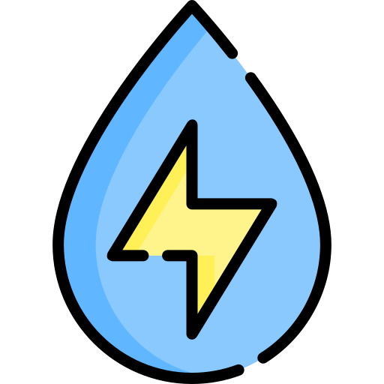
Hydro Energy
Education HUB
Chapter 1
Hydro Basics

Slide 9
Basics
Wonders of Moving Water
Learning Objective
By the end of this chapter, you will:
Understand the Essentials of Hydropower: Gain a solid grasp of the geographical locations and natural conditions that make hydropower possible.
Discover the Power of Rivers: Learn how rivers, with their dynamic flows and diverse conditions, play a critical role in generating hydropower.
Dive into Ocean Energy: Explore the fascinating motion of tides and waves and see how innovative systems harness their immense energy potential.
Harness the Energy of Mountains: Investigate how falling water in mountainous regions transforms potential energy into kinetic energy, driving turbines like water wheels to produce electricity.
Marvel at Dams and Reservoirs: Delve into the construction of colossal dams and reservoirs, understanding how they control water flow and fuel large-scale energy production.
Environmental Impacts of Moving Water: Gain fundamental insights into how moving water shapes the land and interacts with ecosystems around it.
By the end of this chapter, you’ll be empowered with foundational knowledge about water energy systems, ready to make informed decisions about optimizing their performance and understanding their role in a sustainable energy future!

Slide 10


Where is Hydro Energy found?
In this Challenge, you and your team will explore and identify potential locations where you would expect hydro energy to be located, focusing on specific regions.
Hydro Power Hunt Challenge!
Instructions
Divide into groups of 3-5 Students. Each group will work together to complete the challenge and share their insights with the class afterwards!
On the next page you will find a map of Ghana to work with!
Exercise
Task 1
Locate Hydropower Sites: Using the map, identify and mark potential locations where you think hydroelectric power plants could be built. Indicate these spots with red dots on your map.
Discuss the Suitability: for each location, consider the geographical features (elevation, proximity to water sources etc.) that make it a good choice for hydropower. Write down your reasons in short bullet points.
Rank the Locations: Arrange your chosen locations from most suitable to least suitable. (for example, indicate it with a 1, 2 … next to the red dots). Be prepared to provide some arguments for your top 3 locations.
Present your Findings and discuss in class!

Slide 11
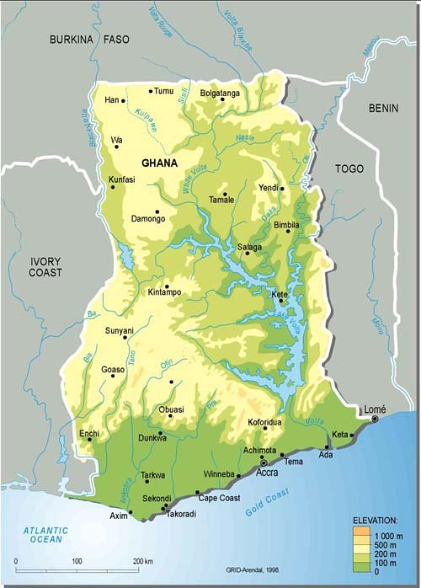
Hydro Power Hunt Challenge

Slide 12
HydroPower Hunt Challenge – Sample Solution
8
4
3
2
7
1
5
6
9
10

Slide 13
Hydro Power Hunt Challenge – Sample Solution
1
Lake Volta could serve as a vast natural reservoir.
As depicted, the lake feeds a network of rivers, making it a prime location for potential dam construction.
Situated in a mountainous region, the rivers benefit from natural water flow due to the incline, enhancing their potential for energy generation.
2
3
4
5
Smaller rivers likely have less hydro energy potential.
However, since the water originates from higher mountainous regions and flows toward the ocean, there is still potential for energy generation.
Additionally, locations where two or more rivers converge into a larger one could result in increased water flow, offering more opportunities to harness hydro energy.
6
7
8
Hydropower potential could also be harnessed from tidal and wave energy.
There may be suitable locations for additional harvesting of water motion.
However, this technology is relatively new, which may make it less suitable for widespread use at present.
9
10

Slide 14
Task 2
Fill in the blanks with the help of the word bank below!
Hydro Energy and Energy Conversion
In __________ regions water can flow very fast, creating more energy.
Water stored behind a dam has __________ energy because of its height.
When water flows downhill due to __________, it gains __________ energy.
The moving water spins __________, which are connected to a __________ to create electricity.
The word "hydro" comes from the Greek word for __________.
Hydro energy is a __________ energy source. It uses the movement of water to perform __________.
__________ also inhabit hydro energy, which can be harnessed with innovative concepts.
__________ are large structures built to block and control the flow of water, aiding in hydroelectric energy production.
The Water Cycle
Fill in the blanks with the correct words from the word bank:
The __________ moves water around the Earth and atmosphere in different stages. First, water turns into vapor through __________ when the heat from the __________ warms it. Next, the vapor cools and turns into tiny droplets in the process called __________. These droplets come together to form clouds. Then, water falls back to the Earth as rain, snow, or hail, a process known as __________. Finally, the water collects in rivers, lakes, and oceans, completing the cycle.
mountainous
potential
gravity
kinetic
turbines
generator
water
renewable
work
Oceans
Dams
water cycle
evaporation
sun
condensation
precipitation
Word Bank:
potential, gravity, turbines, evaporation, water, precipitation, generator, mountainous, dams, condensation, water cycle, renewable, work, oceans, kinetic, sun

Slide 15

In Summary
Hydropower is a major source of electricity in Ghana, with significant untapped potential for expansion. Hydro energy is both renewable and sustainable, relying on the natural water cycle.
The water cycle, driven by solar energy, operates through four key stages:
Evaporation: Water from oceans, lakes, and rivers turns into vapor and rises into the atmosphere.
Condensation: The vapor cools and forms clouds.
Precipitation: Rain or snow falls, often in mountainous regions.
Collection: Water gathers on the ground and flows into rivers, completing the cycle.
There are various locations where water energy can be harnessed effectively. Most important ones are:
Rivers: Providing a water stream, hence water motion.
Oceans: Utilizing the movement of tides and waves.
Mountainous regions: Harnessing the natural downhill flow of water, driven by gravity, to generate energy.
Catchment areas: Storing rainwater to ensure steady energy production.
Each of these sources offers distinct advantages and faces unique challenges. Understanding their potential enables the development of effective strategies for harvesting water's energy while ensuring sustainability.

Slide 16
1. Rivers
The target of this exercise is to understand why rivers are a vital resource for hydro-
energy. You will explore how to manage river streams effectively to harness their energy potential.
Exercise
Task 1
Team up with your seat neighbor and think about a river nearby.
Did you experience differences in the flow of its water stream during the year?
When and why did the water stream appear differently?
Are there parts of the river that have quicker water streams? If so, what could cause these differences?
If you want, you can either answer in bullet points or sketch something with descriptions.
Yes, there are differences.
The water stream often flows faster during the rainy season due to increased rainfall, which adds more water to the river.
In contrast, during the dry season, the flow slows down because there’s less water from precipitation.
Parts of the river with steeper slopes or narrower channels usually have quicker water streams, caused by gravity pulling the water downhill more forcefully or by the water being compressed in narrower spaces.
Obstacles like rocks can also create areas of turbulence and faster flow.

Slide 17

Task 2
Operating a Semi-Regulated River for Energy Production
Objective:
Analyze a semi-regulated river for hydroelectric energy production under different
scenarios. Predict outcomes, discuss challenges, and propose solutions to maintain
energy production while managing other factors.
Start Scenario:
A semi-regulated river flows through a hydroelectric power plant.
Normal production capacity: 30 MW under average water flow conditions.
Your Role:
You work individually or in small groups to analyze each scenario and answer open-ended questions.
Scenario 1: Normal Flow
Description: The river flow is steady and the power plant operates normally, producing a constant rate of 30 MW of electricity.
Questions:
1. What factors might affect the stability of this flow over time?
Seasonal changes such as rainy or dry seasons.
Long-term climate change causing unpredictable water patterns.
Increased human activity upstream, such as irrigation or industrial water use.
2. Why is it important to maintain a balance between energy production and water levels?
Overusing water for energy could deplete reservoir levels, leaving no reserve for
droughts or emergencies.
Excessive water release could disrupt ecosystems downstream.
Balancing ensures consistent energy production and minimizes environmental harm
Notes:
Teacher Note:
Read the Scenario
Go through the classroom and check if help is needed
Stop after each Scenario and explain -> sample solution
Then move on to the next Scenario

Slide 18

Task 3
Scenario 2: Drought
Description:
A prolonged drought reduces the river’s water flow significantly. Rainfall is minimal, and
reservoir levels are dropping.
Questions:
1. What happens to electricity production when water flow is reduced?
Electricity production decreases because there isn’t enough water to drive the turbines effectively.
2. What actions could the power plant operators take to sustain energy production during the drought?
Reduce energy output to preserve water in the reservoir for critical needs.
Supplement with alternative energy sources like solar or wind if available.
Work with the community to promote energy conservation.
3. What are potential consequences of overusing the remaining water in the reservoir?
The reservoir could be completely drained, making the power plant inoperable.
Wildlife and ecosystems that depend on the water would be severely affected.
Downstream communities might face water shortages.

Slide 19
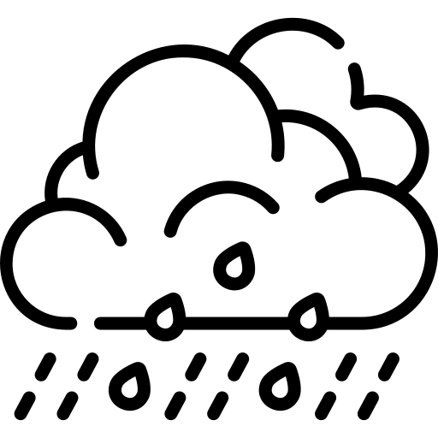
Task 4
Scenario 3: Heavy Rainfall
Description:
Monsoon-like rains cause a sudden surge in the river’s water level. The reservoir is at risk
of overflowing, and downstream areas may face flooding.
Questions:
1. Can electricity still be produced effectively when water levels are too high? Why or why not?
Yes, but with limitations. Excess water can overwhelm the system, forcing operators to open for example spillways and release water without using it for energy production.
High flow might also damage turbines or other infrastructure if not managed properly.
2. What strategies could the power plant use to manage the excess water?
Open spillways gradually to release water in a controlled manner, preventing dam overflow.
Use the opportunity to generate as much energy as possible without exceeding safe operational limits.
Coordinate with downstream areas to prepare for potential flooding.
3. How could this scenario impact communities and ecosystems downstream?
Flooding could damage homes, farmland, and infrastructure.
High water flow could disrupt aquatic habitats, affecting fish and other wildlife.
Contaminants or debris could be washed downstream, harming water quality.

Slide 20
In Summary
Rivers are a vital source of Hydro-Energy, providing the continuous water flow needed to power turbines and generate electricity.
Seasonal variations significantly impact river flow:
  Rainy Season: Higher water levels increase energy production.
  Dry Season: Lower flow reduces energy output.
  Dams help regulate river flow to ensure consistent energy generation but may require careful management to mitigate environmental and community impacts.
  Rivers are widely available, renewable, and capable of properly managing reliable energy, making them a key component of Hydro-Energy systems.

Slide 21
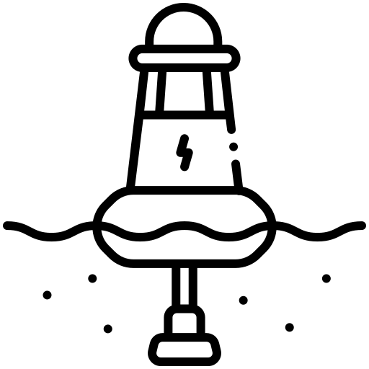
2. Oceans
The target of this exercise is to explore how the motion of ocean water can be harnessed to produce renewable energy. You will investigate technologies like tidal and wave energy
systems that transform this natural motion into sustainable power sources.
Exercise
Task 1
Understanding Tides and Wave Energy:
Think about the ocean, like the Atlantic Ocean, Ghana.
Answer the following questions:
What natural forces create tides and waves in the ocean?
What do you think is the largest tidal difference (highest and lowest water levels) found on earth?
How might we use these natural forces, like tides and waves, to generate hydropower?
1. What natural forces create tides and waves in the ocean?
Tides: Are caused by the gravitational pull of the moon and the sun. Imagine you're pulling on a stretchy rubber band. The moon pulls on Earth’s oceans, causing the water to bulge out toward it. At the same time, there’s another bulge on the opposite side of the Earth because of how the water gets squeezed. That’s why we have high tides and low tides every day.
Waves: Are mostly caused by the wind. Picture blowing on a bowl of soup—your breath creates ripples on the surface. When the wind blows across the ocean, it pushes the water and creates waves. The stronger the wind, the bigger the waves!

Slide 22
2. What do you think is the largest tidal difference (highest and lowest water levels) found on Earth?
The biggest tidal difference in the world happens in a place called the Bay of Fundy, between Canada’s New Brunswick and Nova Scotia.
Here, the water can rise and fall by as much as 16 meters (or 53 feet)! That’s about as tall as a four-story building. Imagine a beach where the water goes way out during low tide, and then hours later, it comes rushing back in, almost like filling a giant bathtub.
3. How might we use these natural forces, like tides and waves, to generate hydropower?
We can turn the ocean's energy into electricity, just like we turn the wind into power with windmills.
Using Tides: Engineers build special underwater “water wheels” or tidal turbines that spin when the tides flow in and out. It’s like riding a bike downhill—the flowing water makes the turbines move and create energy.
Using Waves: Waves are like nature's push and pull. We can build devices that float on the surface or sit underwater. These machines capture the motion of the waves and turn it into electricity, just like how we use a crank to generate power for a flashlight.
Motivation: It’s amazing that we can use the ocean's natural movements to light up our homes, just like plugging into nature’s power socket!

Slide 23
In Summary
Ocean Energy Potential: Oceans cover over 70% of earth’s surface, making them a vast source of renewable energy.
Sources of Ocean Energy:
Tidal Energy: Generated from the rise and fall of tides, driven by the gravitational pull of the moon and sun. Tidal systems are predictable and consistent.
Wave Energy: Converts the up-and-down motion of waves, which are created by wind moving across the ocean surface, into electricity.
Real-Life Example: The Bay of Fundy in Canada has the world's largest tidal range, up to 16 meters (53 feet), demonstrating the immense power of tidal energy.
Technological Challenges and Opportunities:
Harsh ocean conditions and unpredictability present engineering challenges.
Innovations in technology could unlock the ocean's potential as a significant contributor to global renewable energy.
Importance of Oceans: Harnessing ocean energy is like plugging into nature’s power, offering sustainable solutions for lighting homes and reducing reliance on fossil fuels.

Slide 24
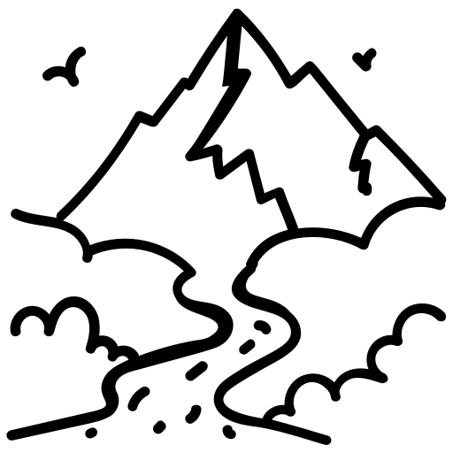
3. Mountainous Regions
The target of this exercise is to understand how hydro energy can be effectively
harnessed in mountainous regions. You will learn about the unique challenges and
opportunities presented by steep terrains and fast-flowing streams in these areas.
Exercise
Task 1
Understanding Hydro Energy in Mountainous regions:
Debating Game
Team GREEN Location 1: High up the mountain, meaning a steep incline.
Team BLUE Location 2: At the bottom of the mountain, meaning the incline is less. steep.
Objective: Each team will argue why their assigned location is the best for building a water wheel to generate energy.
Focus: Compare the differences in water motion (speed and force) and availability (volume and consistency) between the two locations. Which location do you think is more environmentally sustainable for building a water wheel, considering the potential impacts on ecosystems and water resources?
Explain how these differences affect the performance of a water wheel.
You can use this debating structure if you like:
Opening Statements (2-4 minutes per team): Present your main argument for why your location is the best.
Counterarguments (2-4 minutes per team): Address potential weaknesses in your location and critique the opposing team’s position.
Rebuttals (1-3 minute per team): Respond to the opposing team’s critiques.
Closing Statements (1-2 minutes): Summarize your strongest points.
NOW! Split into two equal groups. One group will represent Team GREEN (Location 1: High up the mountain), and the other will represent Team BLUE (Location 2: At the bottom of the mountain).

Slide 25
Team GREEN Argument (Location 1 - High Up the Mountain)
Arguments - Energy
The steep incline at Location 1 means water gains significant velocity due to gravity as it flows downhill. A water wheel at this location would benefit from this increased water motion, as the kinetic energy of faster-moving water translates into more rotational force on the wheel. Additionally, this location ensures consistent water flow due to its position at the start of the mountain stream, reducing the risk of interruptions in water supply caused by upstream usage or diversion. Overall, the greater speed and uninterrupted flow make this location ideal for generating hydro energy efficiently.
Arguments - Environment
Building the water wheel high up the mountain minimizes the environmental impact because the water flow here is typically faster and narrower, reducing the area affected by construction. Additionally, the reduced sediment accumulation at this elevation means less disruption to aquatic ecosystems. Since the water flow remains largely not diverted, it minimizes harm to downstream habitats and preserves the natural water cycle.
----
Team BLUE Argument (Location 2 - Bottom of the Mountain)
Arguments - Energy
The bottom of the mountain has a gentler incline, which allows for a broader collection of water from tributaries and runoff as streams converge. This leads to a larger volume of water available to power the water wheel. While the velocity may be slower compared to higher up the mountain, the increased mass of water compensates, as energy generation also depends on the volume of water interacting with the wheel. Furthermore, maintaining and accessing the water wheel is more practical at the base of the mountain, making this location better suited for sustainable and consistent hydro energy production.
Arguments – Environment
The bottom of the mountain is more environmentally sustainable because water wheels here can harness larger water volumes with less reliance on high-speed flow. This reduces the need for major infrastructure, preserving the mountain's natural landscape and minimizing ecological disruption. Furthermore, being closer to converging streams allows for broader energy generation with less fragmentation of aquatic habitats upstream.

Slide 26
In Summary
Definition – Waterfall Effect
The waterfall effect refers to the energy generated by water falling from a height.
This is a key principle behind many hydroelectric systems and works because of gravitational potential energy converting into kinetic energy which then can be converted into mechanical or electrical energy.
In other words: Water at the top of a hill (elevated) = Stored Energy (Potential Energy) (Remember the rubber band analogy!)
Falling Water = Energy in Motion: When the water starts falling, gravity pulls it down, turning that stored energy into motion.
Spinning the Water Wheel = Using the Motion:
At the bottom, the fast-moving water spins a big wheel (turbine)
The Waterfall Effect works for small systems like a water wheel, and large system like a huge hydroelectric dam in principle equally.
Why Hydro Energy in Mountainous Regions Matters
Efficient Energy Generation: Mountainous regions have fast-flowing rivers and steep inclines, ideal for converting gravitational potential energy into hydroelectric power.
Support for Remote Areas: Hydroelectric systems can provide reliable electricity to isolated communities in mountainous regions.
Economic Development: Harnessing water energy supports local economies through job creation and infrastructure improvements.
Low Environmental Impact: When responsibly managed, hydro energy systems in these regions have minimal ecological disruption compared to other energy sources.

Slide 27

4. Catchment Area and River Basins
The target of this exercise is to learn what a catchment area and river basin are and how
they are connected to dams and reservoirs. Additionally, you will explore how these
systems impact their surrounding environment.
Exercise
Task 1
1. What happens when rain falls on a hill or mountain? Where does the water go?
When rain falls on a hill or mountain, gravity pulls the water downhill. The water doesn’t spread out randomly; instead, it flows into low-lying areas like streams, rivers, or lakes.
Some water may soak into the ground, becoming groundwater, while the rest forms surface runoff. This surface runoff flows through small channels that join to form larger streams and rivers.
2. How do you think water gathers into streams and rivers?
Rainwater collects from the higher parts of the land (like hills or mountains) and flows downhill into natural paths formed by the shape of the land.
Small streams from different parts of the land meet, combining their flow. These streams eventually join together to form larger rivers that continue to flow toward lower ground or the sea.
The land that collects all the rain feeding into these rivers is called the catchment area. All the rivers flowing into one main river system make up the river basin.

Slide 28
3. Draw what you imagine a “catchment area” or “river basin” might look like.
See page 33 teachers presentation
Task 2
Understanding Dams and Reservoirs
Where would you place a dam to collect and store water?
How would the dam affect the flow of the river and the landscape around it (Up-/Downstream of the dam)?
Sketch a dam and reservoir using your knowledge of catchment areas and river basins.
A dam is typically built at a narrow point in the river where it can block the flow effectively, creating a reservoir upstream.
Upstream (Reservoir): The natural river valley is transformed into a reservoir, submerging land and ecosystems. The water stored provides a steady supply for irrigation, drinking water, and hydropower. However, this may lead to the displacement of local communities and loss of habitats.
Downstream: The river flow becomes regulated. Flood risks may decrease, but sediment transport is reduced, affecting downstream soil fertility. Aquatic habitats may change or degrade due to altered flow patterns and water temperatures.
Landscape Changes: The dam structure and reservoir significantly alter the natural landscape, creating new opportunities for recreation but also introducing risks like reduced sediment downstream and potential seismic activity due to the weight of the water.

Slide 29
4. Sketch a dam and reservoir using your knowledge of catchment areas and river basins.
See page 35 teachers presentation
In Summary
A catchment area is a smaller, more specific part of land where rainwater collects and flows into a single stream, river, or reservoir.
It’s focused on just one local water source, like a small stream or lake.
A river basin is much larger. It’s the entire area of land where all the water flows into one big river.
It includes many smaller catchment areas that feed into streams, which then feed into the gib river (at the bottom).
A dam is basically a big wall built across a river to stop or slow the flow of water.
This creates a lake behind it, called a reservoir, where water is stored.
A reservoir is the man-made lake that forms behind the dam.
It collects water, especially in mountain areas where rivers flow from melting snow or rain.
The stored water can be released when needed, like saving energy in a battery.

Slide 30


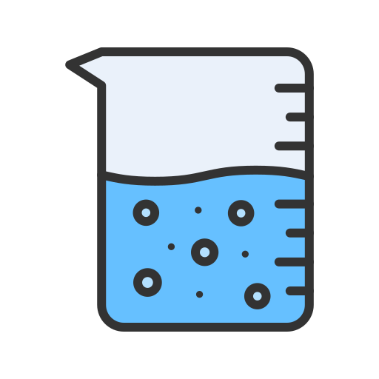


5. Environmental Impacts Game
In this Challenge, you and your team will explore and identify the effects of silting,
flooding, and water obstructions on land. Through a hands-on experiment, you will
observe how these factors can alter the landscape, impact soil stability, and shape the environment over time.
Challenge!
Material you will need for the challenge
Plastic Box (at least A4 size)
Sand
Beaker with 300 mL of water
2 rulers
Bucket / Sink
Cardboard (cut to match the width of the pan's interior, with a 2-3 cm opening in the center)
Books (to support the pan and create an incline of at least 5cm)
Setup Preparation
Fill up the closed end of the box with sand to a depth of 5 centimeters.
Smooth the surface of the sand to create an even layer.
Position the plastic box so that the end with the drain hole is placed over a bucket or sink to catch runoff water.
You can find an example setup of the Impacts game on the next page.

Slide 31
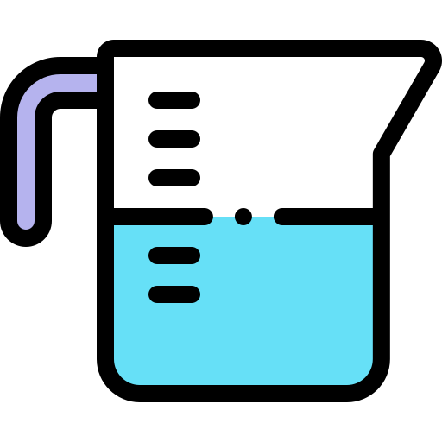
Environmental Impacts Game: Initial Setup
10 cm
5 cm
Sand
5 cm
Drain Hole

Slide 32

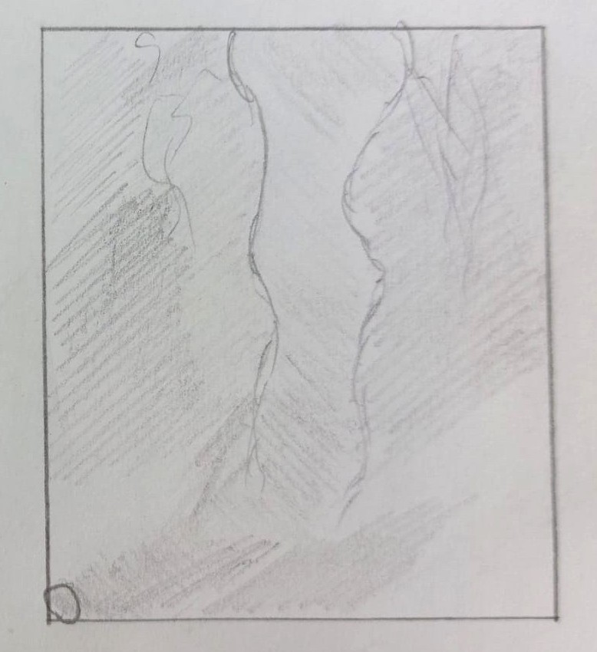
Exercise
Task 1
How does water change land?
Follow these steps to conduct Task 1
Place books underneath the box, such that it raises the end of it for at least 5cm. (make sure it’s not wobbling!)
Hold the beaker 10 centimeters above the sand and pour it onto the end in a slow, steady stream.
Record your observations below.
Draw top-view pictures of the sand before and after pouring water on it.
Sand Before Water
Sand After Water

Slide 33
Explain how the water’s movement affected the sand in your experiment. What changes did you notice, and what might these represent in a real-world environment?
Observation of Water Flow:
Water created small channels and grooves in the sand.
The sand at the top of the slope was eroded as the water flowed down.
Sediment Movement:
Sand was carried downward, forming a pile or small delta near the drain hole.
Conclusion:
The experiment shows how water erodes higher land and deposits sediment in lower areas, changing the shape of the land over time.
Task 2
Water Obstruction
Follow these steps to conduct Task 2
Prepare the box as described on page 30.
Insert one ruler into the sand near the middle on the right side and another ruler on the left side of the pan.
Elevate the end of the box containing the sand to create an incline.
Hold the beaker 10 centimeters above the sand. Slowly and steadily pour the water onto the raised end of the pan.
Record your observations in the space provided on the next page.
Draw top-view pictures of the sand before and after pouring water on it.

Slide 34


Sand Before Water
Sand After Water
Explain how the water’s movement affected the sand in your experiment. What changes did you notice, and what might these represent in a real-world environment?"
The flat layer of sand shows how sediment is initially spread out but gets mobilized by flowing water.
The rulers demonstrate how obstacles (natural or artificial) can concentrate sediment buildup, leading to obstructions.
This simulates how dams or narrowed river channels often experience silting, which can block water flow over time.
Takeaways
Sediment in water systems can be redistributed and accumulate over time.
Barriers, like dams or riverbanks, can trap sediment, leading to blockages.
This experiment mimics the effects of obstacles such as rocks, trees, or human structures (like dams) on water flow in rivers and streams.
Managing sediment is critical to ensure water flow and maintain hydro systems.

Slide 35


Task 3
Water Silting & Riverbank Erosion
Follow these steps to conduct Task 3
Prepare the box as described on page 30.
Shape a river: Use your finger or tool to form a winding river (meandering path) in the middle of the box, leading to the end of it.
Elevate the end of the box containing the sand to create an incline.
Hold the beaker 10 centimeters above the sand. Slowly and steadily pour the water onto the raised end of the box until its half empty (simulate river flow)
When the water is flowing in your river, increase the amount by pouring the rest of the water from the beaker faster.
Record your observations in the space provided on the next page.
Draw top-view pictures of the sand before and after pouring water on it.
Sand Before Water
Sand After Water

Slide 36
Explain how the water’s movement affected the sand in your experiment. What changes did you notice, and what might these represent in a real-world environment?
Water’s Effect on Sand:
As the water flowed slowly, it eroded the riverbanks and deepened the riverbed, carving out channels.
When the water flow increased, more sand was carried away from the banks and deposited at the end of the river, forming a small mound or delta.
The river, which previously had sharp meanders, now has softer curves due to sediment being washed away
If the river flow is slow and there is a significant amount of silt, such as from a mountain, the silt would settle at the bottom of the river due to reduced water velocity. This process, called sedimentation, can lead to the riverbed becoming silted, potentially affecting water flow and the surrounding ecosystemReal-World Implications:
This experiment shows how rivers shape the land by eroding soil and depositing sediment in slower-moving areas, creating natural features like river deltas and floodplains over time.

Slide 37


Task 4
Water Flooding
Follow these steps to conduct Task 4
Prepare the box as described on page 30.
Insert the cardboard into the box to act as a barrier.
Use a ruler or another piece of cardboard to cover the opening in the barrier, ensuring no water can flow through when you start pouring.
Place books underneath the end of the box with the sand to raise it. Ensure the box is stable and does not wobble.
Hold the beaker 5 centimeters above the sand. Pour all the water from the beaker onto the raised end of the pan (slow and steady) to simulate a reservoir filling up behind the barrier.
Simulate the Flood: Once the beaker is empty, remove the ruler or cardboard covering the opening to release the water.
Draw top-view pictures of the sand before and after pouring water on it.
Pan Before Water
Pan After Water

Slide 38
Explain how the water’s movement affected the sand in your experiment. What changes did you notice, and what might these represent in a real-world environment?
Water’s Effect on Sand:
As the water filled up behind the barrier, it created a buildup of pressure, causing the sand to become saturated and more compacted. It also created a reservoir behind the ruler.
Once the barrier was removed, the water rushed through the opening, eroding the sand and carrying a lot of it down the slope. The floodwater spread, moving sand and forming new channels.
Real-World Implications:
This mimics how floods can occur when a dam or barrier breaks, causing erosion and redistributing sediment, which can change the landscape by forming new river channels or floodplains.

Slide 39



In Summary
Silting
Concern: Dams retain sediment (dirt and sand) that would normally flow downstream. These sediment deposits behind the dam can reduce the capacity of the reservoir and affect water quality.
Impact: The lack of sediment downstream can reduce soil fertility for agriculture and harm ecosystems that depend on the natural flow of nutrients.
Waterway Obstruction
Concern: Dams block the natural flow of rivers, preventing fish and other aquatic animals from migrating to spawn or move to different areas.
Impact: This obstruction can harm fish populations (like salmon), disrupt ecosystems, and reduce biodiversity in both the river and the surrounding areas.
Flooding
Concern: Building a dam often causes large areas upstream to be flooded, which can destroy ecosystems, forests, and animal habitats.
When there is too much water in the reservoir, all channels of the dam must be opened to release the pressure. As a result, flooding can also occur downstream.
Impact: Flooding can displace local communities, drown wildlife habitats and disrupt the natural balance of the surrounding environment, leading to long-term ecological damage.
A dam causes targeted flooding by moving the river that feeds the reservoir upstream!

Slide 40

Hydro Energy
Education HUB
Chapter 2
Water Wheel and Turbine Types

Slide 41
Craft Your Own Water Wheel!
Learning Objective
In this chapter, you will embark on an exciting journey into the world of hydropower. Together with your team, you will construct your very own water wheel and explore the mechanics behind its operation. This hands-on task will help you understand how to efficiently run a hydroelectric power plant and uncover the critical role that buckets play in its functionality. You will also investigate the ideal types of water motion for a water wheel and discover how this connects to the formula for energy in hydropower systems.
Additionally, through a hands-on experiment, you will see state-of-the-art turbines and learn about three distinct turbine designs. You will explore how these turbines differ, the principles behind their operation, and the reasons for their unique designs.
By the end of this chapter, you will not only have built a deeper understanding of hydropower but also gained practical insights into the technology driving modern hydroelectric systems.
Material you will need for the experiment
Fully printed template of the Paper Water Wheel
Scissors
Paper Glue
Waterproofing spray for paper (regular waterproofing spray)
Instructions to build the Water Wheel
Build the Water Wheel in Class together! Assemble the water wheel following the steps provided on page 1 of the template. Allow the glue to dry completely before proceeding.
Apply the Waterproofing Spray. Once the glue has dried, use the waterproofing spray to coat the water wheel. Spray carefully at every angle, ensuring the entire surface is covered. This will protect the water wheel from water damage and ensure it remains functional during testing.

Slide 42
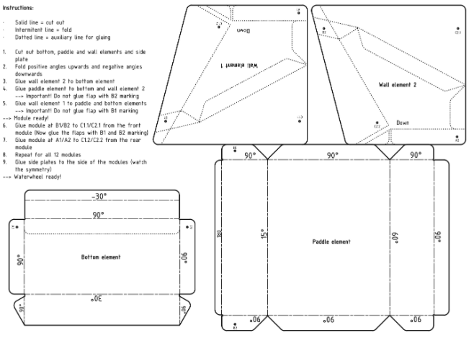
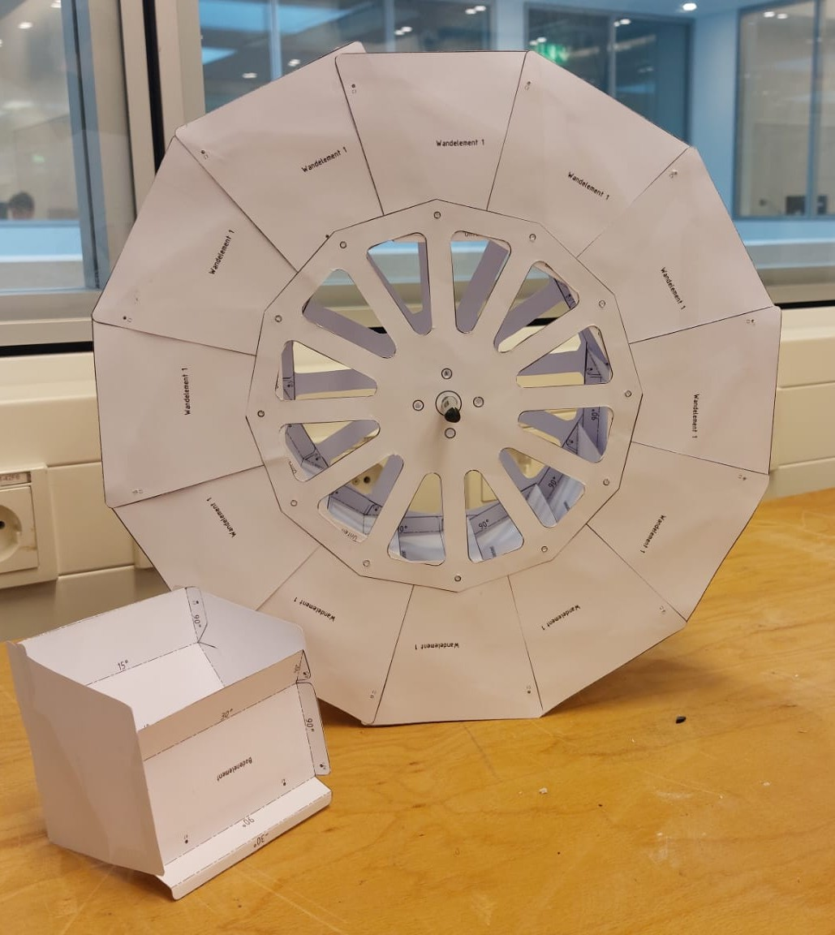
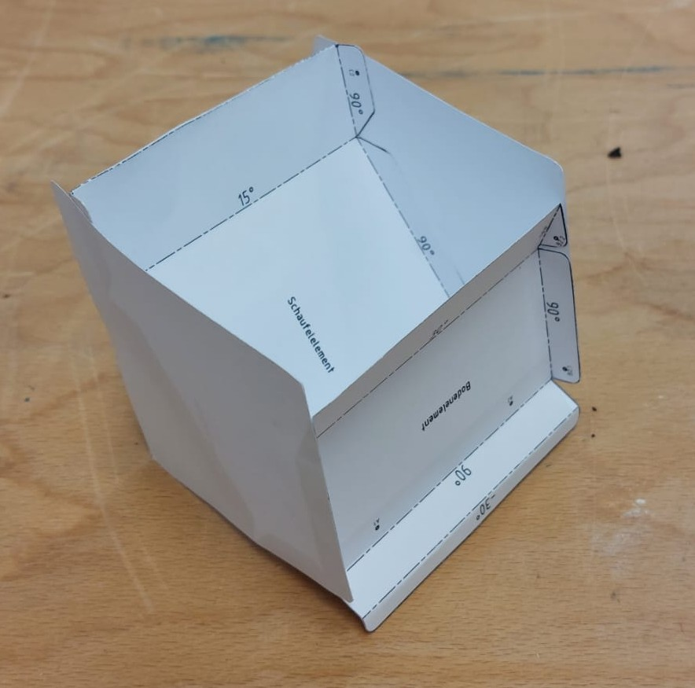
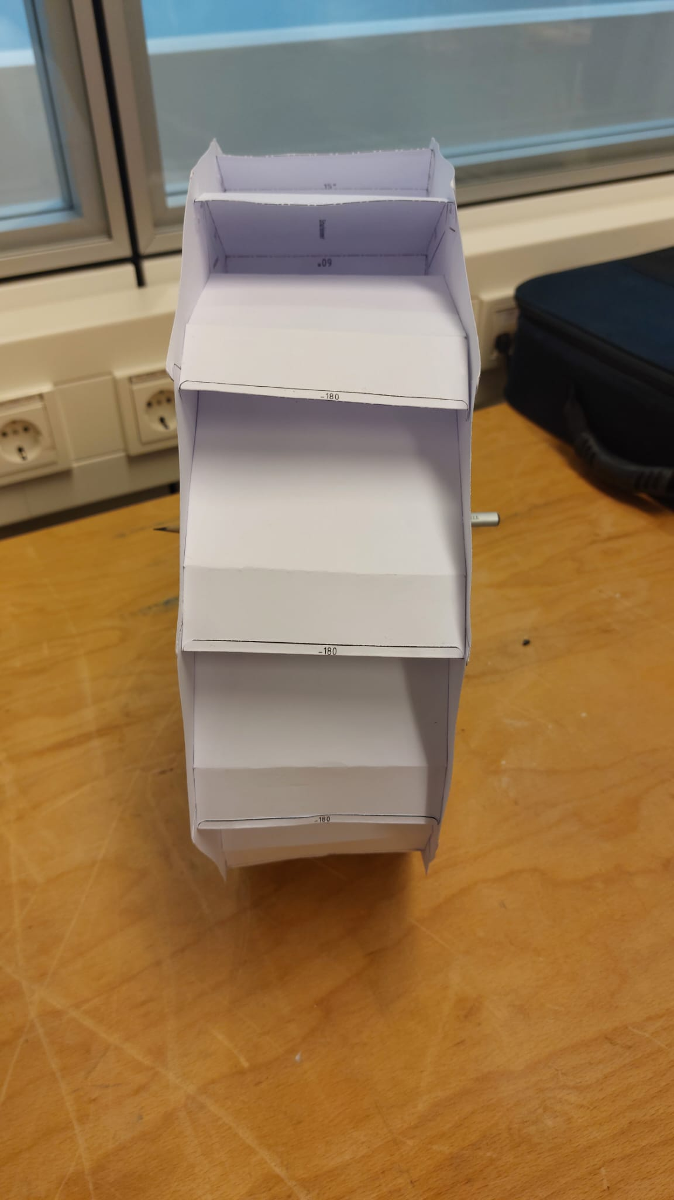
Follow the instructions carefully to build the water wheel
Accurately. Find the pdf in the Moodle-Box!
You need 12 single Buckets!
All the necessary instructions are located on the first page of the
Paper Water Wheel kit!

Slide 43
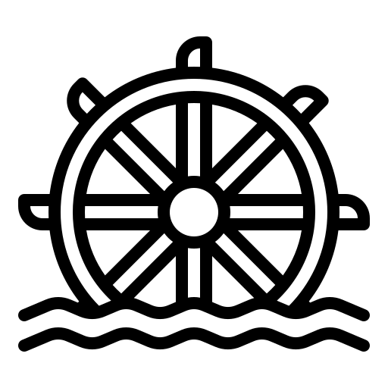
Exercise
Task 1
Carefully examine the water wheel you have built. Observe its structure closely and reflect on how it operates.
Question
Which parts do you think are the most important for its operation? Explain your reasoning.
Key parts may include:
Blades or Buckets: These catch the flowing water, making the wheel spin. Think of them like your hands catching water to splash — it’s how the water moves the wheel.
Wheel (Rotor): This is the round part of the water wheel that turns when water hits the blades. It's like the main body of your wheel.
Axle: The rod in the middle of the wheel that spins as the wheel turns. This can connect to machines to make them work.
Supports or Frame: The structure that holds the wheel steady and keeps it in place while it spins.
Water Source (Channel or Stream): Where the water comes from, like a river or stream, which gives the wheel its energy.

Slide 44
Task 2
Take a closer look at the buckets on your water wheel.
Imagine how they work when water flows into them.
Questions
Why are the buckets the most important part for making the water wheel work well?
How can the buckets be made such that they work more efficiently/provide more power?
What else is a crucial parameter to get more power from a water wheel?
1.
Buckets are the most important part to make a water wheel work …
… because they are the parts that interact directly with the water, capturing its energy and transferring it to the wheel. The buckets "catch" the water and create the force needed to turn the wheel. Therefore, you could say the buckets “grab” the energy from the water, “hold onto it” for a certain amount of time and eventually turn it into movement of the whole water wheel.
Recall Windmill: The windmill uses its blades to catch the wind to spin. The buckets on a water wheel do the same thing, but with water instead of wind.
2.
Shape and Size: A curved or deep bucket holds water better, like a spoon compared to a flat plate. Curved buckets prevent water from spilling out quickly, giving the wheel more time to spin.
Placement: Buckets spaced evenly around the wheel help balance the forces, making the wheel spin smoothly without wobbling.
Angle: Adjusting the angle of the buckets can make them catch water more effectively. If they are tilted too much, the water might spill out; if they’re too flat, they won’t catch enough water.
3.
The water stream:
Direction of the water stream: aimed perfectly into the buckets, so it gives the water wheel the best “push”.
Amount of water (Volume): The more water in the stream, the more power it has! If all your buckets are filled up exactly 100% each time the buckets carry 100% of the weight, hence can provide more power.
Strength of the Water Stream (flow speed): the faster the water moves, the stronger its push on the buckets.
Consistency of the water stream

Slide 45
In Summary
Key Parts of the Water Wheel are:
Blades or Buckets: Capture the flowing water, causing the wheel to spin.
Wheel (Rotor): Holds the buckets and transfers motion.
Axle: The central rod around which the wheel rotates.
Supports/Frame: Keeps the wheel stable and secure.
Important Factors:
Buckets are the most important part because they directly interact with the water, capturing its energy and transferring it to the wheel. Their efficiency can be improved by optimizing their shape, size, placement, and angle.
The direction of the water stream is crucial for optimal performance.
A water wheel works best with high-volume, low-head water flow.
Formula for Energy:
In Words:
Energy = Density (p) * Volume (V) * Gravity (g) * Height (h)
m for mass: relates to the amount of water.
h for height: the higher the water is, the more potential energy it contains.
g for gravity: which pulls the water down, converting potential energy into kinetic energy (approximately 9.8 m/s² on earth)
p for density of water
Potential Energy = m * g * h
Mass can be written as Volume * Density of water: m = p * V
Insert m in the Potential Energy Equation = p * V * g * h
Energy = p * V * g * h
In other words:
Total energy = potential energy + kinetic energy
= Etotal = Epot + Ekin

Slide 46
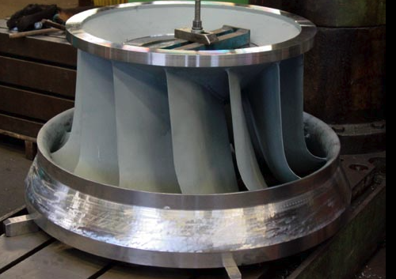
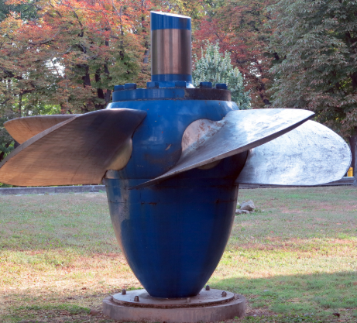
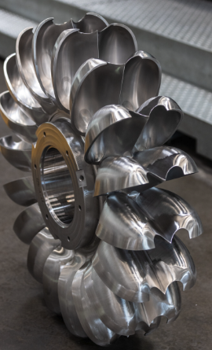




2. Different Turbine Types in Hydro Energy
Learning Objective
In this chapter, you will embark on an exciting experiment involving a 3D-printed
hydropower plant equipped with Francis, Pelton, and Kaplan turbines. The goal of this
experiment is to help you understand the three major types of water turbines, their
unique designs, and the specific conditions in which they operate most efficiently. You
will gain insight into why different turbine types are necessary to harness the energy of
water effectively in various environmental and flow conditions.
Exercise
Task 1
Francis Turbine
Kaplan Turbine
Pelton Turbine
Videos and animations about the principles of operating different types of hydro turbines:

Slide 47
Task 2
Guess: Why do you think the types of turbines shown exist?
Because of different environmental circumstances water is moving in a different way.
Sometimes its slower, sometimes faster and also the volume is varying.
Therefore, to fully utilize water energy we need different turbine types.
In Chapter 1, you were introduced to a wide range of environmental conditions and water motion, which can vary in energy levels. To efficiently harness the motion of water, specific types of turbines are required.
Task 3
Which Turbine Type would you recommend for following operation range scenarios:
Very high head height and low flow rate of the water
Low head height and high flow rate
Medium head height and very high flow rate
For every scenario add a location where those conditions could be found in real world (for example: River, Dam, …)
1. Pelton Turbine:
Example: a tall mountain dam, like the Hoover Dam in the USA. Water falls from a great height, spinning the Pelton wheel to create energy.
2. Kaplan Turbine:
Example: A huge River. Kaplan turbines are used where there is a. lot of water moving gently but powerfully.
3. Francis Turbine:
Example: Itaipu Dam between Brazil and Paraguay, where there is a good mix of height and flow.

Slide 48
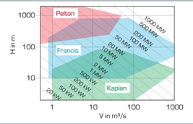
Task 4
Turbine types and their operation ranges
Below you can find a Turbine Operation Ranges Plot
Indicate where Pelton, Francis and Kaplan Turbines operation ranges are
  X-axis: Flow Rate in m³ / s (flow of water per second)
  Y-axis: Head height in meters
HINT: first make a dot to indicate the general location, then think about an operation area!

Slide 49
In Summary
The Kaplan, Francis, and Pelton turbines exist because water behaves differently in various environments, requiring specific turbine designs to harness its energy efficiently:
Kaplan Turbine: Ideal for large volumes of slow-moving water with low height differences, such as wide rivers.
Kaplan: Head range 2 – 75m / Flow rate up to 800 m³ / s
Francis Turbine: Best for environments with a balanced combination of flow rate and height, like medium-sized dams.
Francis: Head range 30-800m / Flow rate up to 800 m³ / s
Pelton Turbine: Designed for high water pressure and large height differences, such as tall mountain dams.
Pelton: Head range 150 – 1800m / Flow rate up to 60 m³ / s
These three turbine types perform better in different environments because they are optimized for specific water flow conditions (speed, volume, and pressure) to maximize energy generation.

Slide 50
Hydro Education HUB
Chapter 3
Factors Affecting Turbine Performance - Pelton Turbine Experiments

Slide 51
Factors affecting turbine – Pelton turbine experiments
In this chapter, you will explore:
The Role of Head Height in Hydro-Energy: Discover how the height of water sources impacts velocity and energy generation, guided by Torricelli’s Law.
Water Resistance and Flow: Learn how obstacles in the water path create resistance, reducing energy output, and understand its analogy to electrical circuits.
Water Volume and Energy Output: Understand the significance of water volume in sustaining turbine performance and optimizing energy production.
Turbine Design and Efficiency: Dive into the importance of rotor designs, blade types, and their adaptation to different water conditions for maximum efficiency.
This chapter will provide you with a clear understanding of the mechanics and factors influencing the performance of Hydro-Energy systems, enabling you to appreciate how water is transformed into a powerful renewable energy source.
Learning Objective
By the end of this chapter, you will:
Apply Principles of Physics: Use Torricelli’s Law to explain how water velocity changes with head height and impacts turbine performance.
Evaluate Flow Resistance: Analyze how resistance in water paths reduces energy output and draw comparisons to electrical circuits.
Assess the Role of Water Volume: Understand how water availability affects the efficiency and output of Hydro-Energy systems.
Design for Efficiency: Recognize the importance of turbine design, including rotor shape and blade number, and evaluate their role in maximizing energy generation.
Connect Concepts Across Systems: Compare Hydro-Energy mechanics with PV and wind systems, identifying unique optimization strategies for each.
By the end of this chapter, you will be equipped to critically evaluate the factors that influence Hydro-Energy performance and design systems that adapt to varying conditions effectively.

Slide 52
1. Effect of volume on the force of water
Experiment
Material you will need for the experiment
1 empty 2-liter soda bottle
1 ruler
1 push pin
1 shallow tray or container to catch water
Towel or paper towels
Permanent marker
Water supply
Duct tape
Follow these steps to conduct the experiment:
Use the ruler to measure from the bottom of the bottle to 5 cm. Mark this spot with a dot and draw a horizontal line across the bottle.
Repeat this step at 10 cm, 15 cm and 20 cm, marking the positions on the bottle.
Use the push pin to create a hole at the 5 cm mark and cover it with duct tape.
Decide whether to leave the bottle cap on, loosen it, or remove it entirely during the experiment.
Procedure:
Fill the soda bottle with water up to the 20 cm mark.
Place the bottle in a shallow tray or container with the hole pointing downward to catch the water.
Remove the duct tape from the hole at 5 cm and let the water stream out.
Measure the distance the water jet projects from the hole and record the result.
Refill the bottle to the 15 cm mark. Remove the tape from the hole and measure the water jet distance again. Record the result.
Refill the bottle to the 10 cm mark. Repeat the process of measuring and recording the water jet distance.
Finally, refill the bottle to the 5 cm mark and repeat the measurement process.
Repeat all measurements (steps 3–7) three times for accuracy and consistency.

Slide 53
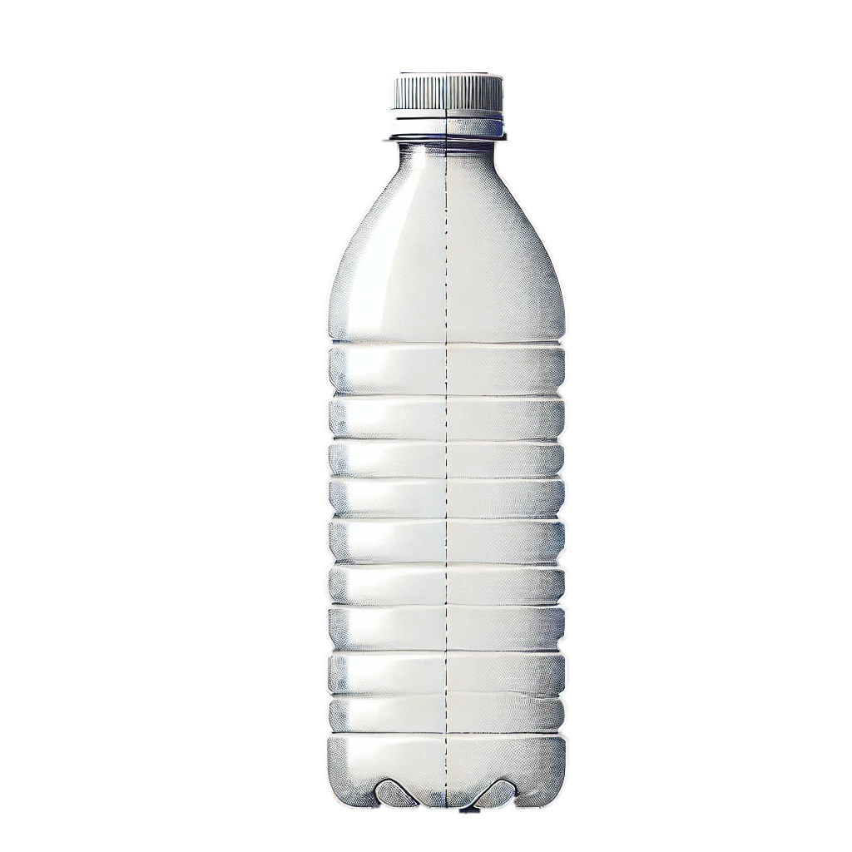
20 CM
15 CM
10 CM
5 CM
Volumen | Trial 1 | Trial 2 | Trial 3 | Average
5 CM
10 CM
15 CM
20 CM
Task 1
Discuss with a partner:
How does the water level affect the distance the jet travels?
Can you think of a real-life situation where this principle might apply? Write down two examples
1. How does the water level affect the distance the jet travels?:
The higher the water level, the farther the water jet travels. This is because more pressure at greater water volumes pushes the water out with more force.
2. Real life examples:
In fountains, the height of the water source affects how high the water sprays.
In household water tanks, higher water levels ensure stronger water flow through taps..

Slide 54
In Summary
The Effect of Water Volume on Force: Water volume directly impacts the force and pressure exerted. The experiment demonstrated that as the water level in the bottle increased, the force of the water jet also increased. This is because greater water height corresponds to higher potential energy, leading to more powerful water flow. This principle illustrates the importance of maintaining adequate water volume for consistent and efficient energy generation in hydro-energy systems.
The Relationship Between Height and Energy Output: By varying the water levels, the experiment revealed how changes in head height influence the velocity and reach of the water jet. This aligns with the concept that higher head heights increase kinetic energy and stronger water flow, optimizing energy output in hydro systems.
Practical Application in Hydro Systems: The experiment’s results simulate real-world scenarios, such as the use of reservoirs in hydroelectric plants. Maintaining higher water levels ensures more potent and efficient turbine operation, while understanding water flow mechanics helps mitigate energy losses due to inadequate water pressure or volume.
This experiment provided hands-on insight into how water volume and head height affect energy output, forming a foundational understanding for optimizing hydro-energy systems.

Slide 55
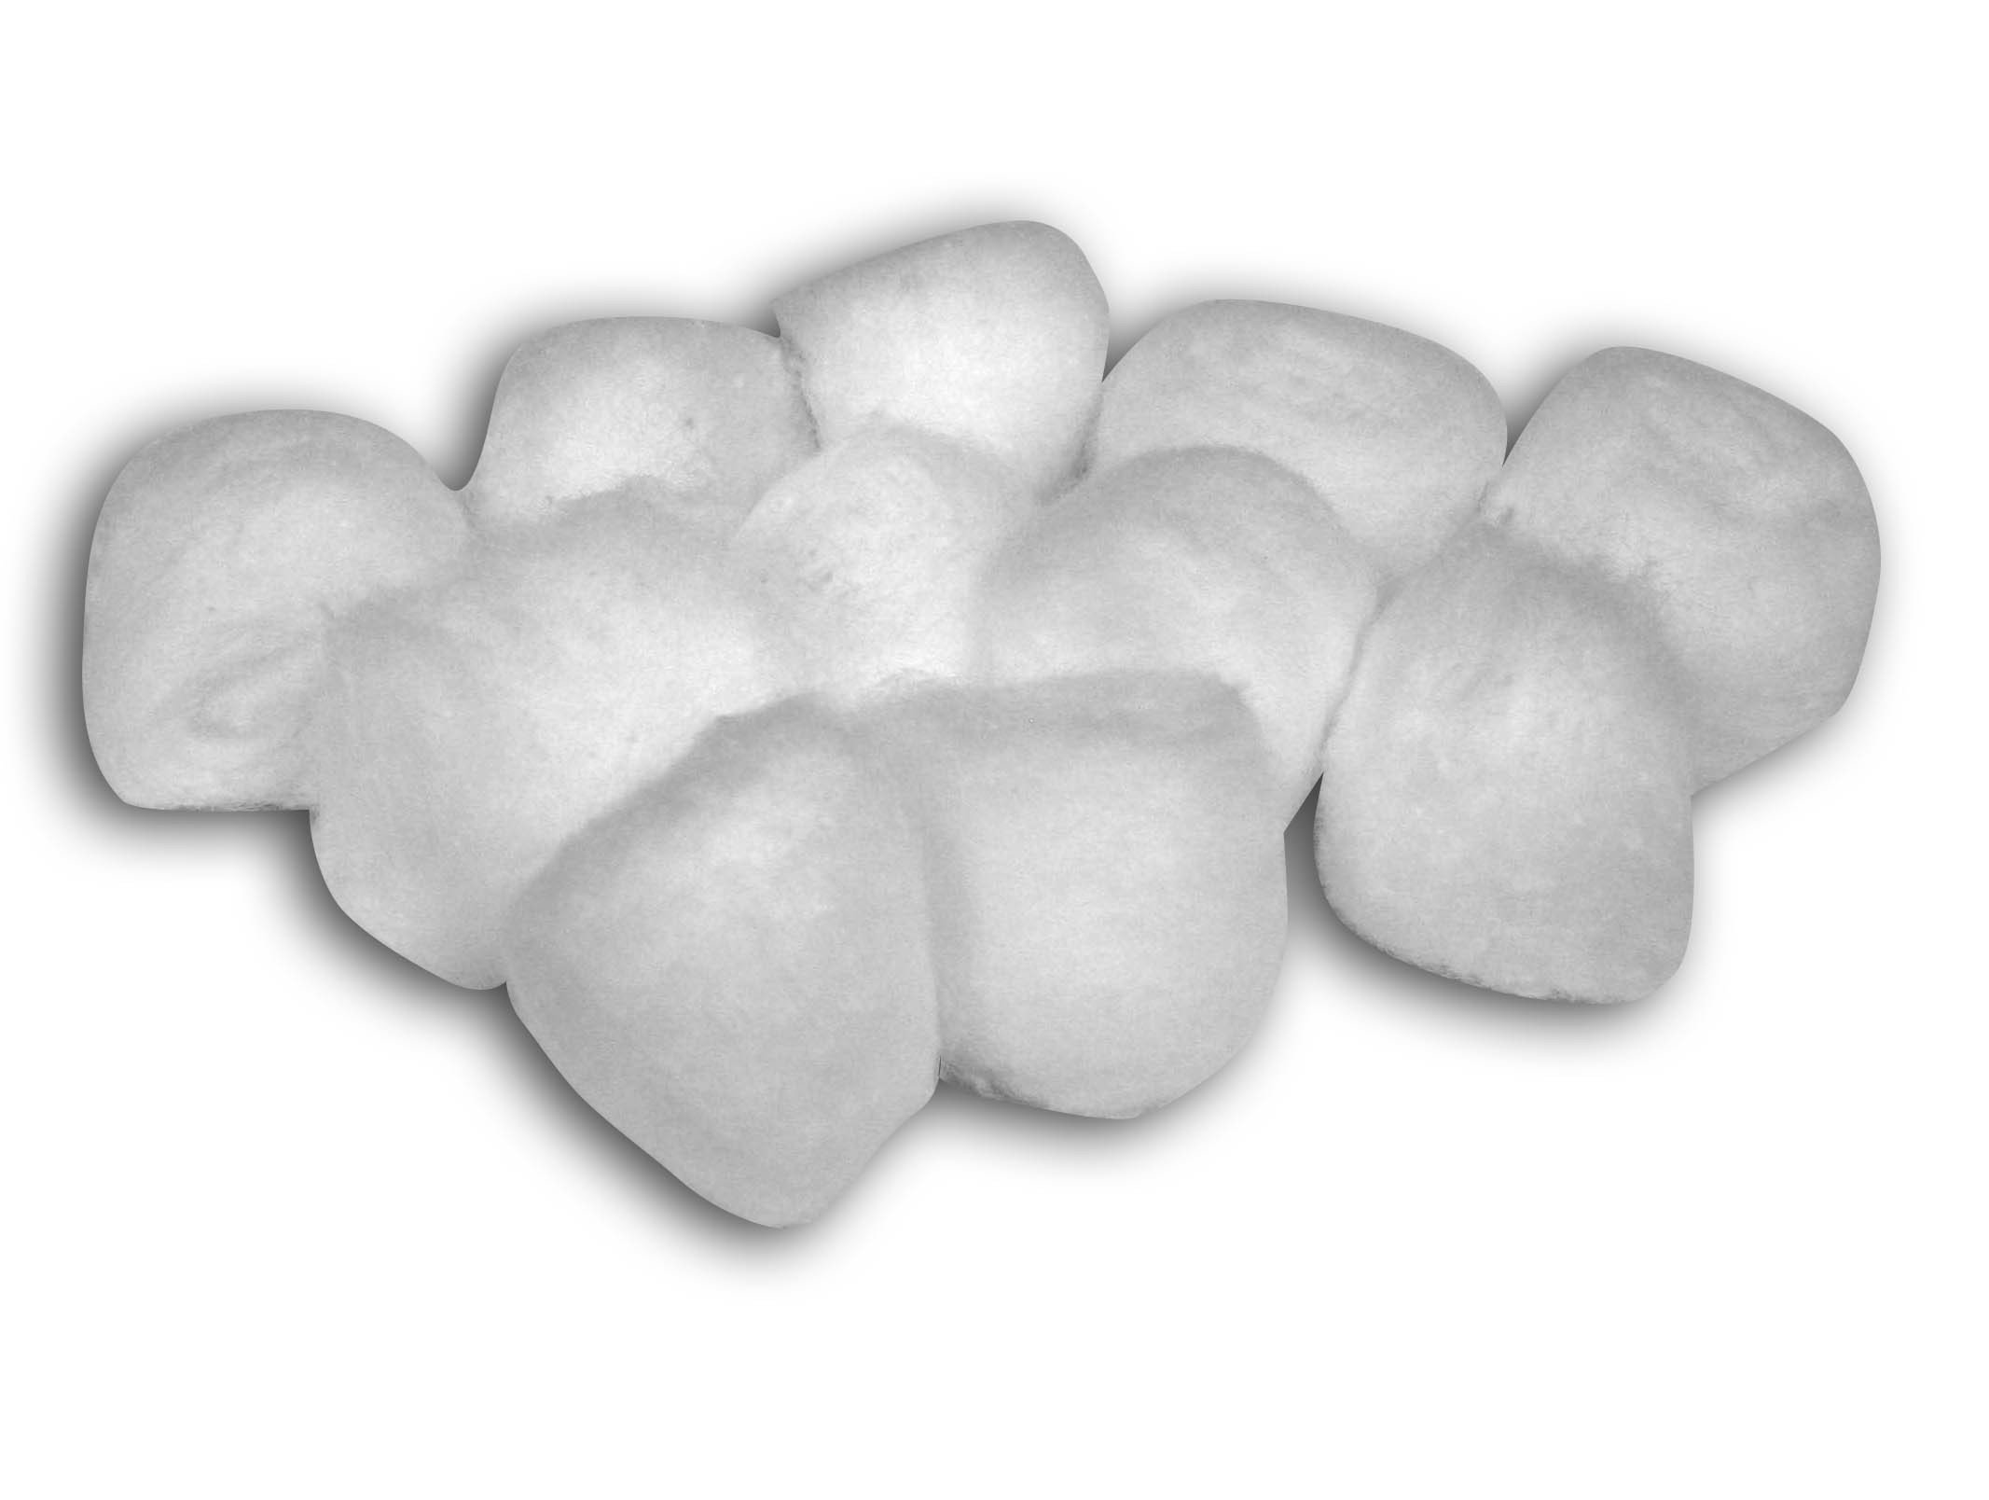
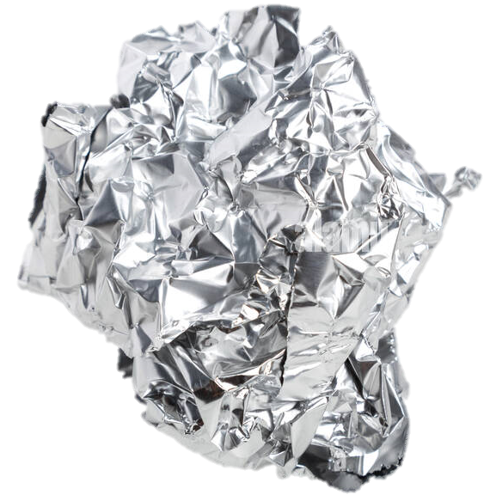
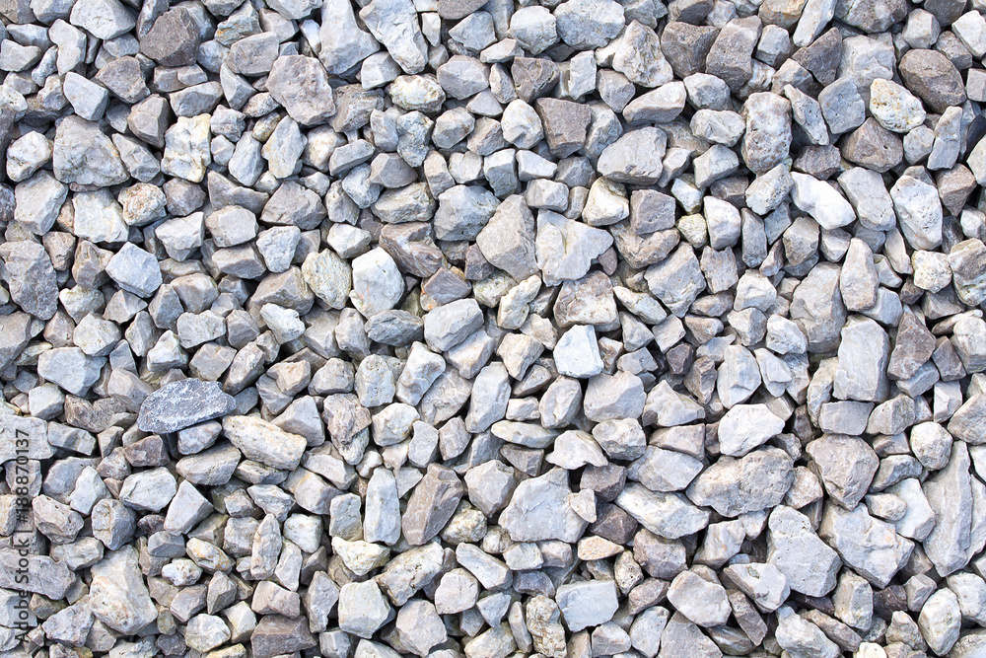
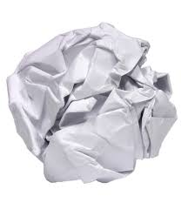
2. Effect of obstacles on the force of water
Task 2
The next experiment will focus on the water path and how obstacles can disrupt its flow. When an obstacle intervenes, water’s movement changes significantly, affecting both its speed and energy. In this activity, we’ll explore how these disruptions impact the flow.
For this task, imagine you have a pipeline with flowing water. Midway through the pipeline, the flow encounters a significant obstacle made of one of the following materials:
Your task: Rank the materials from 1 to 4, with 1 being the material that you think would have the most significant impact on disrupting the water flow. Give a brief explanation of your ranking
Cotton balls: These are likely to absorb water and create the most significant blockage, disrupting the flow considerably.
Paper balls: While not as absorbent as cotton, they can clump together and block the path, slowing the flow significantly.
Little rocks: Rocks are dense and might create obstacles, but water can flow around them with less disruption compared to softer materials.
Aluminum balls: These are smooth and less likely to block the flow as water can easily pass around them.

Slide 56
Experiment
Material you will need for the experiment
1 empty 2 liter soda bottle
1 ruler
1 push pin
Duct tape
1 shallow tray or container to catch water
3 drinking straws (preferably wide)
Permanent marker
Water supply
Small objects to create obstacles (e.g., cotton balls, sponge pieces, or crumpled paper)
Follow these Steps to conduct the Experiment:
Prepare the Bottle: Use the ruler to measure from the bottom of the bottle to the 5 cm mark. Mark this spot with a dot and draw a horizontal line across the bottle. Repeat this step at 10 cm and 15 cm, marking the positions on the bottle.
Use the push pin to create a hole at the 5 cm mark. Insert one end of the straw into the hole and secure it tightly with duct tape to avoid leaks.
Connect two or more straws to form a longer water path. Tape the straws together securely to prevent disconnections during the experiment.
Identify a section of the straw path where obstacles can be added. Mark this area with a permanent marker.
Perform initial testing to ensure a steady flow from the straw.
Procedure:
Fill the soda bottle with water up to the 15 cm mark.
Place the bottle on a stable surface with the straw directed downward toward the shallow tray or container.
Let the water flow through the straw without any obstacles. Measure the distance the water path travels and record it.
Insert one type of obstacle into the marked obstacle zone of the straw (e.g., cotton ball or sponge).

Slide 57
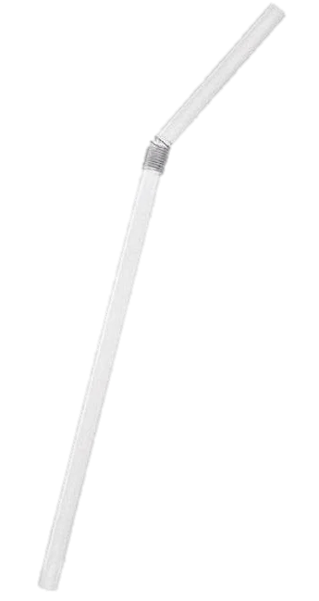
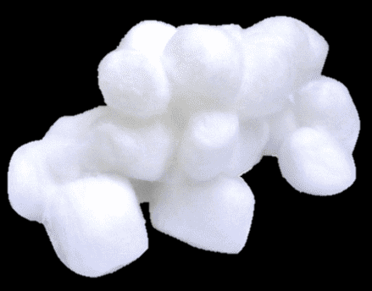
Repeat the experiment and measure the new distance of the water path. Record the data.
Test additional obstacles (e.g. sponge pieces, crumpled paper). Perform the same steps and record the distance for each.
Repeat the tests for water levels of 10 cm and 5 cm to observe the effect of both obstacles and water volume on the distance of the water path.
Water Level | Obstacle | Trial 1 | Trial 2 | Trial 3 | Average
5 CM | No Obstacle
5 CM | Type of Obstacle 1
5 CM | Type of Obstacle 2
10 CM | No Obstacle
10 CM | Type of Obstacle 1
10 CM | Type of Obstacle 2
15 CM | No Obstacle
15 CM | Type of Obstacle 1
15 CM | Type of Obstacle 2

Slide 58
In Summary
Effect of Obstacles on the Force of Water
Impact of Obstacles on Water Flow:
Obstacles in the water path significantly disrupt the flow, reducing the speed and force of water. This mirrors how resistance impacts the efficiency of water energy systems and electrical circuits. Softer materials, such as cotton balls, absorb water and create the most significant disruption, whereas smoother obstacles, like aluminum balls, have a minimal effect, allowing water to pass around them.
Influence of Water Volume on Flow Force:
The higher the water level, the greater the pressure and force of the flow. This demonstrates the direct relationship between water volume and energy output in hydro systems, highlighting the importance of sufficient water availability for efficient energy generation.
Experimental Observations:
Combining varying water levels with different obstacles revealed that softer and more absorbent materials cause significant disruption compared to denser or smoother objects. The experiments underscored the importance of designing systems that minimize flow resistance to optimize energy output.
Applications to Hydro Systems:
This experiment illustrates the principles of flow resistance and water pressure, which are critical in designing and optimizing hydro turbines and energy systems. By understanding these dynamics, you can appreciate how real-world hydro systems must account for obstacles and maintain adequate water pressure to achieve efficient energy production.

Slide 59
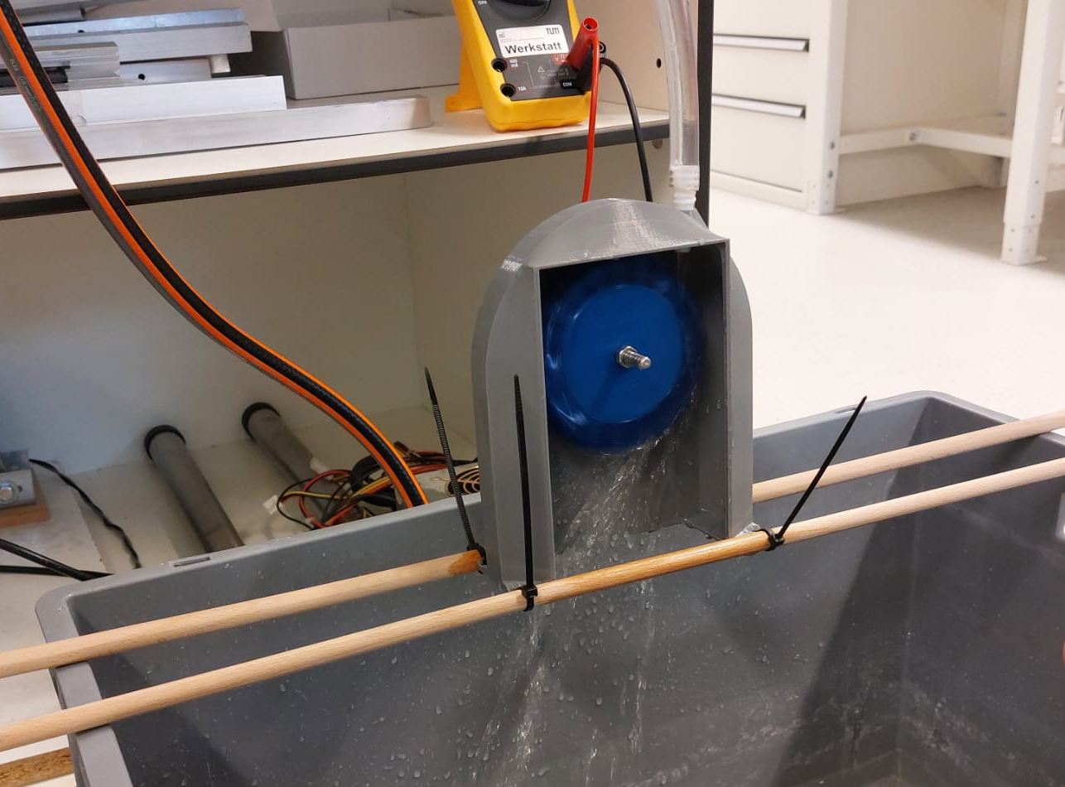

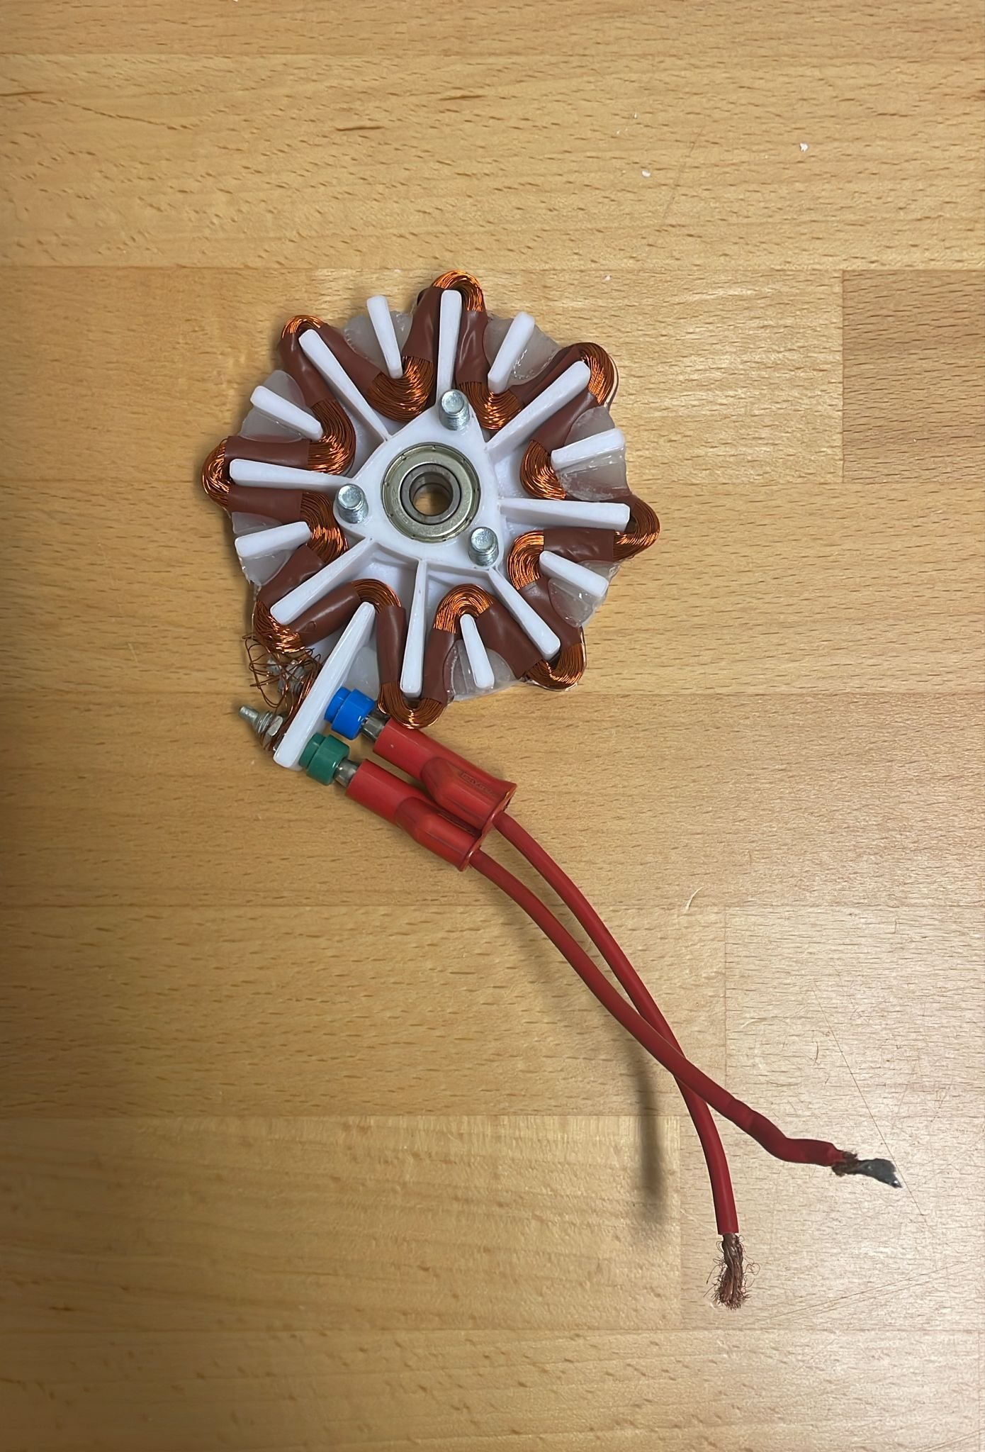
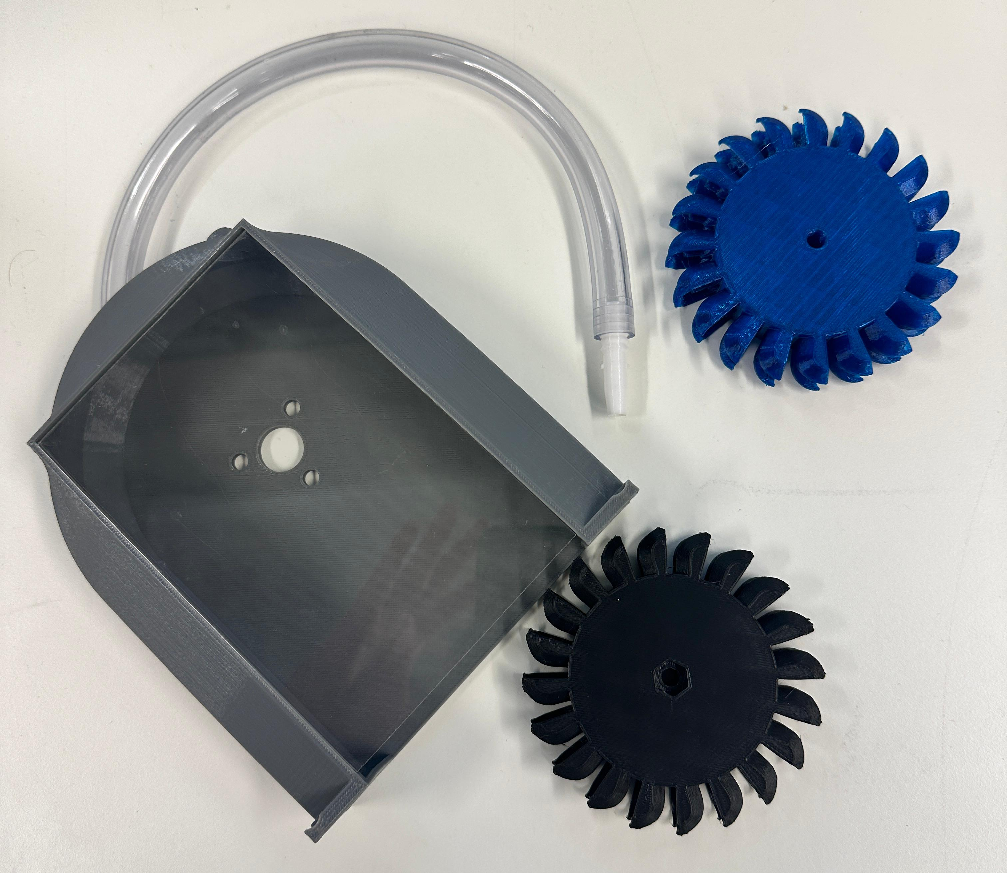
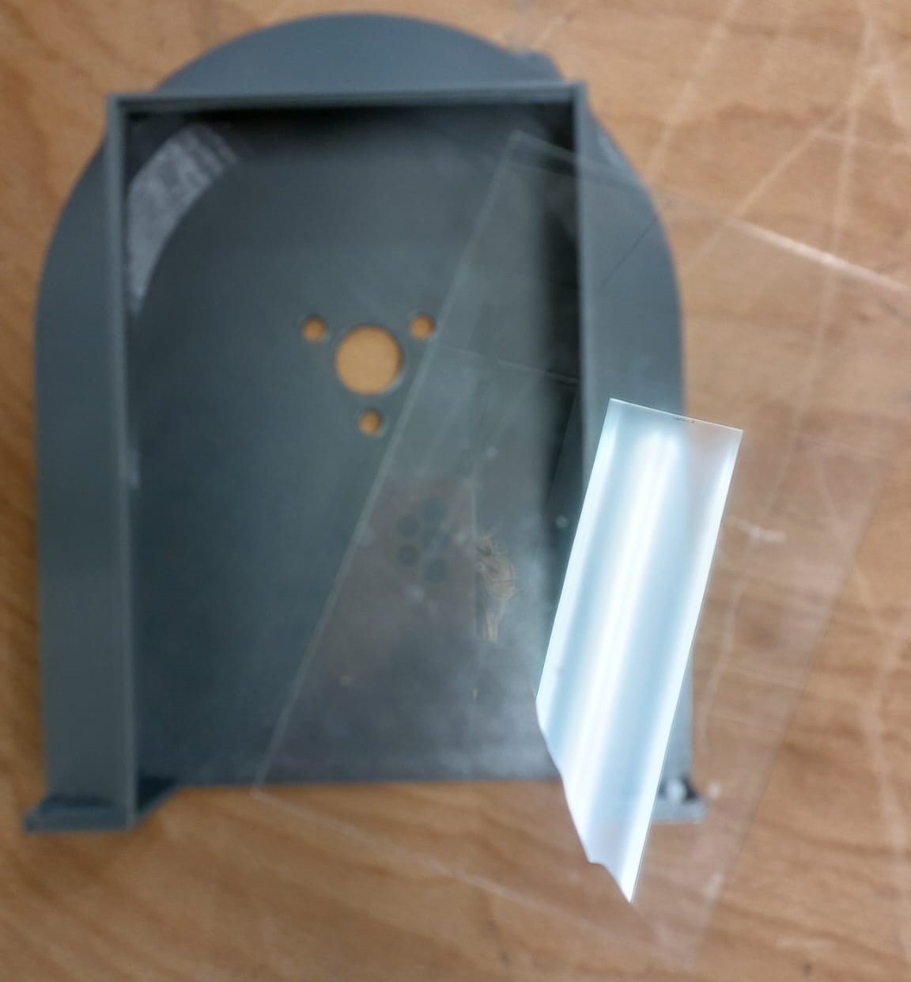
Hydro-energy Kit Overview
6
5
3
7
4
2
1
8
Hydro turbine case
Turbine
Hose (different length of hose to the one on the picture)
Nozzle to connect the hose to the case of the turbine
Magnetic generator
Long bolt
Cables to connect to the multimeter
Acrylic cover

Slide 60
Step-by-Step Instructions for Assembling the Hydro Energy Kit
Step 1: Attach the Turbine to the Case
Gather the Parts: Locate the turbine, the turbine case, and the acrylic cover.
Position the Turbine: Place the turbine inside the turbine case, ensuring it fits securely and is aligned properly for smooth rotation.
Secure the Turbine: Attach the turbine to the case using the provided mounting mechanism inside the case. Ensure the turbine can spin freely without obstruction.
Step 2: Connect the Generator
Attach the Generator: Place the generator at the back of the turbine case, aligning it with the turbine's shaft.
Secure the Connection: Insert the long bolt through the case, connecting the turbine to the generator.
Adjust the Pressure: Tighten or loosen the bolt to adjust the pressure between the turbine, the case and the generator. Ensure the connection is firm but allows the turbine to spin smoothly.
Step 3: Install the Acrylic Cover
Place the Acrylic Cover: Position the acrylic cover in front of the turbine case to enclose the turbine securely.
Adjust the Bolt Tip: Extend or retract the tip of the bolt as needed to ensure the acrylic cover fits snugly over the turbine case. This ensures the setup is water-tight and ready for use.
Step 4: Attach the Hose
Connect the Hose: Attach the hose to the top of the turbine case using the nozzle provided in the kit.
Ensure a Tight Fit: Check that the hose is securely attached to prevent leaks during water flow.

Slide 61
Step 5: Secure the Case to a Surface
Locate the Mounting Holes: Use the pre-drilled holes at the bottom of the turbine case.
Fix the Case: Secure the turbine case, generator, and hose to a stable surface using screws or clamps (not included in the kit). This ensures the assembly remains steady during the experiment.
Important Notes for Experimentation:
Ensure all parts are securely tightened before conducting any experiments.
The acrylic cover must be properly aligned to avoid water leakage.
Place the assembled kit on a flat, stable surface to ensure safety and efficiency during use.
By following these steps, you can successfully assemble the hydro energy kit and prepare it for experiments to observe the principles of hydro energy in action.

Slide 62
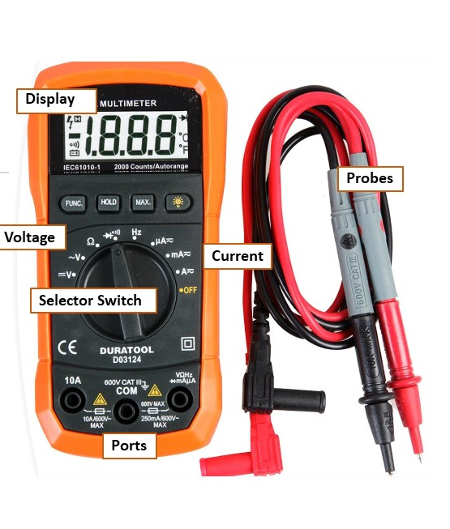
How to use a Multimeter
What is a Multimeter?
A multimeter is a handy tool that can measure electrical quantities like voltage, current and resistance. Here’s a simple guide on how to use it, along with an explanation of its key parts and steps.
Parts of a Multimeter
Display: Shows the measurement results.
Dial/Selector Switch: Used to select the quantity you want to measure (voltage, current, or resistance).
Probes: Two wires with metal tips that you hold against the point you want to measure. The red probe is usually for positive connections, and the black probe is for negative connections.
Ports: Sockets where you plug in the probes. There are usually three:
  COM: Common port, always for the black probe.
  VΩmA: For the red probe when measuring voltage, resistance, or small currents.
  10A: For the red probe when measuring high currents.
Important Steps to Use a Multimeter
Turn on the Multimeter: Make sure the multimeter is on by turning the dial.
Select the Measurement Type:
  Voltage (V): To measure voltage, turn the dial to "V" with a straight line (for DC voltage) or a wavy line (for AC voltage).
  Current (A): To measure current, turn the dial to "A" with the corresponding symbol. Choose between "mA" (milliamps) and "A" (amps) depending on the expected current. → we usually just use mA!
  Resistance (Ω): To measure resistance, turn the dial to the "Ω" symbol.

Slide 63
Set the Range:
  When measuring voltage, current, or resistance, it’s important to set the multimeter to the highest expected range first. This prevents damage to the multimeter and ensures safety.
  For example, if you expect to measure a current up to 5A, set the dial to the 10A range first.
Connect the Probes:
  Plug the black probe into the "COM" port.
  Plug the red probe into the appropriate port:
    For voltage and resistance measurements, use "VΩmA".
    For current measurements, use "VΩmA" or "10A" depending on the current.
Take the Measurement:
  Voltage: Hold the metal tips of the probes against the two points where you want to measure the voltage. Make sure to observe the correct polarity (positive and negative).
  Current: Insert the multimeter into the circuit by breaking the circuit and connecting the multimeter in between so that the current flows through the multimeter.
  Resistance: Hold the metal tips of the probes against the two ends of the component or connection where you want to measure resistance.
Read the Result:
  Read the measurement on the display. Pay attention to the unit (V, A, mA, Ω).
Turn Off the Multimeter:
  After the measurement, turn off the multimeter by turning the dial to "OFF".
Important Safety Tips
Never measure voltage when the multimeter is set to measure current or resistance! This can damage the device or put you at risk.
Be cautious with high voltages and currents and make sure you know what you are doing.
Always start with the highest expected range to avoid damaging the multimeter or endangering yourself.
Tip: Just like with any electrical work, remember "hands off!" If your fingers touch the probes, the current might pass through your body, meaning the multimeter won’t measure the circuit accurately.
With these steps, you can safely and effectively use a multimeter. Enjoy measuring and discovering the world of electricity!

Slide 64
3. Effect of Head Height on Energy Generation in a Pelton Turbine
Experiment
Material you will need for the experiment
1 Pelton turbine (included in your kit)
1 flexible hose to connect the water source to the turbine (included in your kit)
1 measuring tape or ruler
1 small generator connected to the Pelton turbine to measure the impact of head height changes (included in your kit, attached to the turbine)
Water supply
Follow these steps to conduct the experiment:
Set up the Turbine: Connect the Pelton turbine to the generator and ensure it is securely placed.
Connect the Hose: Attach the hose to the water tank or reservoir. Make sure the other end is directed toward the turbine's nozzle.
Mark Heights: Using the measuring tape, mark three head heights (80 cm, 130 cm, and 180 cm) on a nearby wall or stand to guide the elevation of the water tank.
Procedure:
Fill the water tank or reservoir with water and place it at 80 cm above the turbine.
Open the valve or allow water to flow through the hose to power the Pelton turbine.
Using the multimeter, measure the voltage or current generated by the turbine and record the value.
Repeat the procedure with the tank elevated to 130 cm. Measure and record the voltage or current generated.
Finally, repeat the procedure with the tank elevated to 180 cm, recording the corresponding voltage or current generated.
Perform at least two trials for each height to ensure accuracy.

Slide 65
Height (cm) | Trial 1 Output (Volts/Hz) | Trial 2 Output (Volts/Hz) | Trial 3 Output (Volts/Hz)
140 CM | 1,85 V | 1,80 V | 1,82 V
170CM | 2,35 V | 2,30 V | 2,37 V
200 CM | 3,25 V | 3,22 V | 3,20 V
Task 3
Discuss with a partner what you just saw in the experiment:
How did the head height of the water affect the energy output of the Pelton turbine?
Why does increasing the height result in a higher energy output?
How could this concept be applied in designing real-world hydropower plants?
. The experiment showed that higher head heights increased energy output. At greater heights, the water had more potential energy, resulting in stronger pressure and faster turbine rotation, which generated more electricity.
Higher head heights enhance the water’s potential energy, which converts to kinetic energy as it flows. This more substantial flow spins the turbine faster, producing more electricity efficiently.
Hydropower plants use head height by selecting locations with natural elevation differences or building dams to increase water height, ensuring efficient energy generation from turbines.

Slide 66
In Summary
Objective
This experiment aimed to explore how variations in head height influence energy output in a Pelton turbine. By adjusting water height, you observed changes in water pressure, turbine speed, and energy generation, providing insights into real-world applications of hydropower systems.
Key Findings
Impact of Head Height on Energy Output
Higher head heights significantly increased energy output. Elevated water levels resulted in more significant water pressure, leading to faster turbine rotation and higher electricity generation.
The experiment demonstrated the direct correlation between head height and kinetic energy conversion efficiency.
Understanding Potential Energy
The experiment illustrated how water's potential energy is proportional to its height. Potential energy converts more effectively into kinetic energy at greater heights as water flows toward the turbine, maximizing efficiency.
Real-World Application
The concept of head height is critical in designing hydropower plants. Engineers often use natural elevation differences or dams to optimize water pressure and ensure consistent energy output from turbines.
Practical Skills Developed
Kit Assembly: You learned how to assemble the hydro energy kit, including attaching the turbine to the case, connecting the generator and ensuring all components were securely fastened.
Instrument Usage: The experiment provided practical training in using a multimeter to measure voltage and current.
Data Collection and Analysis: You were able to record and analyze energy output at different heights, enhancing their ability to interpret experimental results.

Slide 67
Hydro Energy
Education HUB
Chapter 4
Concepts of Grid and Combining DERs

Slide 68

1. Baseload and Reliability of PV, Wind and Hydro Energy
This bingo game offers a playful yet essential way to understand the varying reliabilities of renewable energy sources like PV, wind, and hydro, with a focus on baseload and its impact on grid stability.
Exercise
Task 1
Instructions
Below are 16 Answers, each corresponding to one of 16 Questions in a Question Bank.
Your teacher will randomly select 1 Question from the Question Bank and read it aloud.
Your task is to match the Question with the correct Answer!
If you correctly match 4 in a row (horizontally, vertically or diagonally), you score a BINGO!
1 Hydropower is the most reliable renewable energy source for meeting baseload needs | 10 Battery storage helps manage supply | 4 It ensures that essential services, like refrigeration and streetlights, continue running. | 6 Their output depends on weather and time, making them unreliable without backup storage
11 The minimum power the grid always needs | 7 Combining sources like wind, solar, and hydro ensures a more stable and consistent energy supply | 12 Hydro is better than solar for this | 8 Hydropower < PV (Solar) < Wind.
9 Solar energy is predictable based on the time of day and weather, while wind is highly variable | 2 Solar energy is only generated during the day and stops at night, making it unreliable for 24/7 power | 13 Battery storage can store excess energy for use during low production times, helping solar and wind support baseload | 3 Hydropower uses stored water in reservoirs to generate electricity continuously
15 Baseload energy provides a constant supply, while additional resources meet peak demand periods | 15 Diversification reduces reliance on a single source and mitigates risks from variability or outages | 5 The grid can becomes unstable, leading to blackouts or system failures | 16 Renewables have lower operational costs and reduce dependency on imported fossil fuels, saving money over time

Slide 69
Question: Which renewable energy source is most commonly used to meet baseload energy needs?
Answer: Hydropower is the most reliable renewable energy source for meeting baseload needs.
Question: Why does solar energy struggle to provide baseload power?
Answer: Solar energy is only generated during the day and stops at night, making it unreliable for 24/7 power.
Question: How does hydropower maintain a consistent energy supply?
Answer: Hydropower uses stored water in reservoirs to generate electricity continuously.
Question: What role does baseload energy play during periods of low electricity demand?
Answer: It ensures that essential services, like refrigeration and streetlights, continue running.
Question: What happens to the electricity grid if baseload requirements aren’t met?
Answer: The grid can become unstable, leading to blackouts or system failures.
Question: What is one challenge of using solar and wind for baseload without storage?
Answer: Their output depends on weather and time, making them unreliable without backup storage.
Question: Why is integrating different renewables important for maintaining baseload?
Answer: Combining sources like wind, solar, and hydro ensures a more stable and consistent energy supply.
Question: How would you rank hydro, PV, and wind energy in terms of fluctuations, from least to most variable?
Answer: Hydropower < PV (Solar) < Wind.
Question: Why does solar energy fluctuate less than wind energy?
Answer: Solar energy is predictable based on the time of day and weather, while wind is highly variable.
Question: What technology helps renewable energy sources store surplus energy for use during periods of low production?
Answer: Battery storage helps manage supply.
Question: What is the definition of baseload energy?
Answer: The minimum power the grid always needs.
Question: Which renewable energy source is more suitable than solar for providing baseload energy?
Answer: Hydropower is better than solar for this.
Question: What technology can help solar and wind energy contribute to baseload supply?
Answer: Battery storage can store excess energy for use during low production times, helping solar and wind support baseload.
Question: What is the relationship between baseload energy and peak demand periods?
Answer: Baseload energy provides a constant supply, while additional resources meet peak demand periods.
Question: Why is it important to diversify renewable energy sources for baseload power?
Answer: Diversification reduces reliance on a single source and mitigates risks from variability or outages.
Question: What is the economic advantage of using renewables for baseload energy?
Answer: Renewables have lower operational costs and reduce dependency on imported fossil fuels, saving money over time

Slide 70
In Summary
Baseload energy is the minimum power required to keep the grid running
continuously, ensuring critical services like lighting, refrigeration, and public infrastructure remain operational. Maintaining baseload is essential to prevent grid instability and blackouts.
Renewable energy sources like hydropower, photovoltaic (PV) solar, and wind differ in their reliability for providing baseload:
Hydropower is the most reliable, offering consistent and controllable energy through stored water in reservoirs.
PV Solar is moderately reliable, producing predictable energy during daylight hours but ceasing production at night.
Wind Energy is the least reliable, with highly variable output dependent on wind conditions.
Through the bingo game, you explored how the fluctuating behavior of these energy sources impacts their ability to support baseload.
This highlights the importance of combining diverse renewables and
incorporating technologies like energy storage to ensure a stable and reliable
grid.
Game Guidance:
Randomly Select Questions: Pick questions from the Question Bank, randomly.
Read Each Question Aloud: Read the chosen question three times to ensure clarity.
Pause for a Minute: After reading the question, pause for a minute to give participants time to match it with the correct answer.
Control the Game Duration: The more spread out your question selection (across the bingo board), the longer the game will last. You can adjust the pace and duration based on how many questions you pick and the intervals between them.
When Someone Calls "BINGO": Verify their answers to confirm if they have matched four in a row correctly. If they have, the game ends. If not, continue the game.

Slide 71
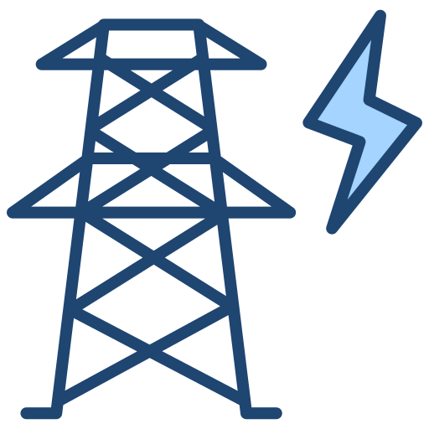
2. Energy Balancing Game
Generation = Demand!?
Understand the causes and effects of fluctuating renewable electricity generation when it meets varying energy demand. Explore how these fluctuations impact the energy grid, including issues like surpluses and deficits. Gain hands-on experience in identifying strategies to achieve and maintain a perfect balance within the system, ensuring grid stability and efficiency.
Exercise
Instructions
On the next page, you will find an Energy Demand Sheet detailing the electricity
requirements for a city over five working days (Monday to Friday). The city
generates electricity using a PV & Wind park, and a hydro power plant.
At the bottom of the sheet, you will see whether there is a surplus or deficit in
energy during the morning, midday or evening for each day.
Your task is to guide the city through various scenarios that arise during the week including sunny, windy, and high-demand situations.
Carefully analyze the energy demand and generation data provided.
Work through Tasks 1 to 4, using the information to solve the challenges presented for each day.
Apply your understanding of energy balancing to ensure the city maintains a stable and reliable electricity grid.

Slide 72
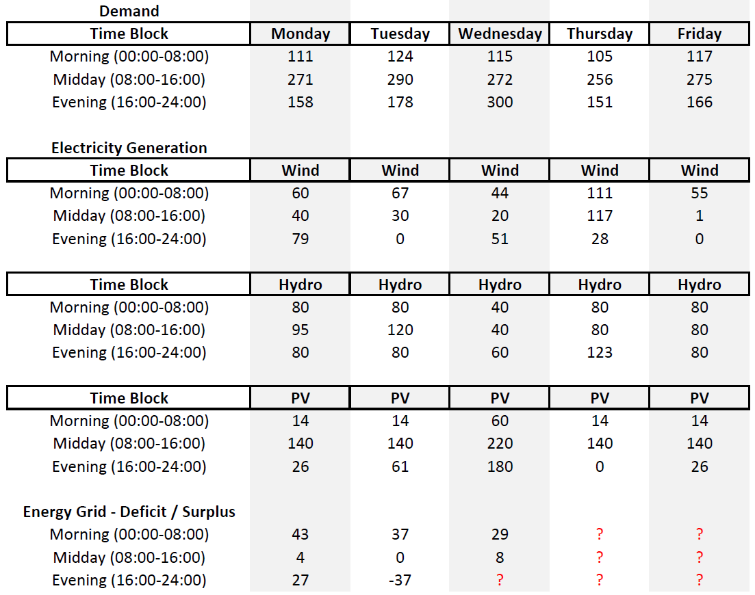
Task 1 - Monday
Explore electricity generation and demand.
a. What can you tell about the electricity generation of PV, wind, and hydro?
b. Rank the reliability of the three renewable energy sources from highest to lowest.
c. What is surplus/deficit energy, and how is it calculated? Why is it important?
d. What would you consider baseload and peakload on Monday?

Slide 73

Sample Solution Energy Sheet

Slide 74
What can you tell about the electricity generation of PV, wind, and hydro?
    PV fluctuates strongly because of the sun.
    Wind also fluctuates but not as much as PV.
    Hydro is very stable
Rank the reliability of the three renewable energy sources from highest to lowest.
    Hydro (most reliable)
    Wind
    PV (least reliable)
What is surplus/deficit energy, and how is it calculated? Why is it important?
  Surplus/deficit represents the over-/underproduction of the of electricity in the grid.
  Formula: Surplus/Deficit = Demand - (PV + Wind + Hydro generation)
  It is important because in a real grid, generation must always equal demand. Fluctuations in supply and demand require buffers to stabilize the grid.
What would you consider baseload and peakload when looking at the whole week?
  Baseload: is the minimum level of electricity demand that is consistently required over a given period, such as a day, week or year in the grid
  Here: Min. Demand observed = 105 MW
  Peakload: referes to the ighest level of electricity demand observed during a specific period, such as a day or a week
  Here: Max Demand observed = 300 MW

Slide 75
Task 2 - Tuesday
a. Calculate the surplus/deficit energy during the evening (16:00-24:00)?
b. How would you handle a deficit in the energy grid? What could you do in this situation to avoid a blackout due to a deficit in the evening?
a) Calculate the surplus/deficit energy during the evening (16:00-24:00)?
    Without wind, the city faces a deficit in the evening because only PV and hydro are available.
    Electricity Generation: 0 + 80 + 61 = 141
    Demand: 178
    141 – 178 = -37
b) How would you handle a deficite in the energy grid? What could you do in this situation to avoid a blackout due to a deficite in the evening?
    Use stored energy from batteries to supply the grid.
    Import electricity from neighboring regions or grids.
    Implement demand-side management to encourage reduced energy use during peak hours.
    Shift flexible loads, like charging electric vehicles, to times of surplus generation earlier in the day.
Task 3 - Wednesday
What happens to the demand during the street festival in town?
    Demand increases significantly due to the festival, especially in the evening when many activities are taking place

Slide 76
How does the surplus/deficit look during this period?
    The energy demand is almost equal to the generation, resulting in only a minor deficit due to the sunny weather.
    Generation = 51 + 60 + 180 = 291
    Demand = 300
    Deficit = 291- 300 = -9
How can you handle this deficit without being able to produce more energy or use storage?
  Implement demand-side management, such as encouraging citizens to reduce non-essential electricity use during peak hours.
    Use imports from neighboring grids to cover the small deficit.
    Shift flexible energy demand (e.g turning on the dishwasher, charging the EV … ) to midday when generation is higher.
Task 4 – Thursday & Friday
Calculate the deficits/surpluses for each period on Thursday and Friday.
    Thursday:
    Morning: Demand = 120, Generation (PV + Wind + Hydro) = 200 → Surplus = 200 - 120 = 80 units.
    Midday: Demand = 250, Generation = 320 → Surplus = 320 - 250 = 70 units.
    Evening: Demand = 150, Generation = 310 → Surplus = 310 - 150 = 160 units.
    Friday:
    Morning: Demand = 117, Generation = 90 → Deficit = 117 - 90 = 27 units.
    Midday: Demand = 275, Generation = 200 → Deficit = 275 - 200 = 75 units.
    Evening: Demand = 166, Generation = 120 → Deficit = 166 - 120 = 46 units.

Slide 77
Why is the city experiencing such large surpluses and deficits on these two days?
    Thursday: High wind generation causes significant surpluses throughout the day.
    Friday: Low wind and moderate PV generation lead to higher deficits, as they cannot meet demand.
What should the city do to balance electricity generation and demand for Thursday and Friday?
    Thursday:
    Store surplus energy in batteries or export it to neighboring regions.
    Use surplus to charge electric vehicles or power other flexible loads.
    Friday:
    Utilize stored energy from Thursday’s surpluses to cover deficits.
    Import electricity from other grids.
    Encourage demand response programs to reduce peak usage.

Slide 78
In Summary
The electricity grid operates on the fundamental principle that generation
must always equal demand to ensure stability and reliability. Imbalances in this equilibrium can have serious consequences:
Over-Generation: Leads to power surges and potential damage to equipment.
Under-Generation: Results in blackouts or system instability.
Why Balancing Matters
Maintaining Frequency: Electricity grids operate at a specific frequency (e.g., 50/60 Hz). Deviations indicate imbalance and must be corrected promptly.
Stability and Efficiency: Continuous adjustments are essential to match fluctuating demand with generation and maintain reliable operations.
Buffer systems ensure grid reliability, prevent blackouts, and handle renewable energy variability. Solutions like storage, demand management, and regional collaboration maintain the critical balance of generation and demand.
Key Buffer Systems for Grid Stability – Balancing Mechanisms
Batteries: Store surplus electricity for later use, offering backup power, grid stabilization, and support during peak demand.
Pumped Hydro: Use water reservoirs for large-scale energy storage.
Peaker Plants: Provide rapid, short-term energy during high-demand periods. Examples include natural gas turbines, diesel generators, renewable pumped hydro storage, and biomass power plants.
Demand-Side Management (DSM): Load Shifting: move consumption to low-demand periods.
Grid Interconnections: Share surplus or import electricity across regions.

Slide 79
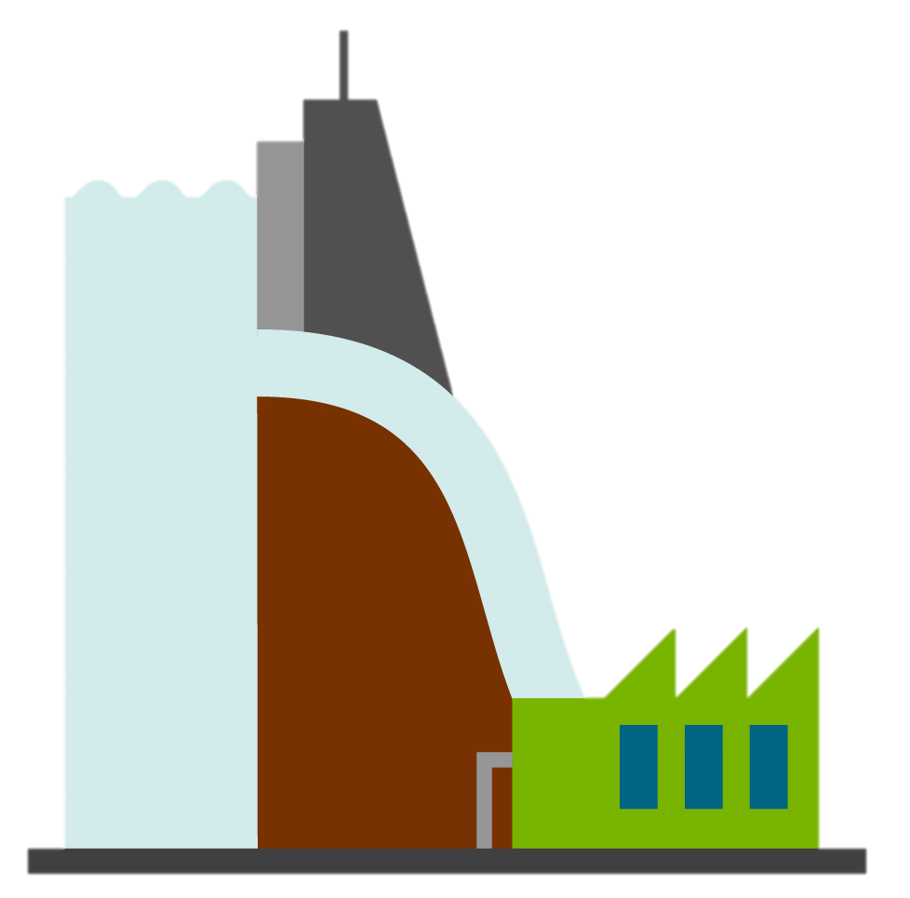


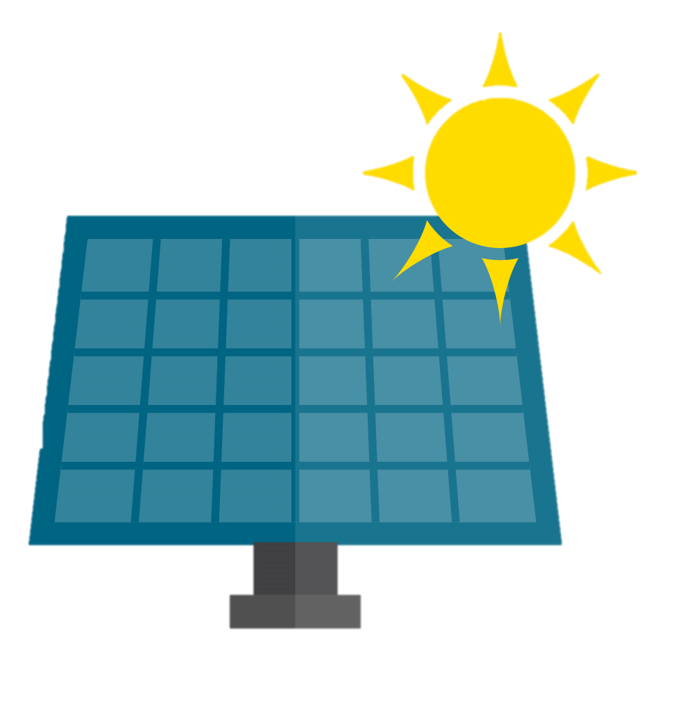
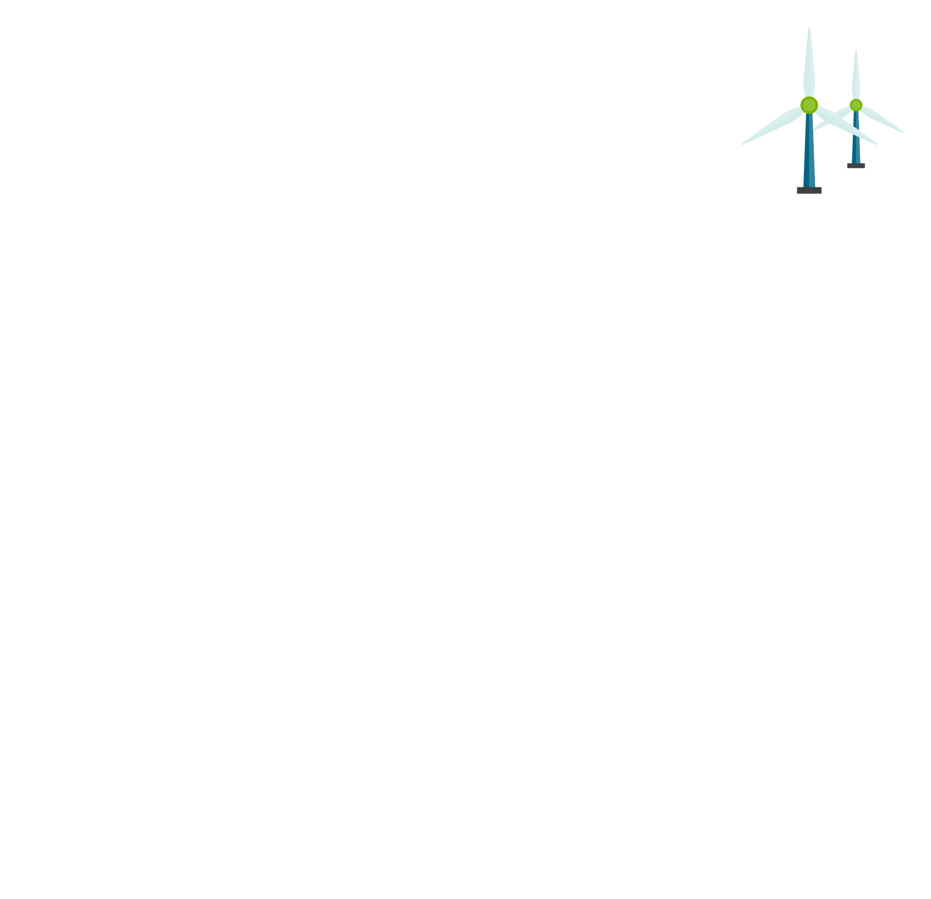
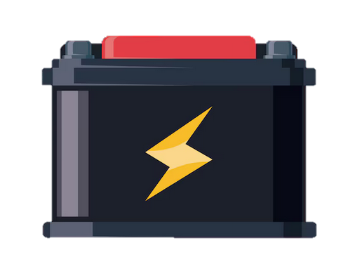
Design an energy grid game
Now you will design and operate a simulated power grid, making decisions about energy generation, storage, and connectivity to meet the demand of a central grid while dealing with variability in energy sources.
Exercise
Materials Needed:
Grid template (provided in the workbook).
Markers or pens.
Notebook
Instructions
You are given a blank grid template with three energy zones (Solar, Wind, Hydro) and one central demand zone.
Draw connections between the energy zones and the central demand zone.
Decide whether to connect a battery storage and where to place it.
Each connection will cost one energy token per round.
Grid template
Demand Center

Slide 80
Playing the Game
Materials Needed:
  One six-sided dice per energy zone (You can also use just one dice and throw it independently for each energy zone, or you can use a virtual dice (https://dice.virtuworld.net/ ).
  Student notebooks (to track energy generation, usage, and demand).
  Battery tracker (drawn in notebooks, max capacity: 10 energy units).
  Demand tracker sheet (provided in the workbook).
Gameplay Rules
Set Up the Notebook:
  Create a simple table in your notebooks to track:
    Energy is generated by each source (solar, wind, hydro).
    Energy stored or retrieved from the battery.
    Energy sent to the central grid.
    Total energy available vs. demand for each round.
  Draw a battery tracker with a max capacity of 10 units to record energy storage and dissipation.
  Roll the Dice for Energy Generation: Each energy zone rolls one six-sided die to determine its energy output:
  Record the results of the dice rolls in your notebook under "Energy Generated."
Solar: |  | Wind : |  | Hydro :
Dice Result | Energy Generation | Dice Result | Energy Generation | Dice Result | Energy Generation
1 | 2 energy units | 1 | 1 energy units | 1 | 5 energy units
2 | 3 energy units | 2 | 2 energy units | 2 | 6 energy units
3 | 4 energy units | 3 | 4 energy units | 3 | 7 energy units
4 | 5 energy units | 4 | 6 energy units | 4 | 8 energy units
5 | 6 energy units | 5 | 7 energy units | 5 | 9 energy units
6 | 8 energy units | 6 | 9 energy units | 6 | 10 energy units

Slide 81
Decide on Connections:
Decide which energy zones will connect to the central grid or battery
For every connection used, subtract 1 energy unit per round in your notebook under "Connection Cost."
Store and Retrieve Energy:
Excess energy can be stored in the battery (max capacity: 10 units).
If demand exceeds generation, stored energy can be retrieved from the battery.
Each turn, subtract 1 unit from the battery tracker for energy dissipation.
Meet the Demand: Calculate the energy sent to the grid from connected zones and the battery (if used).
Compare the total energy sent to the demand level:
Round 1 Demand: 10 units.
Round 2 Demand: 15 units.
Round 3 Demand: 20 units.
Record the outcomes in the notebook:
  Shortfall: Available energy is less than demand.
  Excess: Available energy exceeds demand (recorded as wasted energy).
Scoring:
Reliability: 2 points for each round where demand is fully met.
Efficiency: 1 point for minimizing wasted energy (1 point for each round with zero excess energy).
Strategy: 1 bonus point for practical battery usage (e.g., no overflows or under-utilization).
Discussion:
Once the game is finished, answer the following questions:
How did variability in energy generation (dice rolls) impact your ability to meet demand?
How did your choice to use (or not) the battery affect your grid's reliability?
If you redesigned the grid, how would you improve reliability and efficiency?
What lessons can you apply from this activity to real-world energy systems?

Slide 82
In Summary
Why Balancing Sources matter:
Generation Fluctuations: Renewable energy sources like wind and solar are inherently variable.
Importance of Storage: Batteries act as a crucial buffer, storing excess energy when generation exceeds demand and releasing it during shortages, ensuring continuity in energy supply.
Dynamic Decision-Making: The choice to connect batteries and other distributed energy resources (DERs) reinforces the importance of adaptability in managing demand peaks and avoiding energy shortages.
Lessons from the Game
Resource Interconnectivity: Pooling energy from various resources reduces the impact of generation variability, ensuring a more reliable energy supply.
Planning for Variability: The dice mechanics highlight the unpredictability of renewable energy.
Balancing Costs: Allocating resources strategically to maintain grid balance without overusing batteries or over-investing in connections fosters cost-conscious decision-making.
Mitigating Peaks: Ppooling energy in a grid smooths demand peaks, reducing strain on individual resources and improving overall system efficiency.
Key Takeaways:
Batteries are indispensable for maintaining reliability and handling demand fluctuations in a renewable energy-based grid.
Connecting multiple energy sources reduces risks associated with the variability of any single resource.
Thoughtful grid design and interconnections create a robust system that minimizes disruptions and maximizes efficiency.

Slide 83

Well done!
Designed by Slidesgo und Freepik

Slide 84
Thanks!
Do you have any questions?
youremail@freepik.com |+34 654 321 432 | yourwebsite.com
Please keep this slide for attribution

