Slide 1

PV Education HUB
TUM x KNUST

Slide 2
Introduction
Welcome to the World of Solar Power!
Imagine harnessing the power of the sun to generate electricity. This is exactly what photovoltaic (PV) energy does. PV energy is a clean, renewable source of energy that converts sunlight directly into electricity using solar panels. In this workbook, you'll explore the fascinating world of PV energy, learning how it works, its benefits, and its potential to transform our energy future.
Why Study Photovoltaic Energy?
As our world faces the challenges of climate change and finite fossil fuel resources, renewable energy sources like PV energy are becoming increasingly important. Studying PV energy allows us to understand how we can reduce our carbon footprint and promote a more sustainable way of living. By learning about PV energy, you'll be gaining knowledge and skills that are essential for the future of our planet.
What Will You Learn?
In this workbook, you'll embark on an exciting journey through the science and technology of PV energy. Here are some of the key topics we'll cover:
The Basics of Photovoltaic Energy: Learn how solar panels convert sunlight into electricity.
Types of Solar Panels: Discover the different types of solar panels available.
External factors: Learn how external factors can influence the performance of a PV panel.
Connecting to a Load: Explore how PV systems connect to various loads, from household appliances to industrial machines
Hands-On Activities: Engage in experiments and projects that demonstrate the principles of PV energy.
How to Use This Workbook
This workbook is designed to be interactive and engaging. Each section includes experiments, explanations and exercises to help you understand and apply the concepts of PV energy.

Slide 3
You'll find:
Learning Objectives: Clearly defined goals for each chapter to help guide your learning.
Key Terms: Important vocabulary words related to PV energy.
Hands-On Activities: Practical exercises that reinforce the concepts you're learning.
Check Your Understanding: Questions and quizzes to assess your knowledge and understanding of the material.
Project Ideas: Suggestions for projects you can undertake to explore PV energy further.
Get Ready to Shine!
By the end of this workbook, you'll have a solid understanding of photovoltaic energy and its potential to shape a sustainable future. You'll be equipped with the knowledge to think critically about energy solutions and the skills to engage in innovative projects. Let's get started on this enlightening journey and discover how we can harness the power of the sun to create a brighter tomorrow!

Slide 4
Table of contents
Why is PV important?
6
Definitions
7
How to use a Multimeter
8
Introduction into the Experiment KIT
10
Chapter 1 – PV Basics
Light colour
Angle of incidence
Light intensity
Impact of heat on PV module performance
Impact of pollution on PV module performance
Impact of shadows on PV module performance
13
16
19
23
26
31
34
Chapter 2 - Connecting PV to a load and MPP
PV panels in Series
PV panels in Parallel
Fixed load (Resistor)
Changing load
Local conditions and load changes
38
40
43
47
50
54

Slide 5
Chapter 3 – Understanding MPPT with TUM Controller
MPPT – Maximum Power Point Tracking
Controlling the MPPT
PWM vs. MPPT
56
57
61
63
Chapter 4 – Application - Analyzing Energy Consumption Profiles of Household Appliances
Task 1: Visualizing Energy Consumption Profiles of Household Appliances
Task 2: Analyzing Different Usage Modes for the Kettle
Task 3: Practical Examples - Kettle
Task 4: Practical Examples – Hair Dryer
Task 5: Evaluating the PV System Options for Residential Use
64
67
69
71
73
76

Slide 6
Why is PV important?
This part now will introduce photovoltaic (PV) energy! PV stands for “Photo”,
which means light, and “Voltaic” which refers to electricity. PV technology
makes it possible to convert sunlight into electricity. It is an amazing
technology that is not just about science; it is about our lives and our
environment.
Why is PV particularly important in Ghana?
In Ghana, there is a lot of sunshine which makes it a very good place for generating PV energy. With the increasing demand for electricity and the need for sustainable solutions, PV offers a clean, renewable, and accessible source of energy. It helps reduce the dependence on fossil fuels, which are limited and harmful to our planet. By adopting PV technology, we can move towards a brighter and more sustainable future.
Furthermore, PV panels are expected to become the main renewable technology in Ghana, providing energy security and independence.
What are some Advantages of PV?
Renewable Energy Source: The sun provides a continuous source of energy, unlike coal or oil. This means we can generate electricity as long as the sun shines, which is practically infinite.
Environmentally Friendly: PV systems are a clean source of energy that does not harm the environment.
Low Operating Costs: Once installed, PV systems require minimal maintenance, and the energy from the sun is free! There are no fuel costs, and the systems are designed to last for many years.
Energy Independence: PV enables communities to generate their own electricity and improve their energy security. This means less dependence on external energy sources and more control over the local energy supply.
Multiple Applications:
PV panels can be installed on rooftops, farms, devices, lakes… They can be used to power homes, schools, hospitals or just your cell phone!
What’s next?
In the following chapters, you will explore PVs in more detail. You will learn about their functions, what makes them efficient and how to maintain them. With fun experiments and exercises you will see PV panels in action.
Now get ready to explore and experiment to learn more about PV technology. The journey to use the power of the sun starts here!

Slide 7
Definitions
Photovoltaics (PV):
Technology that converts the energy in visible light from the Sun into an electric current by means of solar cells. Using the photoelectric effect, where photons dislodge electrons into the electrical grid, the upper layer of the solar cell are caused to move, thus creating an electric current that can be used to operate an electrical device or be fed into the electrical grid
Photovoltaic system (PV system):
A system for converting solar energy into electrical energy. Usually consists of several components, including solar panels, inverters, and often batteries, that collectively convert and manage the production of solar energy into usable electrical energy.
Solar cell (PV cell):
The basic unit of a PV system that converts light into electrical energy.
PV module:
An array of multiple PV cells connected in series to boost the voltage to useful levels.
Semiconductor Material (usually silicon):
The main material responsible for converting light into electricity.
P and N layers:
The P layer contains positive charge carriers (holes), and the N-Layer contains negative charge carriers (electrons).
Pn-junction:
The interface between the P and N layers where light is converted to electricity.
Electrodes:
Collect and conduct the generated elections to create electric current.

Slide 8
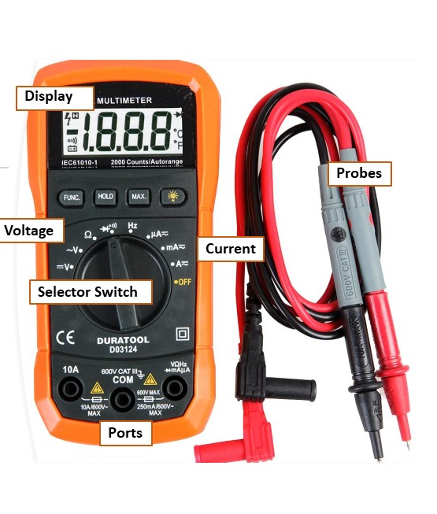
How to use a Multimeter
What is a Multimeter?
A multimeter is a handy tool that can measure electrical quantities like voltage, current, and resistance. Here’s a simple guide on how to use it, along with an explanation of its key parts and steps.
Parts of a Multimeter
Display: Shows the measurement results.
Dial/Selector Switch: Used to select the quantity you want to measure (voltage, current, or resistance).
Probes: Two wires with metal tips that you hold against the point you want to measure. The red probe is usually for positive connections, and the black probe is for negative connections.
Ports: Sockets where you plug in the probes. There are usually three:
COM: Common port, always for the black probe.
VΩmA: For the red probe when measuring voltage, resistance, or small currents.
10A: For the red probe when measuring high currents.
Important Steps to Use a Multimeter
Turn on the Multimeter: Make sure the multimeter is on by turning the dial.
Select the Measurement Type:
Voltage (V): To measure voltage, turn the dial to "V" with a straight line (for DC voltage) or a wavy line (for AC voltage).
Current (A): To measure current, turn the dial to "A" with the corresponding symbol. Choose between "mA" (milliamps) and "A" (amps) depending on the expected current. → we usually just use mA!
Resistance (Ω): To measure resistance, turn the dial to the "Ω" symbol.

Slide 9
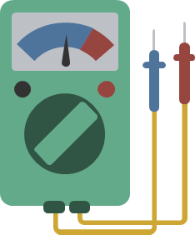
Set the Range:
When measuring voltage, current, or resistance, it’s important to set the multimeter to the highest expected range first. This prevents damage to the multimeter and ensures safety.
For example, if you expect to measure a current up to 5A, set the dial to the 10A range first.
Connect the Probes:
Plug the black probe into the "COM" port.
Plug the red probe into the appropriate port:
For voltage and resistance measurements, use "VΩmA".
For current measurements, use "VΩmA" or "10A" depending on the current.
Take the Measurement:
Voltage: Hold the metal tips of the probes against the two points where you want to measure the voltage. Make sure to observe the correct polarity (positive and negative).
Current: Insert the multimeter into the circuit by breaking the circuit and connecting the multimeter in between so that the current flows through the multimeter.
Resistance: Hold the metal tips of the probes against the two ends of the component or connection where you want to measure resistance.
Read the Result:
Read the measurement on the display. Pay attention to the unit (V, A, mA, Ω).
Turn Off the Multimeter:
After the measurement, turn off the multimeter by turning the dial to "OFF".
Important Safety Tips
Never measure voltage when the multimeter is set to measure current or resistance! This can damage the device or put you at risk.
Be cautious with high voltages and currents and make sure you know what you are doing.
Always start with the highest expected range to avoid damaging the multimeter or endangering yourself.
Tip: Just like with any electrical work, remember "hands off!" If your fingers touch the probes, the current might pass through your body, meaning the multimeter won’t measure the circuit accurately.
With these steps, you can safely and effectively use a multimeter. Enjoy measuring and discovering the world of electricity!

Slide 10
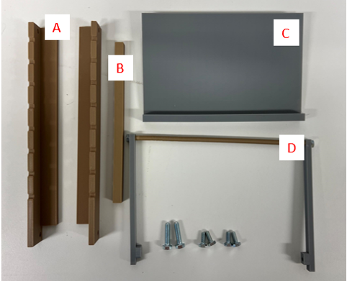
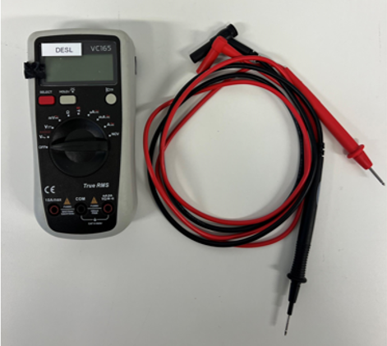
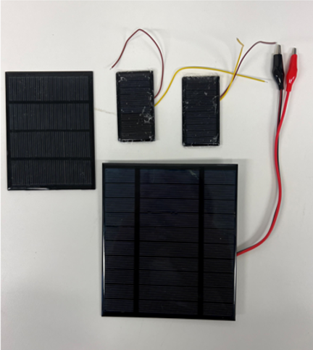
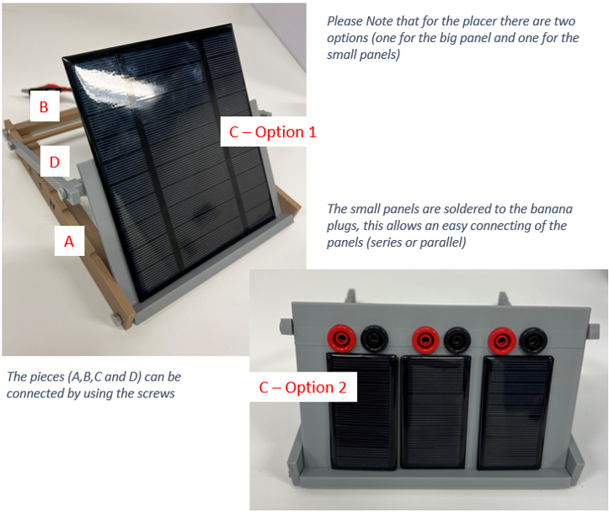
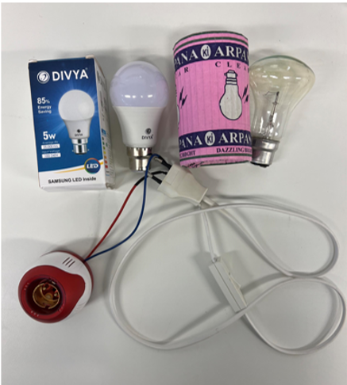
PV Kit Overview
Inside the PV Kit Box you will find the following materials:
Multimeter and cables
Materials needed to build the holder: two bottom pieces (A), one middle strap (B), one placer for PV panel (C), one element to move the position (D) and 6 screws (2 long, 4 short ones)
Please note that for the placer there are two options (one for the big panel and one for the small panels)
The small panels are soldered to the banana plugs, this allows an easy connecting of the panels (series or parallel)
Different sizes of PV panels (at least 2-3 small ones)
The pieces (A, B, and D) can be connected by using the screws
Light bulbs: one LED and one yellow light bulb

Slide 11
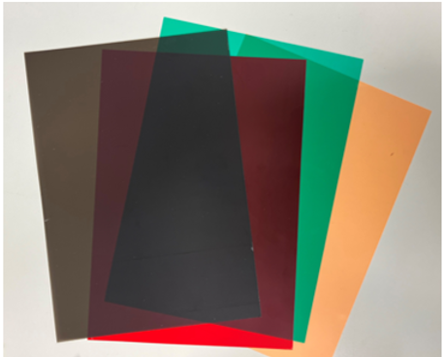
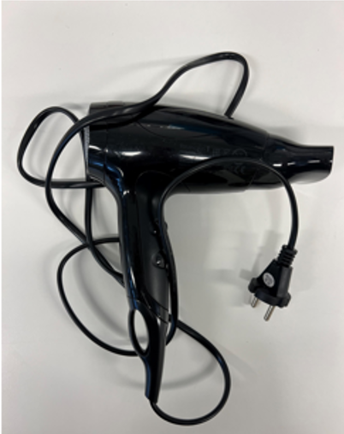
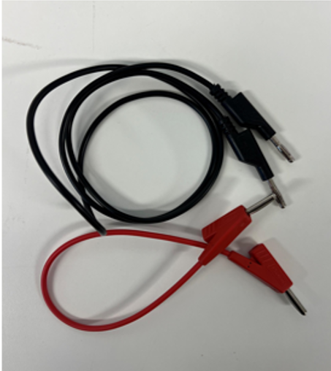
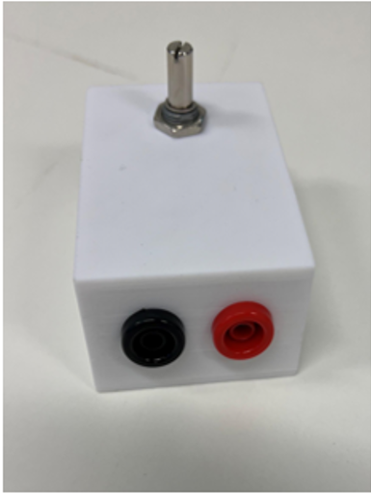
Light filters in different colors and pollution layer (brown)
Hair dryer
Connecting cables
Potentiometer (variable resistances)

Slide 12
How to Start Using the PV Panel Kit
Step 1: Assemble the Holder
To begin using the kit, you first need to assemble the holder. Follow these steps:
Gather the Parts: Locate the bottom pieces (A), the middle strip (B), the piece for the PV panel (C), and the elements to move the position (D) of the PV panel. You will also need screws (2 long, 4 short).
Connect the Parts: Attach parts A, B, C, and D using the screws. Part C is the actual holder for the PV panel.
There are two versions of the holder:
- Option 1: For the larger PV panel.
Option 2: For the smaller PV panels, which are soldered onto banana plugs. This configuration allows for easy connection of the small panels in series or parallel.
Step 2: Prepare the Light Source
Before starting the experiments, prepare the light source:
Insert the yellow light bulb into its holder. For the experiment where the white light bulb is needed the white light bulb can be placed into its holder.
Step 3: Position the PV Panels
Place the PV panels onto the holder you assembled.
Step 4: Measure Voltage and Current
Connect the cables to the multimeter as described in the multimeter's instructions.
Use the crocodile clips to connect these cables to the PV panel.
You can find video instructions on how to measure the voltage and current of the PV panel on moodle. -> Follow the instructions!
Additional Materials for Experiments
The kit also includes additional materials necessary for specific experiments:
Light filter: Needed for experiments where the color of light is evaluated.
Connecting Cables: Multiple connecting cables with banana plugs are required for experiments where you connect the panels in series or parallel.
Potentiometer: To change the resistance.
Hair dryer: To heat up the PV panel.

Slide 13

PV Education HUB
Chapter 1
PV Basics

Slide 14
Basics
External factors influencing PV systems
In this chapter, we will find out how the following external factors:
Yellow/white light
Angle of incidence
Light intensity
Heat
Pollution
Shade
influence a Photovoltaik (PV) system.
Learning Objective
At the end of this chapter, you will:
Gain a comprehensive understanding of photovoltaic (PV) systems, including the fundamental principles of how they convert sunlight into electricity.
Understand the key factors that influence the performance of PV systems, such as light quality, angle of incidence, light intensity, temperature, pollution, and shading.
Evaluate and analyze different environmental conditions to determine their impact on the efficiency and output of PV systems.
Identify the optimal location and orientation for installing PV panels to maximize energy production, taking into account site-specific conditions.
Apply theoretical knowledge in practical scenarios, enabling you to set up and configure PV modules effectively in real-world situations.
By the end of this chapter, you will be equipped with the skills to optimize PV system performance and make informed decisions about PV panel installation.

Slide 15

Material you will need for the experiments
PV module (e.g. minimum 1 big: 5 V, 2.5 W and minimum 2 small: 5 V, 0.3 W)
Multimeter
LED Lamp (e.g. 230 V, 35 W)
Yellow light bulb
Colored light filters
PV module holder
Meter rule
Hair dryer
Various cables

Slide 16

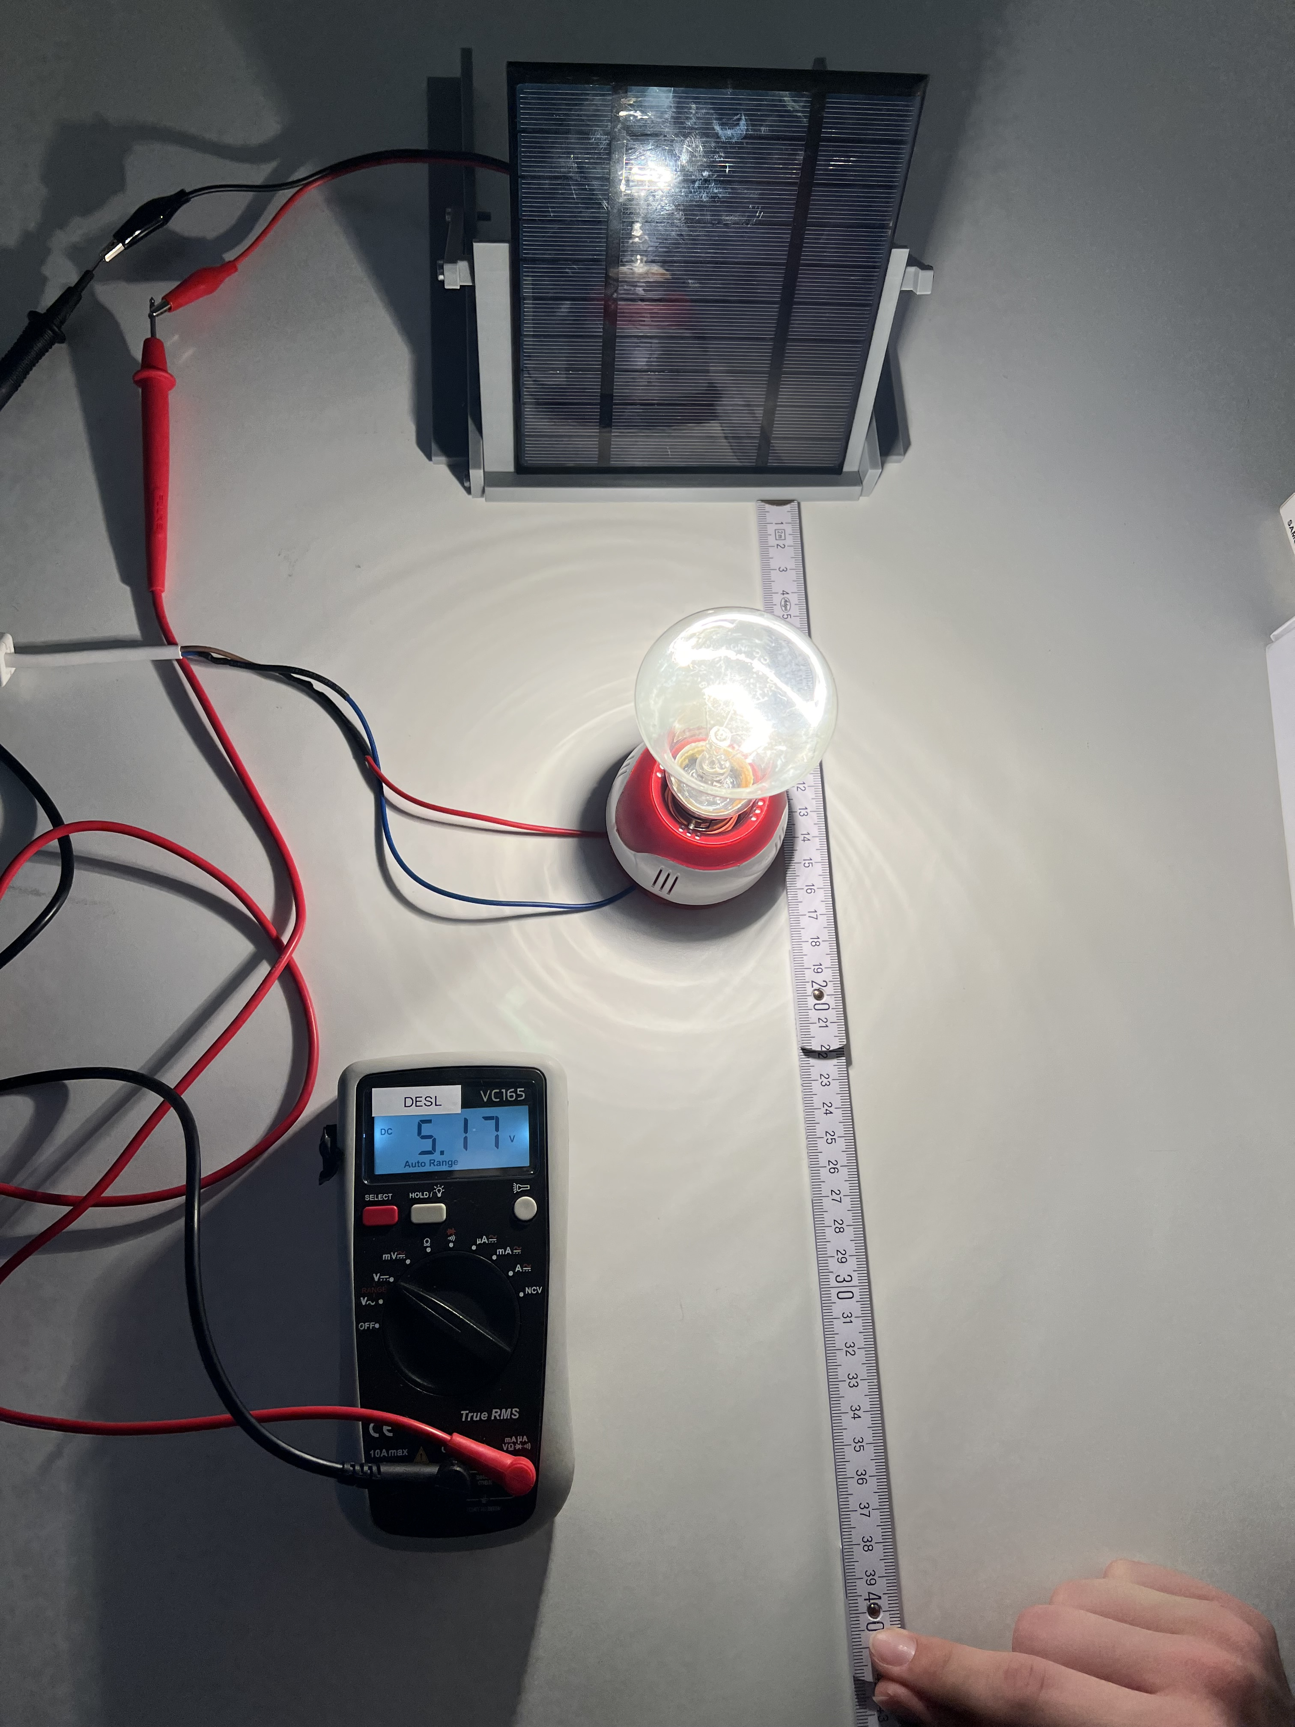
1. Light colour
In this chapter you will find out how different light colors (wavelengths) affect the performance of a photovoltaic (PV) cell.
Experiment
Material you will need for the experiments
Two Lamps, LED and yellow light bulb
PV modules (small or big)
Multimeter
Holder for PV panels
Follow these steps to conduct the experiment:
Place the PV cell in a fixed position.
Set up the first light source (Yellow light), so that it directly illuminates the PV cell.
Measure the open-circuit voltage (U) and the short-circuit current (I) with the Multimeter and record the values.
Repeat the process with the white light source.

Slide 17

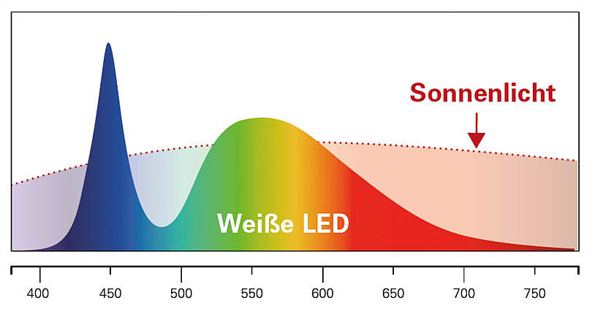
Light Source | Open-Circuit Voltage (U) | Short-Circuit Current (I)
Yellow Light
White Light
Exercise
Task 1
Which light source is less effective? Think about why and discuss with your neighbors.
Task 2
Which curve is white light? Which one is the curve for yellow light? Fill in the boxes accordingly.
Yellow Light
White Light (LED)

Slide 18

Task 3
Do the statements refer to white or yellow light? Tick the boxes accordingly.
PV cells convert light into electricity. However, not all light is equally good at this job. PV cells are really good at using certain colors of light, especially those in the yellow to red range. These colors have just the right amount of energy to be converted into electricity efficiently.
White Light Yellow Light
o This light contains all the colors. It has both high-energy and low-energy light. PV cells can’t use all of these colors equally well.
o Blue and violet light have too much energy, which PV cells can’t use effectively.
o Red and infrared light have lower energy, which might not be absorbed as well.
White Light Yellow Light
o This light, which is in the middle of the spectrum, has the right amount of energy and is absorbed efficiently by most PV cells (as most of them are made by silicon). This makes it better for generating electricity than the mix of colors in white light.
In summary
• PV cells perform differently under various light colors due to the specific energy each color carries.
• Yellow light is generally more effective for PV cells because it falls within the optimal energy range for conversion to electricity.
• White light, containing a mix of all colors, is less efficient because not all the spectral components are ideal for energy conversion in PV cells. High-energy blue and violet lights are not effectively used, and lower energy red and infrared might not be absorbed as well.
Understanding how different colors of light affect PV cells helps us use these cells better to generate electricity from the sun!

Slide 19
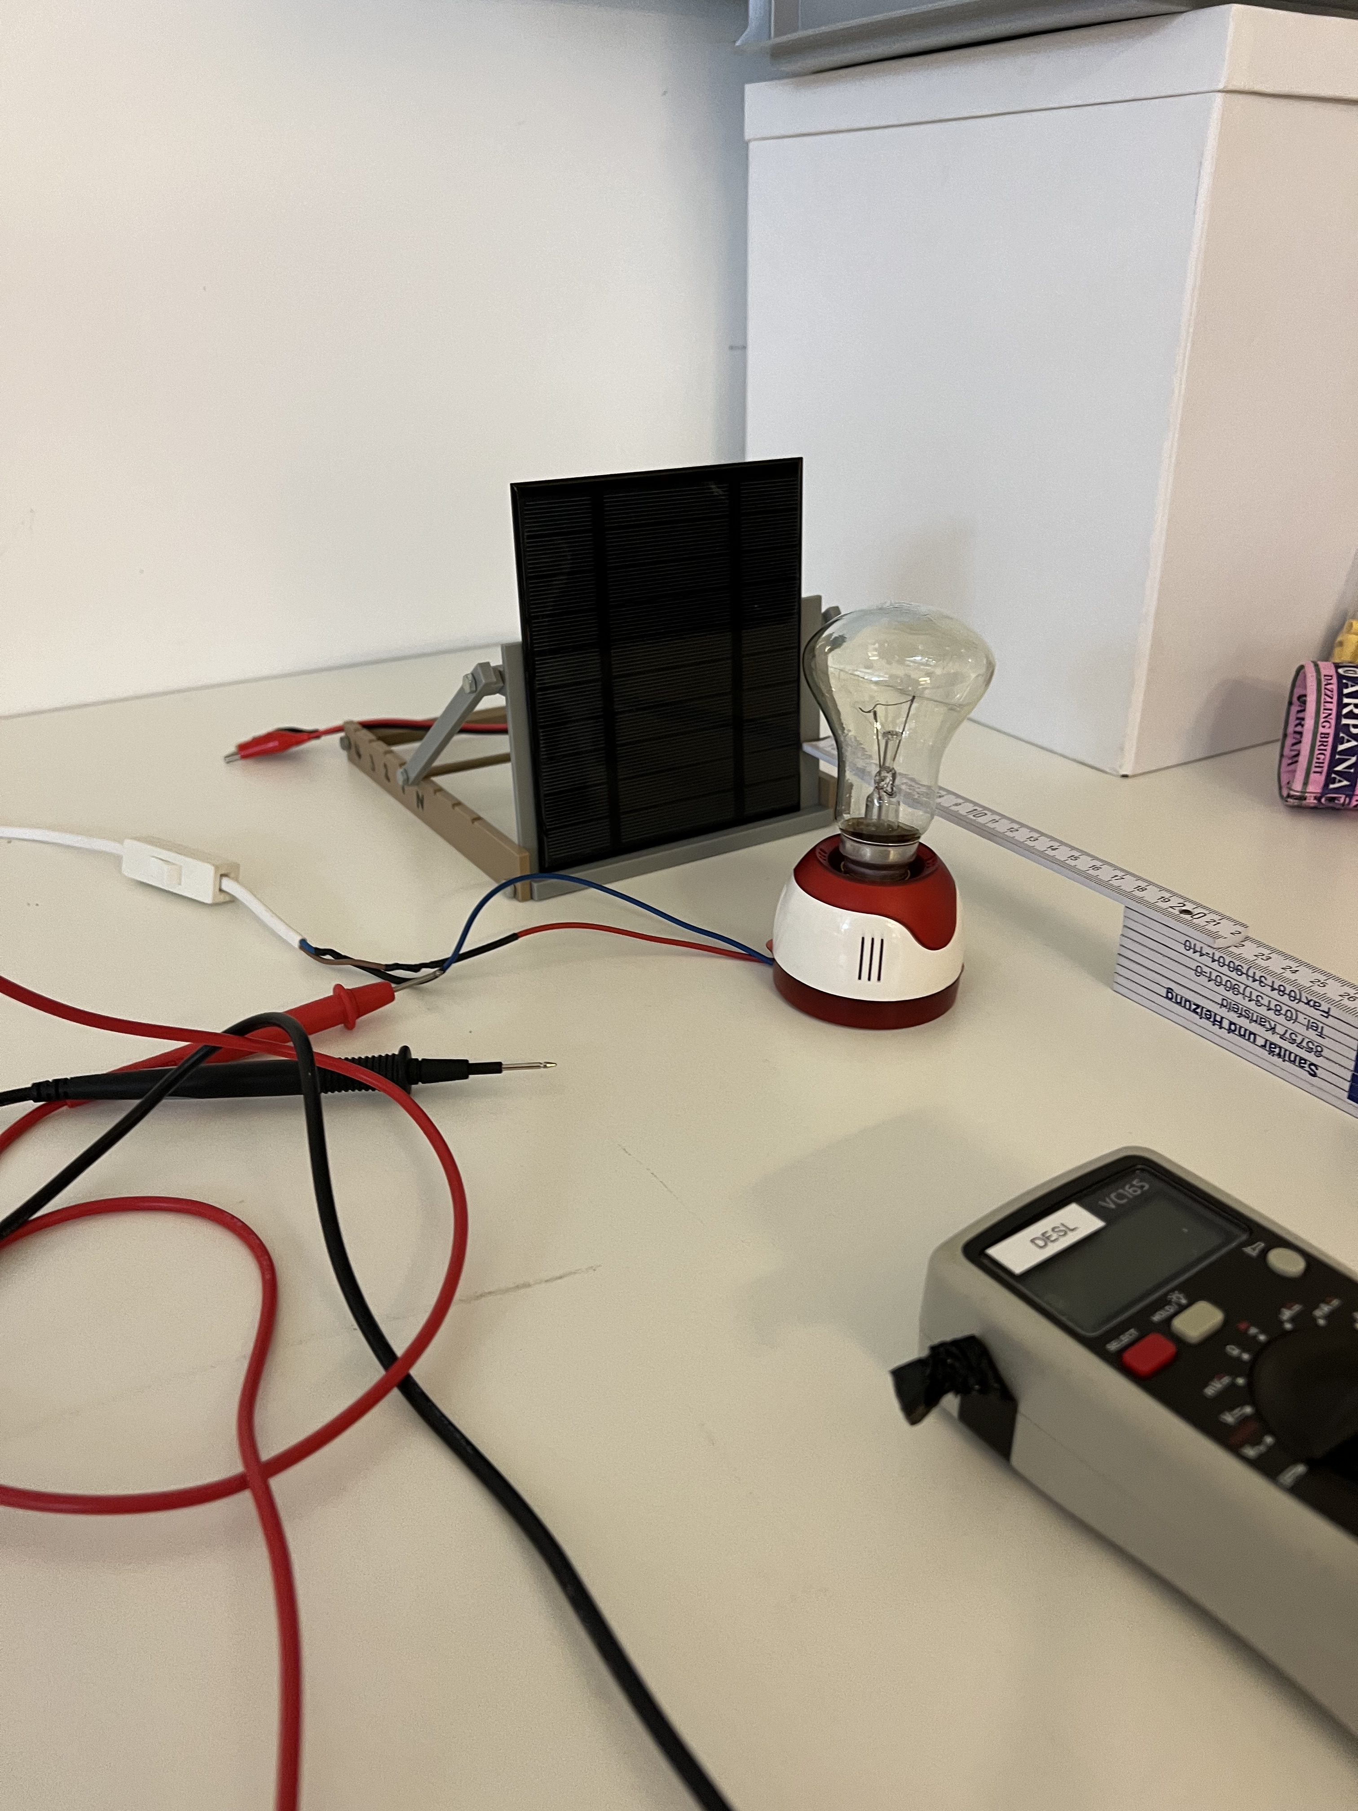
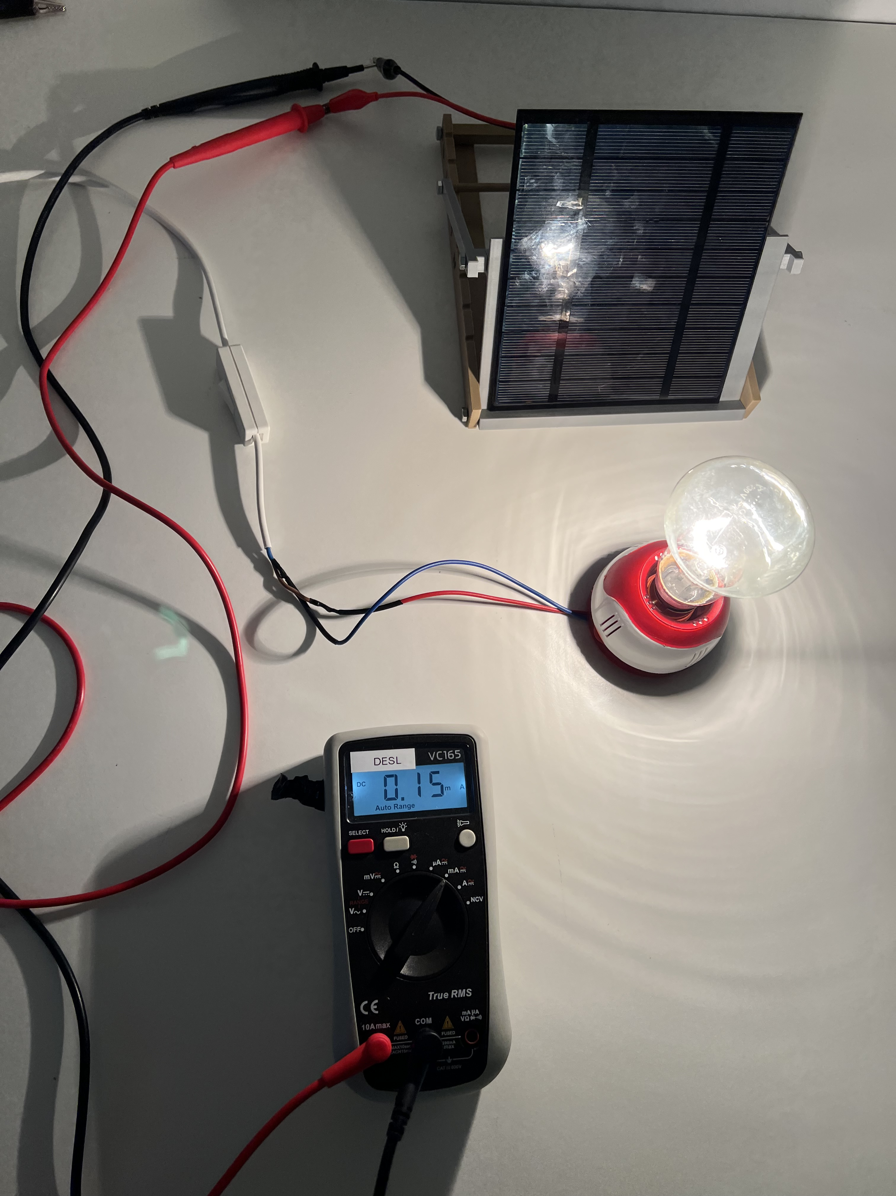
2. Angle of incidence
This experiment explores how changing angle (inclination) of a PV cell affects its power output.
Experiment
Material you will need for the experiments
One Lamp, yellow light bulb
PV modules (small or big)
Multimeter
Meter rule
Holder for PV panels
Follow these steps to conduct the experiment:
Place the yellow light source at a fixed distance from the PV cell. Place the PV cell in the neutral position i.e., in the position where light shines directly at the PV cell (the PV cell surface is perpendicular to the light radiation).
Adjust the angle of the PV cell in increments (e.g., 1st, 2nd, 3rd position).
Measure the voltage U and the current I for each position.
Optional: Measure the respective angle of incidence for each position (i.e., the angle between the neutral position and the effective one)

Slide 20
Inclination Angle | U | I
Neutral Position
1st position
2nd position
3rd position
4th position
Exercise
Task 1
Based on your observations, which position leads to the highest current and voltage? Which respective angle of incidence has this position?
The neutral position, i.e., the position where the PV panel surface is perpendicular to the sun radiation, (angle of incidence=0°) leads to the highest current and voltage.
Optional: Consequently, to capture the most sunlight throughout the day, a photovoltaic (PV) cell should generally be oriented towards the equator. This means:
- In the Northern Hemisphere, PV cells should be faced south.
- In the Southern Hemisphere, PV cells should be faced north.
Task 2
Based on your observations, what is the relationship between the angle of incidence and the current/voltage.
The current I and the voltage V generated by a PV cell are highest when the angle of incidence is 0 degrees. Both current and voltage decrease as the angle of incidence increases.

Slide 21
Task 3
To understand how the angle affects the power output, let’s derive the formula for the losses due to inclination:
Background
The power output of a PV cell is directly proportional to the cosine of the angle (θ) between the incoming sunlight and the line perpendicular to the PV cell surface.
→ This is known as the cosine loss.
When the PV cell is perpendicular to the light source (θ = 0°), the cosine of the angle is 1
→ meaning there is no loss.
As the angle θ increases from 0°, the cosine value decreases, reducing the power output, due to less solar radiation being effectively captured.
Derive the Formula for inclination induced losses
Let’s denote:
P_{max} = the maximum power output when the PV cell is perpendicular to the light
P_{eff} = the effective power output when the PV cell is tilted at an angle θ
The relationship can be written as: P_{eff} = P_{max} × cos(θ)
This formula tells us that the effective power output decreases as the angle increases
Task 4
Let’s assume a PV panels maximum power is Pmax = 100kWh. The angle of incidence is 30°. Calculate the effective power output Peff .
P_{eff} ​= 100kWh × cos(30∘)=100×0.866=86.6kWh

Slide 22
In summary
• The angle of incidence is the angle between an incoming light-ray and the perpendicular to the surface it strikes, crucial for understanding how light interacts with surfaces in optics and solar energy applications.
• The efficiency of PV cells is highest when sunlight strikes perpendicularly, minimizing cosine losses and maximizing energy absorption.
• Cosine loss occurs as the angle of incidence increases, leading to a decrease in power output. This is calculated as proportional to the cosine of the angle of incidence, making 0° (direct sunlight) the most efficient angle.

Slide 23
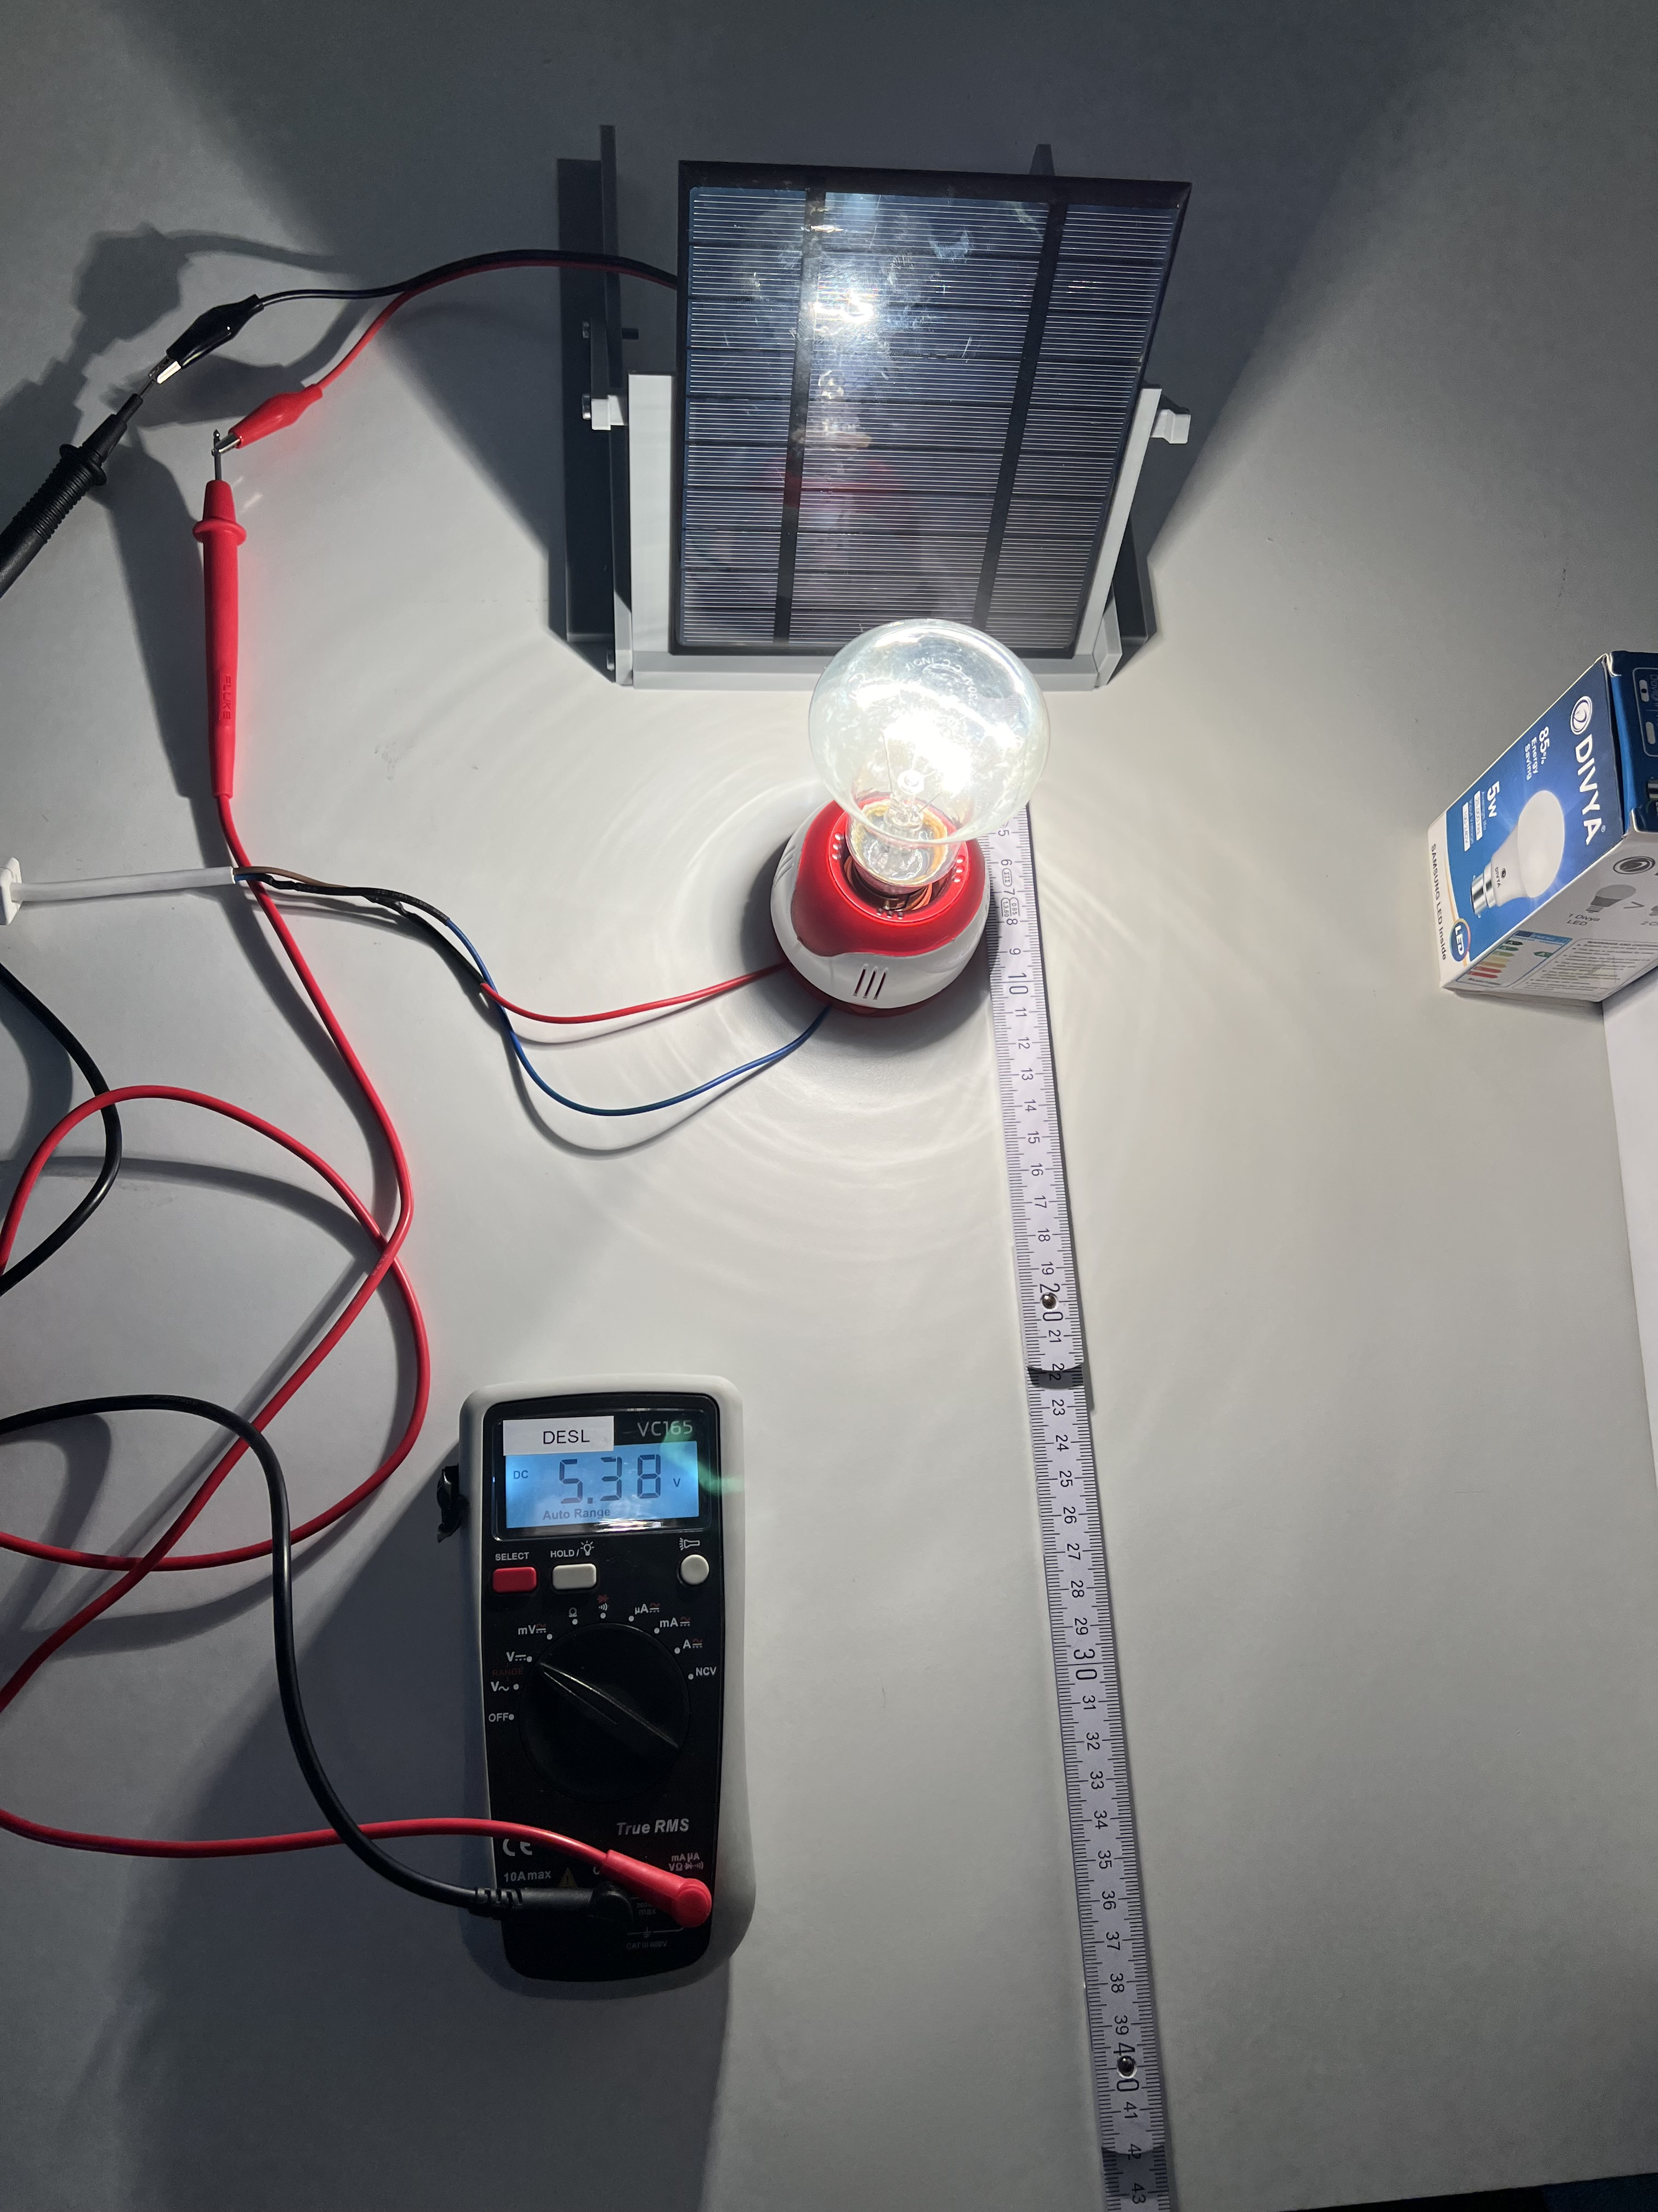
3. Light intensity
In this chapter you will find out how light intensity influences the performance of a PV module.
Experiment
Material you will need for the experiments
One Lamp, yellow light bulb
PV modules (small or big)
Multimeter
Meter rule
Holder for PV panels
Follow these steps to conduct the experiment:
Place the lamp at a distance of 5 cm in front of the PV module.
Measure the open-circuit voltage (U) and the short-circuit current (I) of the PV module using the multimeter and enter your values in the table below.
Move the lamp 5 cm further away (total distance of 10 cm from the PV module), repeat the measurements for open-circuit voltage (U) and short-circuit current (I) and enter the new values in the table.
Repeat the experiment for a total distance of 15 and 20 cm to fill out the table.

Slide 24
Distance | U | I
5 cm
10 cm
15 cm
20 cm
Exercise
Task 1
Reflect on what you have just observed and the data you have collected. Answer the following question in the space below: What is the relation between the distance of the lamp from the PV module (i.e., the intensity of the light) and the functioning of the PV module (i.e., the current and voltage generated)?
From this experiment, you should observe that the performance of the PV module, particularly the current generation, decreases as the distance from the light source increases. This demonstrates the importance of light intensity in the efficiency of PV cells. The voltage is less affected but still shows a downward trend with increasing distance.
Task 2
Discuss your answer with the other groups and your teacher.

Slide 25
Task 3
Fill in the blanks.
The _______________(greater/lower) the light intensity, i.e. the _______________ (greater/lower) the distance of the light source from the PV module, the lower the_____________________ and the ______________________. However, the influence on the short-circuit current (I) is significantly __________________(greater/lower) than the influence on the open-circuit voltage (U). The light intensity therefore has a considerable influence on the functioning of the _____________________.
lower
greater
open-circuit voltage I
short-circuit current I
greater
PV-module
In summary
• Light intensity, measured in watts per square meter, describes the radiant energy hitting a surface per unit area, directly influencing the electrical output of PV modules.
• As the distance from a light source increase, light intensity decreases, leading to a reduction in both open-circuit voltage and short-circuit current of PV modules, with a more pronounced effect on current due to its higher sensitivity to light intensity changes.
• Understanding and optimizing light intensity is crucial for the design and efficiency of solar panels, as it affects the amount of energy converted from light to electricity.
Definitions
Light intensity: The light intensity (𝐼) describes the radiant energy (𝑊) that hits a surface (𝐴) perpendicularly in the time (𝑡).

Slide 26
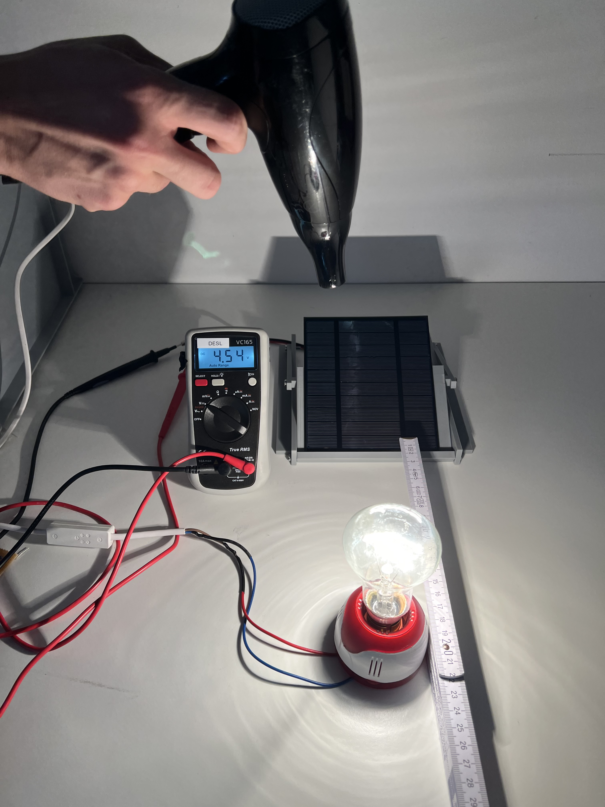
4. Impact of heat on PV module performance
In this chapter you will explore how heating affects the performance of PV modules..
Experiment
Material you will need for the experiments
One Lamp, yellow light bulb
PV modules (small or big)
Multimeter
Blow dryer
Holder for PV panels
Follow these steps to conduct the experiment:
Position the PV module securely and connect it to the multimeter.
Measure the open-circuit voltage (U) and short-circuit current (I) of the PV module without any additional heating. Record the values in the table below.
Use the hair dryer to evenly heat the PV module for 10 seconds.
Measure the open-circuit voltage (U) and short-circuit current (I) of the heated PV module again and record the values.
Repeat the measurements after 20 and 30 seconds of heating.

Slide 27
Distance | U | I
0 sec (no heat)
10 sec
20 sec
30 sec
Exercise
Task 1
How does the performance of the PV module change when it is heated?
When a PV (photovoltaic) module heats up, its performance decreases. Specifically, its efficiency drops, meaning it produces less electricity from the same amount of sunlight.
Discuss with your partner: What would be the best location in the world for installing PV systems?
The best locations for installing PV systems are areas with high solar irradiance and clear skies, such as the Sahara Desert, parts of Australia, the Middle East, the southwestern United States, and regions near the equator. These regions receive abundant, consistent sunlight year-round, maximizing energy production.
PV cells use the photoelectric effect to convert light energy into electrical energy. This effect is the core principle of every PV cell, allowing us to transform sunlight into electricity.

Slide 28
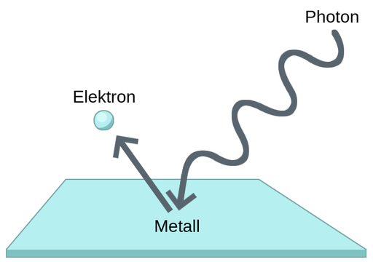
Task 2
What is the photoelectric effect? The photoelectric effect occurs when light hits a material (in our case ….) and knocks electrons out of the material. These released electrons can then flow through a circuit, creating an electric current.
Put the following words into the right boxes: Photon, Electron, Metal
Photon
Electron
Metal
Task 3
Match the following terms with their descriptions. Draw a line between corresponding term and description.
Term
Description
Photon
Conducts the generated electrons away from the PV cell, allowing the generated electricity to be used
Electron
Positive charge carriers
Semiconductor Material
The material, typically silicon, is responsible for converting light into electrical energy
P-Layer
N-Layer
A particle of light carrying energy
Pn-Junction
A negatively charged particle
Electrode
Interface between the P and N layers where electrons and holes separate to generate current
Negative charge carriers

Slide 29
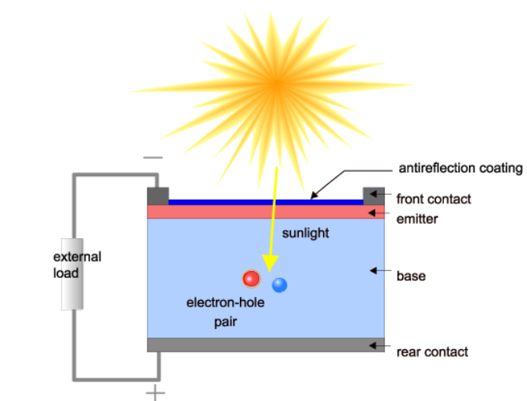
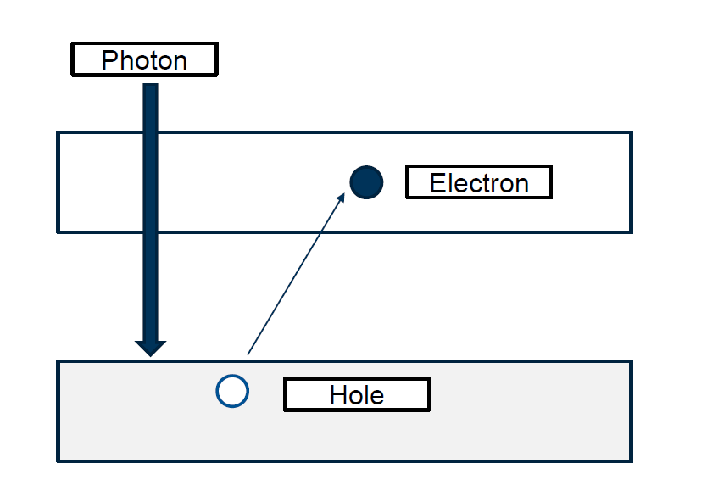
Task 4
The statements on the next page are about the process of energy generation. Bring them in the correct order by putting number 1-5 in the provided space.
4
Separation of Charge Carriers: At the pn-junction, electrons and holes are separated; electrons move to the N-layer and holes to the P-layer.
2
Release of Electrons: The energy from the photons knocks electrons out of the atoms in the semiconductor material.
3
Creation of Electron-Hole Pairs: As electrons are released, they leave behind positive charge carriers called holes.
1
Absorption of Photons: The PV cell absorbs sunlight, where photons strike the surface.
5
Flow of Electrons: The separated electrons flow through the circuit to the electrode, generating electric current.

Slide 30
In summary
Light consists of photons (energy)
PV cells absorb sunlight, where photons (light particles) transfer their energy to electrons within the cell's semiconductor material (commonly silicon).
This energy from the absorbed photons excites electrons, freeing them from their atomic bonds and creating electron-hole pairs within the semiconductor.
These free electrons are driven by an internal electric field created from a pn-junction, where p-type and n-type materials meet in the semiconductor to flow in a particular direction, creating an electric current.
The electric current is then collected by metal contacts on the top and bottom of the PV cell and routed through an external circuit, powering connected devices or sending energy to the grid.

Slide 31
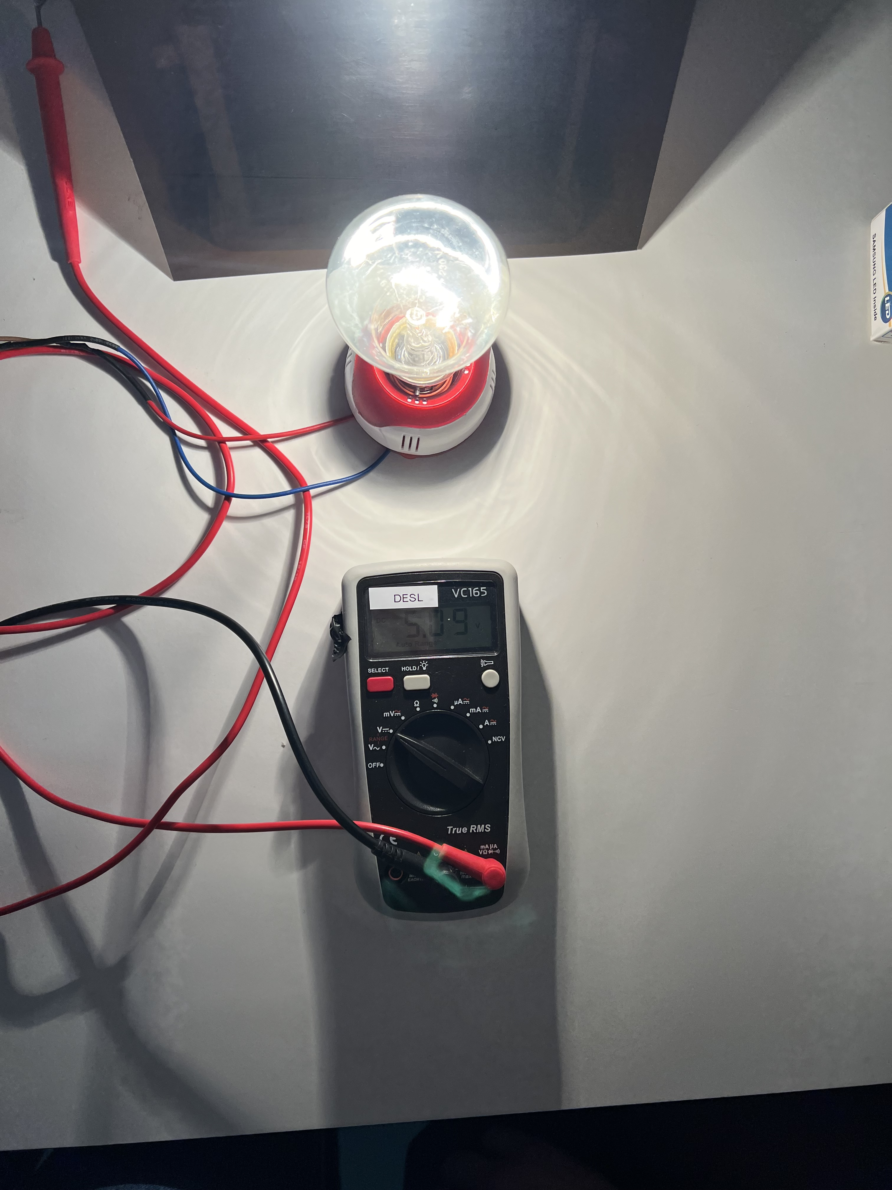
5. Impact of pollution on PV module performance
In this chapter, you will find out how pollution affects the performance of PV panels.
Experiment
Material you will need for the experiments
One Lamp, yellow light bulb
PV modules (small or big)
Multimeter
Light / Pollution filters
Holder for PV panels
Follow these steps to conduct the experiment:
Measure the open-circuit voltage U and the short-circuit current I of the PV panel again.
Add a Polluted Layer (sprinkle dust on the surface of the panel).
Measure the voltage U and the current I again.
Clean the panel.
Measure the voltage U and the current I again.

Slide 32
Distance | U | I
Non-polluted
Polluted
Exercise
Task 1
How did the voltage and the current change?
What effect did cleaning have on the panel’s performance?
From this experiment, you should observe that pollution on the PV panels significantly reduces their performance by decreasing both the voltage and the current generated. Cleaning the panels restores their performance, highlighting the importance of regular maintenance to ensure maximum efficiency of PV panels.
Pollution such as dust, dirt, and leaves block the sunlight from reaching the solar cells. This reduces the panels’ ability to generate electricity effectively and leads to lower voltage and current output.
Task 2
What can be some strategies to keep PV panels functioning optimally?
Regular cleaning, especially after significant accumulation of pollutants.
Installing anti-soiling coatings to reduce dirt adherence.
Optimizing the installation angle to minimize debris buildup.
Implementing automated cleaning systems for large solar arrays.

Slide 33
In summary
Pollution such as dust, dirt, and organic residues on the surface of PV panels blocks sunlight, reducing the panels' ability to effectively convert solar energy into electricity. This leads to a significant drop in both voltage and current output, which in turn decreases the overall efficiency and energy yield of the PV system.
Regular cleaning and maintenance are essential to prevent and mitigate the effects of pollution on PV panels. Without proper cleaning, accumulated pollutants can cause long-term degradation in panel performance, even affecting the lifespan of the panels.

Slide 34
6. Impact of shadows on PV module performance
In this chapter, you will find out how shadows affect the performance of PV panels.
This is important because in reality, PV cells often receive less sunlight due to shadows caused by clouds or tall objects such as trees. In the following experiment, we want to find out how much shadows affect the energy flow.
Experiment
Material you will need for the experiments
One Lamp, yellow light bulb
PV modules (small or big)
Multimeter
Holder for PV panels
Follow these steps to conduct the experiment:
Position the PV module securely and connect it to the multimeter.
Set up the lamp, positioned at the direction of the PV-cell.
Measure the open-circuit voltage (U) and the short-circuit current (I) with the multimeter while the usual light shines on it.
Repeat the process but now place your hand between the light source and the PV cell so that a shadow is cast on the PV cell. (see illustration)
Now measure the open-circuit voltage (U) and the short-circuit current (I) with the multimeter again, while you/or your team partner creates the shadow and record the values in the table under “with shadow”.

Slide 35
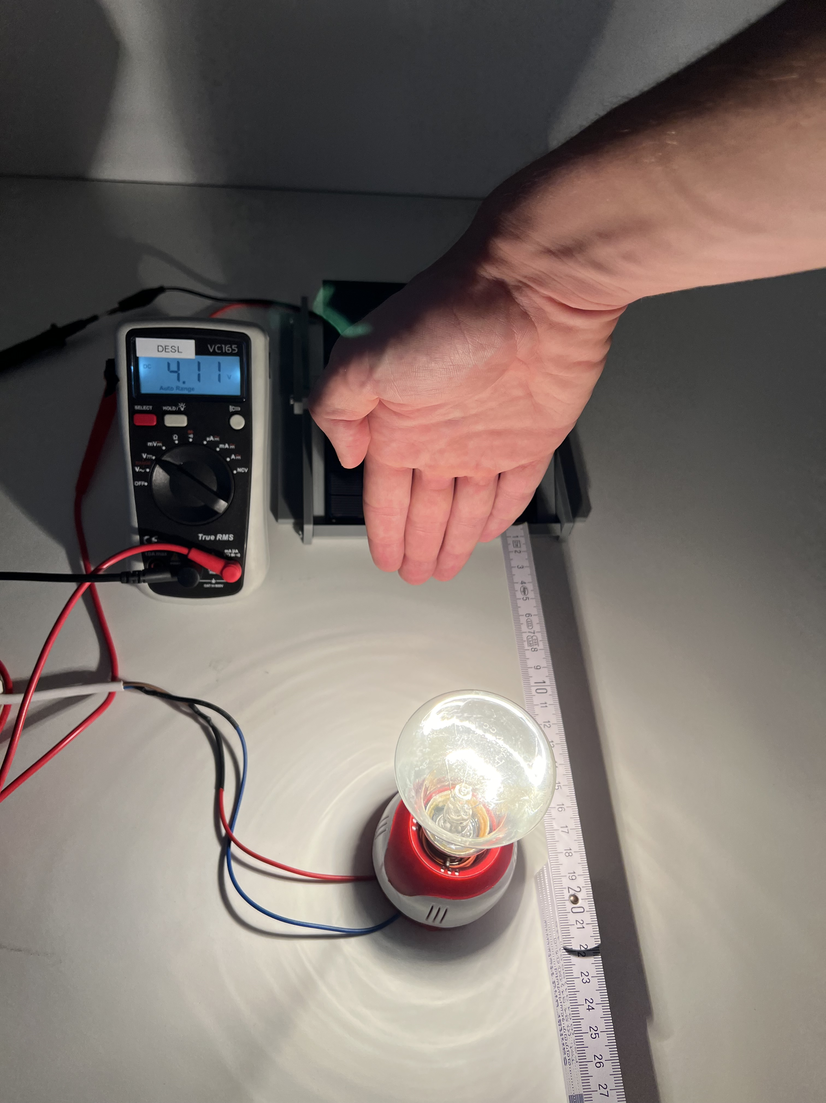


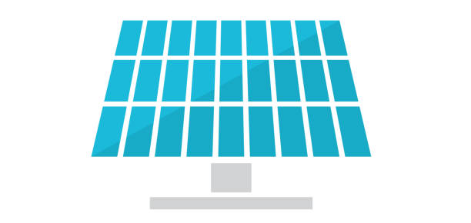

Light | U | I
Normal
With shadow
Exercise
Task 1
How did the voltage and the current change?
What effect did the shadow have on the panel’s performance?
From this experiment, you should observe that shadows cast on PV panels significantly reduce their performance by decreasing both the voltage and the current generated. This demonstrates the sensitivity of PV panels to shading and the importance of maintaining an unobstructed path for sunlight to maximize the energy output of the panels.

Slide 36
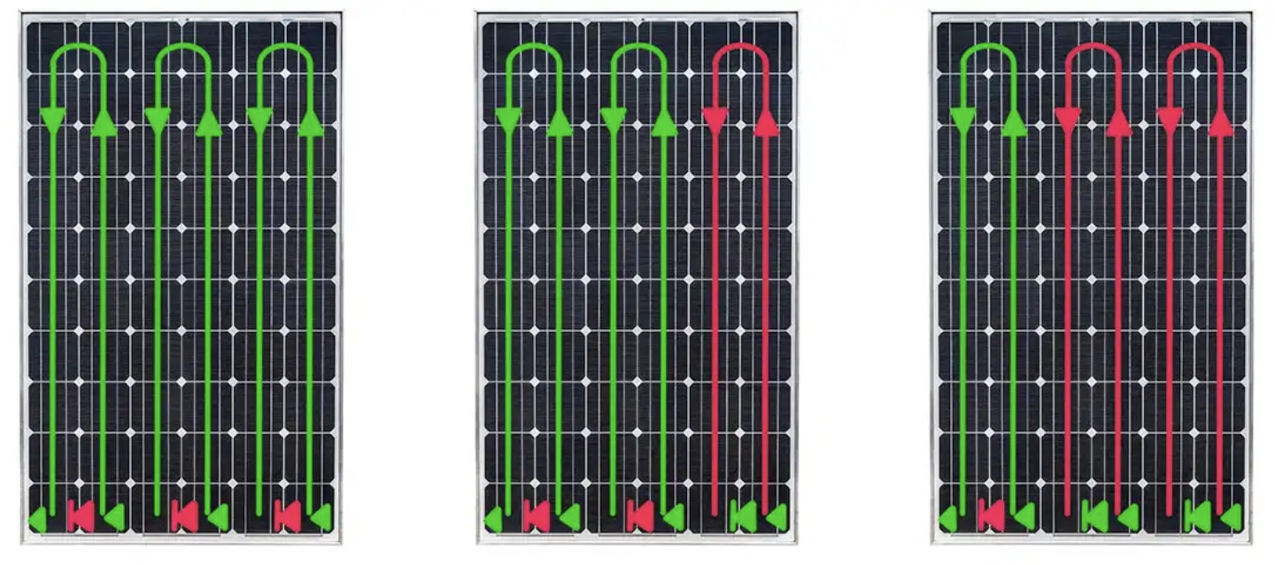
The shadow cast by your hand, or objects such as clouds and trees, block the PV-cells and therefore reduce the amount of sunlight that are reached by the rest of the PV cells. This also reduces the amount of energy absorbed dramatically.
You can see this better in the following figures:
Good to know
To prevent the negative effects of shading, bypass diodes are used. A bypass diode is an essential component in solar modules. It acts as a protective mechanism by diverting the current flow around solar cells or module sections with lower performance. This enables a better power yield from the remaining cells and increases the reliability and efficiency of the entire solar module. Thanks to the bypass diodes, solar modules can achieve high performance even when they are in the shade or shadow.
Entire module not shaded: no bypass diode active, 100% of power.
Right side shaded: one bypass diode active, 66% of the power.
Centre and right side shaded: two bypass diodes active, 33% of power.

Slide 37
Task 2
What can be some strategies to avoid shadows like this?
Optimal Placement and Orientation:
Position Panels in Open Areas: Install PV panels in open areas where they are less likely to be obstructed by buildings, trees, or other structures.
Orient Panels Toward the Equator: As previously mentioned, in the Northern Hemisphere, face panels south, and in the Southern Hemisphere, face panels north to maximize sunlight exposure.
Site Assessment and Planning:
Conduct a Shading Analysis: Before installation, use tools like shading analysis software to predict shadow patterns throughout the day and year. This helps in choosing the best locations for PV panels.
Evaluate Seasonal Changes: Consider how the position of the sun changes with seasons to avoid future shading issues, especially from deciduous trees that may lose leaves in winter but cast shadows in summer.
Use of Solar Tracking Systems:
Single-Axis Trackers: These systems tilt the panels to follow the sun's movement from east to west, reducing the impact of shadows throughout the day.
Dual-Axis Trackers: These systems adjust both the tilt and orientation of the panels to follow the sun more precisely, further minimizing shading.
Regular Maintenance and Trimming:
Tree Trimming: Regularly trim trees and vegetation near the PV installation to prevent shadows from encroaching on the panels.
Remove Debris: Ensure the panels are kept clean and free of debris that could cause partial shading.
In summary
Shadows from various objects, including clouds, trees, or structures, significantly impact PV panels by blocking sunlight and thereby reducing the voltage and current output. This reduction directly affects the overall energy production efficiency of the panels.
PV panels are highly sensitive to shading, where even small shadows can disproportionately decrease power production due to interconnected panel circuits.
Ensuring that PV panels receive unobstructed sunlight is crucial for maximizing their energy output. Effective placement and orientation are key strategies to minimize the effects of shadows, enhancing the consistent performance of solar power systems.

Slide 38
PV Education HUB
Chapter 2
Connecting PV to a load and MPP

Slide 39
Connecting to a load and MPP
In this chapter, you will learn about:
PV panels in Series
PV panels in Parallel
Fixed load (Resistor)
Changing load
Local conditions and load changes
Learning Objective
At the end of this chapter, you will:
Understand how connecting PV panels in series or parallel influences voltage and current
Be able to evaluate how different configurations affect overall system voltage, current, and power output.
Manage the impact of both fixed and variable loads on PV system performance.
Apply Maximum Power Point (MPP) tracking to optimize the energy output from PV panels.
Adapt to local environmental conditions to maximize the efficiency of your PV system.
Material you will need for the experiments
One lamp (Yellow light bulb)
PV modules (Small & Big)
Multimeter
Various cables
Holder for PV panels
Resistance (Potentiometer)

Slide 40
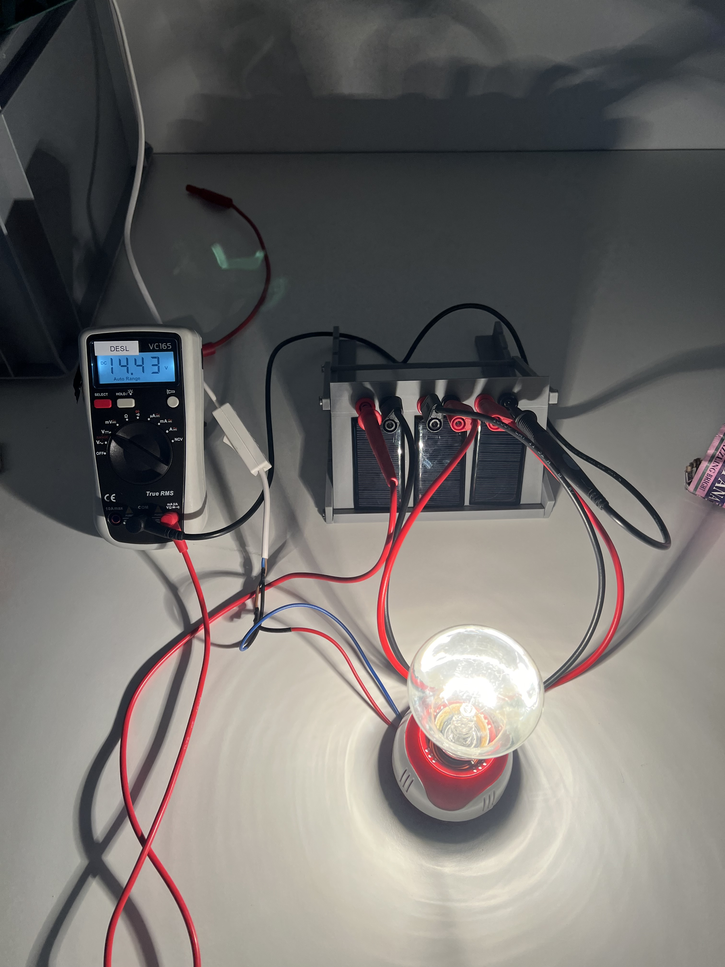
1. PV panels in series
In this chapter, you will understand the effect of connecting two PV cells in a series.
Experiment
Material you will need for the experiments
One Lamp, yellow light bulb
PV modules (small)
Multimeter
Various cables
Holder for PV panels
Follow these steps to conduct the experiment:
Make sure both PV panels receive the same amount of light.
Now write down what voltage U and what current I one panel has and write it down.
Connect the positive terminal of the first PV panel to the negative terminal of the second PV panel.
Connect the multimeter to the remaining positive and negative terminals to measure the voltage and current.
Write down the following values:

Slide 41
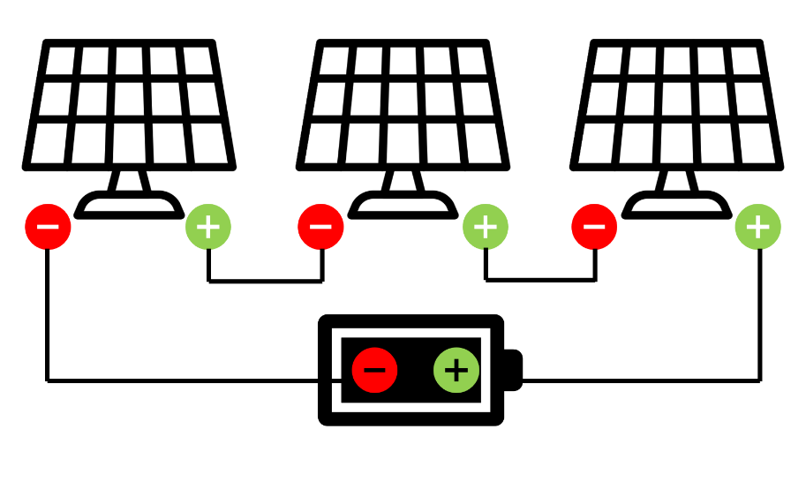
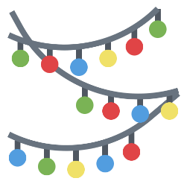
Light Source | Open-Circuit Voltage (U) | Short-Circuit Current (I)
One PV panel
Series of connection
Example
Series Connection
Think of the classic string of holiday lights. If one bulb goes out, the entire string stops working. This is because holiday lights are often connected in series. In a series circuit, electricity flows through each bulb one after the other. If one bulb breaks, it breaks the circuit, and all the lights go out

Slide 42
Exercise
Task 1
Discuss with others in the room (maybe stand up and talk to different people in the class)
What are the PROS and CONS of series connection?
PRO | CON
1. Increased Voltage: The voltage (volts) of each module adds up, providing a higher total voltage, which is beneficial for systems that require higher voltage levels.
2. Simpler Wiring: Series connections typically require less wiring and fewer connectors, which can reduce installation complexity and costs.
3.Efficient for Long Distances: Higher voltage systems are more efficient for transmitting electricity over long distances, as they reduce energy losses.
1. Dependent Operation: If one PV module is shaded or fails, it affects the entire string of modules, reducing or stopping the energy production.
2. Limited Current: The current remains the same as a single module, which might not be sufficient for applications that require higher current.
3. Harder Maintenance: Identifying and fixing problems can be more challenging, as a failure in one module impacts the whole series, making troubleshooting more complex.
In summary
Series connections of PV panels increase the total voltage output (sum of all voltages of individual panels), which is beneficial for high-voltage systems and improves efficiency over long-distance electricity transmission. The current in a series connection remains the same as that of an individual panel.
Wiring PV panels in series reduces the complexity and cost of installation due to fewer required connectors and wiring components.
Any shading or failure in one panel affects the entire series, limiting current output and complicating troubleshooting and maintenance efforts.

Slide 43
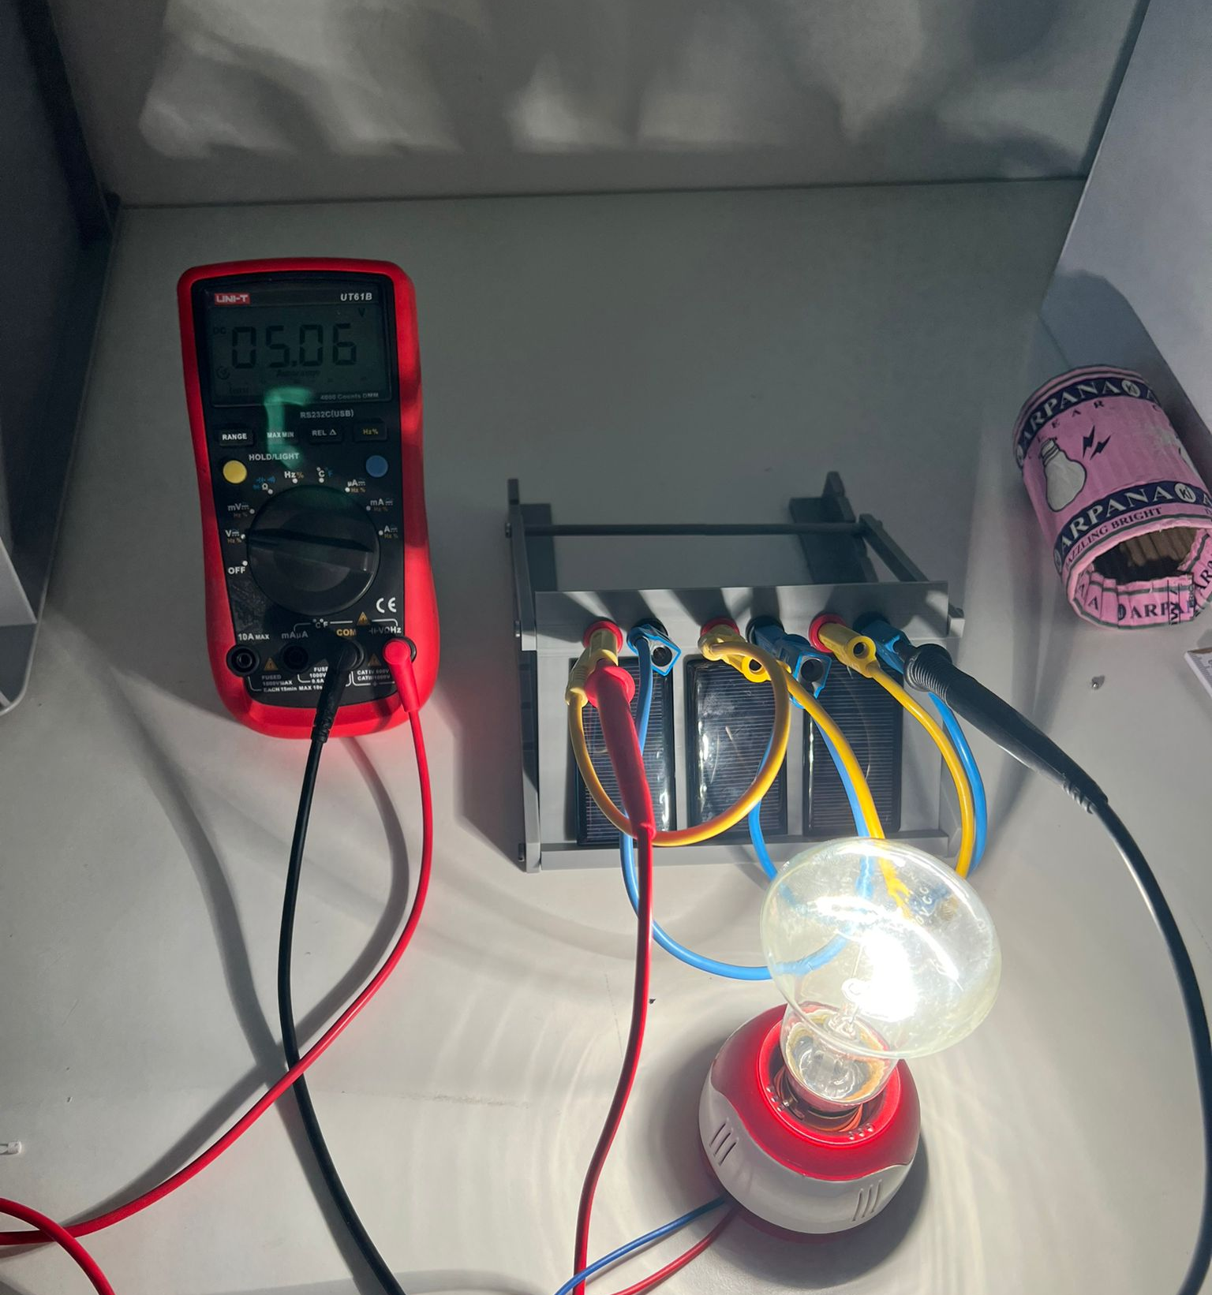
2. PV panels in parallel
In this chapter, you will understand the effect of connecting two PV cells in parallel.
Experiment
Material you will need for the experiments
One Lamp, yellow light bulb
PV modules (small)
Multimeter
Various cables
Holder for PV panels
Follow these steps to conduct the experiment:
Make sure both PV panels receive the same amount of light.
Now write down what voltage U and what current I one panel has and write it down.
Connect the positive terminals of both PV panels together.
Connect the negative terminals of both PV panels together.
Connect the multimeter to the combined positive and negative terminals to measure the voltage and current.

Slide 44
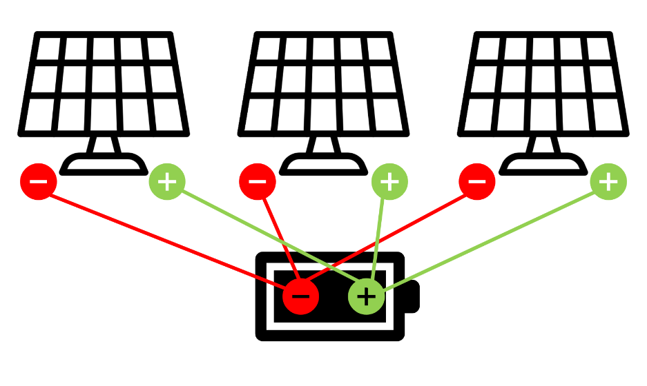
Inclination Angle | U | I
One PV panel
PV panels in parallel
Example
Parallel Connection
Modern holiday lights often use parallel connections. In this setup, each bulb has its own direct path to the power source. So, if one bulb goes out, the rest keep shining brightly! This is because, in a parallel circuit, electricity has multiple paths to follow. Each bulb operates independently of the others.
Exercise
When we say, “PVs are current sources”, we’re highlighting that PV systems primarily produce a steady flow of current, based on the available sunlight. Unlike a battery, which provides a fixed voltage, a PV system adjusts the amount of current it generates according to the intensity of the sunlight.

Slide 45


Task 1
What happens with the current on a sunny day?
Lots of sunlight means lots of free electrons, resulting in a strong current.
What happens with the current on a cloudy day?
Less sunlight means fewer free electrons, resulting in a weaker current
Why does this matter?
Understanding that PVs are current sources helps us design better solar power systems. Therefore, when we connect multiple solar panels, we can choose between series or parallel connections to optimize the system’s performance based on how much current or voltage we need.
Task 2
What are the PROS and CONS of parallel connection?
PRO | CON
1. Independent Operation: If one PV module is shaded or fails, the others continue to produce electricity at full capacity. This ensures a more reliable energy supply. 2. Increased Current: The current (amperes) from each module adds up, providing a higher total current, which is beneficial for applications that require more current. 3. Easier Maintenance: Since each module operates independently, identifying and fixing problems is simpler. If one module fails, it doesn't impact the others. | 1. Same Voltage: The voltage remains the same as a single module, which might not be sufficient for systems that require higher voltage levels. 2. More Wiring: Parallel connections often require more wiring and connectors, which can increase installation complexity and costs. 3. Potential Imbalance: If the modules are not identical or if they age differently, there can be an imbalance in current, which can affect the performance and lifespan of the

Slide 46
In summary
When PV panels are connected in parallel, the output voltage remains the same as that of a single panel. The total current is the sum of the individual currents of each panel, resulting in a higher overall current.
Connecting PV panels in parallel allows for independent operation; if one module fails or is shaded, the others continue to function unaffected, also increasing the total current output, beneficial for high-current applications.
Since each module operates independently, troubleshooting and repairs are more straightforward, minimizing the impact of one module’s failure on the overall system.
While parallel connections maintain the same voltage as a single module, potentially unsuitable for high-voltage requirements, they require more wiring, increasing installation complexity and costs. Additionally, imbalances due to non-identical modules or differential aging can affect system performance and longevity.

Slide 47
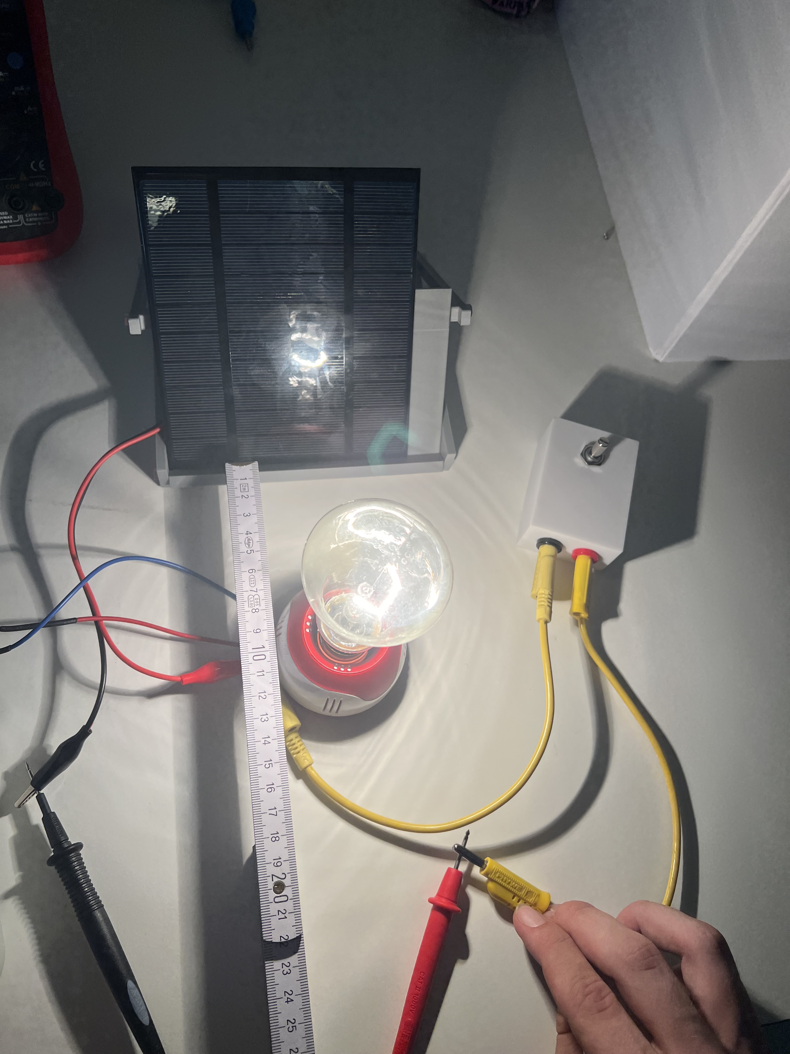
3. Fixed Load (Resistor)
In this chapter, you will understand how a resistor works.
Material you will need for the experiments
One Lamp, yellow light bulb
PV modules (small or big)
Multimeter
Various cables
Holder for PV panels
Resistance (Potentiometer)
Experiment
Follow these steps to conduct the experiment:
First, measure the open-circuit voltage (Voc) and the short-circuit current (Isc) again.
Connect the Resistor to the positive and negative terminals of the PV module.
Now connect the Multimeter leads across the resistor to measure the voltage and the current again

Slide 48

Inclination Angle | U | I
Without Resistor
With Resistor
Exercise
Task
How did the voltage and current change when the resistor was connected?
Please draw a graph now, with the voltage V on the X-axis and the current A on the Y-axis.
Insert the values that you measured above as points on the graph.
For example: with Resistor P ( Voltage | Current )
y
x

Slide 49
In summary
A resistor stabilizes the voltage and current output from a PV panel, drawing power based on its resistance.
It helps the PV cell operate near its maximum power point, ensuring efficient energy conversion.
A fixed resistor limits maximum current flow, protecting PV components from potential overcurrent damage.
The operating point on the V-I curve is the specific point where the PV module is operating at a given moment. This point is determined by the load connected to the module. The load can be a resistor, a battery, or any other electrical device that uses the power generated by the PV module.

Slide 50
4. Changing Load
Experiment
Material you will need for the experiments
One Lamp, yellow light bulb
PV modules (small or big)
Multimeter
Various cables
Holder for PV panels
Resistance (Potentiometer)
Follow these steps to conduct the experiment:
Put the lamp at a distance of 10cm in front of the PV panel.
Now change the load resistance slowly and find different resistances.
Put the current and voltages at the different resistances you try out in the table below:
Please measure the voltage and the current, when the potentiometer is at the far left stop.
Now measure the voltage and the current, when the potentiometer has been increased by three, six and ten rotations.

Slide 51
Resistance (Ω) | U | I
Put the new points Pnew ( U | I ) in the graph you drew in the exercise before!!!
How does changing the resistance affect the operating point?
High Resistance (Open Circuit):
When the resistance is very high (like when there's no load connected), the current is close to zero.
The operating point is at the open-circuit voltage (Voc), which is the maximum voltage the PV module can produce.
Low Resistance (Short Circuit):
When the resistance is very low (like when the terminals are directly connected), the voltage is close to zero.
The operating point is at the short-circuit current (Isc), which is the maximum current
the PV module can produce.
U = R x I
Intermediate Resistance:
When a resistor is connected, it creates an intermediate load.
The voltage and current depend on the value of the resistance. This moves the operating point along the V-I curve.
A higher resistance will result in a higher voltage and lower current.
A lower resistance will result in a lower voltage and higher current.

Slide 52
High resistance | Low Current | High voltage
Low Resistance | High current | Low voltage
Intermediate Resistance | Balanced point somewhere between Voc and Isc
Exercise
Task 1
Plot the different points you found in the graph. Connect the dots to draw a curve.
Can you find a Maximum?
y
x

Slide 53
In summary
At very high resistance, current drops close to zero, placing the operating point at the open-circuit voltage (Voc), which is the maximum voltage output of the PV module.
With very low resistance, voltage nears zero, shifting the operating point to the short-circuit current (Isc), the maximum current the PV module can produce.
Connecting a resistor sets the operating point to intermediate levels on the V-I curve. The specific voltage and current values depend on the resistance level; higher resistance yields higher voltage and lower current, while lower resistance leads to lower voltage and higher current.

Slide 54
5. Local conditions and load changes
Experiment
Material you will need for the experiments
One Lamp, yellow light bulb
PV modules (small or big)
Multimeter
Various cables
Holder for PV panels
Resistance (Potentiometer)
Follow these steps to conduct the experiment:
Now put the lamp at a distance of 20cm
Measure the open circuit voltage and the short circuit current again
Connect the changing load
Measure the voltage and the current again for the different loads
Resistance (Ω) | U | I
0

Slide 55
Exercise
Task 1
Replot your curve from module 4.
Now add the curve from this module.
y
x
Task 2
What did change compared to before? What happened with the maximum?
Please discuss this with your seat neighbor.

Slide 56
PV Education HUB
Chapter 3
Understanding MPPT with TUM Controller

Slide 57
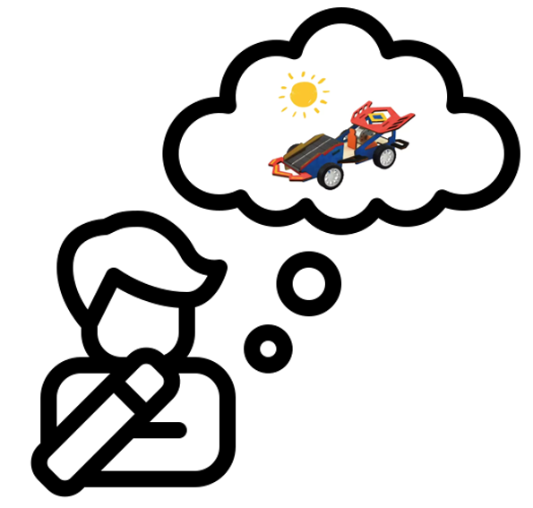

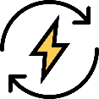

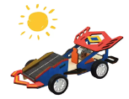
1. MPPT – Maximum Power Point Tracking
Nice to know
Imagine you have a toy car with a PV cell on the roof that is powered only by sunlight.
You know that it gets its energy from the sun through small solar cells on its roof. For the car to go as fast as possible, it needs to get just the right amount of energy from the sun all the time. But the amount of sunlight hitting the solar cells changes all the time – sometimes it's very sunny, sometimes it's cloudy, and sometimes the sun is in a different position in the sky.
MPPT, or Maximum Power Point Tracking, is like a very smart friend
who makes sure your solar car always gets the best possible amount of energy, no matter how the sun is shining.
This smart friend constantly watches and adjusts things to make sure the car always gets the maximum power it can use.

Slide 58
Repetition
As we have learned before, there are changing Sunlight Conditions: The amount of sunlight hitting the solar cells keeps changing. When it’s sunny, the solar cells produce more energy, and when it’s cloudy, they produce less. The temperature also affects how well the solar cells work – they perform differently when it’s hot compared to when it’s cool.
Here’s how MPP works
Optimal Energy Use: Solar cells have a specific point where they produce the most energy. This point is called the Maximum Power Point (MPP). Because the sunlight conditions keep changing, this optimal point also keeps changing.
MPPT Controller: The MPPT controller is a device that constantly measures how much energy the solar cells are producing and how the conditions are changing. It adjusts the electrical load so that the solar cells always operate at the Maximum Power Point. This means it makes sure the solar cells always produce the maximum amount of energy, no matter how the sunlight or temperature changes.
Practical Benefit: By making sure the solar cells always work optimally, your solar-powered car can run longer and faster. Without MPPT, your car wouldn’t always get as much energy as it could, and it would be slower or stop sooner.
Automatic MPP is needed!

Slide 59
Experiment
Connect the PV to the MPPT controller
Bild
Exercise
Task
What might be happening inside this MPPT controller? Please discuss this with your seat neighbor.

Slide 60
In summary
Maximum Power Point Tracking (MPPT) is a technology used in solar applications, like a solar-powered car, to ensure that the solar cells are always operating at their most efficient point, known as the Maximum Power Point (MPP).
The MPP varies with sunlight intensity and temperature, affecting the energy output of the solar cells.
An MPPT controller is crucial in this system; it continually monitors the energy produced by the solar cells and the changing environmental conditions. It then adjusts the electrical load dynamically so that the solar cells operate at the MPP at all times. This optimization allows the solar-powered car to achieve maximum energy efficiency, enabling it to run faster and longer, even under fluctuating sunlight and temperature conditions.
Without MPPT, the car would not utilize solar energy optimally, leading to reduced performance and speed.…

Slide 61
2. Controlling the MPPT
In this chapter, we want to find out how we can track MPP
Experiment
Try to control the MPPT controller manually, as the load is changed.
Exercise
Task 1
What do you notice?
How can the MPP direction be estimated?
Please discuss this with your seat neighbor. And write your guess in the following box:
Task 2
How can the MPP be tracked automatically?

Slide 62
Switch the MPPT to automatic mode.
Now, try to control the MPPT controller manually, as the load is changed.
Task 3
What can you observe?
Now switch the controller to pure PWM mode.
Task 4
Do you notice anything?
In summary
Maximum Power Point Tracking (MPPT) systems function automatically to optimize the efficiency of solar panels.
These systems continuously monitor the output of solar panels and use this data to calculate and adjust to the Maximum Power Point (MPP), where the panels produce the most power.
The adjustments are made in real-time to respond to changes in sunlight intensity, sun angle, and temperature, ensuring that the solar panels operate at peak efficiency.
This automatic adaptation maximizes energy harvest without the need for manual intervention, enhancing both the performance and convenience of solar power systems.

Slide 63
3. PWM vs. MPPT
Exercise
Task
Which is better in your opinion: PWM or MPPT?
Please consider both the benefits of each application and the costs!
Benefits and costs of PWM
Benefits and costs of MPPT
In summary
PWM (Pulse Width Modulation) and MPPT (Maximum Power Point Tracking) are techniques used in PV systems.
PWM: Regulates charging current to batteries by modulating the width of pulses, ensuring efficient battery charging.
MPPT: Optimizes energy harvest from solar panels by continuously tracking and adjusting to the Maximum Power Point (MPP) of the panel array, maximizing overall system efficiency

Slide 64
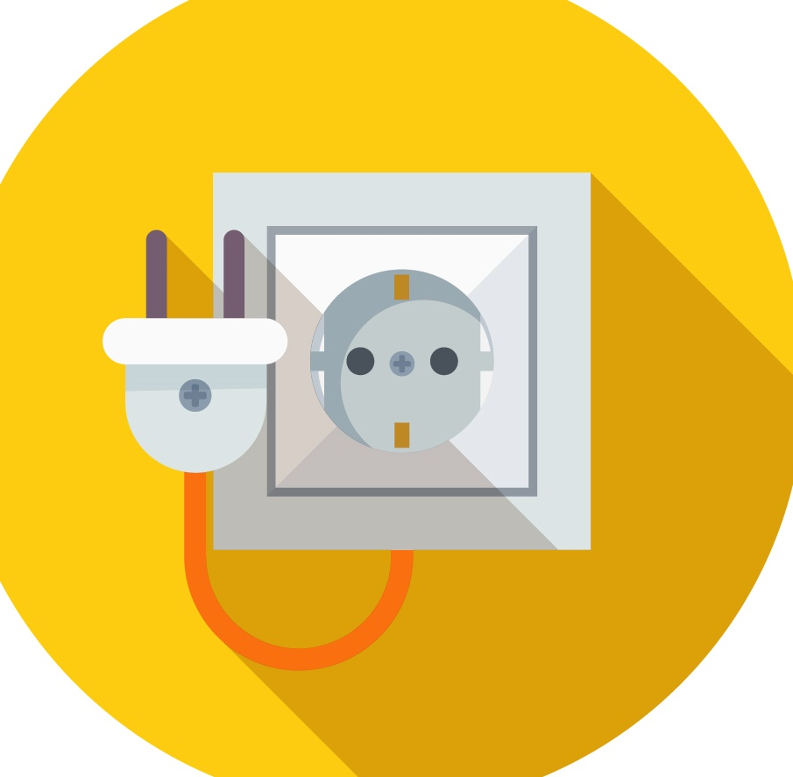
PV Education HUB
Chapter 4
Application - Analyzing Energy Consumption Profiles of Household Appliances

Slide 65
Connecting to a load and MPP
In this chapter, you will learn about:
PV panels in Series
PV panels in Parallel
Fixed load (Resistor)
Changing load
Local conditions and load changes
Learning Objective
At the end of this chapter, you will:
Understand how connecting PV panels in series or parallel influences voltage and current
Be able to evaluate how different configurations affect overall system voltage, current, and power output.
Manage the impact of both fixed and variable loads on PV system performance.
Apply Maximum Power Point (MPP) tracking to optimize the energy output from PV panels.
Adapt to local environmental conditions to maximize the efficiency of your PV system.
Material you will need for the experiments
One lamp (Yellow light bulb)
PV modules (Small & Big)
Multimeter
Various cables
Holder for PV panels
Resistance (Potentiometer)

Slide 66
Exercise: Analyzing Energy Consumption Profiles of Household Appliances
For this exercise, please use the Excel file named "Exercise_Appliances" along with the worksheet and follow the directions to find the solutions. You can download the Excel on the Moodle Box.
Task 1: Visualizing Energy Consumption Profiles of Household Appliances
Initial Descriptions: In this part you are given brief descriptions of the energy consumption profiles of four different household appliances. In the next section you will be asked to create charts using Excel, that visualize the actual energy consumption profiles of these devices. Then you will match the descriptions with the corresponding visuals. Here are the basic descriptions:
Washing Machine (WM):
Multiple Peaks over the duration of operation
High peaks during washing/heating cycles,
Relatively lower peaks for spinning cycles towards the end
Dishwasher (DW):
Multiple Peaks over the duration of operation
Peak level values of the spikes are generally close to each other
Kettle (K):
Rapid and high spike in power usage
Consistent power level during operation
Hair Dryer (HD):
Rapid and high spike in power usage
Depending on the operation mode it can have different peak values (The peak is lower than Kettle for the example)
Consistent power level during operation

Slide 67
Data Analysis and Visualization:
Open the Excdel file named "Exercise_Appliances" and navigate to the sheet named "Task 1". Here you will find the combined datasets for the energy consumption profiles of 4 household appliances mentioned in part 1.
They are labeled as HA1 (HouseholdAppliance1), HA2 (HouseholdAppliance2), HA3 (HouseholdAppliance3) and HA4 (HouseholdAppliance4), in a random order.
Your task is to perform a Pivot Table Analysis to generate charts for appliances. After creating the PivotTable charts, you can discuss and make educated guesses about which label belongs to which appliance. Please fill your answers in the boxes below. (Washing Machine, Dishwasher, Kettle, Hair Dryer).
Guide for PivotTable Analysis
Select all the data available on the sheet (Task 1)
Click on the “Insert” tab.
Click on PivotTable and choose the "New Worksheet" option from the pop-up window.
Note: Rename this sheet as "Task1_Profiles"
In the “PivotTable Analyze tab”, click the "Field List"
Configure the PivotTable fields as follows:
1. Columns: Appliance Type
2. Rows: Operation Time (Seconds)
3. Values: Power Converted (Watts) (Ensure it is set to "Sum" by right-clicking on "Power Converted (Watts)" and selecting "Value Field Settings.")
Click on the PivotTable, navigate to PivotTable Analyze → Tools → Pivot Chart, and select "2D Area Chart." (Avoid selecting a stacked area chart.)
Lastly navigate to PivotTable Analyze tab again and click on “Insert Slicer”, from the pop-up window you should select “Appliance Type”. This slicer will allow users to easily manipulate which appliance/s are shown in the chart.
Household Appliance 1 (HA1) | Household Appliance 2 (HA2) | Household Appliance 3 (HA3) | Household Appliance 4 (HA4)

Slide 68
Task 2: Analyzing Different Usage Modes for the Kettle
For task 2 and task 3, we will focus on a single appliance, namely the Kettle. Now you should navigate to the sheet named “Task 2” in the Excel file (Exercise_Appliances).
Data Analysis and Visualization:
Open the sheet named “Task 2". Here you will find the combined datasets for the energy consumption profiles of different modes of operation of a Kettle.
6 different usage modes of the Kettle are pre-assigned as ModeA, ModeB ModeC, ModeD, ModeE and ModeF, representing differing amounts of water in the container of the kettle (from minimum 2 cups of water up to 7 cups), in a random order. Note: 1 cup = 250 ml of water.
Your task is to create two Pivot Tables based on this dataset. One for energy consumption profiles of each mode and the other one for calculating the total energy consumption of each mode.
Energy Consumption Profiles: Please fill in how many cups of water was used for each mode (from 2 cups of water up to 7 cups).
Guide for PivotTable Analysis
Select all the data available on the sheet “Task 2”
Click on the “Insert” tab.
Click on PivotTable and choose the "New Worksheet" option from the pop-up window.
Note: Rename this sheet as 'Task2_Profiles’
Click on anywhere on the PivotTable and navigate to the “PivotTable Analyze” tab, open the "Field List.“
Configure the PivotTable fields as follows:
1. Columns: Operation Mode
2. Rows: Operation Time (Seconds)
3. Values: Power Converted (Watts) (Ensure it is set to "Sum" by right-clicking on "Power Converted (Watts)" and selecting "Value Field Settings.")
Again, click anywhere on the PivotTable and navigate to PivotTable Analyze ➔ Tools ➔ Pivot Chart, and select "2D Area Chart." (Avoid selecting a stacked area chart.)
Lastly navigate to PivotTable Analyze tab again and click on “Insert Slicer”, from the pop-up window you should select “Appliance Type.” This slicer will allow users to easily manipulate which appliance/s are shown in the chart

Slide 69
Mode A | Mode B | Mode C | Mode D | Mode E | Mode F
Total Energy Consumption: Please fill in the total amounts of energy consumed by each mode (Round your answers to three decimal places).
Guide for PivotTable Analysis
Navigate back to sheet “Task2” and select all the data available on the sheet.
Click on the “Insert” tab.
Click on PivotTable and choose the "New Worksheet" option from the pop-up window.
Note: Rename this sheet as 'Task2_TotalConsumption’
Click on anywhere on the PivotTable and navigate to the “PivotTable Analyze” tab.
In the calculations section click "Field, Items, & Sets” and choose “Calculate Field”.
1. In the pop-up window there are 2 areas of interest “Name” and “Formula”.
2. Configure as follows:
Name: Type in this field “Total Energy Consumption in kWh”
Formula: Click on the Formula window ➔ choose “Power Converted (Watts) from the “Fields” window ➔ Click “insert” ➔ then type the Formula. To convert from Ws to kWh we need to divide our figure with this value “(3600*1000)”. The resulting formula should look like this
“= ‘Power Converted (Watts)’ / (3600*1000)”
➔ Click “Add” and then “Ok”
Note: This formula divides the total power consumption by 1000 to convert watts to kilowatts and then by 3600 to convert seconds to hours.
Configure the Fields as follows:
1. Columns: Operation Mode
2. Values: Total Energy Consumption in kWh
PivotTable Analyze ➔ Tools ➔ Pivot Chart and select "Column or Bar Charts." (Avoid selecting the stacked chart options.)
Lastly navigate to PivotTable Analyze tab again and click on “Insert Slicer”, from the pop-up window you should select “Appliance Type”. This slicer will allow users to easily manipulate which appliance/s are shown in the chart.

Slide 70
2 Cups | 3 Cups | 4 Cups | 5 Cups | 6 Cups | 7 Cups
Task 3: Practical Examples: Kettle
For the following exercises we will use the same Kettle and its data, and we will make an assumption,
Assumption: We consider that there are three distinct user groups in three different households. They all have the same kettle, and it is the one visualized in Task2. Their habit of using the Kettle is summarized below.
Household 1: Adds exactly 2 cups of excess water per use. (If possible)
Household 2: Adds exactly 1 cup of excess water per use. (If possible)
Household 3: Adds exactly the required/desired amount of water (no excess) per use.
Scenario 1:
Each household uses the kettle 10 times a day,
For all households, out of those 10 times, the actual needed amounts are as follows.
2 times: 3 cups
5 times: 4 cups
3 times: 5 cups
1.1 Calculate the monthly total energy consumptions of these households for the kettle (in kWh), using the results calculated in “Task 2”, “part 3.1 Results” and fill the table below
Household 1 (monthly) | Household 2 (monthly) | Household 3 (monthly)
1.2 Using the information below calculate the electric bill for each household in “GHp”.
Note: The currency represented by "GHp" is the Ghanaian pesewa. It is the subunit of the Ghanaian cedi, where 100 pesewas make up one cedi.

Slide 71
1.2 Using the information below calculate the electric bill for each household in “GHp”.
Effective since 1st of April 2024, the electricity prices in Ghana for residential use are as follows, 0-30 kWh (Lifeline, Exclusive) at 63.4792 GHp/kWh, 31-300 kWh at 140.5722 GHp/kWh, and above 301 kWh at 185.7432 GHp/kWh. This means if a household’s monthly consumption exceeds the bracket 301 kWh, they will be billed for the total consumption amount at 185.7432 GHp/kWh. Note: The currency represented by "GHp" is the Ghanaian pesewa. It is the subunit of the Ghanaian cedi, where 100 pesewas make up one cedi.
For simplicity, students can assume the total energy used by each household, excluding the kettle's contribution, is 260 kWh monthly.
Household 1 (Electric Bill) | Household 2 (Electric Bill) | Household 3 (Electric Bill)
Scenario 2:
Each group uses the Kettle as follows
Household 1: Uses the kettle 9 times daily.
Household 2: Uses the kettle 10 times daily.
Household 3: Uses the kettle 12 times daily.
The actual needed amounts are as follows.
5 times: 5 Cups
Rest of them: 4 Cups
2.1 Calculate the monthly total energy consumptions of these households for the kettle, using the results calculated in “Task 2”, “part 3.1 Results” and fill the table below.
Household 1 (Monthly) | Household 2 (Monthly) | Household 3 (Monthly)
2.2 Calculate the monthly total energy consumptions of these households for the kettle, using the results calculated in “Task 2”, “part 3.1 Results” and fill the table below.
Household 1 (Electric Bill) | Household 2 (Electric Bill) | Household 3 (Electric Bill)

Slide 72
Task 4: Practical Examples: Hair Dryer
Your task for the following two exercises is to perform Pivot Table Analysis to generate charts for a hair dryer’s different operation modes and total energy consumption of these modes. The hair dryer is the same one that was given in Task 1.
Energy Consumption Profiles
Guide for PivotTable Analysis
Navigate to the sheet named “Task4” in excel “Exercise_Appliances”
Select all the data available on the sheet (Task 4)
Click on the “Insert” tab.
Click on PivotTable and choose the "New Worksheet" option from the pop-up window. Note: Rename this sheet as "Task4_Profiles"
In the “PivotTable Analyze tab”, click the "Field List"
Configure the PivotTable fields as follows:
Columns: Operation Mode
Rows: Operation Time (Seconds)
Values: Power Converted (Watts) (Ensure it is set to "Sum" by right-clicking on "Power Converted (Watts)" and selecting "Value Field Settings.")
Click on the PivotTable, navigate to PivotTable Analyze → Tools → Pivot Chart, and select "2D Area Chart." (Avoid selecting a stacked area chart.)
Lastly navigate to PivotTable Analyze tab again and click on “Insert Slicer”, from the pop-up window you should select “Operation Mode”. This slicer will allow users to easily manipulate which mode/s are shown in the chart.
Please fill in the table below with the right Labels.
Note: The hair dryer has three different heat settings (High Heat, Medium Heat, Low Heat) and 2 different fan speed settings (high and low). Therefore, the hair dryer has 6 different configurations for daily use. You can use abbreviations for the Labels (e.g.: High Heat, Low Speed → HHLS or Low Heat, High Speed → LHHS)
Reminder: The operation times for all modes are approximately 120 seconds. Therefore, operation time is not the main factor for the appliance's higher/lower energy consumption in different modes.
Mode A | Mode B | Mode C | Mode D | Mode E | Mode F

Slide 73
Total Energy Consumption
Guide for PivotTable Analysis
Navigate back to sheet “Task4” and select all the data available on the sheet.
Click on the “Insert” tab.
Click on PivotTable and choose the "New Worksheet" option from the pop-up window. Note: Note: Rename this sheet as "Task4_TotalConsumption«
Click on anywhere on the PivotTable and navigate to the “PivotTable Analyze tab”
In the calculations section click "Field, Items, & Sets” and choose “Calculate Field”.
1.In the pop-up window there are 2 areas of interest “Name” and “Formula”.
2.Configure as follows:
Name: Type in this field “Total Energy Consumption in kWh”
Formula: Click on the Formula window → choose “Power Converted (Watts) from the “Fields” window → Click “insert” → then type the Formula. To convert from Ws to kWh we need to divide our figure with this value “(3600*1000)”. The resulting formula should look like this “ = 'Power Converted (Watts)' / (3600*1000) ”
Click “Add” and then “Ok”
Note: This formula divides the total power consumption by 1000 to convert watts to kilowatts and then by 3600 to convert seconds to hours.
Configure the Fields as follows:
1. Columns: Operation Mode
2. Values: Total Energy Consumption in kWh
PivotTable Analyze → Tools → Pivot Chart and select "Column or Bar Charts." (Avoid selecting the stacked chart options.)
Lastly navigate to PivotTable Analyze tab again and click on “Insert Slicer”, from the pop-up window you should select “Operation Mode”. This slicer will allow users to easily manipulate which appliance/s are shown in the chart.
Please fill in the total amounts of energy consumed by each mode. (Round your answers to three decimal places.)
High Heat High Speed | High Heat Low Speed | Medium Heat High Speed | Medium Heat Low Speed | Low Heat High Speed | Low Heat Low Speed

Slide 74
Consider two different households, each using a hair dryer three times a day
•The first household uses the hair dryer as follows: starts with high heat and high speed for 4 minutes, then switches to high heat and low speed for 2 minutes and finishes with medium heat and low speed for 2 minutes.
•The second household starts using the hair dryer with medium heat and high speed for 2 minutes, and then switches to medium heat and low speed for 6 minutes
3.1 Calculate the monthly total energy consumption of these households for the hair dryer.
Household 1 (monthly) | Household 2 (monthly)
3.2 Using the information provided in “Task 3”, “part 1.2”, calculate the electric bill for each household.
Assumption: For simplicity, students can assume the total energy used by each household, excluding the Hair Dryer's contribution, is 260 kWh monthly.
Household 1 (monthly) | Household 2 (monthly)

Slide 75
Task 5: Evaluating the Photovoltaic (PV) System Options for Residential Use
Background Information:
1. PV System Capacity: A 10 kW (kilowatt) photovoltaic (PV) system can provide a peak amount of energy of 10 kW. This is the maximum power output the system can generate under optimal conditions, such as full sunlight with no shading, ideal angle, and optimal temperature (Students conducted experiments with small PV panels and observed that optimal energy production occurs under these conditions)
In professional terms, the instantaneous power output is the maximum real-time power generation capacity of the PV system when exposed to peak sunlight and operating under ideal conditions. If the total wattage required by your devices exceeds the 10-kW capacity of your PV system, you will encounter several potential issues such as insufficient power for your devices, leading to underperformance, shutdowns, or failure to operate.
2. Energy Production Estimates: To understand energy production over time: (These estimates can vary based on geographical location, seasonal changes, and specific installation conditions.)
Daily Energy Production: Assuming 4-6 hours of peak sunlight per day, a 10 kW PV system can produce:
10 kW * 4 hours = 40 kWh (kilowatt-hours) per day (lower estimate)
10 kW * 6 hours = 60 kWh per day (higher estimate)
3. Managing Power Consumption:
Energy Storage and Grid Dependence:
Battery Storage: Temporary compensation for the shortfall if sufficiently charged.
Grid Connection: Drawing additional power from the grid, possibly incurring extra costs.
Demand Side Management:
Staggering the Use of High-Power Devices: Scheduling the operation of high-power appliances at different times to avoid simultaneous peak loads.
Using High-Efficiency Appliances: Investing in and utilizing appliances that consume less energy for the same performance.
Implementing Smart Home Systems: Deploying smart home technologies to monitor, manage, and distribute energy loads effectively, ensuring efficient energy use and reducing waste.

Slide 76
Comparison of Two Households with/without Demand Side Management Measures
Your task is to perform a Pivot Table Analysis to generate charts of the energy consumption profiles for two different households.
Note: The datasets provided for this task represent a two-hour period of the day of two different households (from 12:00:00 to 14:00:00).
Household with Demand Side Management Measures
Guide for PivotTable Analysis
Navigate to sheet “Task5_DSM” and select all the data available on the sheet.
Click on the “Insert” tab.
Click on PivotTable and choose the "New Worksheet" option from the pop-up window.
Note: Note: Rename this sheet as "Task5_DSM_Profile"
Click on anywhere on the PivotTable and navigate to the “PivotTable Analyze tab”
Configure the Fields as follows:
Columns: Application Type and Mode
Rows: TimeStamp (After putting this into the field there can be other entries such as “Hours(TimeStamp), Minutes(TimeStamp), etc. You should deselect these options except the Entry “TimeStamp” itself)
Values: Power Converted (Watts) (Ensure it is set to "Sum" by right-clicking on "Power Converted (Watts)" and selecting "Value Field Settings.")
Click on the PivotTable, navigate to PivotTable Analyze → Tools → Pivot Chart, and select "2D Stacked Area Chart." (Avoid selecting a normal area chart.)
Lastly navigate to PivotTable Analyze tab again and click on “Insert Slicer”, from the pop-up window you should select “Appliance Type”. This slicer will allow users to easily manipulate which appliance/s are shown in the chart.

Slide 77
Household without Demand Side Management Measures
Guide for PivotTable Analysis
Navigate to sheet “Task5_NoDSM” and select all the data available on the sheet.
Click on the “Insert” tab.
Click on PivotTable and choose the "New Worksheet" option from the pop-up window. Note: Note: Rename this sheet as "Task5_NoDSM_Profile"
Click on anywhere on the PivotTable and navigate to the “PivotTable Analyze tab”
Configure the Fields as follows:
Columns: Application Type and Mode
Rows: TimeStamp (After putting this into the field there can be other entries such as “Hours(TimeStamp), Minutes(TimeStamp), etc. You should deselect these options except the Entry “TimeStamp” itself)
Values: Power Converted (Watts) (Ensure it is set to "Sum" by right-clicking on "Power Converted (Watts)" and selecting "Value Field Settings.")
Click on the PivotTable, navigate to PivotTable Analyze → Tools → Pivot Chart, and select "2D Stacked Area Chart." (Avoid selecting a normal area chart.)
Lastly navigate to PivotTable Analyze tab again and click on “Insert Slicer”, from the pop-up window you should select “Appliance Type”. This slicer will allow users to easily manipulate which appliance/s are shown in the chart.
Your task now is fill in the table below with the peak consumption values (highest points on the the chart) of these households discuss what are the possible implications of these peak values.
Household with DSM (Peak Consumption Value) | Household without DSM (Peak Consumption Value)

Slide 78
4. PV System Options: 3 kW, 5 kW, 10 kW (In ideal conditions)
Households from the previous example are now considering investing in a PV system.
They have three different options for their home:
System A: 3 kW capacity with an investment cost of $4,000.
System B: 5 kW capacity with an investment cost of $6,000.
System C: 10 kW capacity with an investment cost of $10,000.
Note: For the following questions we assume the household without DSM measures has a peak consumption value of 9999 Watts instead. Which means it can be covered by an ideal 10 kW PV system. Also use the following conversion rate for your calculations: 1 US Dollar = 15,36 GH cedis or 1 USD = 1536 GH pesewas.
4.1 Energy Production and Cost Savings:
In Accra, the capital city of Ghana, the average sunlight hours per day range from 4
hours and 30 minutes in July to 8 hours in November. Annually, Accra receives about
2377 hours of sunlight, averaging around 6 hours and 30 minutes of sunlight per day.
Note: The 2-hour section of these households consumed the same total energy
“1,33284 kWh”, we can assume that their daily total consumption is 10 times more
“13,3284” and that adds up to “399,8518 kWh” monthly. For simplicity we assume each
household consumes 400 kWh of energy monthly
• Calculate the potential energy production for each system assuming they operate at
100% efficiency under ideal conditions. (Use 4 hours 30 minutes for lower estimation
and 8 hours for higher estimation)
• Determine the daily and monthly energy production for each system. (Take 1 year=12 months, 1 month= 30 days)
• Calculate the cost savings based on the electricity prices in Ghana. (mentioned in Task
3, part 1.2)
Calculations:

Slide 79
Calculations (continued):
• Consider the initial investment cost of each PV system and calculate the payback period for each system (Take 1 year=12 months, 1 month= 30 days)
• From the results discuss and decide which household should choose which system. Fill in the table below
4.2 Investment Cost and Payback Period:
Calculations:
Household with DSM System Selection | Household without DSM System Selection

Slide 80
5. PV System Options: 3 kW, 5 kW, 10 kW (In real-life conditions)
In real-life applications, PV systems do not operate at their theoretical capacity due to
various inefficiencies. For our question we can simply ssume the PV system operates at
75% efficiency (a rule of thumb). The students have conducted experiments with a small
PV panel and are therefore, familiar with the decreased performance of the PV systems.
5.1 Energy Production and Cost Savings:
• Considering the 75% efficiency under real-life conditions . Calculate the potential energy production and cost savings for each system. (Use 4 hours 30 minutes for lower estimation and 8 hours for higher estimation)
• Determine the daily and monthly energy production for each system. (Take 1 year=12 months, 1 month= 30 days)
Calculations:

Slide 81
5.2 Investment Cost and Payback Period::
• Consider the initial investment cost of each PV system and calculate the payback period for each system, (Take, 1 year=12 months, 1 month= 30 days)
• From the results discuss and decide which household should choose which system. Fill in the table below
Calculations:
Household with DSM System Selection | Household without DSM System Selection

Slide 82
Well done!
Designed by Slidesgo und Freepik

