Slide 1
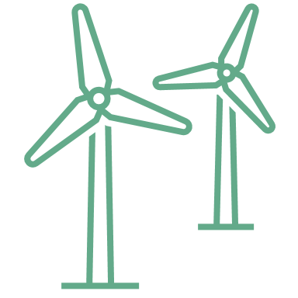



Wind Energy Education HUB
Renewable energy workshop

Slide 2
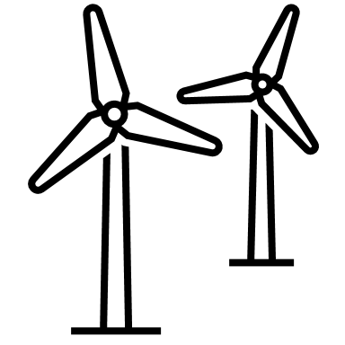
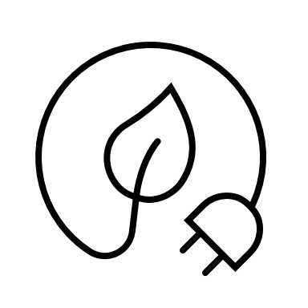


At the end of the session you’ll be able to
Know the basics of energy, wind energy and where you can find the windiest places.
Know how to measure wind and understand how wind can do work.
Create an airfoil and connect it to the principle of Bernoulli.
Use the wind turbine kit and try out which configurations generate the most energy and which is therefore the best way to build a wind turbine in real life.
Notes:
https://i.pinimg.com/originals/36/32/ea/3632ea56e4415244eb44fd078674ae1c.jpg
https://th.bing.com/th/id/OIP.iGsyHNGh0JOFRnQa8SUstgAAAA?rs=1&pid=ImgDetMain
https://wonderfulengineering.com/wp-content/uploads/2014/09/wind-turbine-pictures-2.jpg

Slide 3
Our session’s agenda
01
02
03
04
Basics of wind energy
Measuring and working with wind
Learn about energy, wind energy and the wind atlas.
Learn how to measure wind and understand how it can work.
Airfoils
Experiments with a wind turbine
Learn about airfoils, their shape, and how this helps explain wind blade movement.
Familiarize yourself with the wind turbine kit and try out different configurations.

Slide 4
01
Basics of wind energy
Learn about energy, wind energy and the wind atlas.

Slide 5
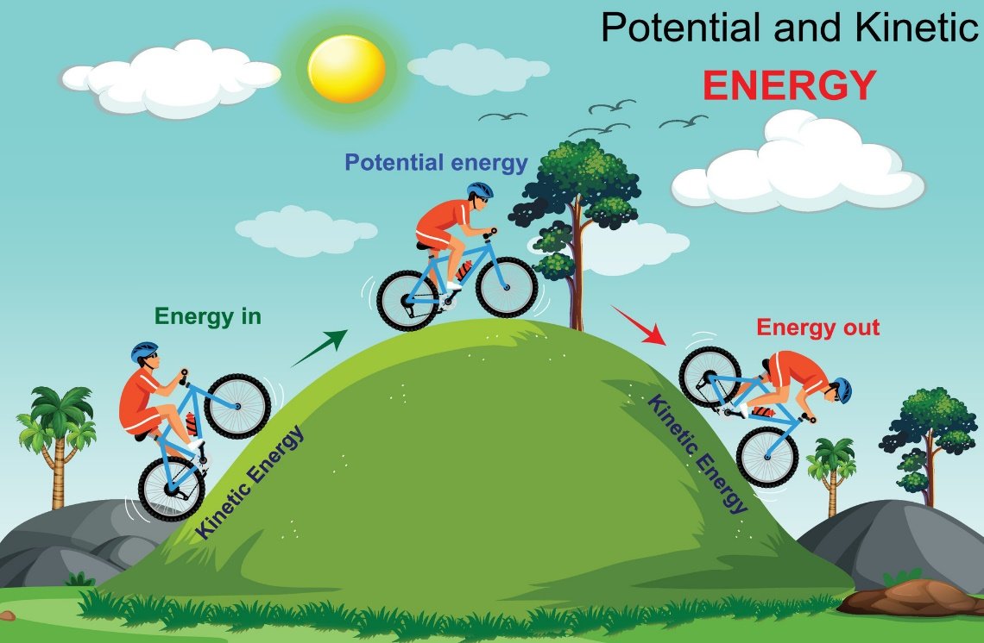
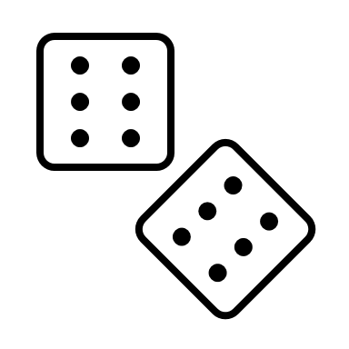
Learning about wind, energy and wind energy
What comes to your mind when you hear the word "energy"?
Energy is what makes things happen—it’s the power to do work!
Look at the picture:
Kinetic energy: It is the movement of things (like a bike).
Potential energy: It is the stored energy (driving down the hill).
Open your worksheet on page 10. Let‘s play an energy name game!

Slide 6

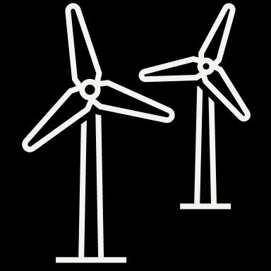
Learning about wind, energy and wind energy
Non-renewable energy
Comes from sources that can be exhausted over time.
These are finite and will eventually run out.
Renewable energy
Comes from natural sources that are constantly replenished.
These sources can be used indefinitely without depleting them.
VS.

Slide 7
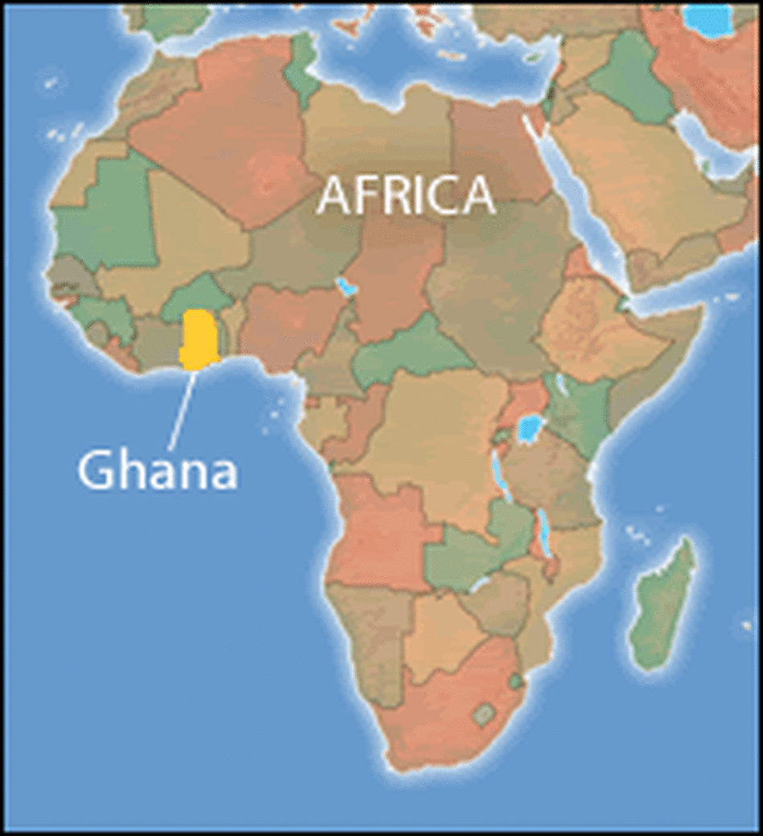


Learning about wind, energy and wind energy
Challenge
Open your workbook on page 11 complete the task 2!
Fun Fact
Did you know that during the years 2000-2020 Ghana has covered its energy consumption with:
10% renewable energy sources
90% non-renewable energy sources
Notes:
Teacher Note: The 10 people representing the precentage and are a metaphor that only one out of ten energy sources is green. Therefore you could say just one person out of ten consumes green energy.
Source: https://th.bing.com/th/id/R.b7f5ca9fde04dce27b5a8b847cb0ffe9?rik=76xKxr0T7Tn3yw&riu=http%3a%2f%2ftravelsfinders.com%2fwp-content%2fuploads%2f2016%2f07%2fmap200-c57f479cada8b2a2727a3749a85509fd6ae59195-s6-c30.gif&ehk=rgCGr%2fuAfsGQAX%2f2KqGObhREUzcrn64Y4LfbCIEmZx8%3d&risl=&pid=ImgRaw&r=0
A review on renewable energy potentials and energy usage statistics in Ghana - ScienceDirect

Slide 8
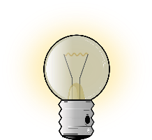

Learning about wind, energy and wind energy
So, can Ghana do more regarding renewable energy sources?
Let`s see...
What comes to your mind when you hear these words together "wind energy"?
Think about the term "wind energy" by yourself and write down everything that comes to your mind.
After 2-3 minutes: Pair up to 3-4 students and compare your answers.
Did you find differences and similarities? Were you able to agree on a definition?
Let‘s find out...

Slide 9
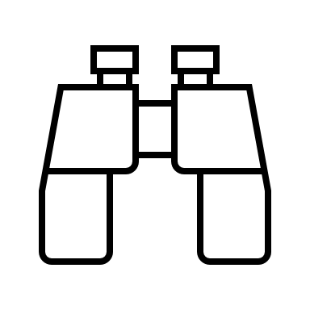
Now sum it up: Wind + Energy
Wind:
Wind is moving air in the atmosphere.
It happens when the air heats up differently in different places and moves around.
Wind in action: We feel the wind when it blows past us.
Energy:
Energy is what makes things move or do work.
It can be in forms like heat, light, or motion.
Example: A lamp needs energy to light up!
Wind Energy:
Wind energy is the energy created by the movement of the wind.
Wind turbines can turn this movement into electricity, which we can use in our homes!
Have you ever seen a wind turbine in real life?

Slide 10
… The more wind the more energy!
Now let`s think about windy places ...
Windy places mostly have one or more of these characteristics in common:
Flat, open spaces
Temperature differences
High elevation
Pressure differences
Attention: How strongly the wind blows varies greatly on a regional scale (in contrast to PV).

Slide 11
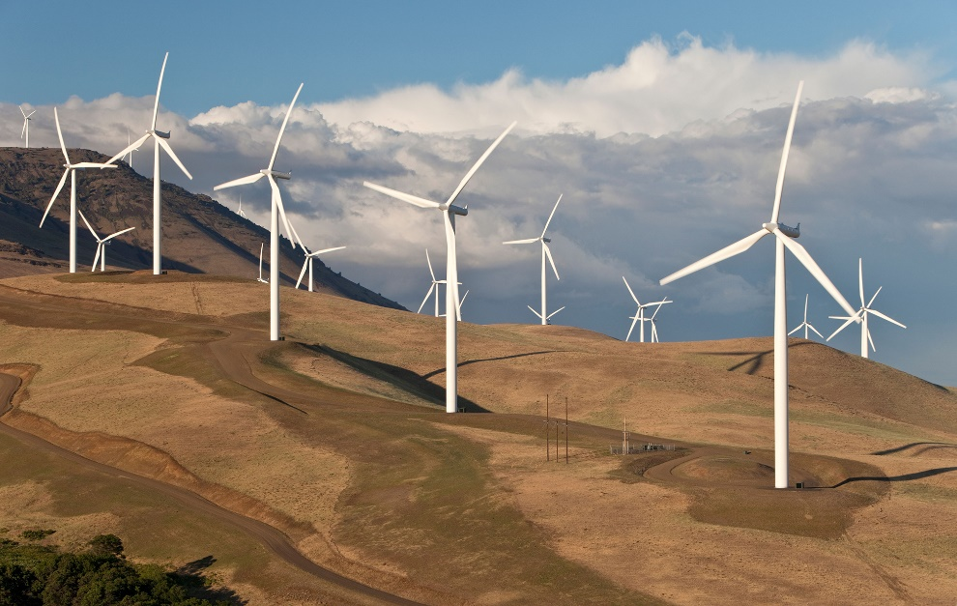
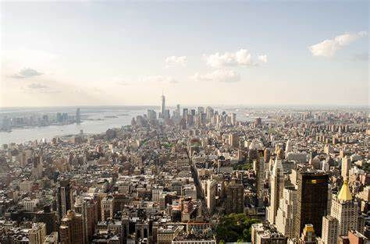
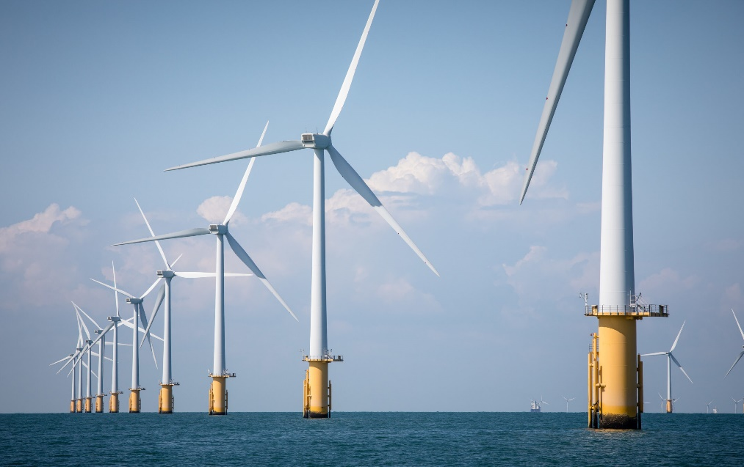
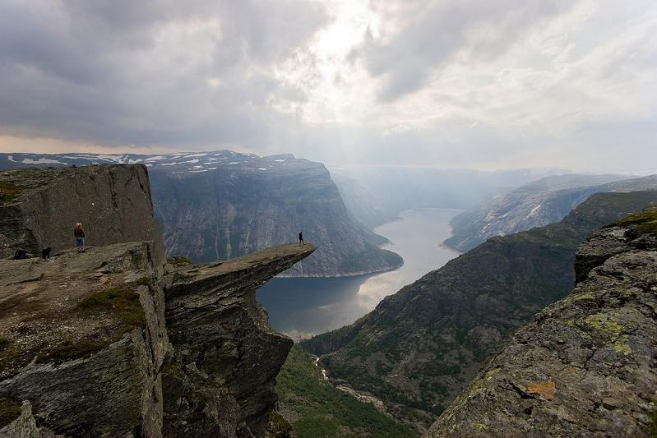
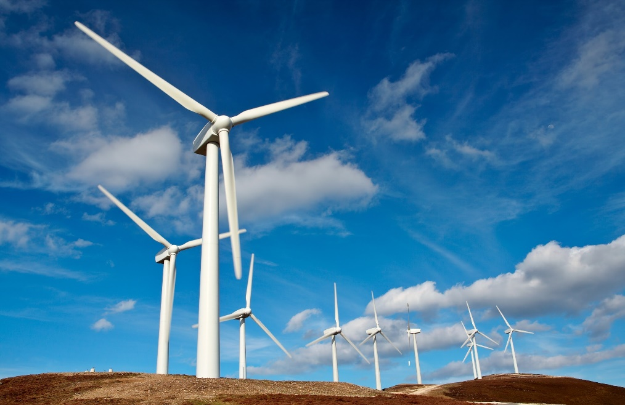
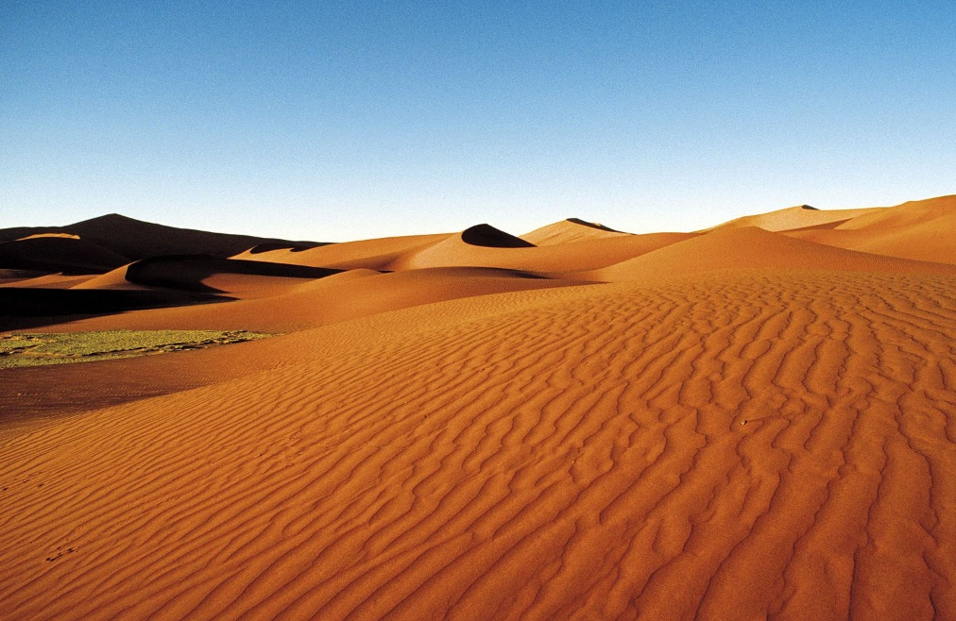
You can get inspired by looking at these pictures
Notes:
Sources: https://th.bing.com/th/id/R.cf01ae7779af262b63783b832d25c043?rik=6aXtW9gO1e90gQ&riu=http%3a%2f%2fcdn.ebaumsworld.com%2fmediaFiles%2fpicture%2f2146605%2f82592521.jpg&ehk=vTWLGpMZKGWYhT1EzorJhPh%2fMQpkOcBfGjl12DqmhYc%3d&risl=&pid=ImgRaw&r=0
https://pixnio.com/free-images/2017/10/27/2017-10-27-06-36-32.jpg
https://www.jacana.de/assets/data/_resampled/CroppedImage14001000-Bild27138.jpg
Copyright: © Will Rose / Greenpeace

Slide 12

Wind speed: Good vs. bad places
Challenge:
Team up in a group of 3-4 and think about where we can find more wind: at high places or at low places for example?
Think about examples too!
→ Look at your worksheet on page 14 and complete the allocation of good and bad wind locations!
Additional question for the quick ones:
Explain why a certain area is good and what makes a certain area bad

Slide 13

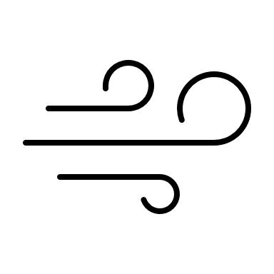
Wind speed: high places vs. low places
The wind speed increases with height because there is less friction from obstacles such as trees, buildings and the ground.
More movement means more wind!
Wind locations in high places, like mountains or exposed sites, are GOOD.
Wind locations in low places, like valleys (mountain or river valleys), are BAD.

Slide 14

Wind speed: open spaces vs. closed spaces
Wind speed is usually higher in open spaces, there are fewer obstacles (for example walls or buildings).
In closed spaces, structures create friction and disrupt airflow, which reduces wind speed.
Wind locations in open spaces, like deserts or open plains, are GOOD.
Wind locations in closed spaces, with trees or buildings, are BAD.

Slide 15
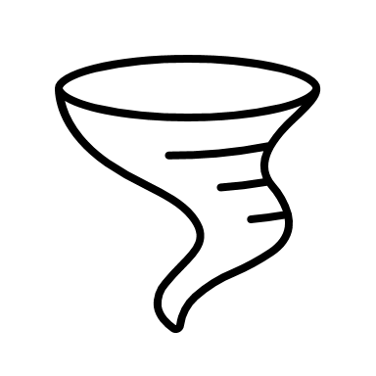
Wind speed: coasts, river banks vs. oceans
Wind speed is usually higher near coasts, riverbanks, and oceans because there are fewer obstructions like buildings or trees to disrupt airflow.
Wind locations near coasts, riverbanks, and oceans are GOOD.
Notes:
Source: https://www.nationalgrid.com/stories/energy-explained/onshore-vs-offshore-wind-energy

Slide 16
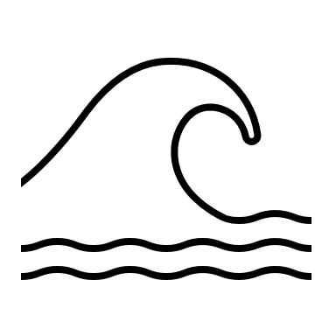

Where does wind blow? Sea & ocean breeze vs. land breeze
A breeze is a gentle wind that happens because of differences in temperature and pressure in the air. On coasts or banks, we observe two types of breezes.
Sea & ocean breeze: A sea breeze is a cool wind that blows from the sea to the land during the day due to the land heating up faster than the water.
Land breeze: During the night, cool wind blows from the sea to the land.
Sea & ocean breeze happens on day, land breeze happen at night!

Slide 17
Good wind locations: offshore wind turbines
Offshore wind power or offshore wind energy is the energy taken from the force of the winds out at oceans & sea, transformed into electricity and supplied into the electricity network onshore.
They are considered more efficient than onshore wind farms, thanks to the higher speed of winds, greater consistency, and lack of physical interference.
Notes:
Sources: https://www.nationalgrid.com/stories/energy-explained/onshore-vs-offshore-wind-energy
https://www.nationalgrid.com/stories/energy-explained/what-offshore-wind-power

Slide 18

Differences between onshore & offshore wind turbines
Location: While onshore wind turbines are built on land, often in open plains or mountainous regions, offshore wind turbines are located in the sea and ocean.
Energy Production: While onshore turbines have more variable wind patterns, offshore wind turbines have steadier winds.
Cost: Onshore wind turbines are significantly less expensive than offshore wind turbines
Notes:
Source: https://www.nationalgrid.com/stories/energy-explained/onshore-vs-offshore-wind-energy

Slide 19

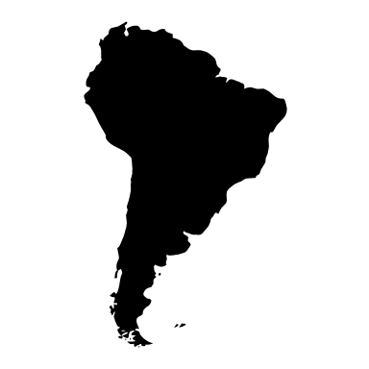
The wind atlas
The wind atlas shows wind conditions in a specific region (wind speed, direction, and energy potential).
It is based on weather data and models to predict long-term wind patterns.
It is used to find the best locations for wind turbines.
It supports planning and decision-making for renewable energy projects.

Slide 20
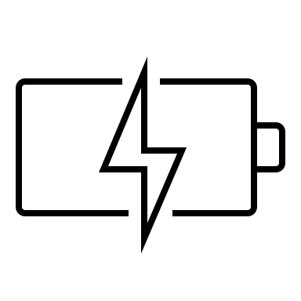
The wind atlas
The wind atlas uses average power density (W/m^2) and the speed of wind (m/s) as units to measure wind speed.
Let`s see what they mean:
Average power density (W/m²):
Measures energy available per square meter from wind.
Higher W/m² means more potential energy to generate electricity.
Wind speed (m/s):
Measures how fast the wind is blowing in meters per second.
Higher wind speed means more energy can be harvested by wind turbines.

Slide 21
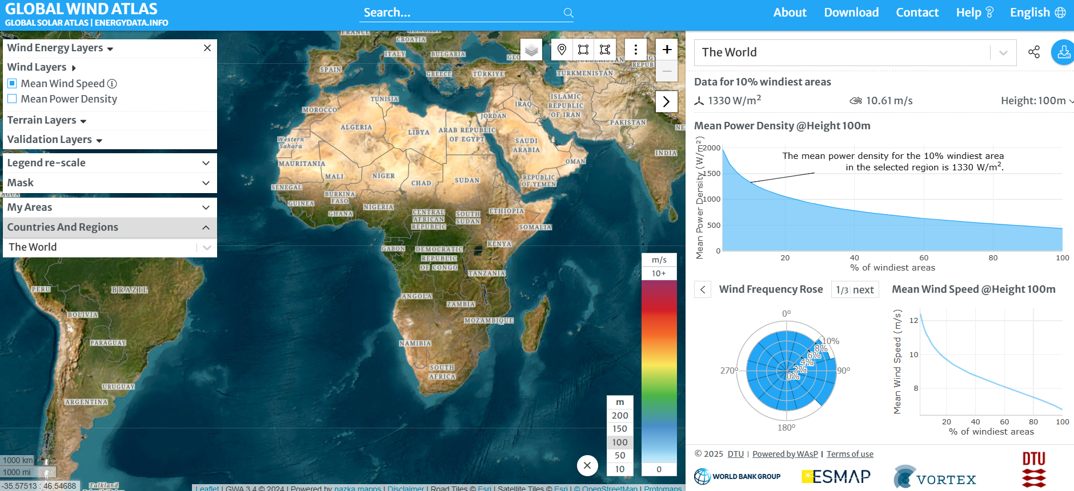
The wind atlas
This is a picture of the wind atlas. Visit the website and complete the challenge in your workbook on page 16, Task 1!

Slide 22


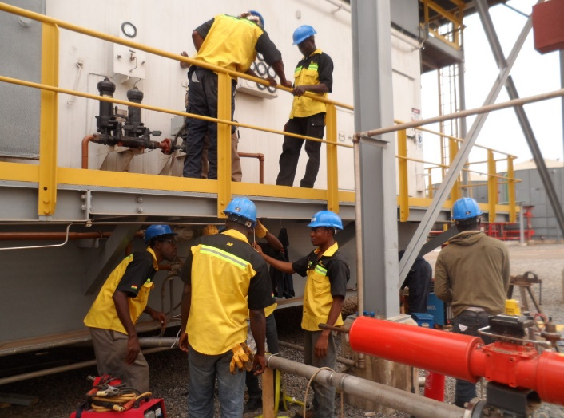

Wrap-up: stakeholders in wind energy
Last challenge for this chapter!
Look at your worksheet and complete the task 1 "Wind energy role play“ on page 17!
Who do you want to be?
local farmer government official engineer student
Notes:
Sources:
https://th.bing.com/th/id/R.165e40ad2e8015844434d94b97bbddc2?rik=sqfzrM4lRhQIyw&pid=ImgRaw&r=0
https://ghanaembassy.at/wp-content/uploads/2021/02/president.jpg
https://www.jnpengineeringgh.com/wp-content/uploads/2016/01/Electrical-instrumentation-works-on-the-turbine-and-pipeline-1144x858.jpg
https://th.bing.com/th/id/R.ced053f2c812ca086332d36d151b3b99?rik=AHxeHtUSoU9x6g&riu=http%3a%2f%2fsites.psu.edu%2fafr110%2fwp-content%2fuploads%2fsites%2f14793%2f2014%2f12%2fImage-3-.jpg&ehk=npu%2bvD8vpZRqF4VRGTW%2bMcFo6uvLGCRrMmTf%2fZAHCe8%3d&risl=&pid=ImgRaw&r=0

Slide 23
02
Measuring and working with wind
Learn about how to measure wind and understand how it can do work.

Slide 24
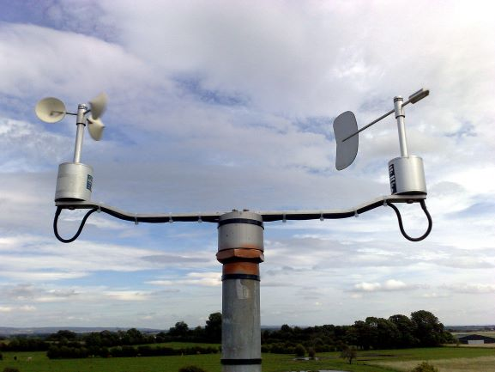
Measuring wind speed
What is wind speed?
Wind speed is the measure of how fast air is moving in a particular direction.
Why is wind speed important?
Faster wind generates more power
Consistent wind is key
Notes:
Faster wind generates more power The energy a wind turbine produces depends on the cube of the wind speed. For example, doubling the wind speed increases energy production by 8 times!
Consistent wind is key Turbines require steady winds to perform effectively

Slide 25
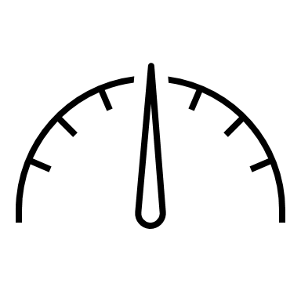
Measuring wind speed
What is wind measurement?
It is the process of determining the speed and direction of wind.
It is crucial for understanding where to place wind turbines for maximum efficiency.
Key concept: Faster and consistent winds mean more energy production!
Why is wind measurement important?
To determine the potential for wind energy in a specific location.
To understand how weather patterns affect energy production.
To ensure turbines are placed in the best locations for maximum energy generation.
Notes:
Why do we measure wind speed?
Energy Potential: Wind turbines work best in areas with strong, steady winds.
Example: Offshore wind farms benefit from consistent sea breezes.
Turbulence and Height: Wind is stronger and steadier at higher altitudes because it faces less resistance from obstacles like buildings or trees.
Did you know? Wind turbines are often taller than 100 meters to catch higher winds!
Safety: Measuring wind helps predict extreme weather conditions, ensuring turbines can be safely shut down during storms.

Slide 26
Measuring wind speed
Let's discuss about wind speed measurement
Please form a group of 3-4 students and discuss the following questions as a group. After 3 minutes, we will share our ideas to the class.
What would happen if we placed wind turbines in a location where the wind speed is too low or inconsistent? Would they generate enough electricity to power homes, schools, and hospitals?
If you had to test the wind speed around your school or home, how would you do it? Would guessing be enough, or would you need a tool to measure accurately?
Notes:
After letting the students discuss for a while, some texts for the teachers: We’ve seen that faster and consistent winds are critical for wind energy generation. But how do we know which areas have the right conditions? Scientists can’t just guess – they need accurate data. Tools like anemometers help measure wind speed and provide essential information. Without accurate data, it’s impossible to identify the best locations for wind farms and ensure they produce enough energy efficiently. For example, imagine trying to power an entire city with turbines placed in low-wind areas. Without these measurements, it would lead to wasted resources and failed projects. Fun fact: The world’s largest wind farms are located in places where scientists used anemometers to study wind speeds for years before starting construction.

Slide 27
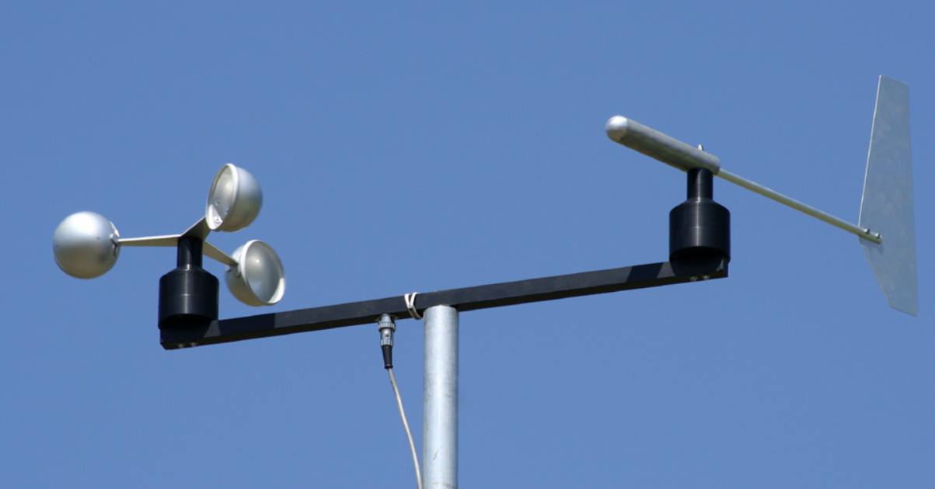
Measuring wind speed
Anemometer
How is wind measured?
Wind speed: Measured using an anemometer.
Wind direction: Measured using a wind vane.
Scientists and engineers use these measurements to determine:
the best locations for turbines.
how much energy a wind farm can produce.
Wind vane

Slide 28
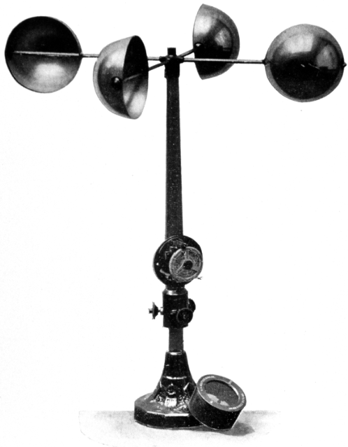
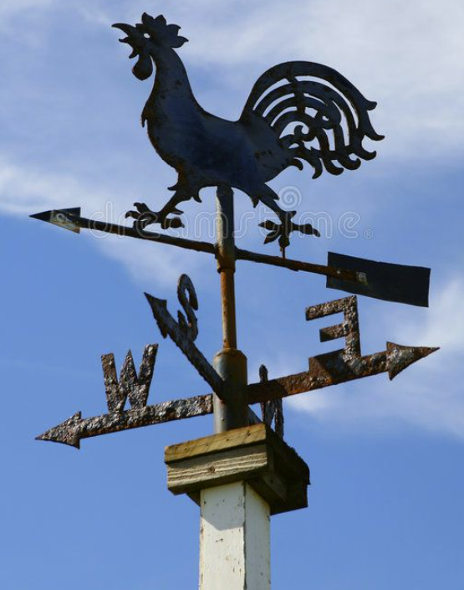
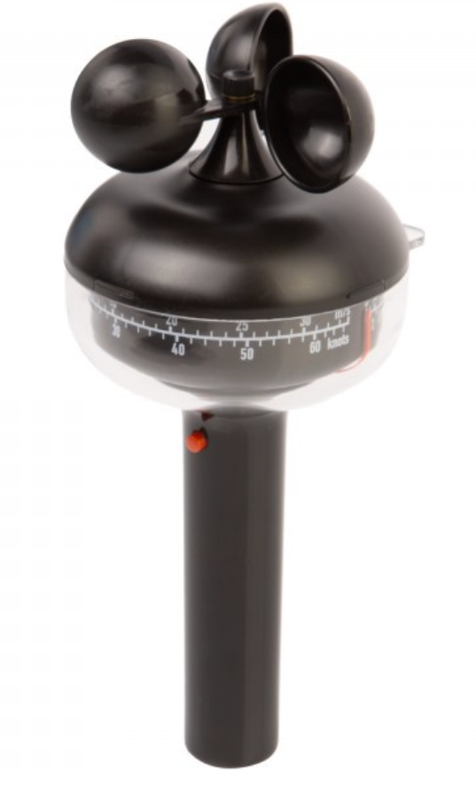
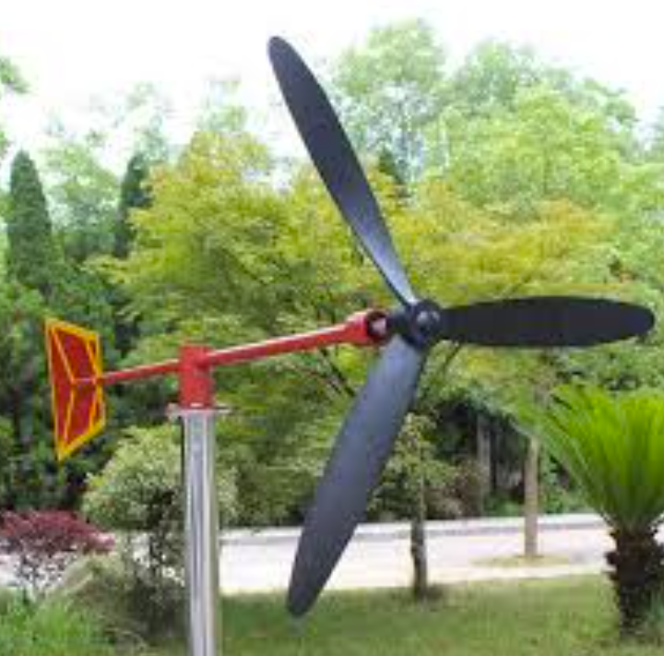
Different kinds of anemometer

Slide 29
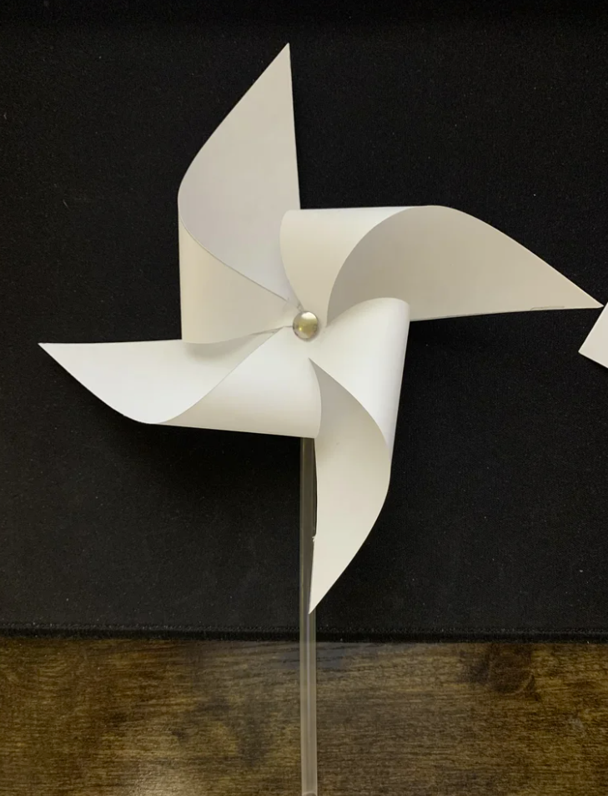

Challenge: making a paper wind rose
Please refer to the experiment on page 22 in the worksheet to make your own paper wind rose. Your wind rose should look like the image shown here. There’s also a video guide that can be followed.
Notes:
https://www.youtube.com/watch?v=HN0GxOQMzME&t=25s

Slide 30
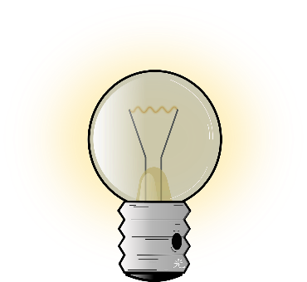
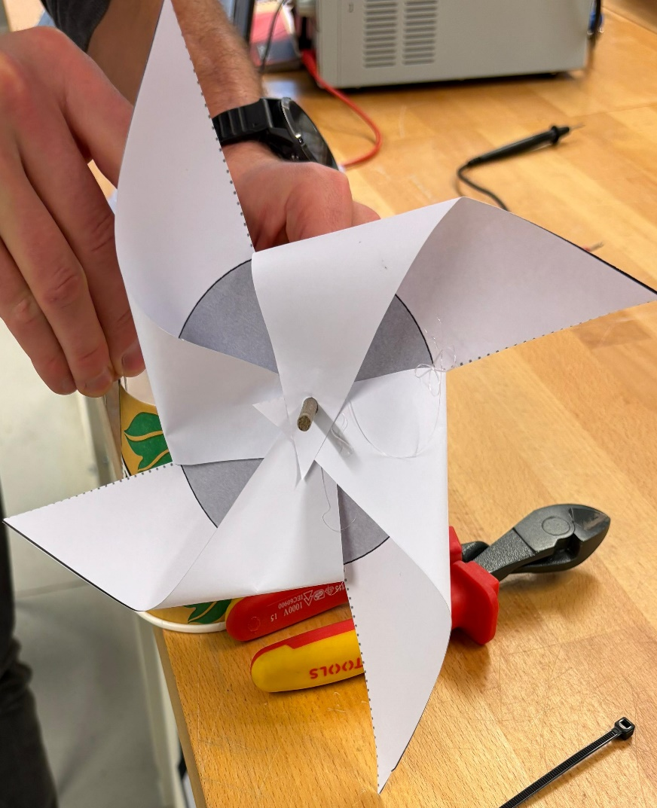
Measuring wind speed
Discussion:
Now that we each have our own windrose, think about how we can measure the wind speed using it. You can look into the handbook for reference.
Additional question for the quick ones:
In what unit can the wind speed be measured?

Slide 31
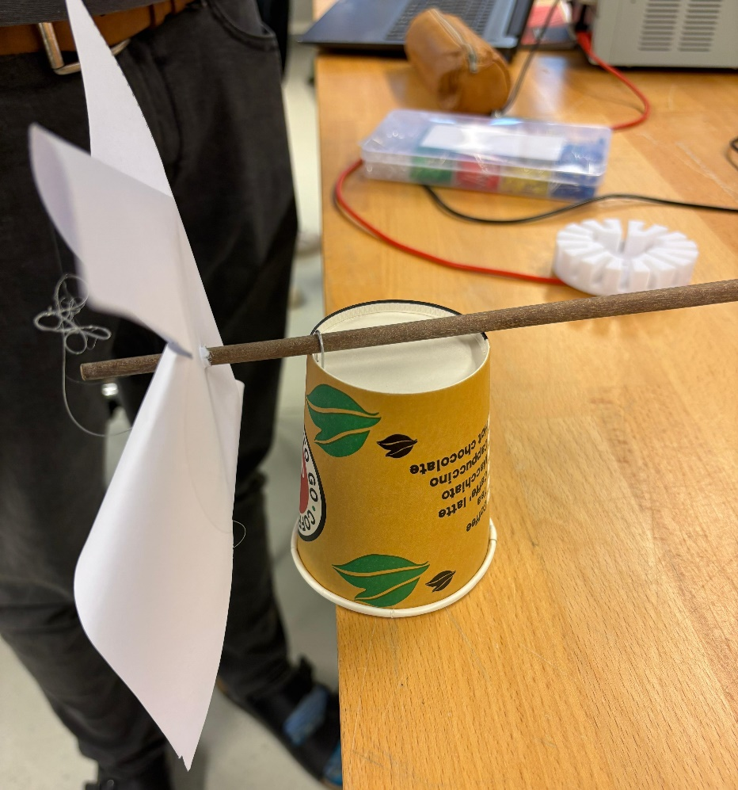
Challenge: Now that you have built the windrose, lets use it to measure the wind speed with the instructions mentioned in the worksheet on page 24.
Experiment: Measuring wind speed

Slide 32
Let's discuss
Task: Please form a group of 3-4 students and discuss the following questions as a group. After 3 minutes, we will share our ideas to the class
Was it difficult to measure wind speed?
Reflect on the experiment:
Did the windrose spin steadily, or did it stop and start?
What might make wind speed harder to record

Slide 33
Wind speed is difficult to measure
Wind is constantly changing:
The wind near a building can suddenly increase or decrease depending on how it flows around the structure.
Height affects wind speed:
A wind turbine on a tall tower captures more energy than one closer to the ground.
Turbulence:
This is especially important during storms when wind direction and speed change rapidly.
Local variations:
Wind behaves differently in open spaces, forests, cities, and along coastlines. These variations make it tricky to gather consistent wind speed data.
Notes:
Wind speed is not constant; it fluctuates over time due to variations in atmospheric pressure, temperature, and obstacles in its path.
Example: The wind near a building can suddenly increase or decrease depending on how it flows around the structure.
Wind is generally stronger and more consistent at higher altitudes because there are fewer obstacles (like trees and buildings) causing friction.
Example: A wind turbine on a tall tower captures more energy than one closer to the ground.

Slide 34
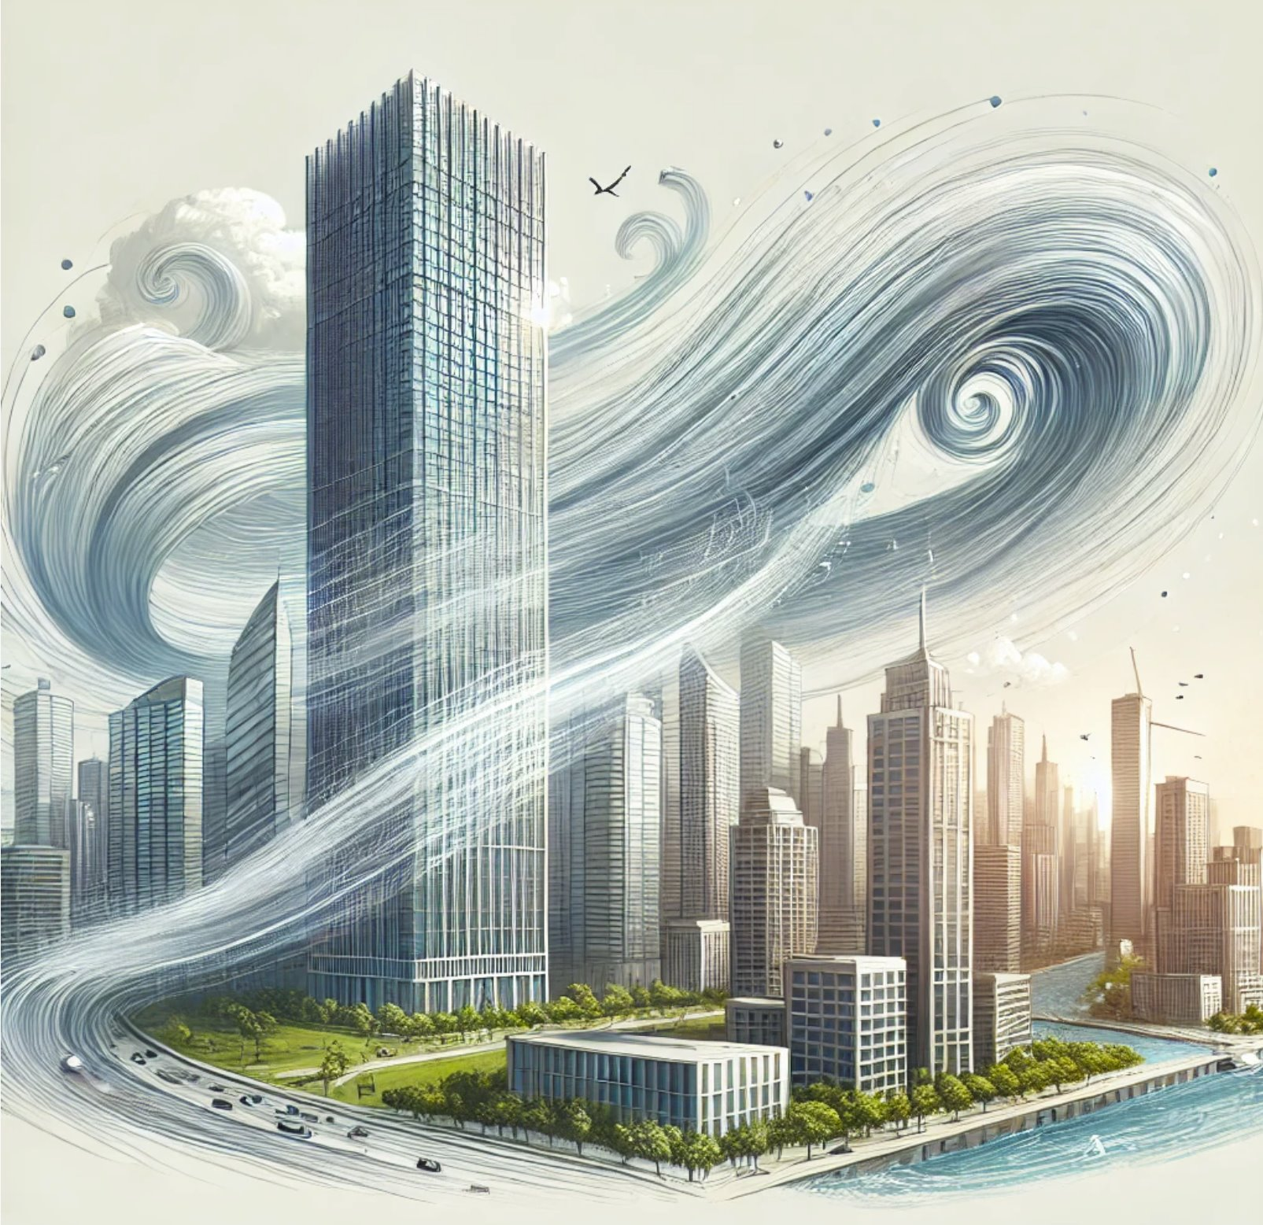
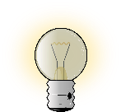
Turbulence
Turbulence refers to irregular, swirling wind patterns that occur when wind is obstructed or flows over uneven surfaces.
What causes it?
Obstacles
Changing wind directions
Temperature differences
Questions to think about:
Have you ever noticed how windy it gets around the corners of tall buildings?
Have you ever wondered why?
Notes:
Obstacles: Buildings, trees, and hills disrupt smooth wind flow.
Changing Wind Directions: When wind changes direction quickly, it creates chaotic patterns.
Temperature Differences: Uneven heating of the Earth's surface can create pockets of rising or falling air, adding to turbulence.
Question to think about:
This is due to turbulence created as the wind splits and swirls around the structure. Similarly, turbulence near wind turbines can reduce their efficiency by disrupting the steady flow of wind.

Slide 35
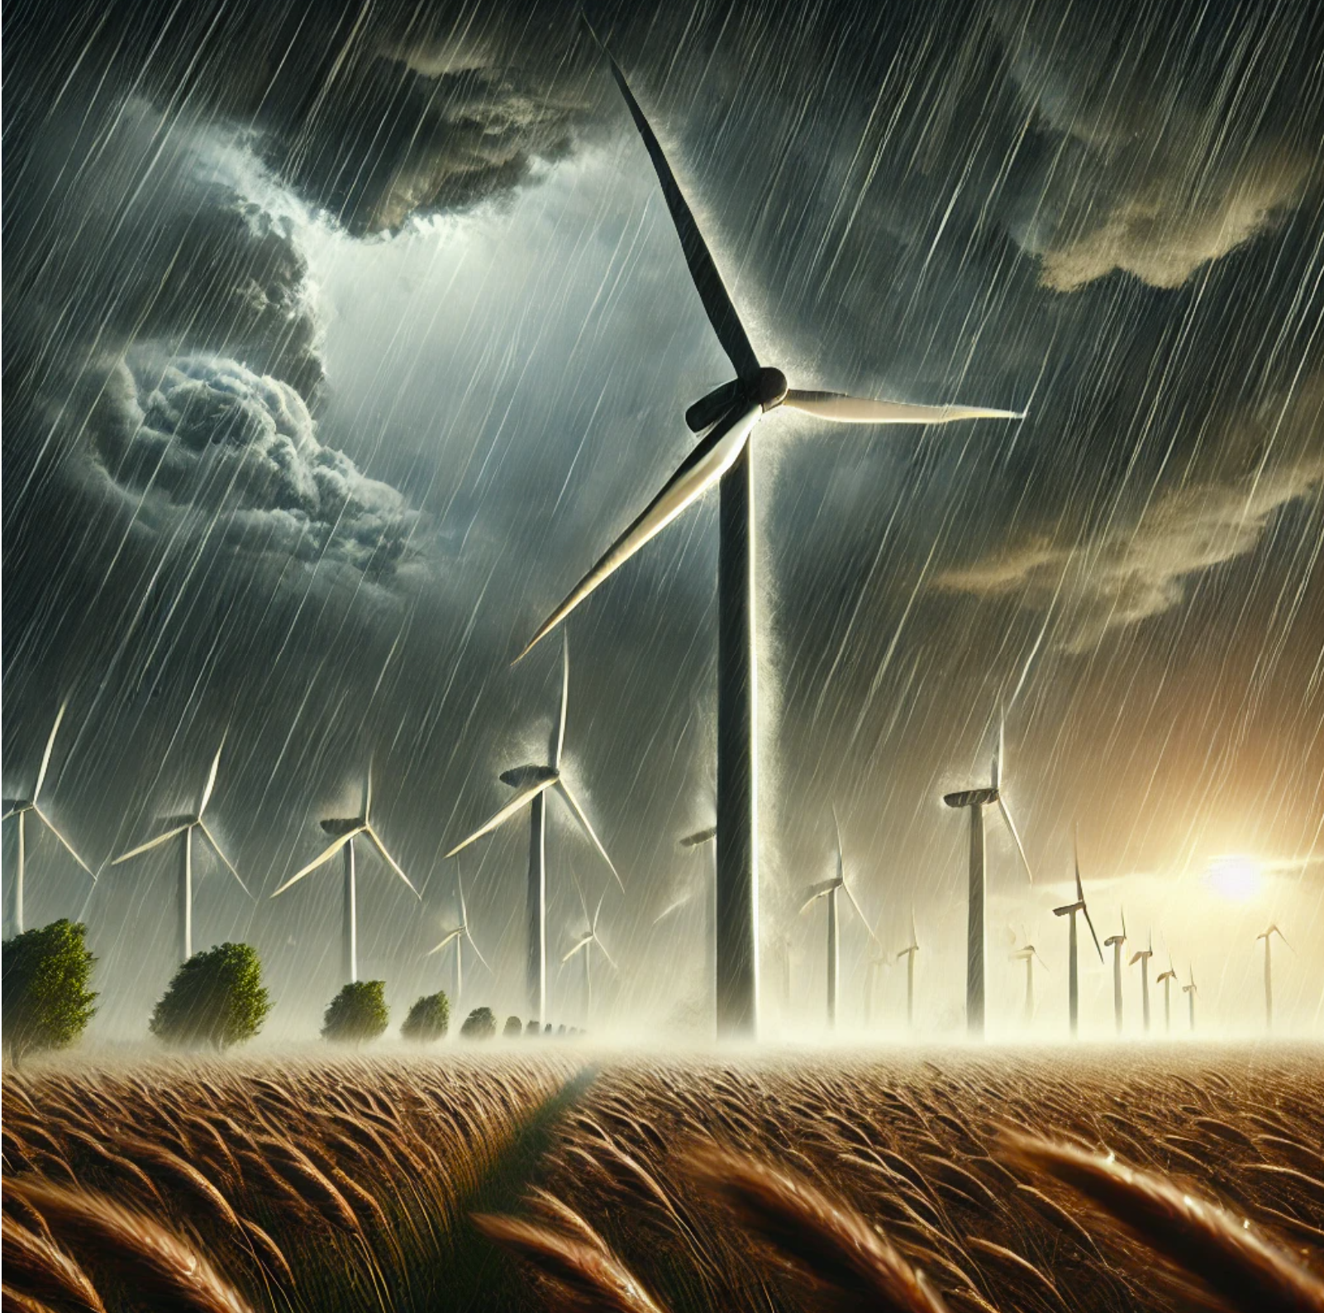
Storms
Storm winds
Wind speeds increase unpredictably, and directions can change rapidly.
This makes it challenging to maintain steady power generation from wind turbines.
Impact on turbines:
Strong gusts can damage turbine blades or structures if not designed to withstand high winds.
Turbines often have mechanisms to shut down during storms for safety.

Slide 36

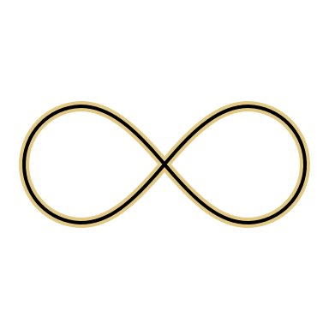

Why is wind a great energy source?
Renewable and clean: Wind will never run out, and it doesn’t pollute the environment.
Widely available: Found almost everywhere, especially on open fields, coasts, and mountains.
Cost-effective: Once a turbine is installed, wind energy is free to use.

Slide 37
Wind can do work
Challenge: We will carry out an experiment to see how wind energy can lift weights.
Please refer to your handbook on page 26.
Here we will use the anemometer that we have built in our previous experiment.

Slide 38
Wind can do work
Discussion:
After completing the experiment, please extrapolate the findings and think on how the speed of the wind affect the work done by the turbine?
Additional question for the quick ones:
Can the turbine lift heavier weights with stronger wind?
Note: Answering only yes or no for the second question is enough. We will soon discuss more on this topic.

Slide 39
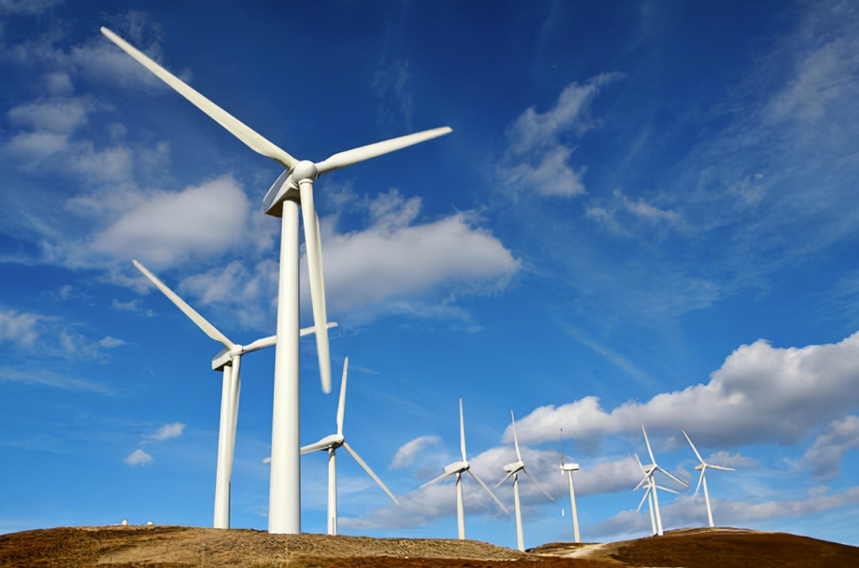
Harnessing wind to do work
What does it mean to harness wind?
Capturing wind's energy and converting it into useful work.
What is work in Physics?
Work happens when a force moves an object over a distance.
Wind applies force to turbine blades, making them spin and do work.

Slide 40
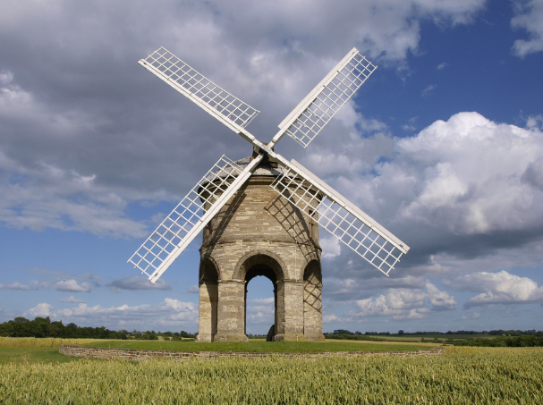
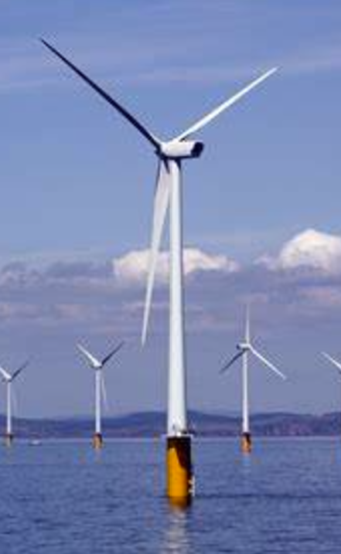
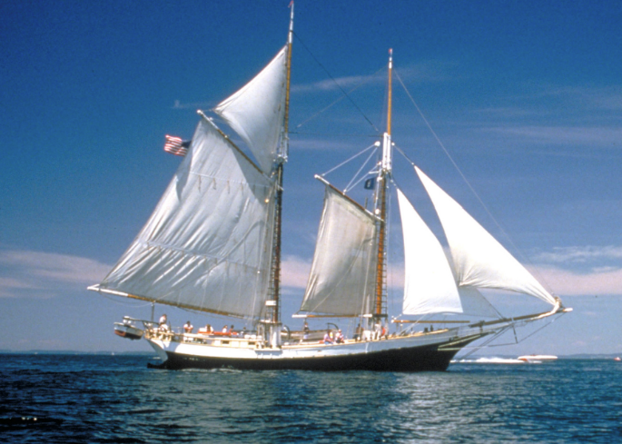
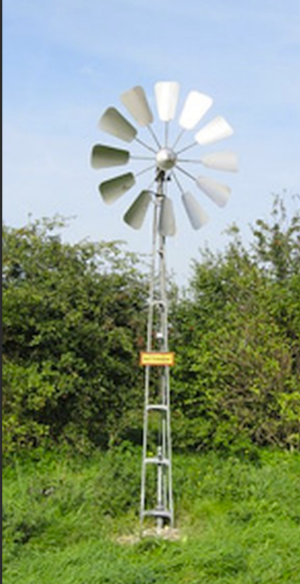
Real life example of wind doing work
Windmills: Used historically to grind grain or pump water.
Wind turbines: Generate electricity for homes, schools, and industries.
Sailboats: Wind pushes sails to move boats forward.
Wind-powered water pumps: Used in farming to bring water to crops.
Notes:
Windmills: Windmills:
Historically, windmills were one of the earliest uses of wind energy.
They were primarily used to grind grain into flour or pump water for irrigation.
Windmills are still seen in many rural and agricultural settings, symbolizing a time when wind was a vital part of daily life.
Wind turbines: Modern wind turbines convert wind energy into electrical energy.These turbines are essential in producing renewable energy for homes, schools, and industries.Offshore wind turbines, like the ones shown in the image, take advantage of strong and consistent winds over oceans.
Sailboats: Sailboats are another example of wind doing work in transportation.Wind fills the sails, propelling the boat forward and enabling travel and trade long before engines were developed.Even today, sailboats are used for recreation and eco-friendly transportation.
Wind-powered water pumps: These pumps are commonly used in farming to draw water from wells or bring water to crops.They are particularly useful in remote areas where electrical access is limited.This application demonstrates how wind energy can directly benefit small-scale, localized needs.

Slide 41
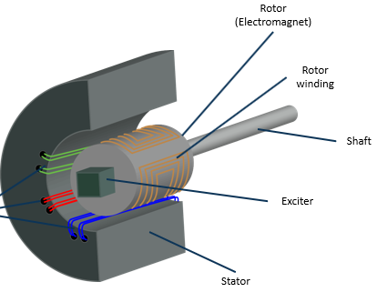
Wind can be used to spin a generator
Have you ever heard of a generator?
A generator is a machine that converts mechanical energy into electrical energy. Electrical energy powers many things we use daily (for example a light bulb).
Key Components of a generator:
Rotor: The rotating part of the generator connected to the turbine shaft.
Stator: The stationary part that contains wires or coils.
Magnetic field: Produces the force needed to create electricity.
Notes:
Start by asking the class, "Have you ever heard of a generator?" Then explain:
A generator is a machine that takes mechanical energy (like motion) and turns it into electrical energy.
This process powers most of the devices and equipment we use in our daily lives.
Explain Key Components:
Rotor: Highlight that this is the rotating part connected to the turbine shaft. The wind turns this part when the blades move.
Stator: The stationary part of the generator. It contains the wires or coils where electricity is produced.
Magnetic Field: Mention that the magnetic field is essential for creating the force that generates electricity inside the stator.

Slide 42
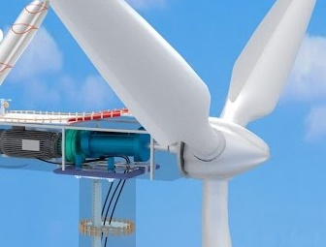
Wind can be used to spin a generator
How does a generator work?
It uses motion to create electricity (electromagnetic induction).
Electromagnetic induction: When a coil of wire moves through a magnetic field, it generates an electric current.
Process in simple steps:
Step 1: Wind turns the turbine blades.
Step 2: The rotating blades spin a shaft connected to the rotor.
Step 3: The rotor moves inside the stator, creating an electric current using electromagnetic induction.
Notes:
Explain How It Works:
A generator works using a principle called electromagnetic induction.
This means when a wire coil moves through a magnetic field, it produces an electric current.
Reinforce that generators rely on external energy sources (like wind or motion) to produce electricity; they don’t create energy on their own.

Slide 43
Wind can be used to spin a generator
Now that we understand what a generator is and how it works, let’s see how wind can power it.
The blades drive a shaft, which connects to the generator, transforming wind energy into electricity
Energy transformation along the way:
Wind energy (kinetic): Wind makes the blades spin.
Mechanical energy: The shaft rotates.
Electrical energy: The generator produces electricity.
Please remember: Generators are not sources of energy. They transform energy that is already available (like wind or motion).
Notes:
Explain How It Works:
A generator works using a principle called electromagnetic induction.
This means when a wire coil moves through a magnetic field, it produces an electric current.
Reinforce that generators rely on external energy sources (like wind or motion) to produce electricity; they don’t create energy on their own.

Slide 44
How is wind captured?
Via wind turbines:
Wind flows over the blades, causing them to spin.
This spinning motion transfers energy to the rotor.
Energy transformation along the process
1. Kinetic energy: Energy in moving air.​
2. Mechanical energy: Blades spinning to drive a shaft.​
3. Work output: Tasks like lifting weights, pumping water, or generating electricity.

Slide 45

Is the speed of the wind turbines good enough?
Discussion:
Think about the following question individually:
Imagine trying to generate electricity with a slow-spinning bicycle wheel. If we tried to connect this wheel to a generator to create electricity, would it be able to produce enough energy?
Additional reflection:
Relate this slow-spinning bicycle wheel to wind turbines, where the blades rotate based on wind speed.
→ Gentle winds cause slower blade rotation.

Slide 46
Is the speed of the wind turbines good enough?
Generators need a high rotational speed to efficiently produce electricity.
Slower spinning may not create enough mechanical energy to convert into electricity.
Therefore, the speed of the wind turbine’s blades is crucial for producing electricity.
This brings us to a big challenge: Wind turbines naturally spin slowly, but generators need to spin fast to produce electricity. How can we address this challenge?
Let’s find out about this in the next slide.

Slide 47
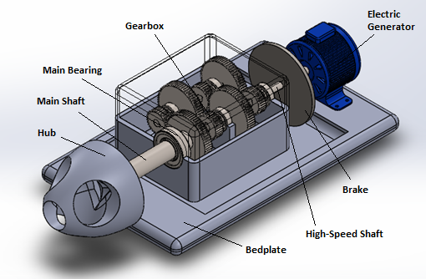
Turbines need gearbox
A gearbox is a mechanical device that changes the speed and torque of a rotating system. It uses a series of gears to transfer energy from one rotating part to another.
Purpose of a gearbox:
→ To increase or decrease rotational speed.
→ To adjust torque (force) as needed for a specific task.
Where are gearboxes used?
Commonly used in cars, bicycles, industrial machines, and wind turbines.

Slide 48
How does a gearbox work?
Basic principle: A gearbox works by combining gears of different sizes to adjust speed and torque.
How it works:
Input gear: Receives energy from the source (e.g., wind turbine blades).
Output gear: Transfers adjusted speed and torque to the next system (e.g., generator).
Gear ratio: Determines how much the speed or torque is increased or decreased.
High gear ratio: Increases speed, reduces torque.
Low gear ratio: Reduces speed, increases torque.
Example: In bicycles, pedaling a smaller gear at the front and a larger gear at the back makes it easier to climb a hill (more torque, less speed). Conversely, a larger gear at the front and a smaller gear at the back increases speed on flat surfaces (more speed, less torque).

Slide 49
How gearboxes solve the wind turbine speed problem
The problem: Wind turbine blades rotate slowly due to their large size and low wind speeds, but generators need high-speed rotation to produce electricity.
The solution with a gearbox:
- A gearbox connects the low-speed turbine shaft to the high-speed generator shaft.
- It increases the rotational speed of the shaft, making it compatible with the generator’s requirements.
Process in simple steps:
- Low-speed input: The turbine blades turn the input shaft slowly.
- Gearbox adjustment: The gearbox increases the rotational speed using a high gear ratio.
- High-speed output: The output shaft rotates quickly enough to drive the generator and produce electricity.

Slide 50
Generators and gearbox
Challenge: Please refer to your handbook on page 28 and 29 for a short quiz to test your knowledge on generators, gearboxes and their implication in wind turbines.

Slide 51
03
Airfoils
Learn about airfoils, their shape, and how this helps explain wind blade movement.

Slide 52
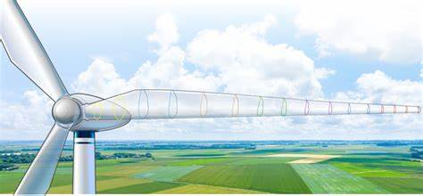
Learning about airfoils
Airfoils are specially shaped structures, like wings or blades, designed to generate lift or reduce drag when air flows over them.
Side note: What is drag?
The force on an object that resists its motion through a fluid is called drag.
When the fluid is a gas-like air, it is called aerodynamic drag or air resistance.
Notes:
Sources Pictures:
Airfoils, Where the Turbine Meets the Wind | Department of Energy

Slide 53
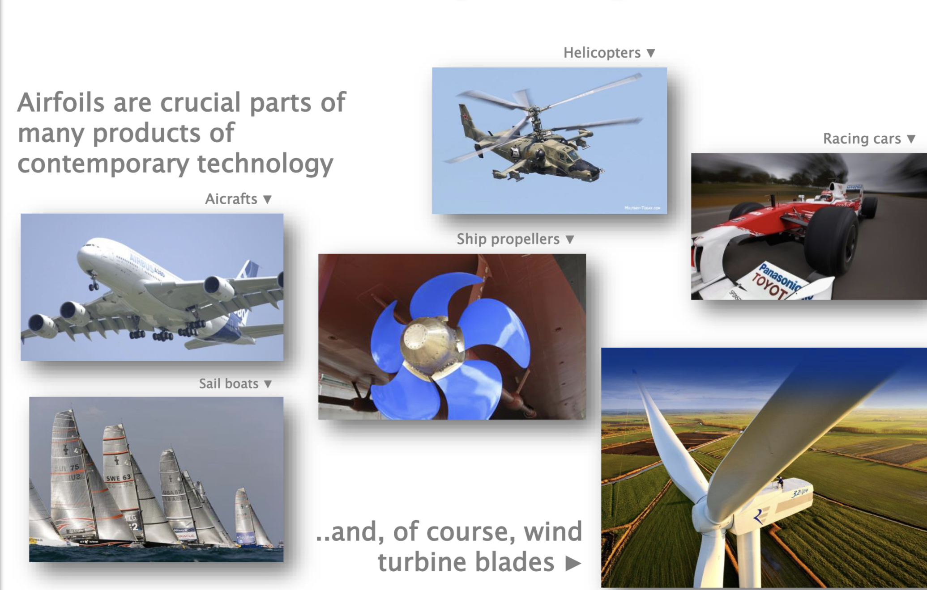
Learning about airfoils
Notes:
Sources Pictures:
Airfoils, Where the Turbine Meets the Wind | Department of Energy

Slide 54
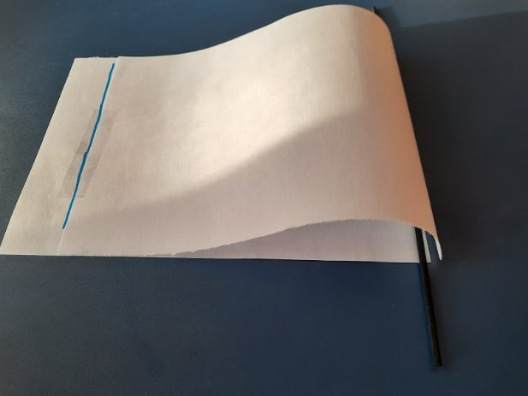
Learning about airfoils
Challenge:
Look at your worksheet on page 32 and build your own airfoil. Take a look at the task "Let‘s make an airfoil"! Also do not forget the questions on page 34.

Slide 55
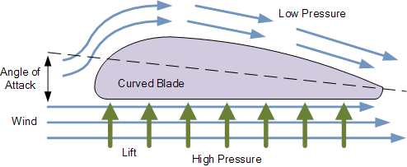
The magic behind an airfoil
The airfoil lifts, when you blow on top of it!
Why?
The airfoil lifts because of the pressure difference:
Faster air over the top surface so the pressure on top is decreased.
This means higher pressure on the bottom.
As a higher pressure always pushes, the airfoil goes up.
→ The blade of a wind turbine should have this specific shape
Notes:
Sources Pictures:
Animation: How Wind Turbines Work

Slide 56
Bernoulli's Principle
Did you know? This is also the principle of an airplane!
What is the Bernoulli's Principle?
The Bernoulli Principle explains how airflow over the curved blades of a wind turbine creates differences in pressure.
Lower pressure on the top of the blade and higher pressure below generates lift.
In wind turbines, this lift causes the blades to rotate around the hub, converting wind energy into mechanical energy.
The rotation of the blades is essential for producing electricity through a generator inside the turbine.
Why do we need it?
This principle helps maximize the efficiency of wind turbines by capturing more energy from the wind.
Notes:
Sources Pictures:
Animation: How Wind Turbines Work

Slide 57
Factors influencing the power output
Think about what other factors could influence the output of power of a wind turbine?
Take some notes in the worksheet!
Wind speed: Faster wind means more power.
Blade size: Longer blades catch more wind.
Blade shape: Curved blades, like airplane wings, work best.
Height: Taller turbines reach stronger winds.
Wind consistency: Steady winds are better than gusty ones.
Machine parts: Clean, well-working parts make more power.
Notes:
Sources Pictures:
Animation: How Wind Turbines Work

Slide 58
04
Experiments with a wind turbine
Familiarize yourself with the wind turbine kit and try out different configurations.

Slide 59
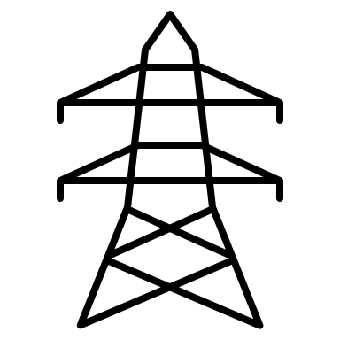

Excurse: measurement of power
To see the difference in the direction of wind, we are measuring the power output of the wind turbine in the following experiments. Therefore, we are using a multimeter to measure power, or to be more precise the voltage of the wind turbine (see worksheet on page 38 onwards).
Why do we use voltage instead of power to measure the output of the wind turbine?
Power = is the energy produced or consumed over time, typically measured in watts (W)
Voltage = acts like the "pressure" in an electrical circuit, indicating how strongly electricity is pushed through wires.
→ When a wind turbine generates more power, the voltage usually increases.
This relationship makes voltage a reliable way to estimate power output.
Notes:
Source: https://th.bing.com/th/id/OIP.dzhxLSfosp7s2vYOYskNAwAAAA?rs=1&pid=ImgDetMain

Slide 60

Direction of wind
Definition:
Wind direction tells us where the wind is coming from.
Imagine a river: Wind is like an invisible river of air.
Just like a river pushes water in one direction, the wind
moves air in a specific direction.
Example: If the wind blows from the east, the air comes from the east and moves towards the west.
Notes:
Source: https://www.wikihow.com/images/thumb/9/94/Determine-Wind-Direction-Step-10.jpg/aid8805106-v4-728px-Determine-Wind-Direction-Step-10.jpg

Slide 61

Direction of wind
Challenge:
Take a look at your worksheet on page 42 and try to identify, which direction of wind has the most power regarding to the pictures.
What do you observe?
Notes:
Source: https://th.bing.com/th/id/OIP.dzhxLSfosp7s2vYOYskNAwAAAA?rs=1&pid=ImgDetMain

Slide 62

Direction of wind
Finding: Direct wind has more power!
Imagine you are running against the wind. It feels harder than running with the wind pushing you from behind. That’s the power of direct wind.
And look at the picture: The direct wind affects the
trees most!
Now we will measure the power of direct wind,
angled wind (45°) and strongly angled wind (90°)
with our wind kit (page 43).
Notes:
Source: https://thumbs.dreamstime.com/z/image-windy-day-trees-cloud-blowing-wind-cartoon-windy-day-trees-cloud-blowing-wind-110475663.jpg

Slide 63


Angle of attack
As operator for your wind turbine, your aim is to generate as much energy as possible!
In previous chapters you learned about the airfoils and now did experience the impact of different wind directions or angles!
The angle of attack describes the angle at which the wind “meets” the turbine blade.
Hence the correct angle is of great importance for improving efficiency and operating at maximum power point!

Slide 64

Angle of attack
Now! Conduct the short Challenge in your worksheet!
Which part do you think is crucial, such that your wind turbine can “find” the right angle?!
Take a look into your worksheet on page 46 and mark the pictures as described in the task.
Notes:
Source: https://th.bing.com/th/id/OIP.bR1Vsk264RbyCOG4OTaauQHaFj?rs=1&pid=ImgDetMain

Slide 65

The usage of a tail fin
We make a wind turbine align towards the wind by the usage of a tail fin!
Why does this happen?
Imagine you are standing outside holding
a large flag in a strong wind. If you rotate
your body sideways to the wind, the flag will flap and resist you.
However, if you turn such that the flag faces directly the wind, it straightens out smoothly.

Slide 66

The usage of a tail fin
The tail fin works by using the force of the wind itself.
When wind hits the tail fin from the side, it creates a turning force, which causes the turbine to rotate.
Effect: Turbine moves to reduce drag on tail fin. Now the turbine faces the direct wind again!
Challenge: Test your knowledge in the worksheet!
Look at page 47. After that try to find solutions for the first recap-quiz on page 49.
tail fin
tail fin in use = vertically oriented
tail fin "not usable" = horizontally oriented
Notes:
Source: https://th.bing.com/th/id/OIP.bR1Vsk264RbyCOG4OTaauQHaFj?rs=1&pid=ImgDetMain

Slide 67

Change blade pitch
Blade pitch is the angle between the plane of rotation of the wind turbine and the blade itself. Adjusting this angle allows the turbine to control how much wind energy is captured by the blades.
If the blade is too angled, we face power drops.
Why? The amount of the wind that blade is exposed to determines how much energy the turbine can capture. The right angle helps the blades spin faster and generate more energy.​
Do the challenge in the worksheet on page 50!
Notes:
Source: https://th.bing.com/th/id/OIP.bR1Vsk264RbyCOG4OTaauQHaFj?rs=1&pid=ImgDetMain

Slide 68

Change blade length
Blade lengths affect how much wind is captured by the wind turbine. It is important to have an ideal length for the turbine.
Longer blades usually provide more power.
However, it does not necessarily mean larger blades always provide the highest power.
Do the challenge in the worksheet on page 52!
Notes:
Source: https://th.bing.com/th/id/OIP.bR1Vsk264RbyCOG4OTaauQHaFj?rs=1&pid=ImgDetMain

Slide 69
Heavy blades – why does weight matter?
Blade weight affects the turbine's ability to start spinning, the amount of energy transferred to the generator, and the efficiency of power production.
Heavy blades have higher inertia. This makes them harder to start spinning and requires stronger winds to overcome their resistance.
Heavy blades can handle strong winds better and remain stable whereas light blades are more efficient at low wind speeds but may struggle in turbulent conditions.
Heavy blades spin slower and produced lower voltage, especially at low wind speeds.
Heavier blades consume more wind energy just to get moving, leaving less energy to generate electricity.
Notes:
Heavy blades in wind turbines play a critical role but come with trade-offs. First, heavier blades require more wind energy to overcome their inertia and start spinning. However, once spinning, their greater momentum provides stability, especially during fluctuating wind speeds. On the downside, these blades are less efficient in low wind conditions as they require more energy to move. Lastly, the added weight places extra stress on turbine structures, including towers and hubs, which must be built stronger and more durable to handle these forces. Engineers must carefully balance these factors when designing efficient and durable wind turbines.

Slide 70

Why does weight matter? → Inertia
Inertia is the resistance of an object to changes in its motion.
Heavier objects have more inertia, meaning they need more force to start moving or stop moving.
Example: A car at rest needs more force to start moving than a bicycle.
This concept can be extrapolated to wind turbines. Heavier blades need more force to overcome drag.
Look around you for objects that differ in weight. Is it easier to push the table or slide a notebook? Which activity would require more force?
Notes:
Explain that inertia plays a role in all motion, including wind turbines and relate it to daily life by asking students to imagine pushing heavy vs light object. Also link this concept to blades of wind turbines: heavier blades have more inertia, requiring more energy to start moving

Slide 71


Real world application of blade weight
Real-world examples of blade design:
Offshore wind turbines often use heavier blades for stability.
Lightweight composite materials (e.g., carbon fiber) are used to make blades lighter yet strong.
Blade weight affects where turbines can be installed (e.g., high-wind vs. low-wind areas).
Offshore wind turbine: heavy blade
Onshore wind turbine: light blade
Notes:
In real-world wind turbines, blade weight plays a crucial role in their efficiency and performance. For example, heavier blades, while requiring more energy to start spinning, offer smoother and more stable rotation in high winds, making them suitable for offshore wind farms. However, they add stress to the turbine's structure, demanding strong towers and robust designs to handle the load.
Innovative materials like carbon fiber are often used in modern turbines because they strike the right balance between strength and lightweight properties, enhancing efficiency and durability. The choice of blade weight also depends on location: lighter blades are ideal for areas with low wind speeds as they require less energy to start spinning, while heavier blades perform better in regions with consistent high winds. This is why engineers carefully consider both material and location when designing wind turbines, ensuring optimal energy production and durability in different conditions.

Slide 72
Is there a minimum speed to start the blades spinning?
Discussion:
Think about the following question individually:
Is there a minimum speed (cut-in speed) needed to start spinning the blades?
If the wind is strong enough, light blades spin quickly, and heavy blades spin slower.
If the wind is not strong enough, then the blades would not spin at all.
So, yes there is a minimum speed needed to start spinning the blades.
To overcome drag/resistance, there is a minimum speed to start the blades spinning.
Notes:
Explain the concept of "cut-in speed"—the minimum wind speed needed to start generating power—and its importance in designing turbines for different wind conditions.

Slide 73

Changing number of blades
Have you ever wondered about the role of number of blades in a wind turbine? What would happen if there were only two blades? Can a wind turbine have 10 blades?

Slide 74



Changing number of blades
Challenge: Let's refer to the worksheet on page 54 and we will carry out the experiment related to the number of the blades in a turbine.

Slide 75

Impact of blade numbers on turbine performance
Efficiency & energy capture: More blades capture more wind but may reduce rotational speed due to increased drag.
Start-up speed: Fewer blades start spinning faster but are less efficient at capturing wind energy.
Design trade-offs: Blade numbers balance efficiency, stability, and cost.
Standard configurations: Most turbines use 3 blades for an optimal compromise.
Notes:
Blades are one of the most critical components of wind turbines, and the number of blades directly impacts their performance. More blades can capture more wind energy but often reduce rotational speed due to the drag they create. Conversely, fewer blades can start spinning faster, making them suitable for low-wind areas, but they capture less energy overall.
Engineers aim to find the perfect balance between efficiency, stability, and cost. While you might think more blades are always better, they can increase manufacturing costs and structural complexity. This is why the majority of modern wind turbines are designed with three blades, as this configuration maximizes efficiency and stability while minimizing cost and structural stress.

Slide 76

Discussion: your time to shine!
If you were designing a wind turbine, how would you decide the number of blades to use?
What factors would you prioritize (cost, efficiency, stability, wind speed in the region)?
Procedure: The students will be divided into 4 groups. Each group will advocate for one of the 4 factors as the most important when deciding the number of blades for a wind turbine.
Activity Rules:
  Each group will have 15 minutes to discuss and prepare their arguments.
  Each group will then present their case for 2 minutes.
  The class will vote on which factor they believe is the most critical.
  You are not allowed to vote for the factor you spoke for. Be fair and vote for the one that you are most convinced about.
Notes:
To make this topic more interactive, we'll engage in a group debate. I've divided you into four groups. Each group will champion one key factor influencing the number of blades on a wind turbine: cost, efficiency, stability, or regional wind speed. Your goal is to convince the class why your factor is the most important.
Take the next 15 minutes to brainstorm your arguments and assign roles within your group. Afterward, each group will present their case in 2 minutes. Once all presentations are complete, we’ll vote as a class on which factor holds the most weight. The winning group gets bragging rights as the ultimate wind turbine designers!
After the activity, we'll reflect on how prioritizing one factor might lead to trade-offs in other areas and how engineers balance these factors in real-world applications.

Slide 77

Finding the balance
Blade weight:
  Heavier blades store more momentum but require higher wind speeds to start.
  Lighter blades spin faster and are efficient in low wind speeds but may lack stability.
Number of blades:
  Fewer blades (1–2): Lower cost, faster spin, but less stability and efficiency.
  Standard three blades: Optimal balance of efficiency, stability, and cost.
  More blades (4+): Increased stability but reduced efficiency due to drag.
Key takeaway:
  Wind turbine design is about optimization.
  Engineers balance weight, number, and environmental factors to create the most efficient turbines for specific needs.
Notes:
To conclude, what we’ve learned today is that designing wind turbines is a complex balancing act. Blade weight and number are interconnected. Lighter blades might spin faster in low winds, but heavier blades are more stable and store more energy once moving. Similarly, fewer blades can reduce costs and allow faster startup, but three blades are generally the best for capturing wind energy efficiently while maintaining stability.
Ultimately, there’s no one-size-fits-all approach. Engineers have to assess environmental conditions, such as wind speed, along with economic factors, like cost, to make the best decisions. What’s critical to remember is that every decision in turbine design links back to the goal of optimizing performance for specific situations.

Slide 78

What happens with a wind turbine with only one blade?
Challenge: It`s time for an experiment!
Take a look into your worksheet on page 57 and figure out, how the wind turbine is moving with...
One-blade turbine
Three-blade turbine
Try to find explanations for your observations!

Slide 79

What happens with a wind turbine with only one blade?
Answer:
The turbine spins still with just one blade, BUT the system is highly unbalanced! With just one blade has a totally different movement dynamic. It moves in a pulsating way, not continuously.
This means more stress on the wind turbine, which causes instability.
Therefore, three blades are the best solution for a stable and efficient wind turbine system!
Watch the following video to get a better understanding:
Notes:
YouTube-Link: Why do (most) Wind Turbines have 3 blades? - YouTube

Slide 80

Three blades on a turbine = three reasons
Balance: Three blades create symmetry, reducing vibrations and stress on the turbine.
Efficiency: They strike the perfect balance between capturing wind energy and minimizing drag.
Practicality: Fewer than three blades compromise stability; more increase weight and cost without significant efficiency gains.
Notes:
Three blades are commonly used because they optimize the turbine's performance. Symmetry reduces vibrations, making the structure more stable and durable. This balance also allows turbines to achieve high efficiency without the drawbacks of excessive drag or unnecessary weight. Engineers consistently find this configuration to be the sweet spot for performance and cost-effectiveness.

Slide 81
Real-world implications of turbine design
Cost efficiency:
  Fewer blades = lower manufacturing costs and less material.
  Balance between cost and energy output ensures profitability.
Adaptation to environment:
  Coastal areas with high winds: Heavier blades for stability.
  Low-wind regions: Lighter blades for faster startup.
Sustainability:
  Lightweight, durable materials like carbon fiber reduce environmental impact.
  Maximized efficiency reduces the number of turbines needed.
Technological innovations:
  Advanced materials and designs optimize blade weight and shape.
  Wind turbines tailored for offshore and onshore applications.
Notes:
In the real world, blade design has profound implications for the cost, performance, and sustainability of wind turbines. Engineers must balance the number and weight of blades with the cost of manufacturing. Fewer blades mean lower costs, but too few might compromise stability and efficiency.
Turbines are also adapted to specific environments. Heavier blades are better suited for high-wind areas, such as offshore locations, where stability is key. In contrast, lighter blades are ideal for low-wind regions where quick startup is essential.
Sustainability is another critical factor. Modern turbines use lightweight, durable materials like carbon fiber to minimize their environmental impact. By maximizing efficiency, fewer turbines are needed to generate the same amount of energy, further reducing ecological footprints.
Finally, technological advancements in materials and designs continue to push the limits of what’s possible, ensuring turbines are tailored to meet the unique demands of offshore and onshore applications.

Slide 82
Could we optimize wind turbines with MPP?
Concept:
  Maximizing power point (MPP) is the point where a wind turbine generates the highest possible power output under given wind conditions.
Key factors:
  Wind speed
  Blade angle (pitch)
  Rotor speed
Why it’s important:
  Ensures the turbine operates efficiently, maximizing energy capture.
  Avoids energy loss due to underutilization or overloading.
Notes:
The Maximum Power Point (MPP) is the sweet spot where a wind turbine extracts the most energy from the wind. It depends on critical parameters like wind speed, blade angle, and rotor speed. Just like a car engine has an optimal RPM for fuel efficiency, wind turbines have an optimal operating condition that varies with the wind. Reaching this point ensures efficient energy generation without overloading the system.

Slide 83

How is MPP applied in real life?
Dynamic adjustments:
  Blade pitch control: Adjusts the angle of the blades to optimize energy capture based on wind speed.
  Yaw control: Rotates the turbine to face the wind direction for maximum efficiency.
Technology:
  Sensors monitor wind speed, direction, and rotor performance in real-time.
  Advanced algorithms compute adjustments to maintain MPP.
Example:
  Offshore wind farms like Hornsea 2 use advanced control systems for real-time MPP optimization.

Slide 84
MPP in Ghana
Wind power potential:
  Coastal areas like Ada Foah, Anloga, and Ningo have strong and consistent wind speeds suitable for wind energy.
Application of MPP:
  Pilot projects could use small-scale wind turbines with MPP tracking systems to generate electricity for rural areas.
  Integration of wind energy with Ghana's renewable energy targets under the "Renewable Energy Act".
Notes:
In Ghana, wind energy remains largely untapped, but the coastal areas, such as Ada Foah and Anloga, show great potential for wind turbine installations. By applying MPP tracking systems, turbines in these regions can maximize energy generation even under varying wind conditions. This could support rural electrification efforts and contribute to Ghana's renewable energy goals.

Slide 85

Challenges of MPP in wind energy
MPP is unique for wind:
  Wind speed is highly variable compared to solar radiation.
  Wind turbines face complex aerodynamics, such as turbulence and changes in wind direction.
  The power curve of a wind turbine is nonlinear, making it harder to determine the exact Maximum Power Point.
Notes:
Unlike solar energy, where irradiance changes relatively predictably, wind energy systems deal with rapidly changing wind speeds and directions. This makes tracking the Maximum Power Point more complex.

Slide 86
Challenges of MPP in wind energy
Key challenges:
  Dynamic wind conditions: Constant changes in wind speed make real-time adjustments crucial.
  Mechanical constraints: Rapid changes to achieve MPP can cause wear and tear on turbine components.
  Grid integration: Matching variable wind energy with grid demand is technically challenging.
  Cost: Advanced MPP systems add complexity and increase the cost of wind energy systems
Notes:
Unlike solar energy, where irradiance changes relatively predictably, wind energy systems deal with rapidly changing wind speeds and directions. This makes tracking the Maximum Power Point more complex.

Slide 87

How engineers address these challenges
Use advanced algorithms for dynamic MPP tracking.
Optimize turbine design to handle mechanical stress.
Hybrid systems (e.g., combining wind and solar) to stabilize energy output.
Final challenge: Make the quizzes from page 60 onwards in your worksheet!
Notes:
Engineers use advanced control systems to adapt to these conditions in real time, but this increases the cost and complexity of wind energy projects. Additionally, grid integration remains a key challenge, as wind energy output often doesn't match demand patterns.

Slide 88

Well done!
You have finished the session on wind energy!
You can be proud of yourself!
Use your knowledge to make the world a better and greener place!

