Slide 1

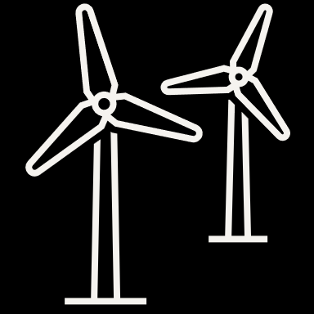
Wind Energy Education HUB

Slide 2
Introduction
Welcome to the world of wind!
Imagine capturing the power of the wind to generate electricity. This is exactly what wind energy does. Wind energy is a clean, renewable source of power that uses wind turbines to convert the movement of air into electricity. In this workbook, you’ll explore the fascinating world of wind energy, learning how it works, its benefits, and its potential to transform our energy future.
Why study wind energy?
As our world faces the challenges of climate change and limited fossil fuel resources, renewable energy sources like wind energy are becoming increasingly important. Studying wind energy helps us understand how we can reduce our carbon footprint and support a more sustainable way of living. By learning about wind energy, you’ll gain knowledge and skills essential for the future of our planet.
What will you learn?
In this workbook, you'll embark on an exciting journey through the science and technology of PV energy. Here are some of the key topics we'll cover:
The basics of wind energy: Find out how locations differ in terms of wind speed and how you can find out about them.
Get to know the numbers: Measuring and working with wind
Get your hands dirty: Build airfoils by your own and learn what factors influence the output power of wind.
Ending with a big bang! Build together your own wind turbine and make measurements, calculations, experiments and much more!
How to use this workbook
This workbook is designed to be interactive and engaging. Each section includes experiments, explanations and exercises to help you understand and apply the concepts of wind energy.

Slide 3
You'll find:
Learning objectives: Clearly defined goals for each chapter to help guide your learning.
Key terms: Important vocabulary words related to wind energy.
Hands-on activities: Practical exercises that reinforce the concepts you're learning.
Check your understanding: Questions and quizzes to assess your knowledge and understanding of the material.
Project ideas: Suggestions for projects you can undertake to explore Wind energy further.
Get ready to soar!
By the end of this workbook, you'll have a solid understanding of wind energy and its potential to shape a sustainable future. You'll be equipped with the knowledge to think critically about energy solutions and the skills to engage in innovative projects. Let's get started on this climbing journey and discover how we can harness the power of the wind to create a green and stable tomorrow for each of us!

Slide 4
Table of contents
Why is wind important? 5
Definitions 6
Chapter 1 – wind basics
Wind, energy & wind energy introduction 10
Windy places 14
The wind atlas 16
Stakeholders in wind energy 17
Chapter 2 – Measuring and working with wind speed
Making a paper windrose 22
Measuring wind speed 24
Wind can do work 26
Short recap: Test your knowledge on generators and gearboxes 28
Chapter 3 – Airfoils
Let’s make an airfoil 32
Chapter 4 – Experiments with wind turbines
How to measure the power of wind turbines 38
How to use a multimeter 39
How to use the wind turbine kit 41
Changing direction of wind 42
Angle of attack 46
Using a tail fin 47
Let`s test your knowledge! 49
Changing blade pitch 50
Changing blade length 52
Changing number of blades 54
What happens with a wind turbine with only one blade? 57
Let`s test your knowledge on chapter 4! 60
Playtime 63

Slide 5
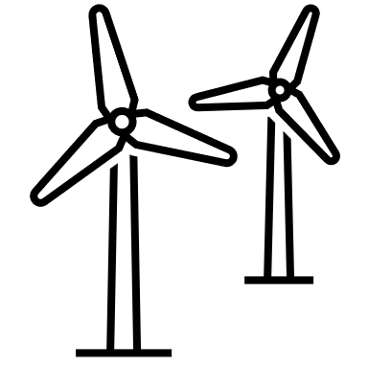
Why is wind important?
Now, let's dive into wind energy! Wind energy harnesses the power of the wind to generate electricity, making use of wind turbines to capture the wind's kinetic energy and convert it into usable power.
Why is wind energy important in Ghana?
Ghana is well-positioned to harness wind energy due to its diverse wind patterns, especially along its coastal regions. With the increasing demand for electricity and the need for sustainable solutions, wind energy offers a clean, renewable source of power. By using wind, Ghana can reduce its reliance on fossil fuels, promoting a greener and more sustainable future.
Furthermore, wind energy can provide independence for the country, which enables Ghana to empower itself and develop even further.
What are some advantages of wind energy?
Renewable energy source: Wind is a free, natural resource that is constantly replenished, providing a sustainable source of energy.
Environmentally friendly: Wind energy is a clean energy source, producing no emissions or pollutants, which helps protect the environment.
Low operating costs: After installation, wind turbines require minimal maintenance, and the wind is free!
Energy independence: Wind energy allows communities to generate their own power, reducing reliance on external sources and increasing local energy security.
Versatile applications: Wind turbines can be used in various settings, from large wind farms to small, localized installations that power homes or businesses.
What’s next?
In the upcoming sections, you will learn more about the basics of energy and wind energy in particular, how to measure and how to work with wind, to build your own airfoil and your own wind turbine.
Through hands-on experiments and activities, you’ll get a deeper understanding of wind energy, how it works and its potential.
Get ready to explore and experiment with wind energy technology – the journey toward harnessing the power of the wind begins here!

Slide 6
Definitions
Average power density: Measures energy available per square meter from wind. → Higher W/m² means more potential energy to generate electricity.
Angle of attack: The angle between the blade and the wind. Adjusting this angle can optimize how much energy is captured.
Bernoulli’s Principle: Explains how faster-moving air creates lower pressure. This principle helps generate lift on turbine blades, making them spin.
Drag: The resistance caused by air pushing against the blades. Reducing drag improves efficiency.
Energy: Energy is the ability to do work or cause change. It can exist in various forms, such as heat, light, motion, or electricity, and is essential for powering devices, systems, and living organisms.
Gearbox: A mechanical system that increases the speed of the turbine shaft to match the requirements of the generator.
Generator: The part of the turbine that converts mechanical energy from the spinning blades into electrical energy.
MPP (maximum power point): The optimal operating condition where the turbine produces the maximum possible power based on wind speed and blade adjustments.
Offshore wind turbine: Offshore wind power or offshore wind energy is the energy taken from the force of the winds out at oceans & sea, transformed into electricity, and supplied to the electricity network onshore.
Onshore wind turbine: Onshore wind turbines are built on land, often open plains or mountain areas, transformed wind into electricity, and supplied to the electricity network.
Power: Power is the amount of energy that something can produce or use in a certain amount of time. For wind turbines, power means the energy they create by turning wind into electricity. The unit is Watts (W).
Power density: It refers to the amount of power (energy per unit time) generated or consumed per unit volume or area, often used to describe the efficiency of a system or material.
Speed of wind: How fast the air is moving. Faster wind speeds mean more energy is available for generating power.

Slide 7
Voltage: Voltage is like the "pressure" in an electrical circuit. It tells us how strongly the electricity is being pushed through wires. The unit is Volt (V).
Wind: Wind is moving air in the atmosphere. It happens when the air heats up differently in different places and moves around.
Wind energy: Wind energy is the energy created by the movement of the wind. Wind turbines can turn this movement into electricity, which we can use in our homes!
Wind speed: Measures how fast the wind is blowing in meters per second. → Higher wind speed means more energy can be harvested by wind turbines.
Work: In physics, work happens when a force moves an object over a distance. For wind turbines, the wind applies force to the blades, causing them to spin and generate energy.

Slide 8

Wind Energy Education HUB
Chapter 1
Wind Basics

Slide 9
Wind energy basics
Learn about energy, wind energy and the wind atlas.
In this chapter, we will find out about the following basics:
Energy in general
Renewable and Non-Renewable Energy Sources
Characteristics of wind
Wind energy
Windy places
How to use the wind atlas
Different stakeholder positions regarding the implementation of wind energy
Learning objectives
At the end of this chapter, you will:
Understand the basics of wind energy: Gain a comprehensive understanding of energy in general and how wind energy is harnessed, including the principles of wind power generation using turbines.
Know the differences of renewable and non-renewable energy sources: Be able to allocate different energy sources correctly.
Explore key factors affecting wind speed and power: Learn about factors such as wind speed, altitude, location, and environmental conditions that influence wind energy production.
Analyze different wind energy sources: Evaluate the differences between high places, open spaces, coastal regions, and offshore areas in terms of wind energy potential.
Understand the mechanism of wind: Gain insight into the dynamics of sea breeze vs. land breeze and how these mechanisms affect wind power.
Explore offshore wind energy: Learn about offshore wind turbines and their advantages in capturing stronger, more consistent winds.
Understand the concept of the wind atlas: Get to know the wind atlas and which it can be a valuable tool to assess the quality of a region.
Assess and apply wind energy in real-world contexts: Develop an understanding of how different stakeholders see the topic of wind energy and how to come up with a solution, which incorporates all view-points.

Slide 10

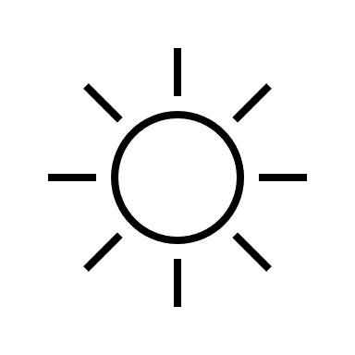
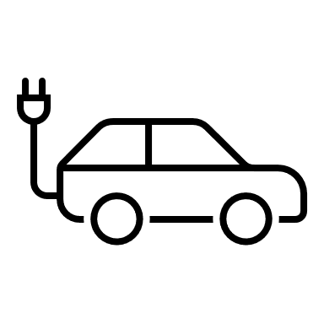
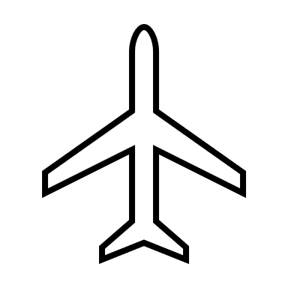

1. Wind, energy & wind energy introduction
In this chapter you will play some games to learn about the basics of wind, energy and wind energy!
Exercise
Task 1
Energy name game:
Form 2 groups from the class.
Form a sitting circle and choose a group leader to explain the procedure.
Now the game begins: Someone starts with the first letter of their family name and relates it to a term, which is energy related - a source of energy, an energy-consuming or -producing device, or energy term.
Look at the examples:
- M: Microwave
- G: Generator
- B: Biomass
5) Now go around the circle; everyone takes their turn. The last letter of the last word is always the first letter of a new energy word.
Biomass
Oven
Generator
Light bulb
Geothermal
Electricity
Be Creative!

Slide 11

Good to know about energy!
Energy is what makes things happen—it’s the power to do work. For example, when you eat food, your body turns that energy into movement, like running or playing.
Energy comes in two main types:
- Kinetic energy: Energy of moving things (like a bike going down a hill).
- Potential energy: Stored energy (like a ball sitting on a high shelf).
There are also other kinds of energy, like:
Heat energy (from fire or sun),
Electric energy (in plugs and batteries),
Gravitational potential energy (energy from height, like water in a dam).
Task 2
Renewable and non-renewable energy sources:
Form a group of 2-4 students.
Look at the pictures on the next side and decide, which of them are renewable energy sources and which of them are non-renewable / conservative energy sources! Tick the right box.
Think about: do you know how they all are named?
Try it on your own first and then discuss it in the group.

Slide 12

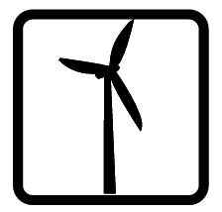





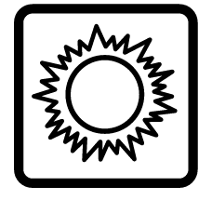
Renewable
Non-Renewable
Name: Coal
Renewable
Non-Renewable
Name: Wind
Renewable
Non-Renewable
Name: Uranium
Renewable
Non-Renewable
Name: Biomass
Renewable
Non-Renewable
Name: Natural Gas
Renewable
Non-Renewable
Name: Geothermal
Renewable
Non-Renewable
Name: Hydropower
Renewable
Non-Renewable
Name: Solar
Notes:
Source: Energy Games and Icebreakers (Free PDF Download) – The NEED Project

Slide 13
Good to know about wind and wind energy:
Wind energy is a renewable energy source.
Wind energy comes from moving air.
Basically, wind is caused by 3 things:
- The heating of the atmosphere by the sun,
-The rotation of the Earth, and
-The earth’s surface irregularities.
Some areas have strong winds, while others have very little.
Wind energy can’t produce electricity all the time—it depends on the wind.
It doesn’t pollute the air but can create noise.

Slide 14




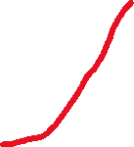
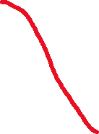
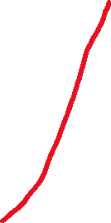

2. Windy places
In this chapter you will learn more about the basics of wind energy and where you can find windier locations.
Exercise
Task 1
Allocate these places according to their wind strength. Good wind locations for the production of energy are (very) windy, bad wind locations have hardly any wind.
High places
GOOD locations - (very) windy
Closed spaces & low places
Coasts & offshore (in oceans, seas) wind turbines
BAD locations – hardly any wind
Open spaces
Draw arrows to the correct answers on the right-hand side

Slide 15
Task 2
Explain why a certain area is good and what makes a certain area bad.​
A good wind location typically has consistent and predictable wind patterns, influenced by factors like proximity to water or flat terrain. These areas allow for steady airflow, making them ideal for wind energy or wind sports. Consistency is crucial for reliable use, ensuring the wind can be harnessed effectively.
Bad wind locations are often marked by irregular, gusty winds due to obstructions like mountains or tall buildings. These disruptions create turbulent conditions, making it harder to predict or use the wind efficiently for activities or energy generation.
In summary
Windy places enable the generation of energy out of the movement of wind turbines.
Good places for wind energy production are where it is very windy.
-> Examples: in high places, places with a lot of space, places next to the sea or ocean.
Bad places for wind energy production are where there is hardly any wind.
-> Examples: in low places, in cities or locations with many obstacles.

Slide 16

3. The wind atlas
Exercise
Task 1
Split the class into groups of 4–5 students.
Now visit the website down below (you can use the QR-Code).
Select "Countries And Regions" on the left-hand side and compare Ghana and Germany.
Check on the right-hand side that height is set to 100m.
Now compare the two countries regarding their average power density (W/m²) and the speed of wind (m/s). What does that mean for the production of wind energy?
https://globalwindatlas.info/en/
Country | Power density (W/m²) | Speed of wind (m/s)
Ghana | 184 | 5.7
Germany | 595 | 8.45
Optional: different country
What is your outcome? What does it mean for the quality of the country to generate wind energy?
Germany has higher power density than Ghana, meaning it can generate more wind energy.
Germany also has faster wind speeds, which increases energy output.
Conclusion: Germany is better suited for wind energy production due to these favourable conditions.
BUT: This is just a comparison; Ghana still has great potential to generate wind energy!

Slide 17

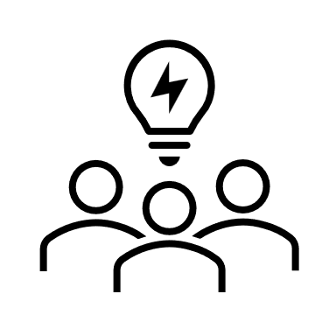

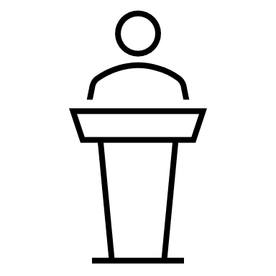

4. Stakeholders in wind energy
Exercise
Task 1
Wind energy role play:
1) Split the class into groups of 4–5 students.
2) Each team represents a different stakeholder, who is affected by a wind energy project in Ghana.
3) Assign roles to each team member:
-Local farmer: Concerned about losing land and the noise from turbines.
-Government official: Focused on promoting renewable energy to support Ghana’s future.
-Engineer: Explains how wind turbines work and discusses technical challenges.
-Student: Curious about how wind energy will affect jobs, the environment, and future opportunities.
- Environmentalist (optional): Advocates for clean energy to combat climate change.
4) Scenario setup: "A new wind farm is planned near a coastal village in Ghana. It will produce electricity for nearby towns but may also affect the local community and environment."
5) Now, look at the scenario and you assigned role and try to find arguments for your position. Write it down on the next slide!
6) Discussion: When everyone is ready, discuss your arguments and perspectives and present it to the class! Don`t be afraid, there is no right or wrong!
The goal is to discuss the benefits and challenges of wind energy while considering all perspectives!

Slide 18
Solution:
Write down – everyone on your own – what are the arguments for your position?
Local farmer: Concerned about losing land and the noise from turbines:
Land loss: "If wind turbines are built on my land, I may lose valuable farmland that I depend on for growing crops and supporting my family."
Noise pollution: "The noise from the turbines could disturb my daily life, my animals, and even make it harder to sleep or concentrate."
Impact on livestock: "The noise and movement from the turbines may cause stress for my livestock, affecting their health and production."
Changes to the landscape: "Large turbines can change the look of the land, which could affect tourism and the beauty of our environment."
Government official: Focused on promoting renewable energy to support Ghana’s future
Renewable energy: "Wind energy is a clean, renewable source of power, helping us reduce dependence on fossil fuels like oil and gas, which are harmful to the environment."
Economic growth: "Investing in wind energy can create jobs in the renewable energy sector, stimulating local economies and helping Ghana transition to a green economy."
Energy Independence: "Wind energy can help Ghana become less reliant on imported fuels, making us more energy-independent and securing our energy future."
Environmental benefits: "Wind energy doesn’t produce harmful emissions, which is crucial for fighting climate change and improving air quality in Ghana."
Engineer: Explains how wind turbines work and discusses technical challenges
How wind turbines work: "Wind turbines convert the kinetic energy of the wind into electrical energy using blades that spin when the wind blows. This movement turns a generator to produce electricity."
Efficiency: "Modern wind turbines are designed to be very efficient, with technologies that allow them to capture wind energy at different speeds and weather conditions."
Challenges: "While wind turbines are effective, they depend on consistent wind, so there may be times when there isn't enough wind to generate power. Additionally, they can be expensive to install and maintain."
Environmental considerations: "Turbines need to be placed in areas with good wind resources, and we must be careful not to disrupt local ecosystems or wildlife."

Slide 19
Solution:
Write down – everyone your own – what are the arguments for your position?
Student: Curious about how wind energy will affect jobs, the environment, and future opportunities
Job creation: "Wind energy projects can create many new jobs, such as in the construction of wind turbines, maintenance, and energy production. This could help young people find stable work."
Future opportunities: "By developing wind energy, Ghana could become a leader in renewable energy in Africa, opening up opportunities for innovation and technological growth."
Environmental impact: "Wind energy is clean and doesn’t pollute the air, which is great for the environment, especially since we need to reduce emissions to combat climate change."
Sustainable growth: "Wind energy can provide a long-term, sustainable solution to Ghana's energy needs, helping future generations live in a cleaner, greener country."
Environmentalist: Advocates for clean energy to combat climate change
Reduction of carbon emissions: "Wind energy is a clean source of power that doesn’t release harmful carbon dioxide or other pollutants, making it essential for fighting climate change and reducing Ghana's carbon footprint."
Sustainable energy source: "Unlike fossil fuels, wind is a renewable resource that will never run out, ensuring a stable and sustainable energy future for Ghana and the planet."
Biodiversity protection: "Using wind energy helps protect ecosystems from the damage caused by mining or drilling for oil and gas, preserving local wildlife and habitats."
Global leadership in climate action: "By embracing wind energy, Ghana can set an example for other countries in Africa and the world, showing that developing nations can lead in the fight against climate change with renewable energy."

Slide 20
Wind Energy Education HUB
Chapter 2
Measuring and working with wind

Slide 21
Measuring and working with wind
In this chapter, you will learn about:
How wind speed is measured
How wind does work
Concepts of wind turbines
Effects of wind conditions on energy generation
Learning objectives
At the end of this chapter, you will:
Understand the importance of measuring wind speed and how it impacts energy generation.
Build and use a basic anemometer to measure wind speed in various locations.
Explore the concept of wind doing work through practical experiments.
Analyze the effects of turbulence and storm conditions on wind energy generation.
Gain insights into the role of gearboxes and how turbines convert wind into usable electricity.

Slide 22


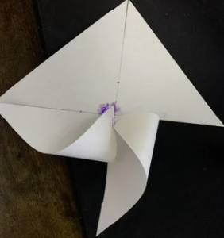
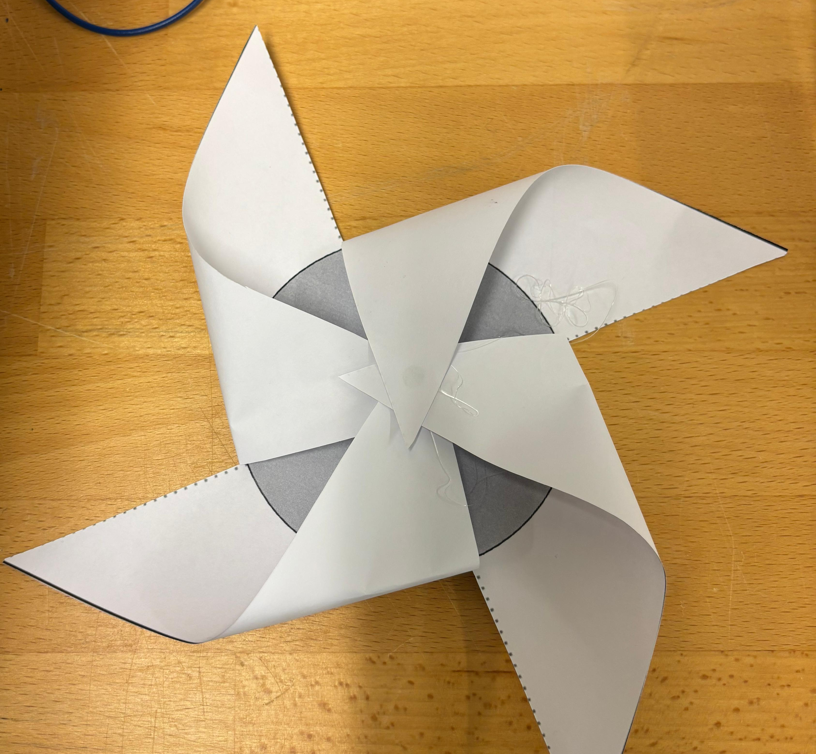
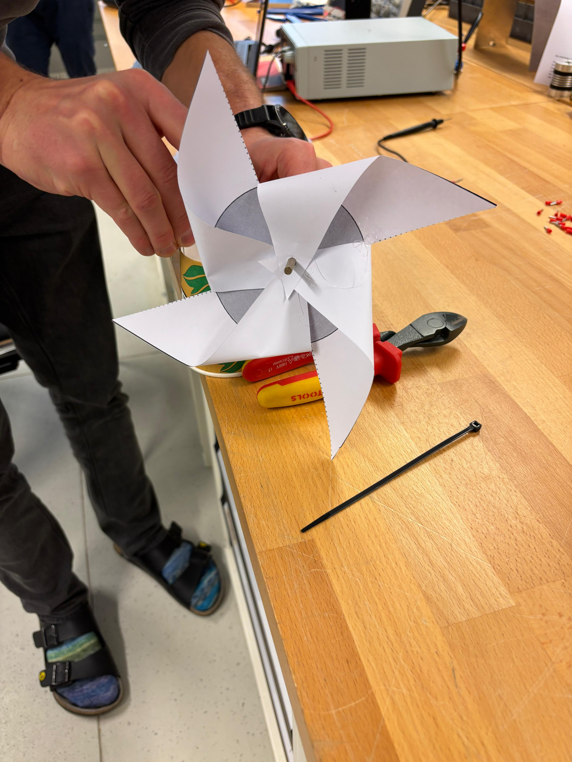
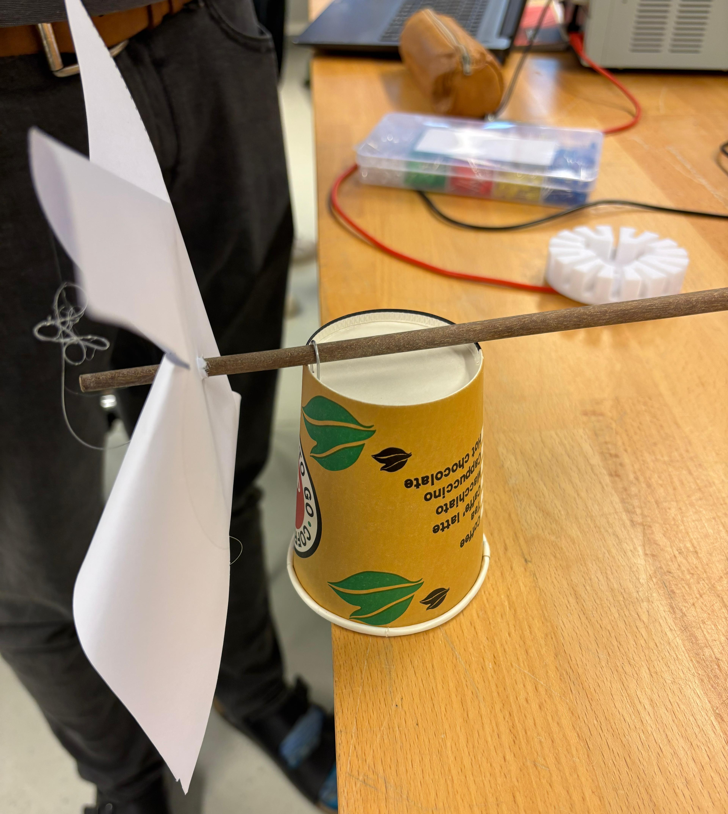
1. Making a paper windrose
Activity
Material you will need for the activity
Scissors
Paper cup
Tape
Straw
Follow these steps to make your own wind rose:
Cut out the square shown on the next page.
Cut diagonally along the dotted lines until you reach the circle and then stop. Do not cut out the circle; leave it as it is.
Place the corners in the center, one by one, as shown in the first and second picture.
Take a straw and push it through the center of the compass rose, as shown in the third picture.
Turn the paper cup upside down and attach the stick to the top of the cup using the adhesive tape, as shown in the fourth illustration.

Slide 23
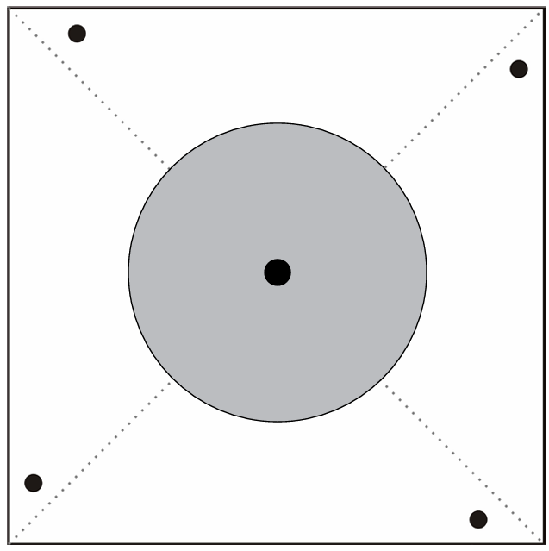

Slide 24
2. Measuring wind speed
Experiment
Material you will need for the experiment
Paper wind rose
Stopwatch
Colorful marker
Follow these steps to measure wind speed using the wind rose:
Take your windrose and color each fan with a different colored marker.
Place the paper windrose on a flat, stable surface where it can spin freely. You can do so by holding the windrose in your hand or by placing it on a stable support.
Blow to move the windrose.
Blow in low speed and count how many full rotations one cup completes in 1 minute. Use the stopwatch to measure time. Record this in the observation table.
Repeat step 4 with different variation in wind speed while blowing and record it in the observation table.
Wind strength | Rotations per minute | Observation
Low
Medium
High

Slide 25
Exercise
Task 1
How does the speed of the wind relate to the number of rotations?
The speed of the wind is directly proportional to the number of rotations.
Faster wind causes the windmill to spin more quickly, resulting in a higher number of rotations per minute (RPM).
At what speed did the compass rose rotate the fastest and why is that?
The windrose spun the fastest when the wind speed was on its highest. This is because higher wind speeds provides (kinetic) energy to the windrose, allowing it to rotate faster.
In summary
Anemometers are tools used to measure wind speed by counting rotations. Building an anemometer helps us understand how engineers measure wind to decide the best locations for wind turbines and other applications.
Wind speed is directly proportional to the number of rotations—the faster the wind, the more the windrose spins.
Wind speed varies across different locations and heights due to obstacles, turbulence, and environmental conditions.
Faster winds mean more energy potential, which is why open areas or high altitudes are ideal for wind energy projects.

Slide 26
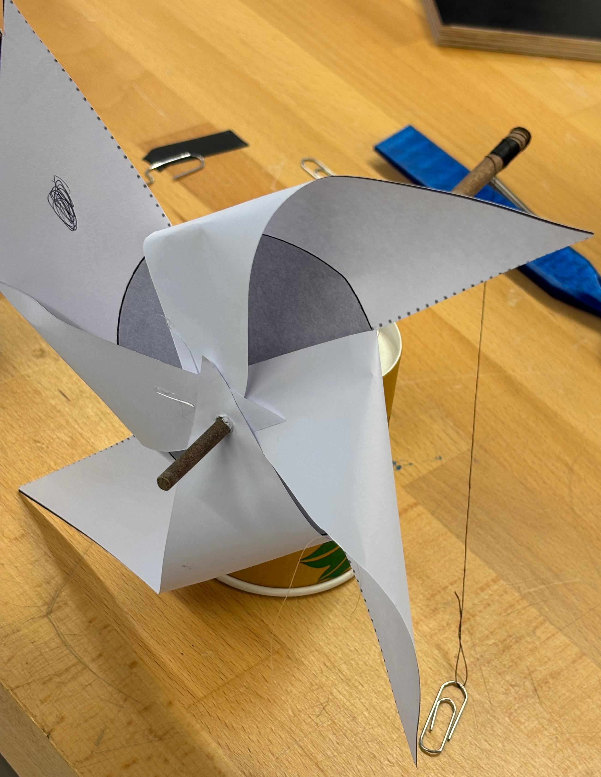
3. Wind can do work
Experiment
Material you will need for the experiment
Paper windrose (built in the previous experiment)
30 cm light thread
Tape
Fan
Stopwatch
Paper clip
Steps to conduct the experiment:
Tie one end of the thread to the end of the straw that binds the compass rose. Make a loop at the free end of the thread and attach a paper clip with adhesive tape to serve as a weight.
Place the paper wind rose on a flat, stable surface on which it can rotate freely, e.g. on a table, as shown in the fourth illustration on page 22.
Position a fan approximately 1 meter away from the windrose.
Set your fan to a low speed to measure the time it takes to lift the paper clips.
Repeat step 4 at different speeds of fan and record it in the observation table.
Fan speed | Time taken to lift the rope | Observation
Low | 10s
Medium | 7s
High | 5s

Slide 27
Exercise
Task 1
How does the wind speed (low, medium, high) affect the speed of lifting weights with the wind rose?
Higher wind speeds provide more energy to the windrose, allowing it to lift weights faster. At low wind speeds, the lifting rate is slower due to less energy being transferred to the windrose.c
Task 2
How does the weight of the load affect the windrose’s ability to lift it at different wind speeds?
At lower wind speeds, the windrose struggles to lift heavier loads due to insufficient energy to overcome gravitational force. At higher wind speeds, the additional energy allows the windrose to lift heavier loads more effectively.
Task 3
How can this experiment relate to real wind turbines?
This experiment demonstrates how wind turbines harness wind energy to perform work, such as generating electricity. The rate of power generation in turbines also depends on wind speed and the load on the turbine. If the load is too high or wind speeds are too low, turbines produce power less efficiently.
In summary
Wind energy can perform mechanical work, as shown with the paper windrose lifting weights.
Higher wind speeds provide more energy, allowing heavier loads to be lifted.
As the load increases, more energy is needed, and the windrose/anemometer/turbine may stop spinning if overloaded.
This demonstrates how wind turbines convert wind energy into useful power and highlights the importance of optimizing design and placement to maximize efficiency.

Slide 28
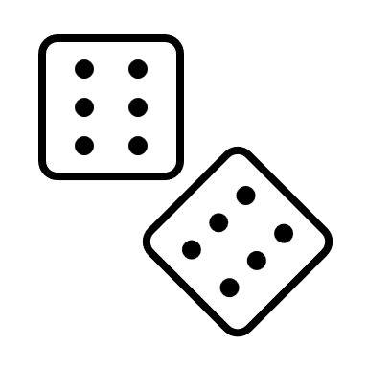
Test your knowledge on generators and gearboxes
Task 1
Fill in the blanks.
A generator converts __________ (mechanical/thermal/chemical )energy into electrical energy.
Wind turbines naturally spin __________ (quickly/slowly/moderately), but generators need a __________ (lower/higher/consistent) speed to produce electricity.
The __________ (rotor/gearbox/stator) in a wind turbine increases the rotational speed of the shaft to match the generator's requirements.
The process of spinning a generator transforms __________ (kinetic/heat/light) energy into electricity.
Gearboxes work by adjusting __________ and __________ (force & mass/speed & torque/direction & rotation) in the system.
Task 2
Write whether the given statements are true or false. Correct the statements if they are false.
Wind turbines spin at a high speed naturally, making them directly compatible with generators. False. Correction: Wind turbines spin at a slow speed naturally, so a gearbox is required to make them compatible with generators.
A generator uses electrical energy to create mechanical energy. False. Correction: A generator uses mechanical energy to create electrical energy.
The rotor is the stationary part of a generator. False. Correction: The rotor is the rotating part of a generator, while the stator is stationary.
Gearboxes are used in wind turbines to adjust the rotational speed and torque. True.
The energy conversion process in wind turbines involves transforming kinetic energy into mechanical energy and then into electrical energy. True.

Slide 29
Task 3
Match the terms in Column A to their corresponding definitions or functions in Column B.
Column A
1. Gearbox (b)
2. Generator (a)
3. Kinetic energy (c)
4. Rotor (d)
5. Electromagnetic induction (e)
Column B
a. Converts mechanical energy into electrical energy
b. Adjusts speed and torque to match system requirements
c. Energy in motion, like wind
d. The rotating part of the generator
e. Process of generating electricity through a magnetic field

Slide 30
Wind Energy Education HUB
Chapter 3
Airfoils

Slide 31
Airfoils
Create an airfoil and connect it to the principle of Bernoulli.
In this chapter, we will find out about the following basics:
Building an airfoil
The reasons for lift when the wind blows from the right direction
Why a certain blade shape is so important
What the Bernoulli principle is
What factors influence the performance of wind turbines in general
Learning objectives
At the end of this chapter, you will:
Understand the basics of airfoils and lift: Learn how the shape of blades (airfoils) creates lift by manipulating airflow and pressure differences.
Explore the Bernoulli Principle in wind turbines: Understand how the Bernoulli principle, which helps airplanes fly, is applied in wind turbines to rotate the blades.
Hands-on experiment with paper: See how a simple paper experiment demonstrates the principle of lift — blowing air over paper makes it rise due to pressure differences.
Evaluate blade design for maximum efficiency: Recognize that the shape of a turbine blade (airfoil) is crucial for efficient wind energy generation.
Consider factors influencing wind turbine performance: Analyze the external factors like wind speed, air density, and blade angle that impact the rotational speed and power output of wind turbines.

Slide 32
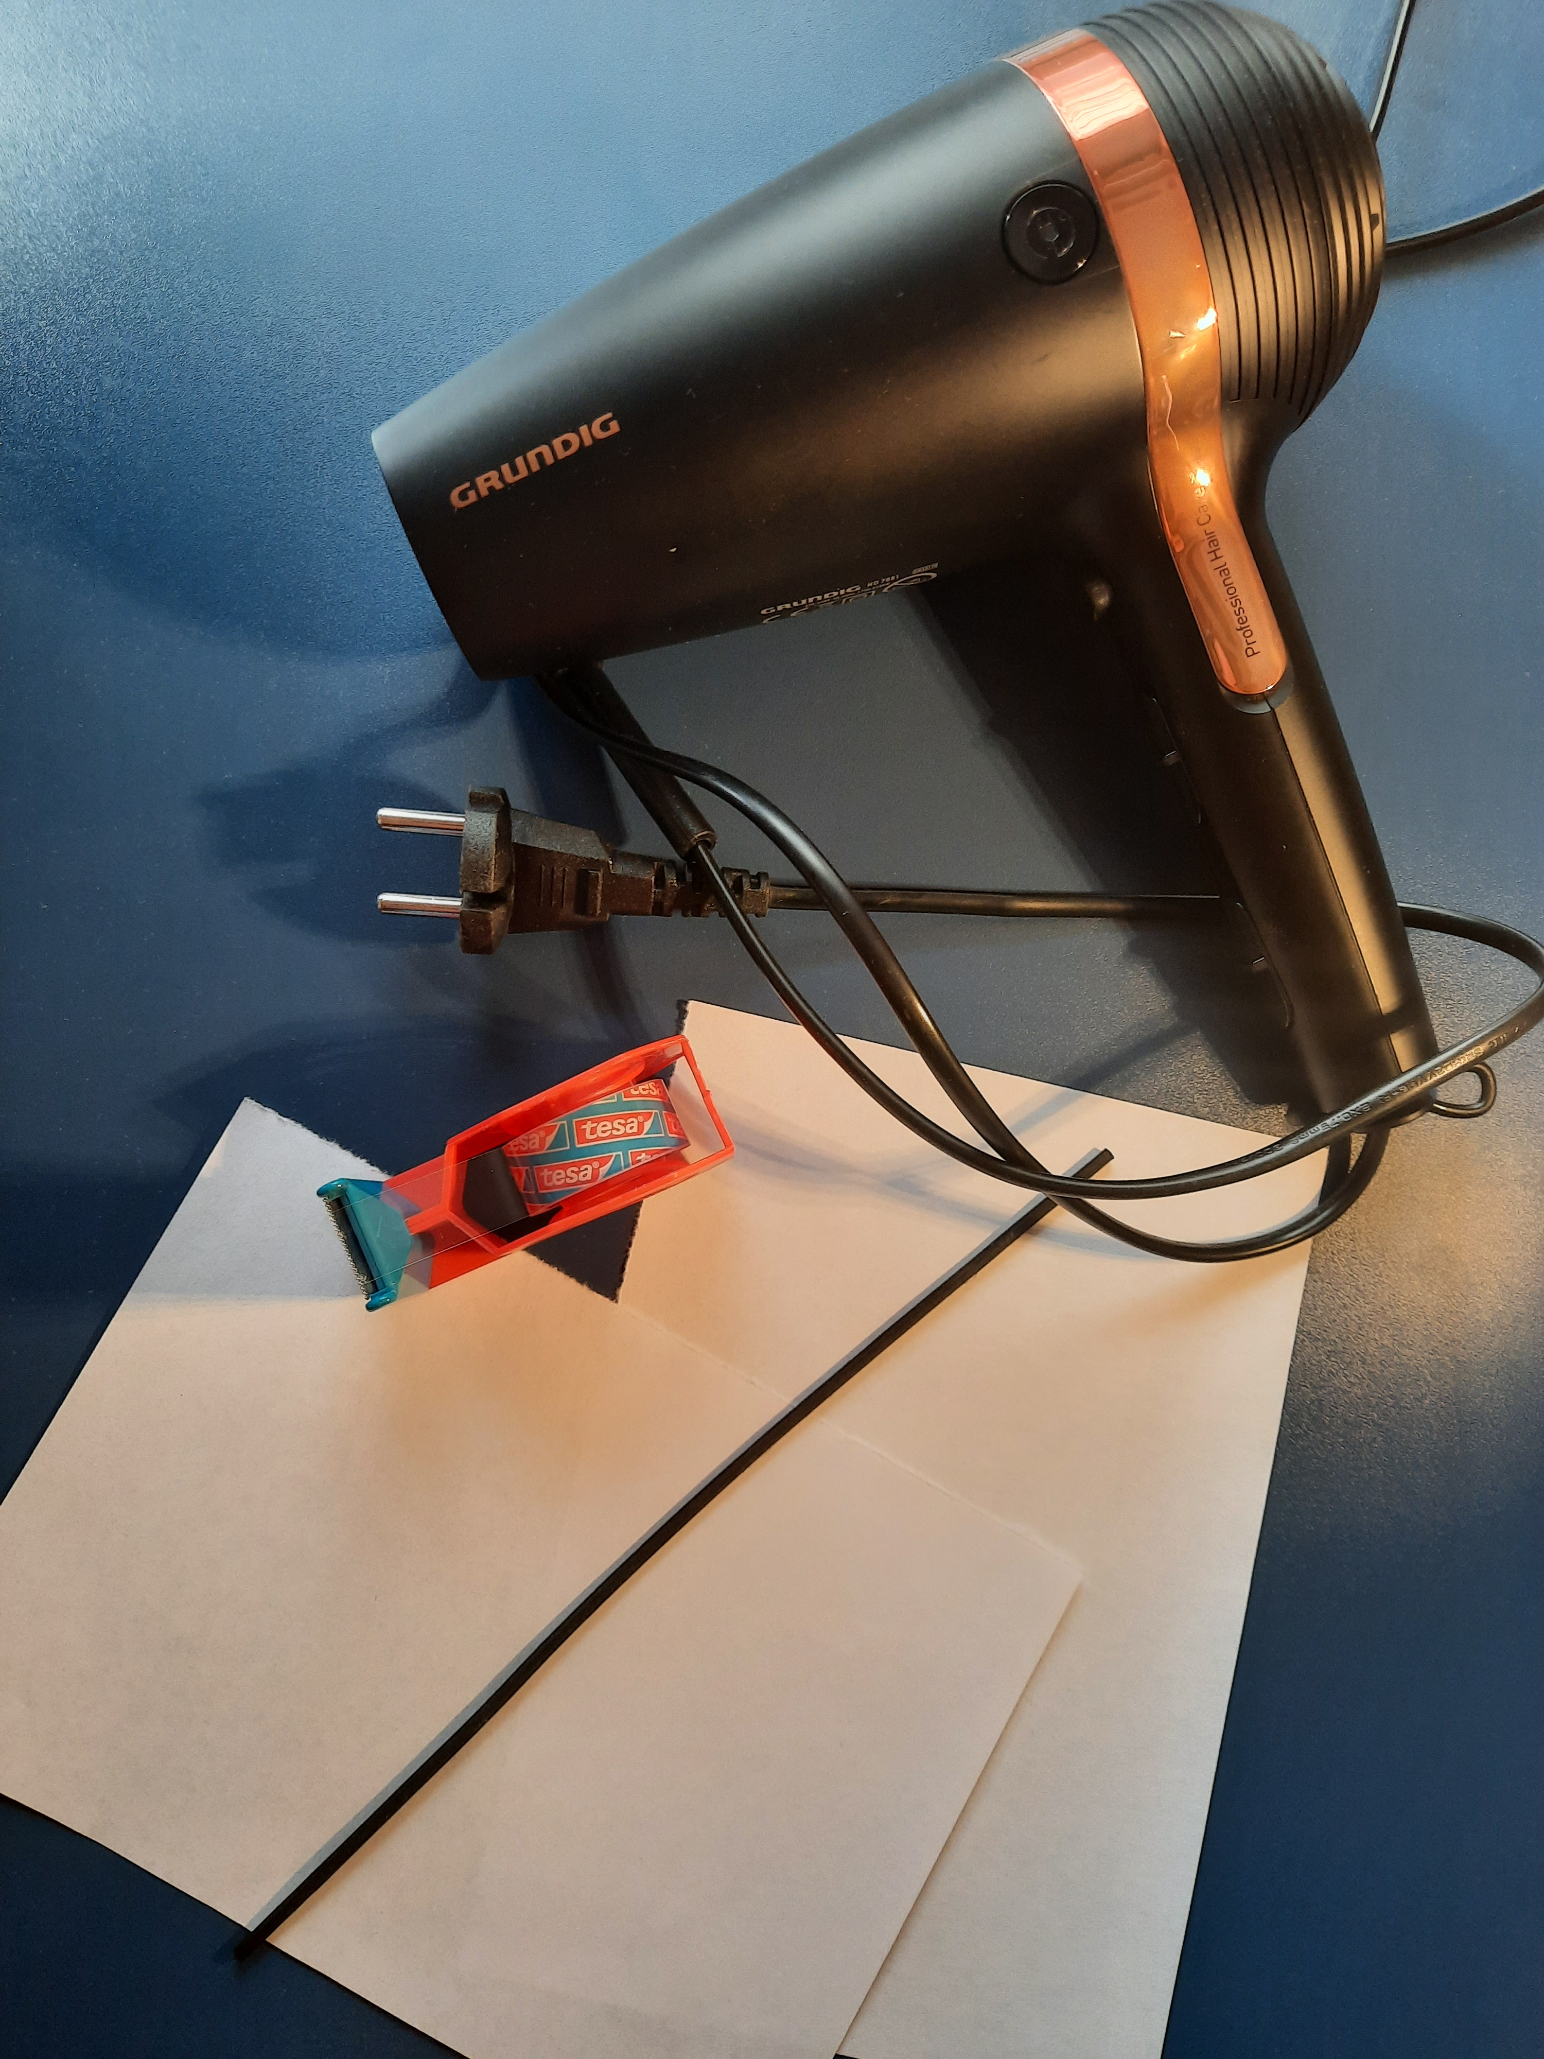
1. Let's make an airfoil!
In this chapter, you will find out how to build an airfoil and how to experiment with it.
Experiment
Material you will need for the experiment
Narrow wooden stick
Adhesive tape
2x rectangular papers, size A5
Hairdryer

Slide 33
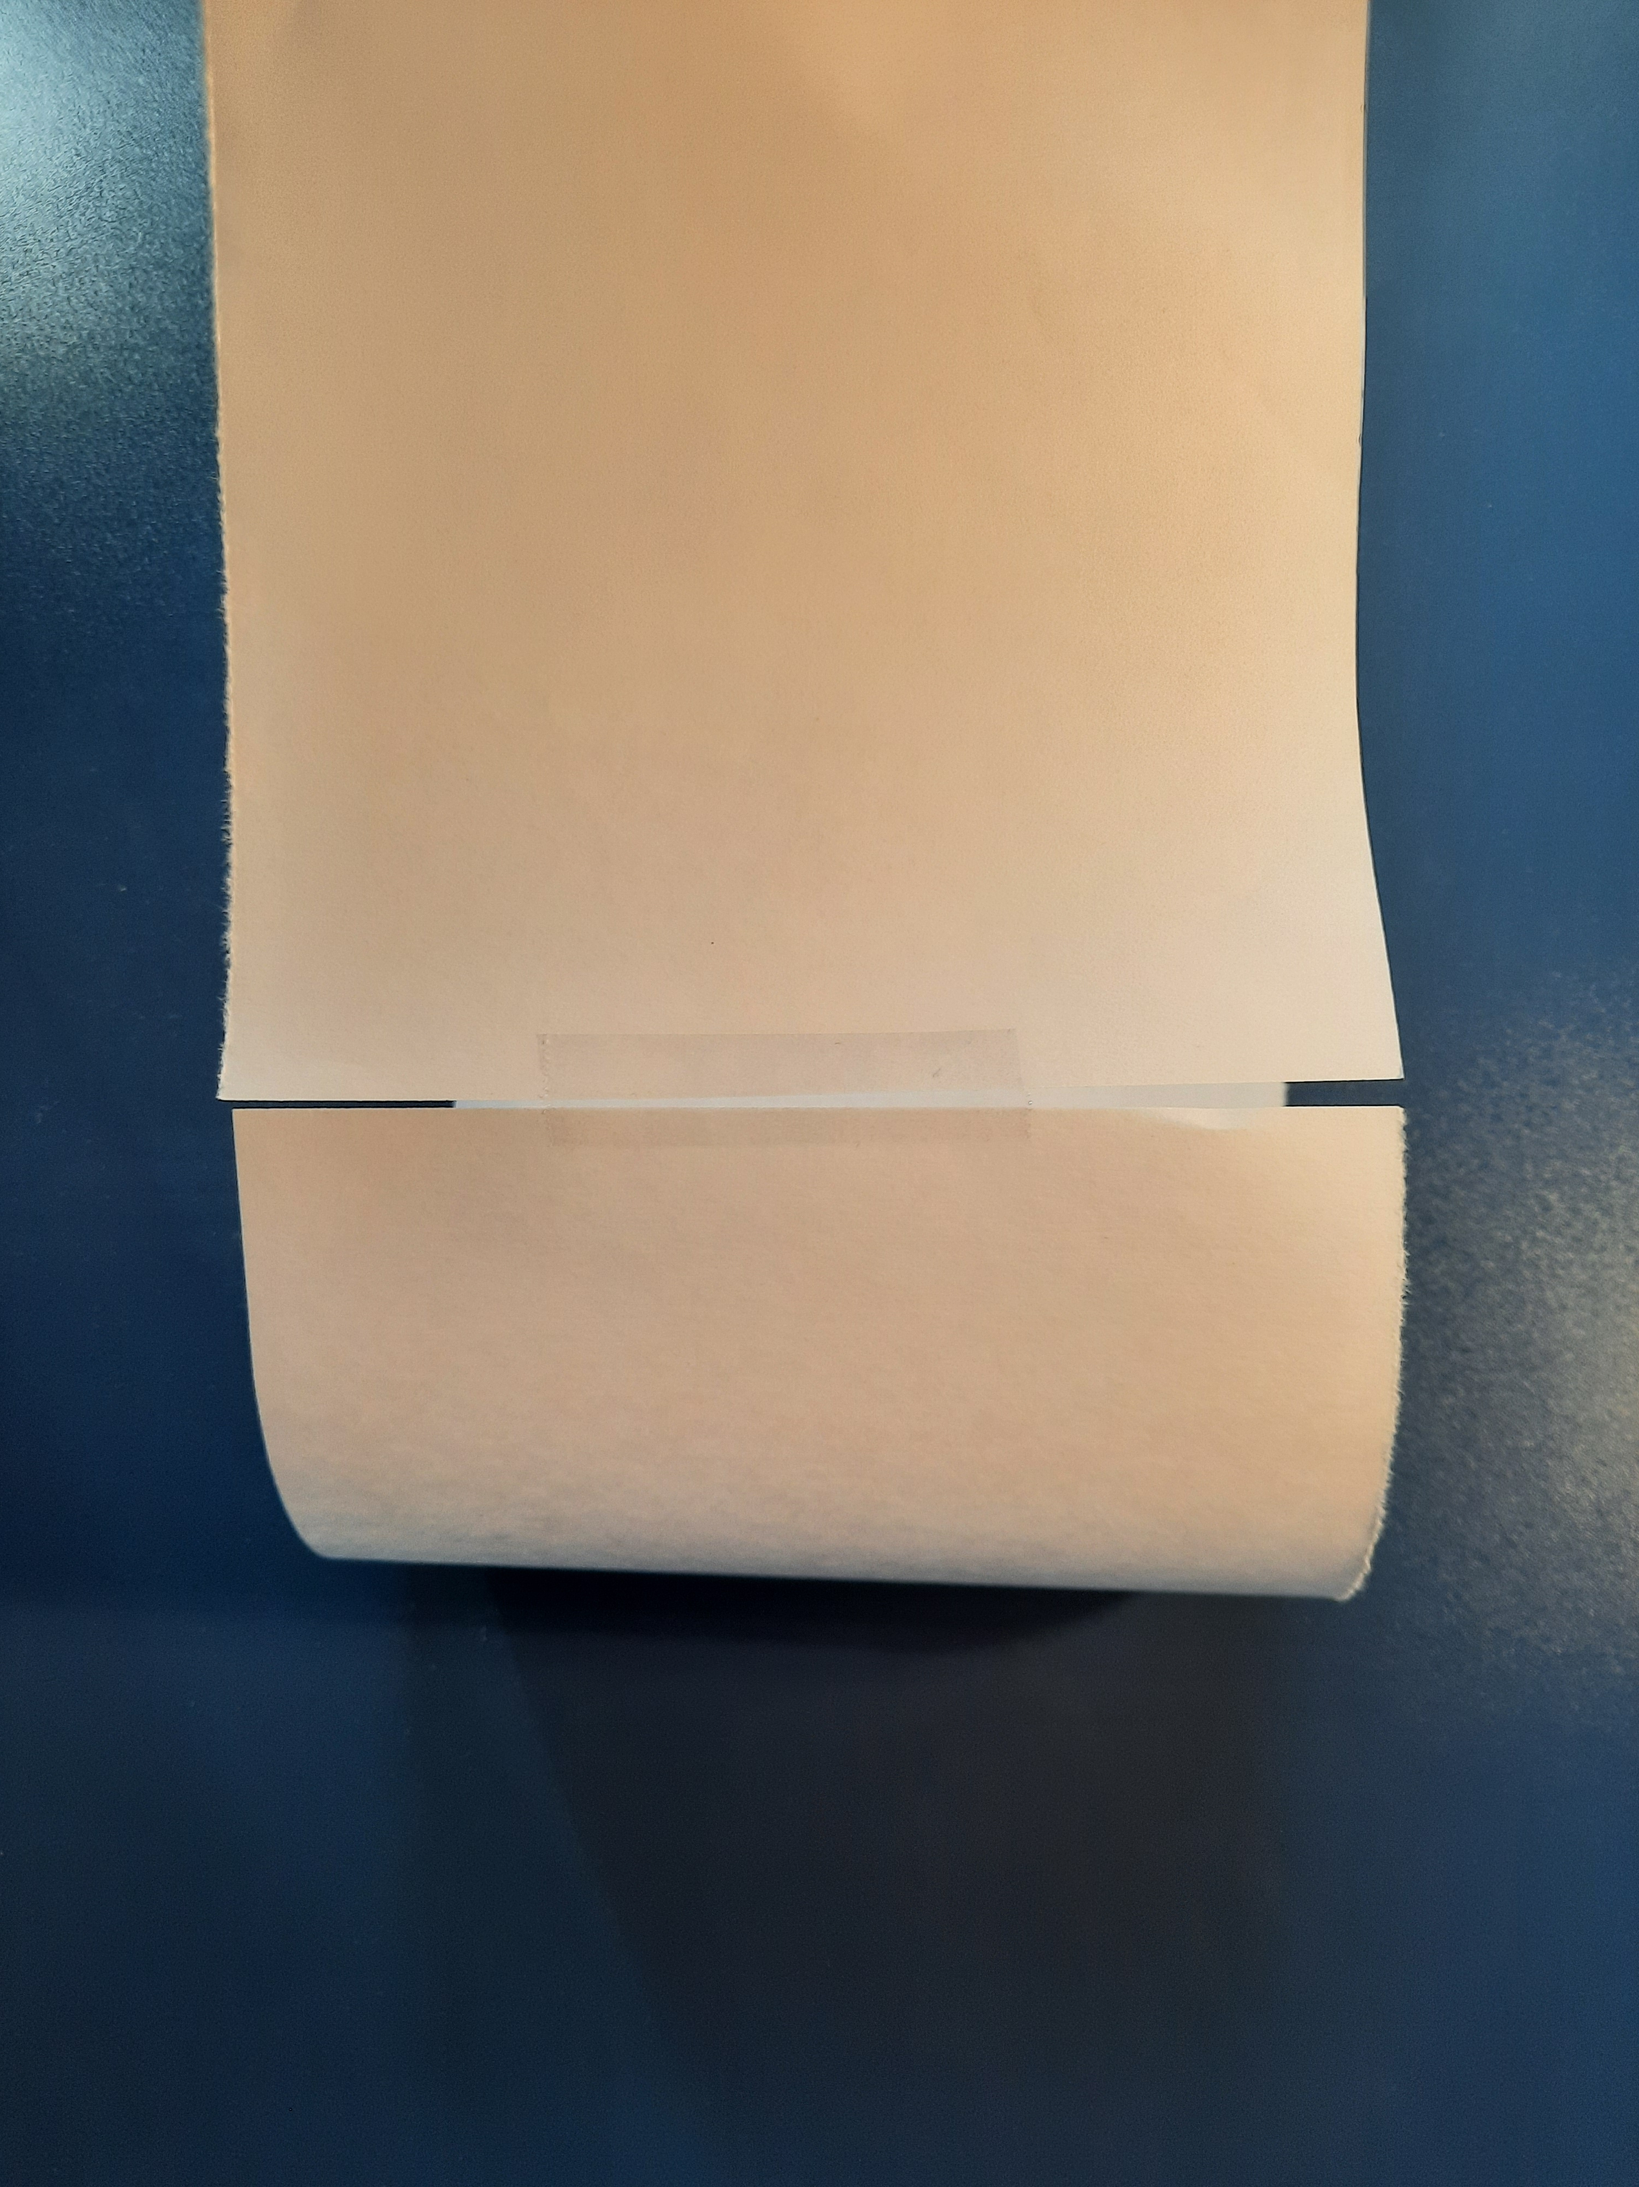
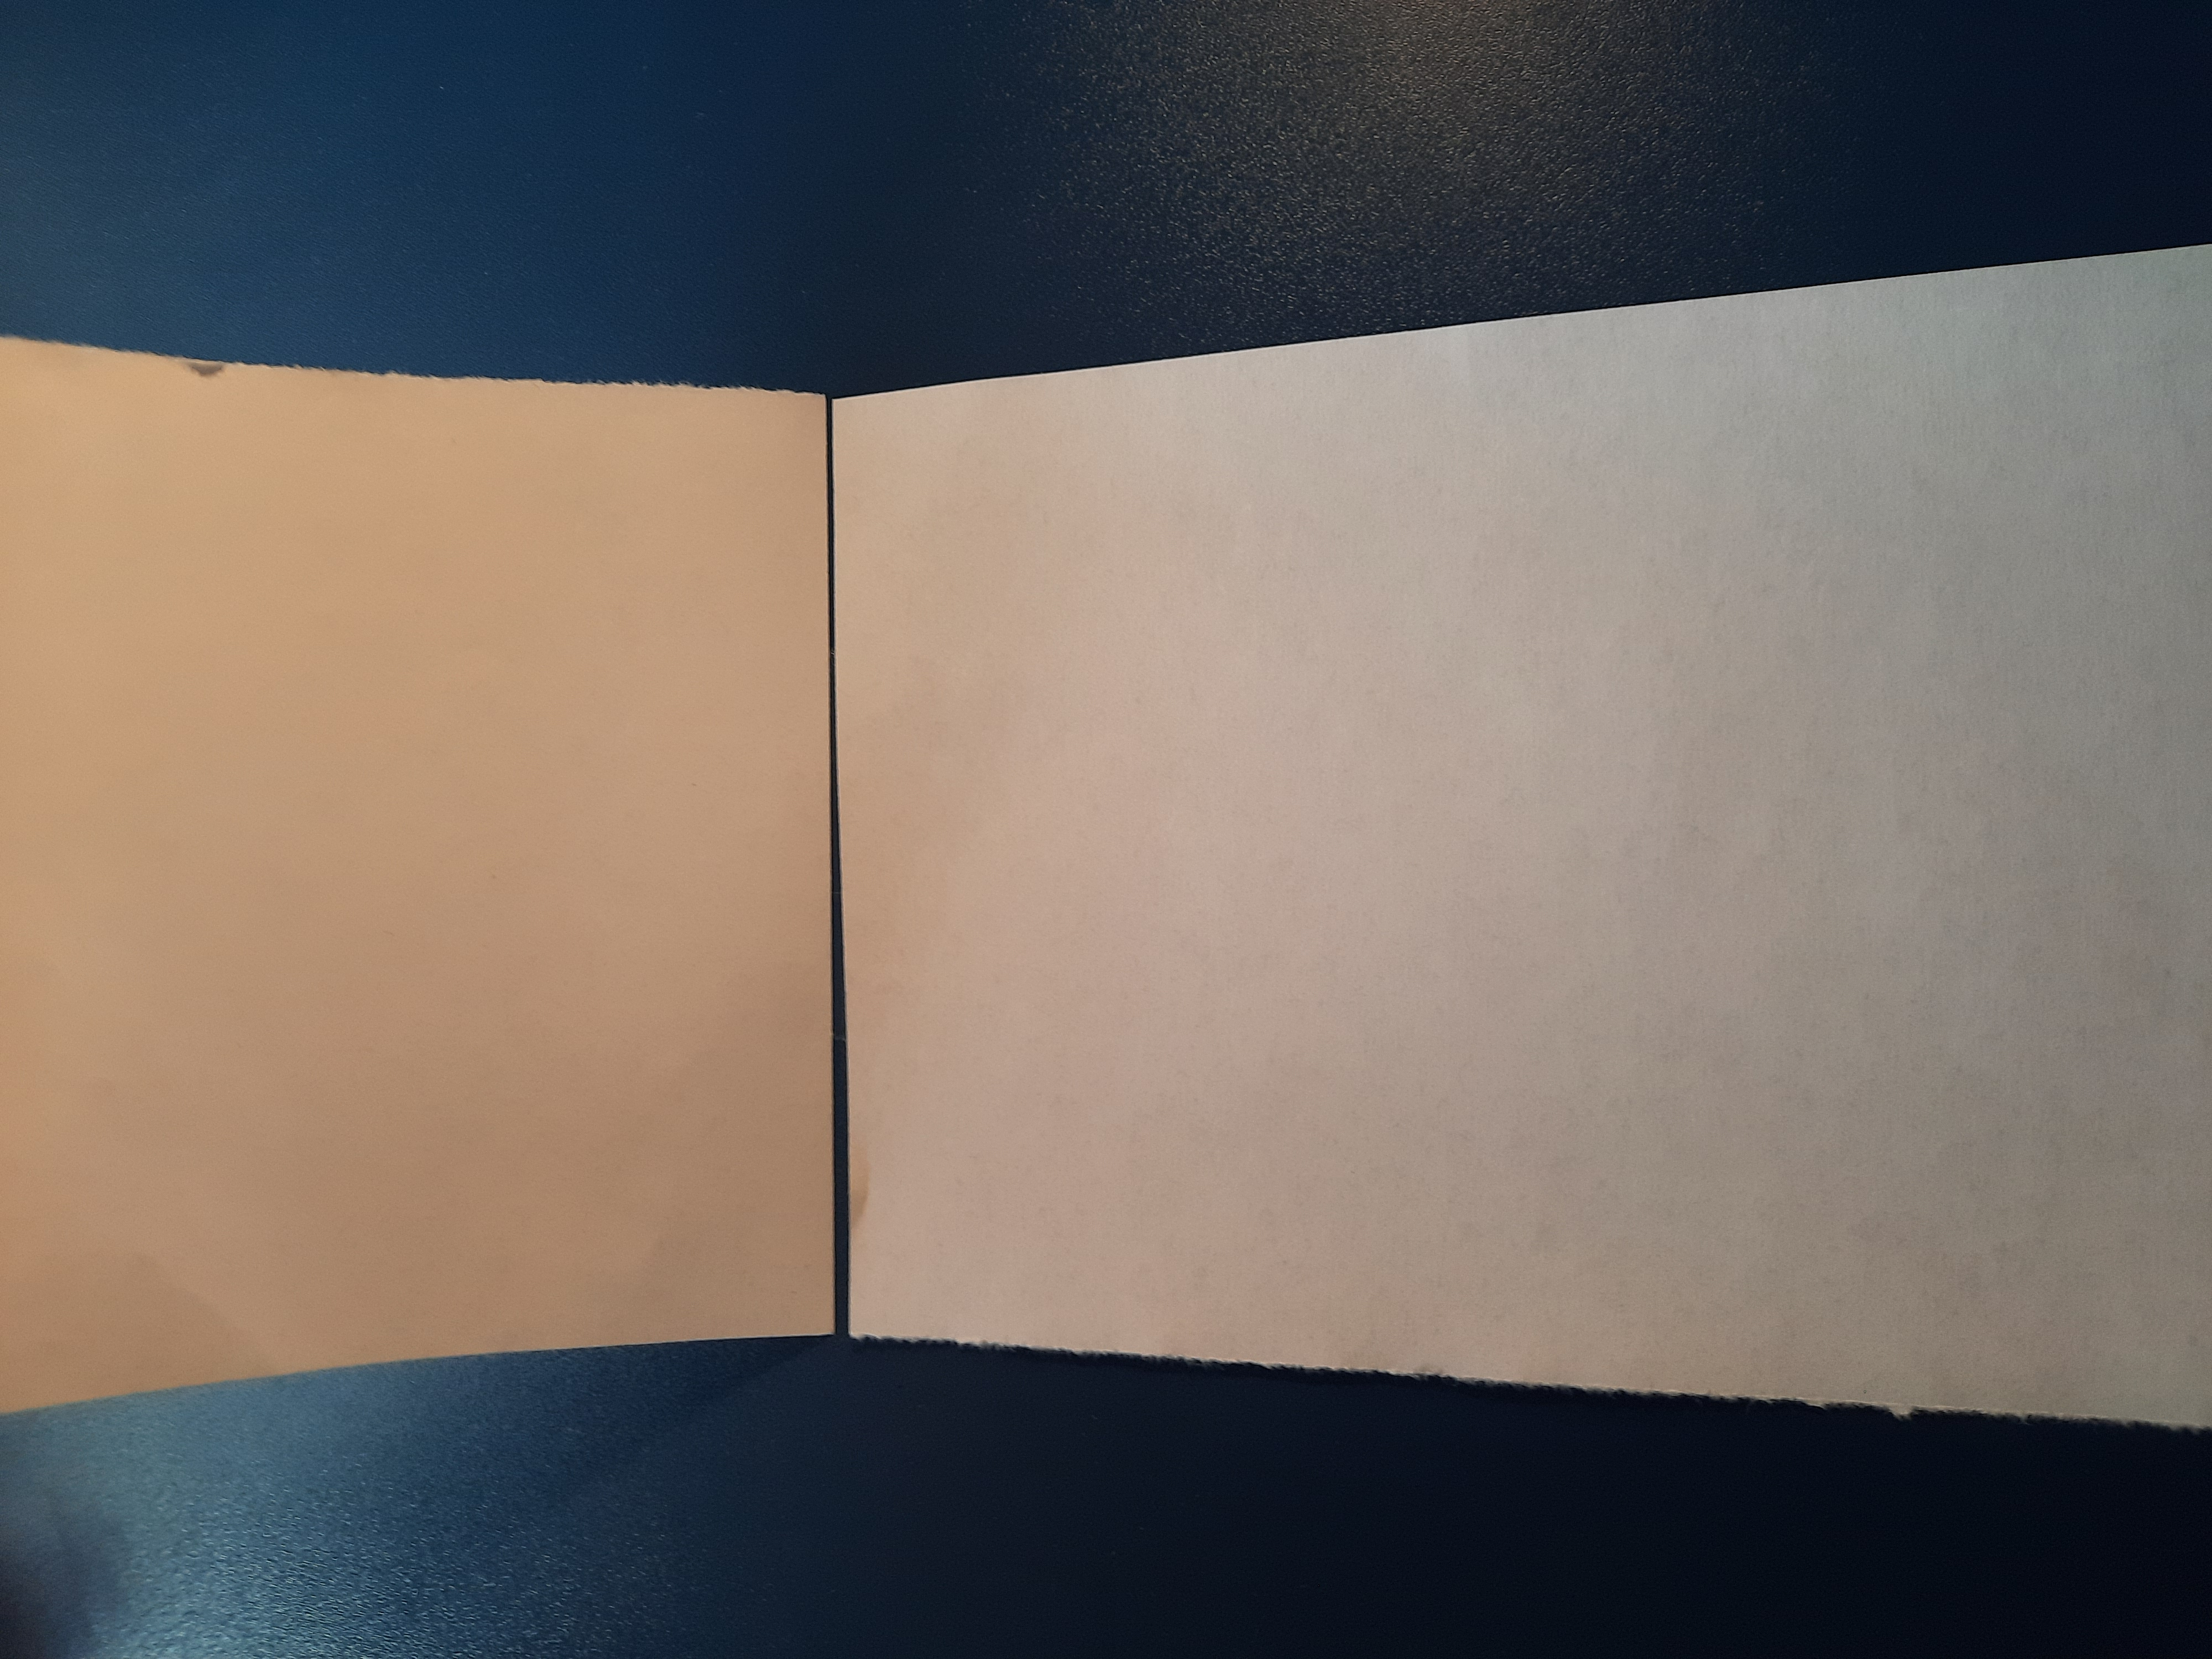
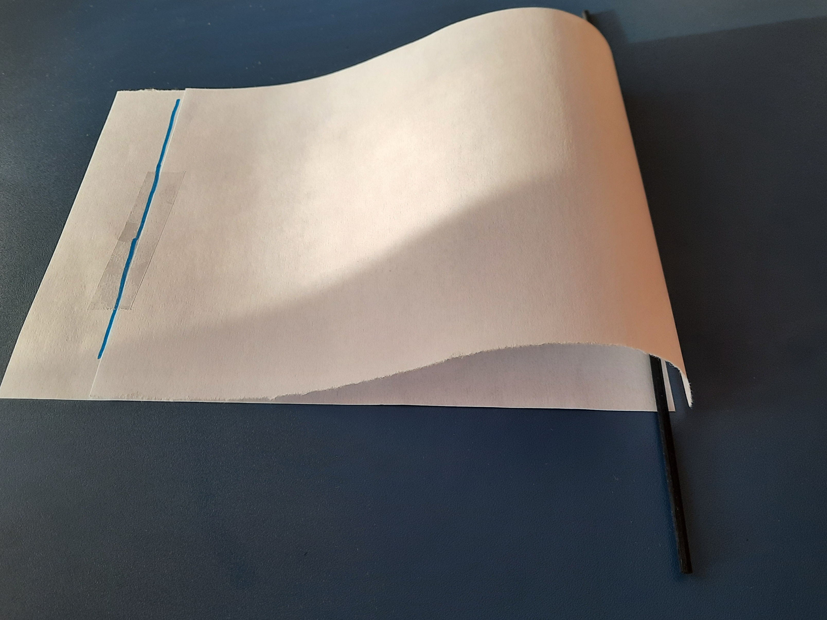
Follow these steps to conduct the experiment:
Place the two papers on top of each other such that they overlap properly.
Now stick the two sheets together with one adhesive tape on one of the two short sides so that they can be opened like a book.
Then lift the top sheet and stick it with another tape a little further into the center of the other sheet (approx. 3 fingers wide).
HINT: You can place an extra tape on the long side, rectangular to the tape you did in step 3, to make the hole flatter.
Check: You should have a curved paper on top and a flat paper on the bottom.
Now push the wooden stick through the hole and place it along the side that makes the larger bend.
Time for the experiment: Blow over the top surface, holding the wooden stick in both of your hands. You can either blow with your mouth or with a hairdryer.
For the steps one and two look at the following pictures:
Tape
Now the following steps in one picture:
Tape 3 fingers wide
Step 7 – blow into this direction
Wooden stick
Extra tape along the side (hint in step 4)

Slide 34
Exercise
Task 1
What happens if you blow over the top surface, holding the wooden stick in both of your hands?
From this experiment, you should observe that the airfoil lifts when you blow on top of it. If there is no one blowing, the airfoil goes down again.
Task 2
What can be the reason for that observation?
The reason for that is the special airfoil shape. The air is going faster over the top surface than it is on the bottom, because of the shape. During this process, the pressure on top is decreased, as the air has less time and possibilities to push on the surface of the top surface.
-> This means low pressure on the top and high pressure on the bottom. As a higher pressure always pushes, the airfoil goes up.
Task 3
What should be the shape of the blades, referring to the observations so far?
The shape of the blades or papers should mimic the profile of a teardrop-shaped airfoil. This shape allows air to flow smoothly over the surface, creating lift on one side of the blade and drag on the other, which causes the turbine to rotate.
Task 4
What factors could influence the output power of wind turbines?
Wind speed, blade size, blade shape, height, wind consistency, and machine parts

Slide 35
In summary
The experimentally constructed airfoils show how wind turbine blades are constructed and how they move when the wind blows.
Airfoils have a shape with a curved top and a flatter bottom to create a pressure difference when the air flows over them.
As the air moves faster over the top of the airfoil, there is a lower pressure at the top and a higher pressure at the bottom, which creates lift as the higher pressure pushes things upwards.
This airfoil is a model for wind energy wings and also for airplane wings!
Wind speed, blade size, blade shape, height, wind resistance and machine parts all influence the performance of wind turbines.

Slide 36
Wind Energy Education HUB
Chapter 4
Experiments with a wind turbine

Slide 37
Experiments with a wind turbine
In this chapter, we will explore:
The wind turbine experiment kit
Direction of the wind
Angle of attack
The task of a tail fin
Different movement of the turbine in different wind directions
What happens if you change the blade pitch
What happens if you change the blade length
How many blades must an ideal wind turbine have to generate the most energy
What happens if you try a one-blade wind turbine
Could you set an MPP (Maximum Power Point) at wind
Learning objectives
At the end of this chapter, you will:
Understand the importance of wind direction: Learn how aligning a wind turbine to the wind direction increases performance and how the angle of attack affects efficiency.
Explore the role of the tail fin: Discover how the tail fin helps the turbine to automatically align with the wind for maximum performance.
Learn about blade pitch adjustment: Understand how changing the blade angle affects the cross-sectional area exposed to the wind and influences power generation.
Evaluate the effects of blade length: See how longer blades can capture more wind and generate more power, but can also become too heavy, affecting performance.
Analyze blade weight: Understand the consequences of blades that are too heavy and the importance of minimum wind speed for take-off.
Compare the effects of blade count: Explore why three blades are often the optimal choice to balance performance and structural stability.
Understand the limitations of single-blade designs: Learn how using only one blade results in unbalanced rotation and increased stress on the turbine structure.
Introduction to the concept of maximum power point (MPP) in wind turbines: Briefly explore how turbine performance can be optimized by adjusting wind direction, blade pitch and design.

Slide 38
1. How to measure the power of wind turbines
To measure the power generated by the wind turbine, the experiments will use a multimeter. It is easy to handle and can measure electrical quantities like voltage, current, and resistance. For our experiments we stick to the unit of voltage to measure energy. Why that?
What is power?
Power is the amount of energy that something can produce or use in a certain amount of time. For wind turbines, power means the energy they create by turning wind into electricity.
How do we measure power?
Wind turbines generate electricity, and we need a way to measure how much power they produce. Normally, power is measured in units like watts (W). However, in some cases, we can use voltage to estimate power.
What is voltage?
Voltage is like the "pressure" in an electrical circuit. It tells us how strongly the electricity is being pushed through wires.
Higher voltage means more electrical energy is moving.
Lower voltage means less energy is being transferred.
Why is voltage a good proxy for power?
Voltage and power are closely related in wind turbines.
When the wind turbine produces more power, the voltage often increases.
You can think of it like water flowing in a pipe: higher water pressure (voltage) means more water (power) flows.
In summary
Voltage is a helpful way to measure the power output of wind turbines because it directly reflects how much electrical energy is being produced at any moment.

Slide 39
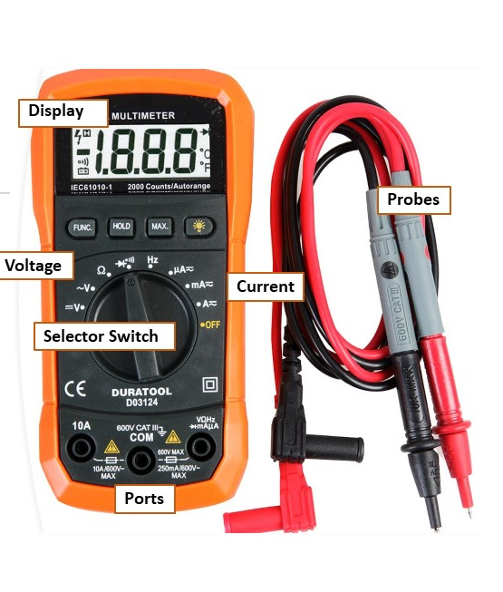
2. How to use a multimeter
What is a multimeter?
A multimeter is a handy tool that can measure electrical quantities like voltage, current, and resistance. Here’s a simple guide on how to use it, along with an explanation of its key parts and steps. For our experiments we stick to the unit of voltage to measure energy.
Parts of a multimeter
Display: Shows the measurement results.
Dial/Selector Switch: Used to select the quantity you want to measure (voltage, current, or resistance).
Probes: Two wires with metal tips that you hold against the point you want to measure. The red probe is usually for positive connections, and the black probe is for negative connections.
Ports: Sockets where you plug in the probes. There are usually three:
COM: Common port, always for the black probe.
VΩmA: For the red probe when measuring voltage, resistance, or small currents.
10A: For the red probe when measuring high currents.
Important Steps to Use a multimeter
Turn on the multimeter: Make sure the multimeter is on by turning the dial.
Select the measurement type:
Voltage (V): To measure voltage, turn the dial to "V" with a straight line (for DC voltage) or a wavy line (for AC voltage).
Just for complete information:
Current (A): To measure current, turn the dial to "A" with the corresponding symbol. Choose between "mA" (milliamps) and "A" (amps) depending on the expected current. → we usually just use mA!
Resistance (Ω): To measure resistance, turn the dial to the "Ω" symbol.

Slide 40
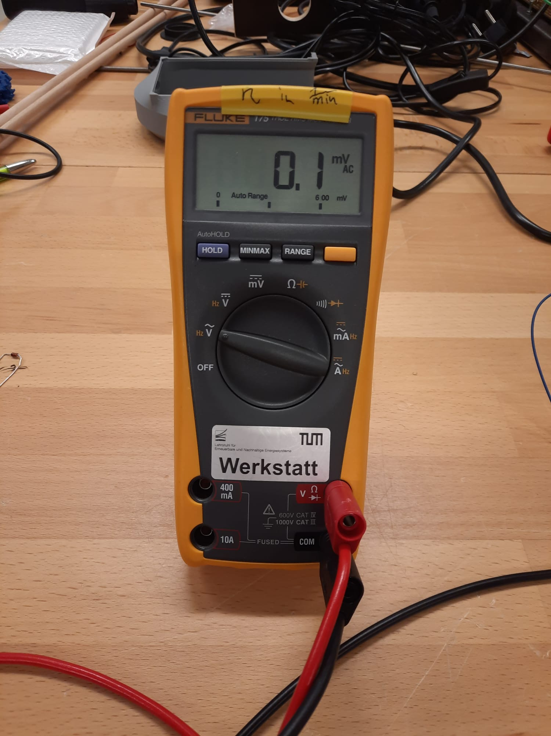
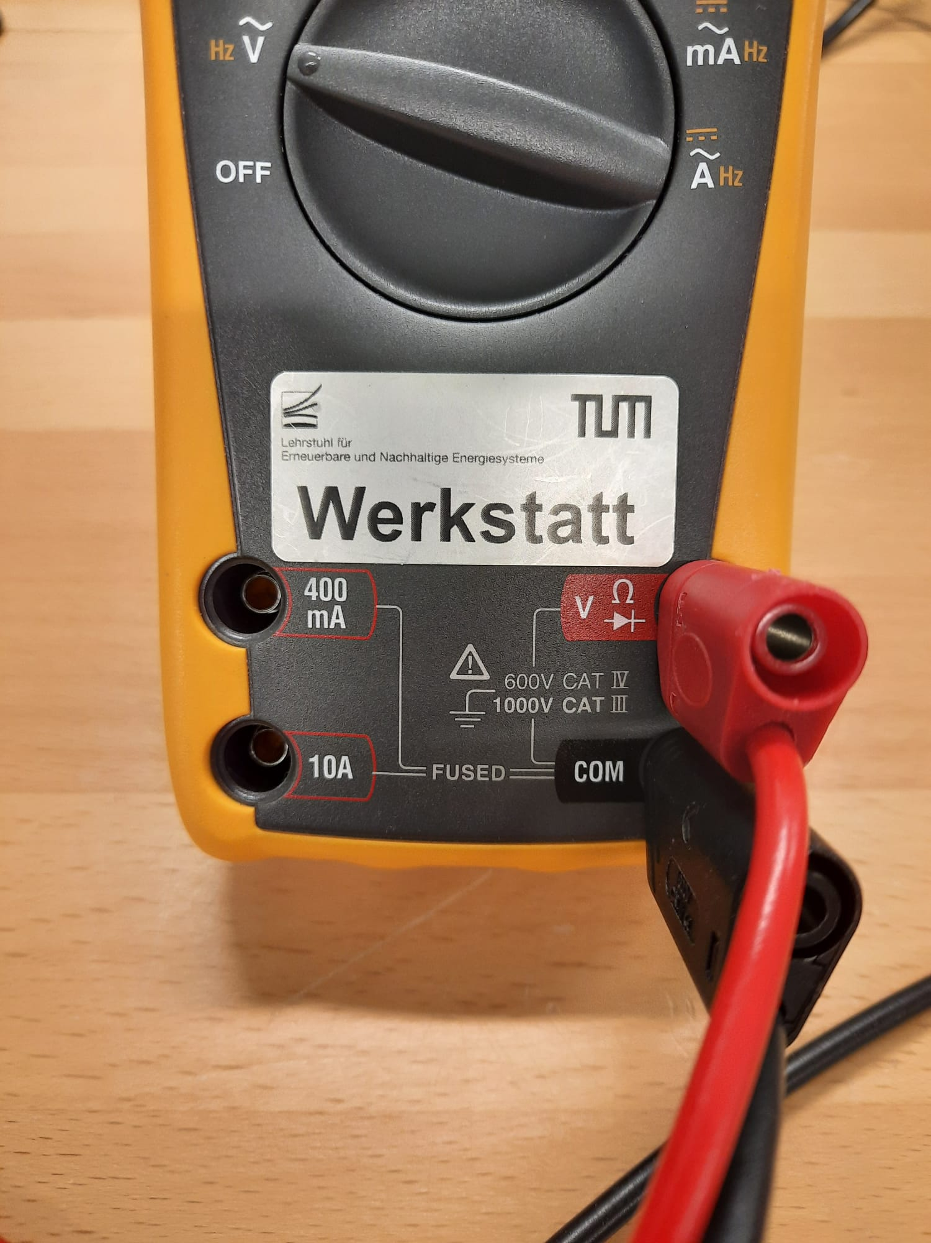
Set it to AC
Put in the cables like this

Slide 41
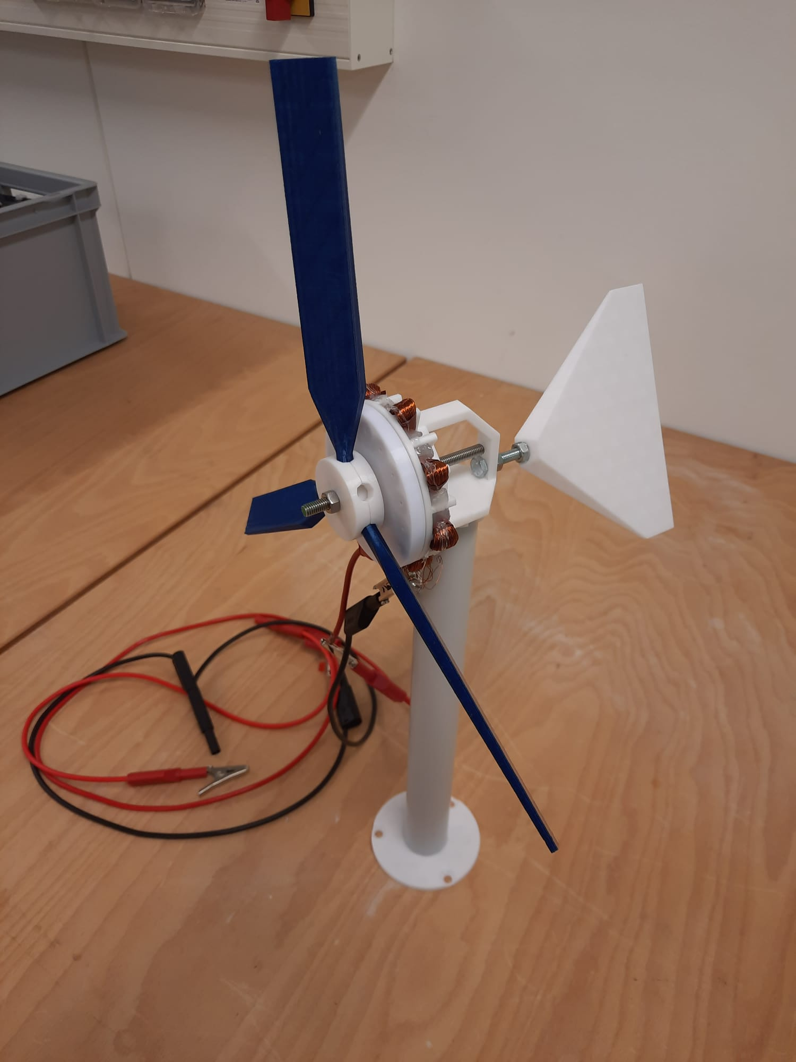
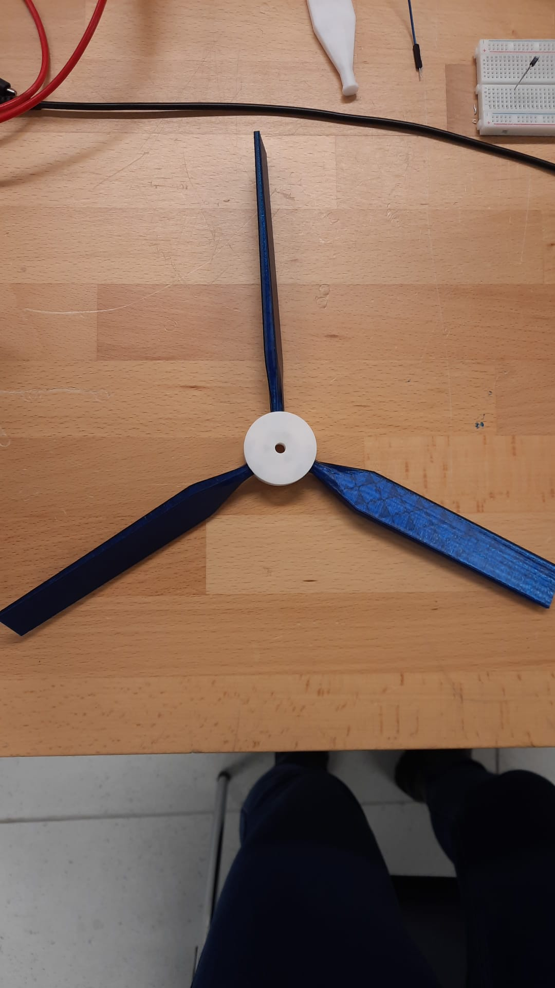
3. How to use the wind turbine kit
It's time for you to gain hands-on experience with our wind turbine experiment kit! The kit replicates the basic functions of a real wind turbine and helps you to explore how it works and which factors influence its efficiency.
The picture below shows the different parts of the wind turbine and how to assemble it. Take a look before you start!
If you have any questions, don't hesitate to ask your teacher for help.
Blades
Tail fin
Nacelle (hole can be used to fix generator with a screw)
Cables
Generator
Tower
Angle of 90°
You can adjust the blade angles, as shown in the picture. For most experiments, we’ll use the blades in a flat position—unless stated otherwise.
Flat
Angle of 45°

Slide 42
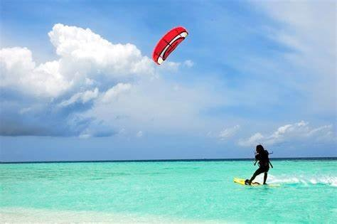
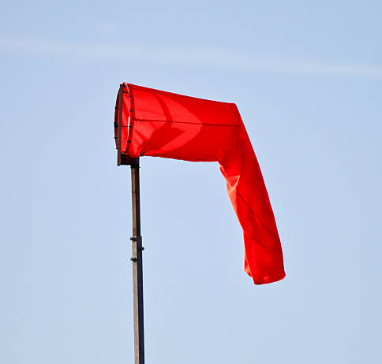
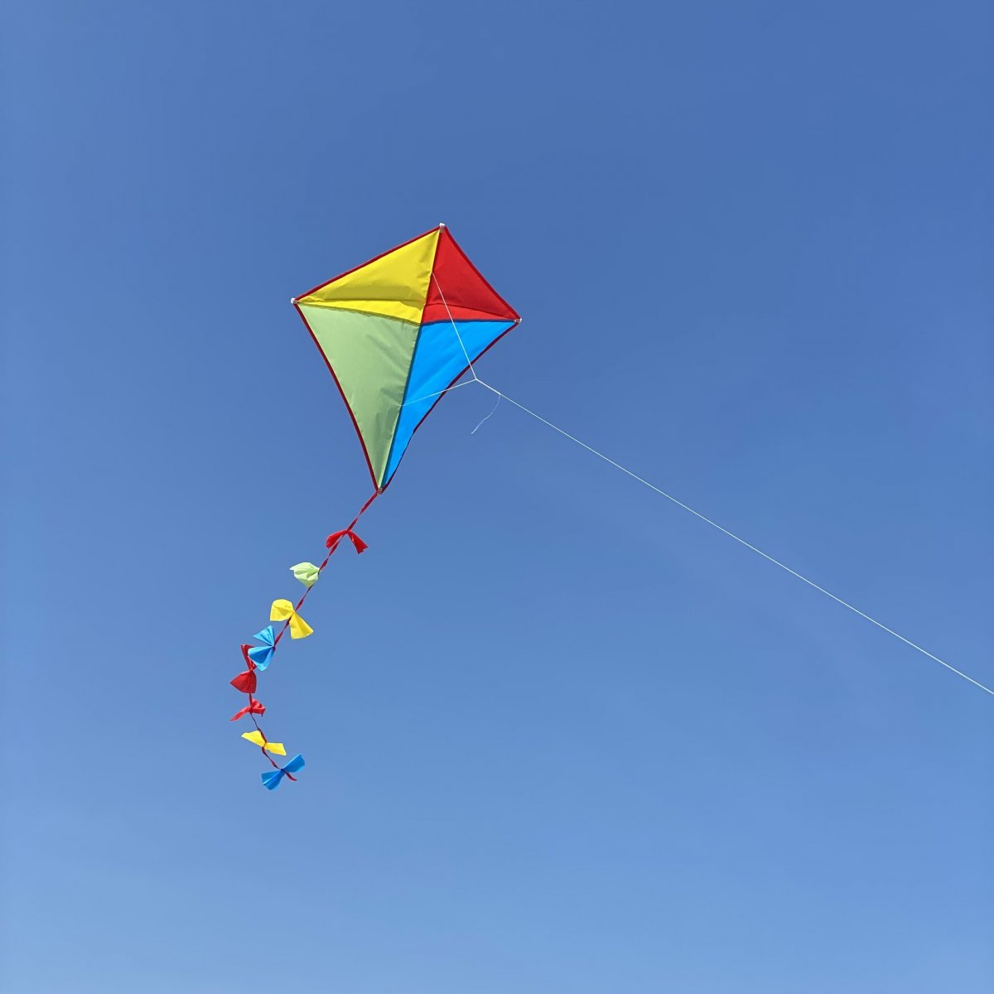
4. Changing direction of wind
Exercise
Task 1
Look at the pictures below and draw the arrows of the wind direction so that the objects move as fast or as well as possible!
What do they all have in common?
If you are finished, compare your answers in a group of 3-4 students.
Direct wind has most power to move the objects.

Slide 43
Experiment
Material you will need for the experiment
Wind kit with 3 blades, medium size
Fan
Multimeter
Follow these steps to conduct the experiment
Take your wind set and prepare it so that it contains three blades and place it in one position. Make sure that this position remains the same to ensure that the results are not affected by a different distance from the fan.
Place your wind set in front of the fan. Attach the nacelle with a screw (there are various holes you can use). The angle of the blades should be flat.
Now measure the voltage with the multimeter for low, medium and high speed with your fan for the following directions (maybe give a first push):
Front view
Turn it to the side (45°)
Turn it to the side (90°)
Look at the pictures below to see what the directions mean and try the same with your wind kit.
Report your answers in the observation table.
Look at the pictures on the next page to see what the different angles mean in execution.

Slide 44
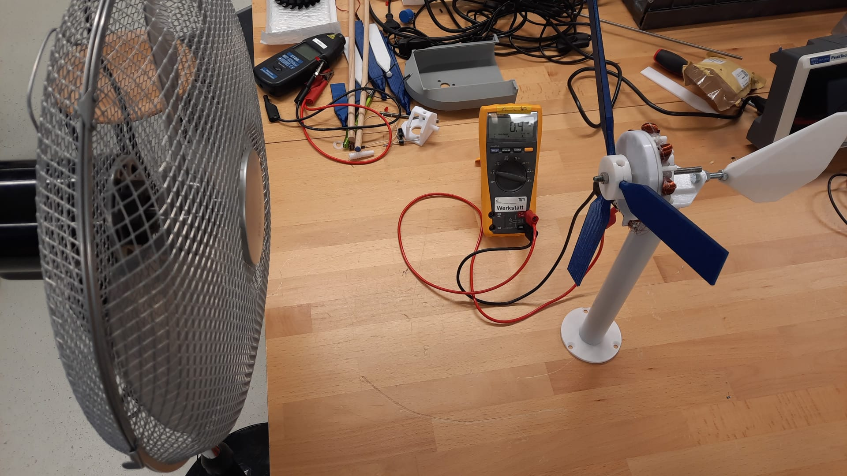
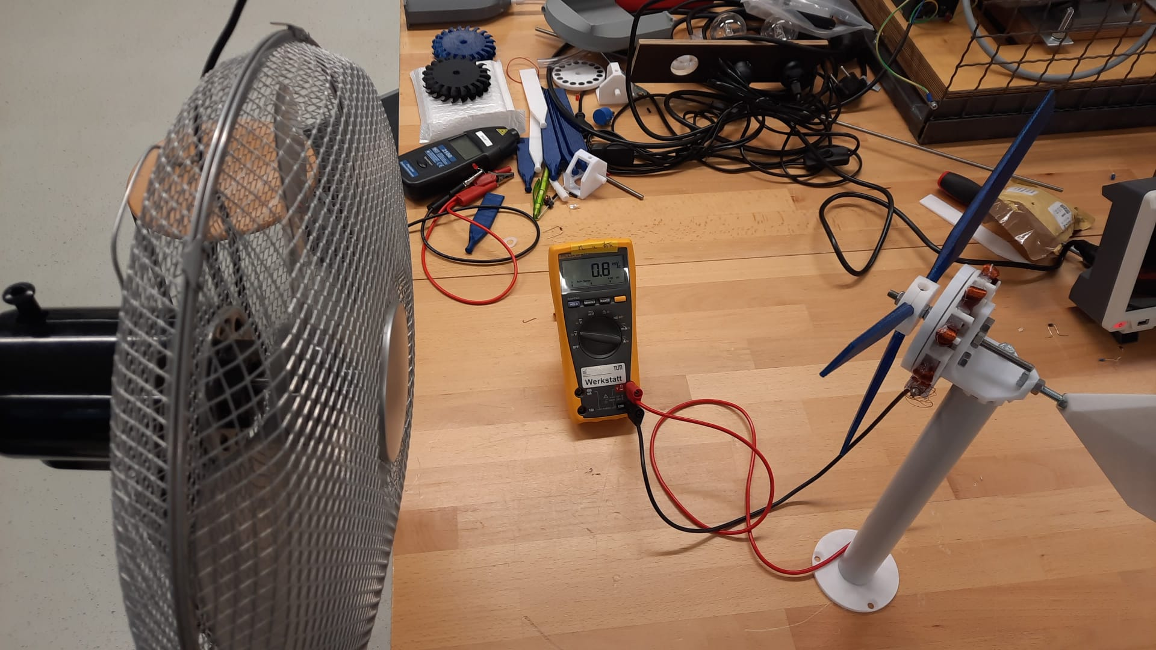
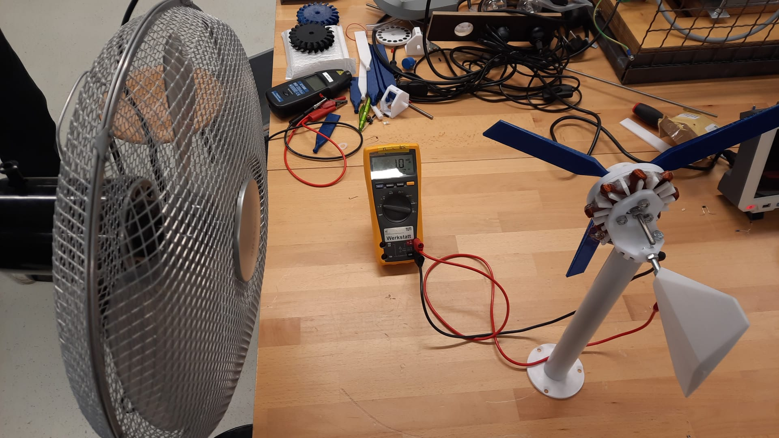
Front view
Side view (45°)
Side view (90°)

Slide 45
Direction of fan | Wind strength | Voltage mV (AC)
Front view | Low | 480
Front view | Medium | 770
Front view | High | 1200
Side view (45°) | Low | 160
Side view (45°) | Medium | 250
Side view (45°) | High | 410
Side view (90°) | Low | 0
Side view (90°) | Medium | 0
Side view (90°) | High | 0
Exercise
Task 2
What did you observe? What does that mean?
The front view has the highest outcome, so direct wind has more power!

Slide 46
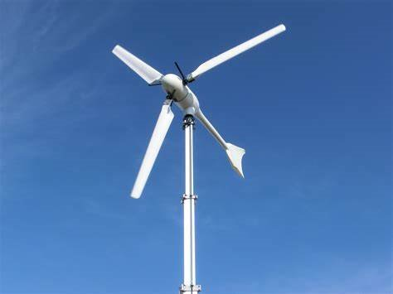
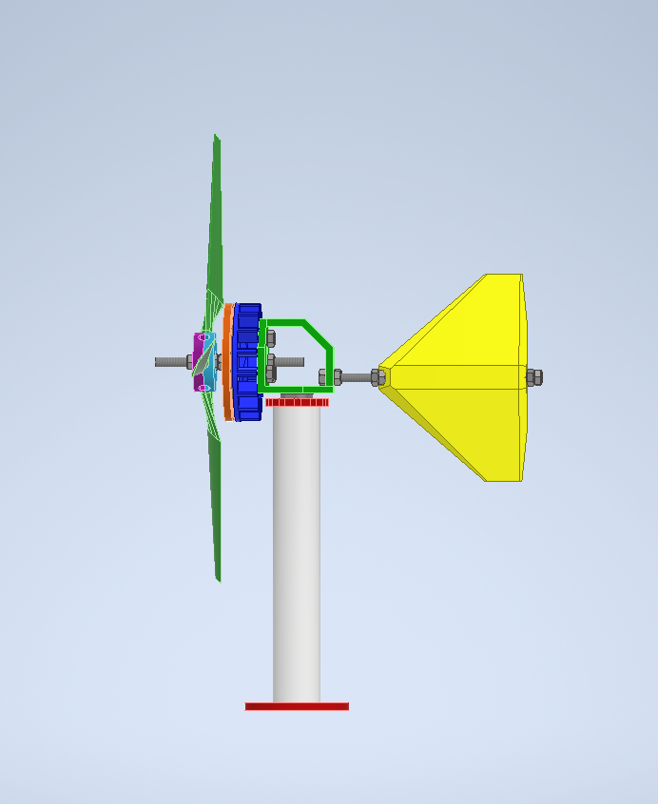
5. Angle of attack
Exercise
Task 1
Since we now know that the wind turbine must face directly into the wind AND the wind changes throughout the day, the wind turbine must adjust its direction.
How can we align a wind turbine so that it faces directly into the wind?
Look at the pictures below and think of a part that could be a solution.
Talk to your neighbor and think about your ideas.
Write your solution in the box below.
Tail Fin
Tail fin
In order to make a wind turbine face the wind, a tail fin is attached.

Slide 47
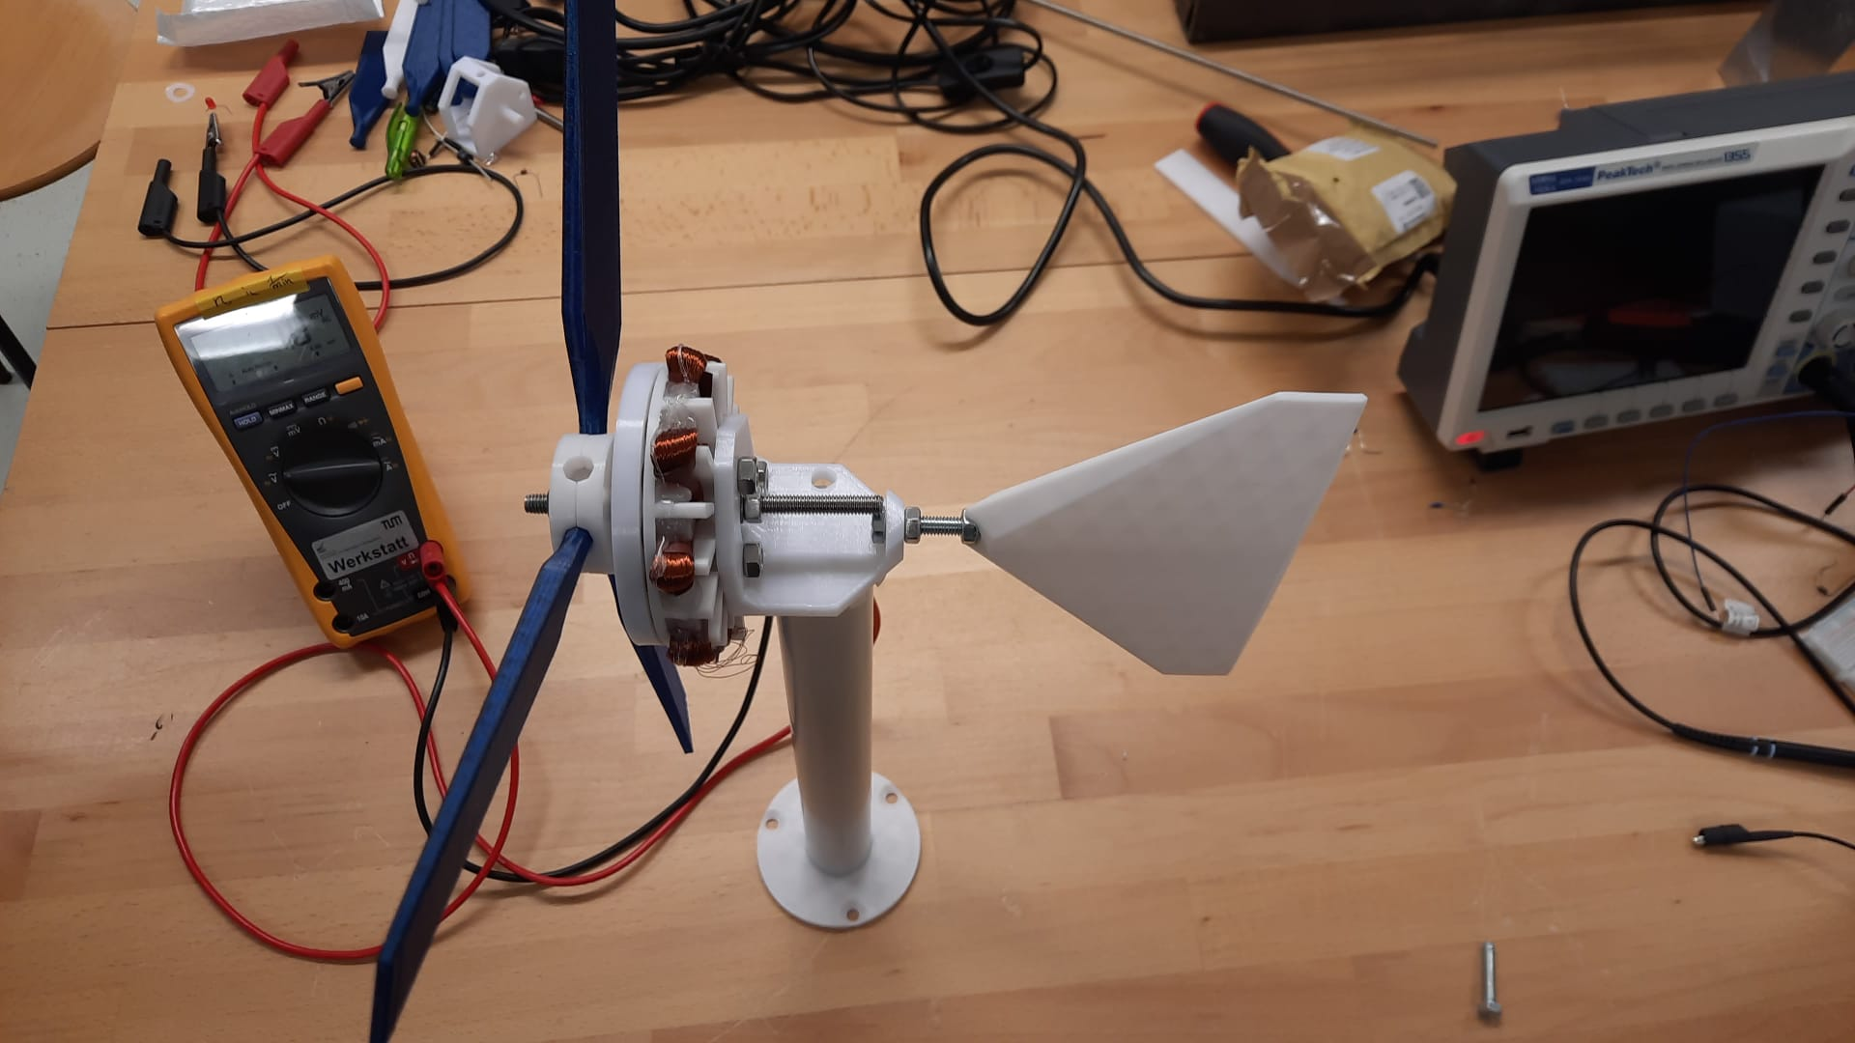
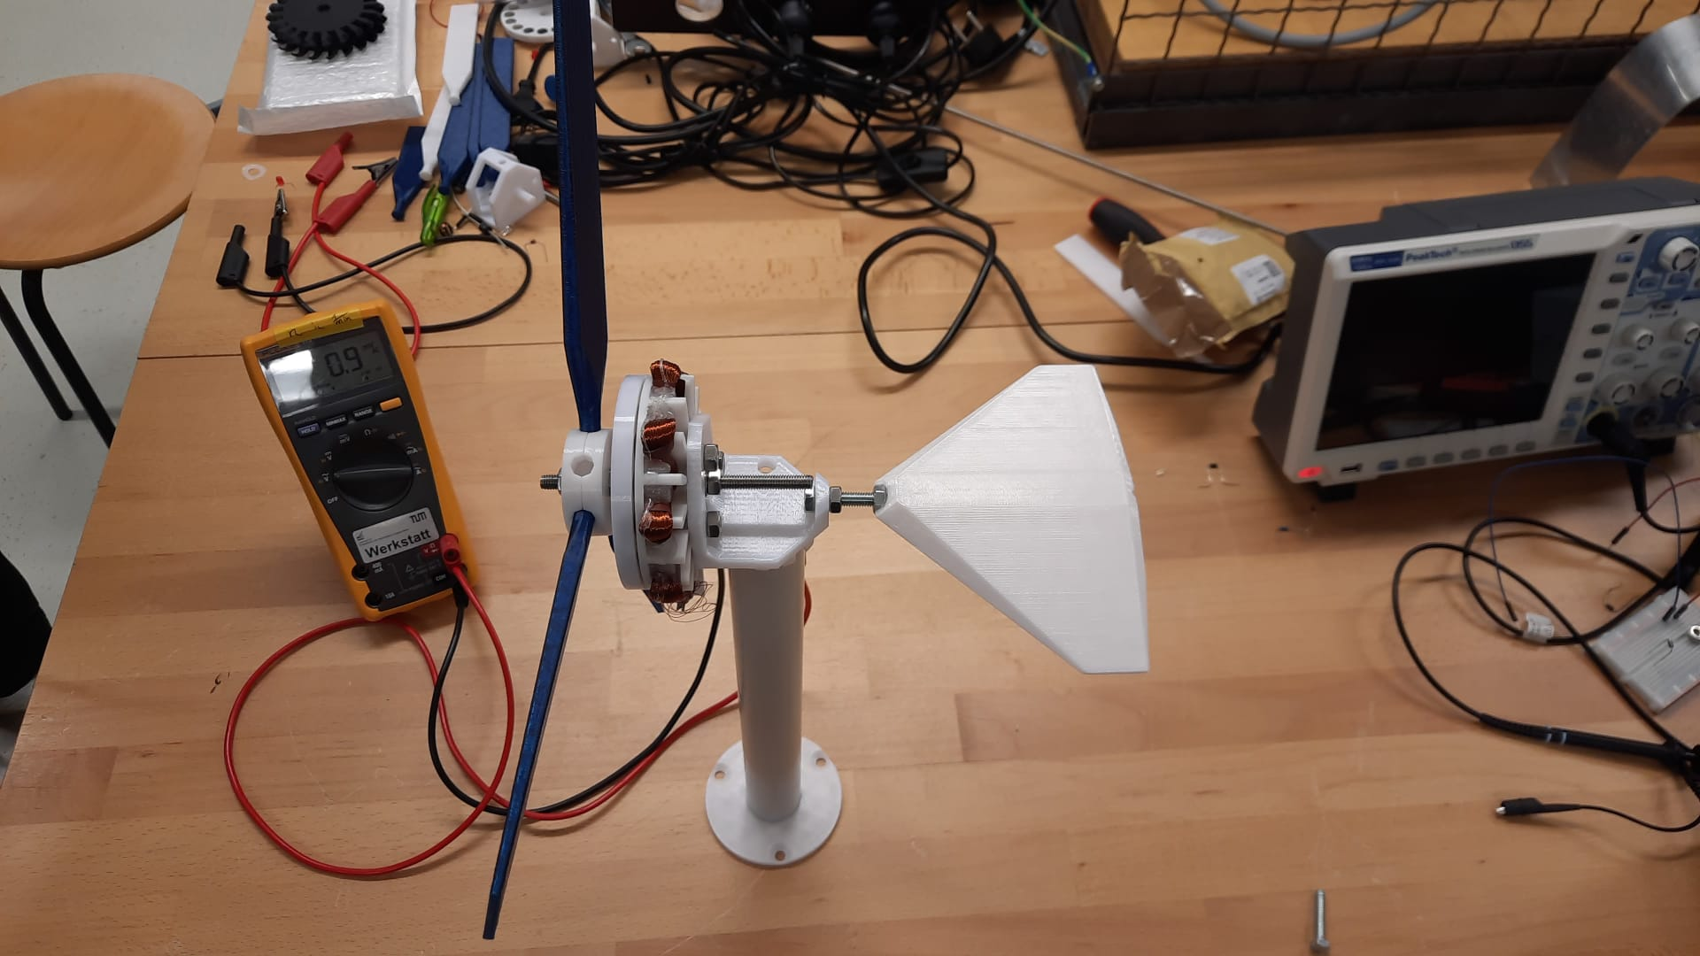
6. Using a tail fin
Experiment
Material you will need for the experiment
Wind kit with 3 blades, medium size
Fan
Follow these steps to conduct the experiment
Take your wind set and prepare it so that it contains three blades and place it in one position. Make sure that this position remains the same to ensure that the results are not affected by a different distance from the fan.
Place your wind set in front of a fan. The angle of the blades should be flat. Do not fasten the nacelle with a screw!
Now measure the voltage with the multimeter for high speed with your fan for the following directions:
Tail fin in work = vertical
Tail fin not in work = horizontal
What did you observe? Write down your answers in the free text space!
Tail fin in progress = vertical
Tail fin not in progress = horizontal

Slide 48
Direction of Tain Fin | Voltage mV (AC)
Tail fin in work
Tail fin not in work
Exercise
Task 1
Why do we need a functioning tail fin?
The tail fin enables the wind turbine to turn in the direct direction of wind. Without a working fin (horizontal), the wind turbine moves randomly away from the wind source.
Task 2
Why do you think the turbine is able to move with the tail fin?
The turbine moves to reduce drag on the tail fin. The lowest drag on the tail fin exists when the turbine faces direct wind.
In summary
The wind direction has an influence on the power generation of a wind turbine.
We have found that direct wind produces more power. Therefore, the angle of attack is an important concept to consider.
A functioning tail fin is required so that the turbine can face directly into the wind. This is because the turbine moves to reduce drag on the tail fin.
Therefore, a tail fin is essential for generating the maximum possible power.

Slide 49
Let’s test your knowledge!
Task 1
What have we learned so far? Fill in the blanks and find out!
The __________ (direct/side) wind has more power.
To make the wind turbine face the wind, we attach a __________ (tail fin/rotor blade).
The __________ (turbine/generator) spins to face the direct wind direction.
The turbine moves to reduce __________ (power/drag) on the tail fin.
The __________ (speed/angle) of attack affects how the turbine faces the wind.
_______ (Direct/Side) wind has more power to move wind turbines.
Wind turbines need _________ (less/more) wind to produce much energy.
Task 2
Are the following statements true or false? Tick the boxes.
Direct wind has more power than side wind.
True False
The tail fin is attached to make the turbine face away from the wind.
True False
The turbine moves to reduce drag on the tail fin.
True False
Wind turbines do not need to face the wind to generate the most power.
True False
The tail fin helps the turbine align with the wind direction.
True False

Slide 50
7. Changing blade pitch
Experiment
Material you will need for the experiment
Wind kit with 3 blades, medium size
Fan
Multimeter
Follow these steps to see the difference in blade pitch:
Take your wind set and prepare it so that it contains three blades and place it in one position. Make sure that this position remains the same to ensure that the results are not affected by a different distance from the fan.
Place your wind set in front of the fan. Attach the nacelle with a screw (there are various holes you can use). The angle of the blades is now different, see the pictures on the next slide.
Now measure the voltage with the multimeter for low, medium and high speed with your fan for the following angles (maybe give a first push):
Angle of 90°
Angle of 45°
Flat
Report your answers in the observation table.
Angle of 90°
Flat
Angle of 45°

Slide 51
Blade Pitch | Wind strength | Voltage mV (AC)
Angle of 90° | Low | 530
Angle of 90° | Medium | 690
Angle of 90° | High | 850
Angle of 45° | Low | 270
Angle of 45° | Medium | 330
Angle of 45° | High | 440
Flat | Low | 760
Flat | Medium | 1000
Flat | High | 1500
In summary
Adjusting the angle of the blades influences how the wind moves them. The right angle ensures that the blades rotate faster and generate more energy.
How much energy the turbine can capture depends on how strongly the wind hits the blade. A flat-angled blade has the highest efficiency.

Slide 52
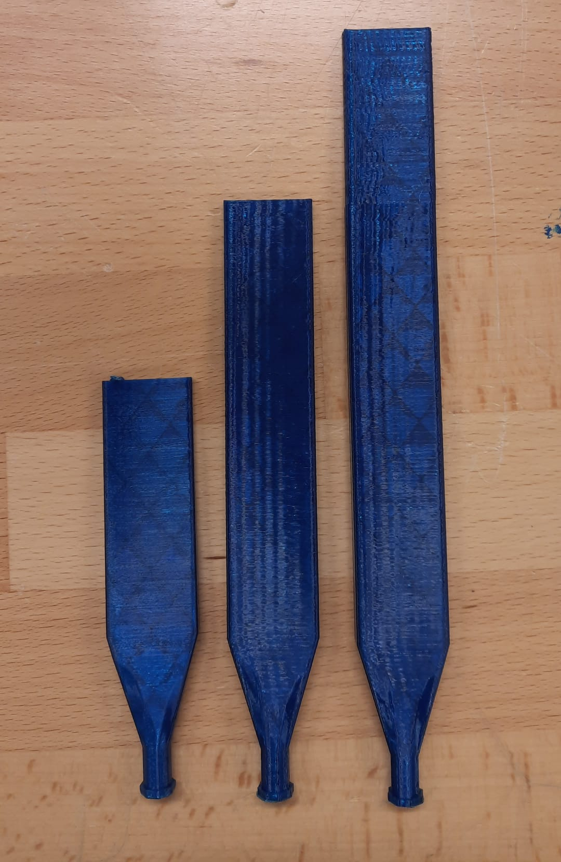
8. Changing blade length
Experiment
Material you will need for the experiment
Wind kit with 3 blades
Fan
Multimeter
Follow these steps to conduct the experiment:
Take your wind set and prepare it so that it contains three blades and place it in one position. Make sure that this position remains the same to ensure that the results are not affected by a different distance from the fan.
Place your wind set in front of the fan. Attach the nacelle with a screw (there are various holes you can use). The angle of the blade should be flat.
Now measure the voltage with the multimeter for low, medium and high speed with your fan for the following blade lengths (maybe give a first push):
short
Medium
Large
Look at the picture to see the lengths.
Report your answers in the observation table.
Large
Medium
Short

Slide 53
Blade Length | Wind strength | Voltage mV (AC)
Short blade | Low | 450
Short blade | Medium | 740
Short blade | High | 1150
Medium blade | Low | 680
Medium blade | Medium | 960
Medium blade | High | 1300
Large blade | Low | 610
Large blade | Medium | 790
Large blade | High | 1000
Exercise
Task 1
What is your observation? How does the length of the blades affect the wind kit’s turning speed?
Shorter blades have lower voltage output and the medium size blades are optimal. Therefore, the longer the blades, the better the output is not always true.
In summary
Blade lengths affect directly how much wind is captured by the wind turbine.

Slide 54
9. Changing number of blades
Experiment
Material you will need for the experiment
Wind kit with 2, 3, 6 blades, medium size
Fan
Multimeter
Follow these steps to conduct the experiment:
Take your wind set and prepare it so that you have different blade lengths and place it in one position. Make sure that this position remains the same to ensure that the results are not affected by a different distance from the fan.
Place your wind kit in front of a fan. Attach the nacelle with a screw (there are various holes you can use). The angle of the blades should be flat.
Now measure the voltage with the multimeter for low, medium and high speed with your fan for the following blade numbers (maybe give a first push):
Two blades
Three blades
Six blades
Look at the pictures on the next slide to see how it looks and try the same with your wind kit.
Report your answers in the observation table.

Slide 55
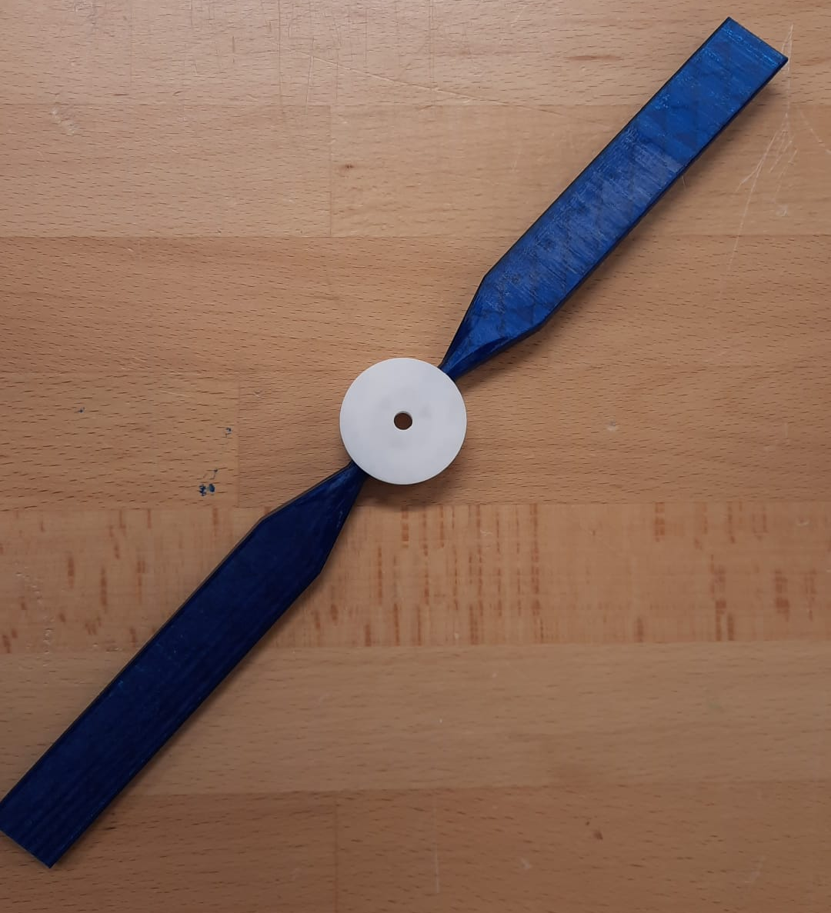
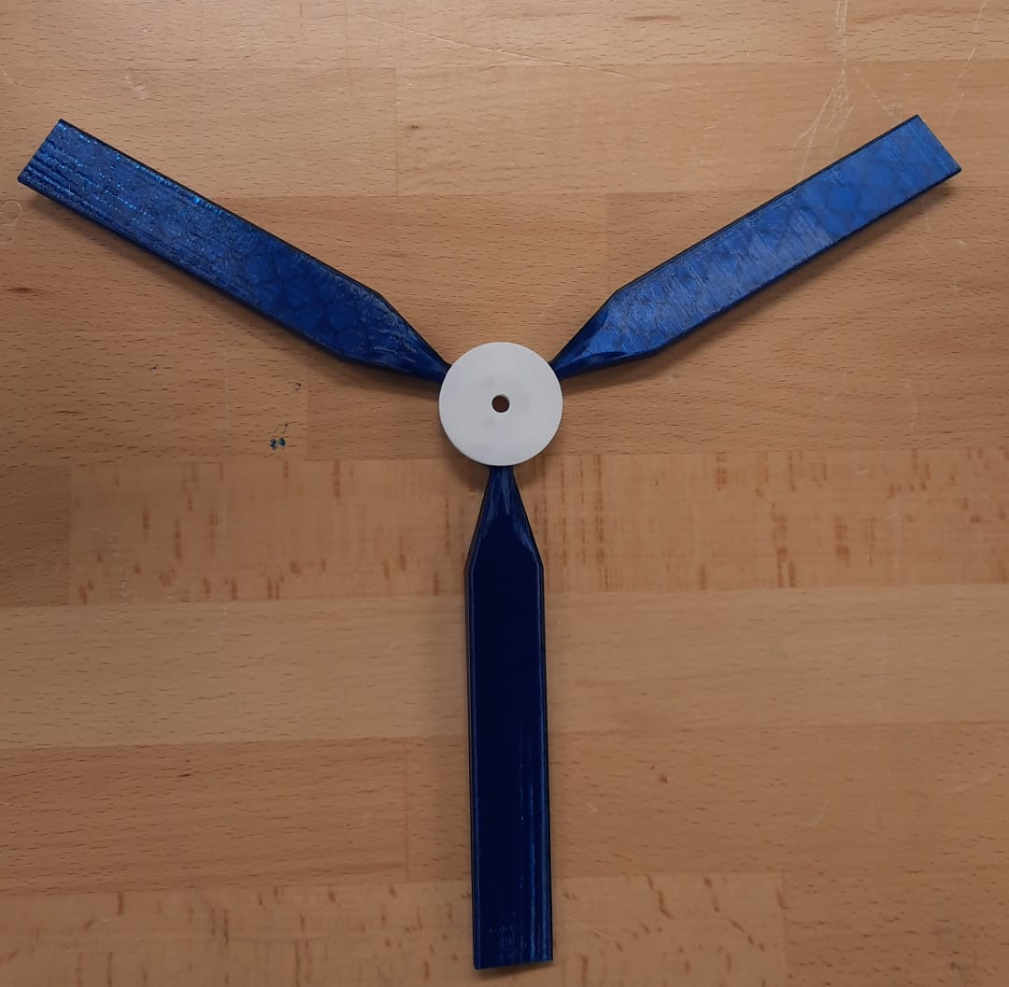
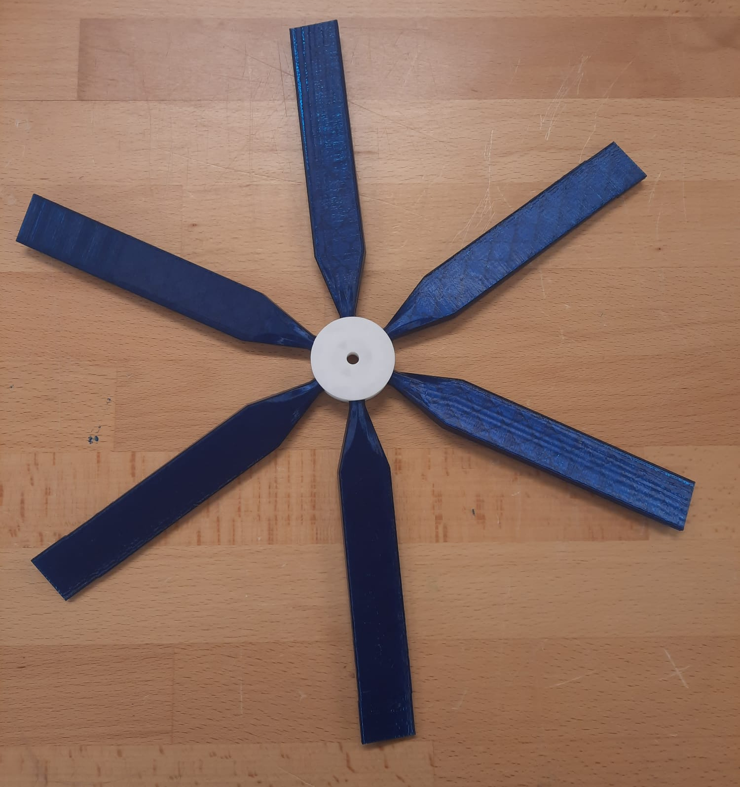
Blade Length | Wind strength | Voltage mV (AC)
2 blades | Low | 490
2 blades | Medium | 730
2 blades | High | 1000
3 blades | Low | 680
3 blades | Medium | 960
3 blades | High | 1300
6 blades | Low | 860
6 blades | Medium | 1400
6 blades | High | 2300
Exercise
Task 1
What differences do you notice in voltage output between different blade configurations?
The number of blades directly affects the turbine's ability to generate voltage. With fewer blades, the turbine produces less voltage output. A higher number of blades (e.g., 6-blade configuration) generally increases voltage output and stability but may introduce resistance, particularly at high wind speeds.

Slide 56
Task 2
What happens to the stability when the number of blades increases?
As the number of blades increases, stability improves because the wind force is distributed evenly across more blades. However, additional blades also create drag and turbulence, which can reduce rotational speed and overall efficiency.
Task 3
What are the advantages and disadvantages of using turbines with more blades in real-world wind farms?
Advantages: More blades provide greater stability, especially in lower wind conditions. Higher voltage output due to improved wind energy capture. More reliable performance across a range of wind speeds. Disadvantages: Higher resistance to starting and spinning due to increased inertia. Lower efficiency in very high wind conditions. Increased material costs and engineering challenges.
In summary
The number of blades affects the efficiency of the turbine, the ease of starting and the voltage output.
Fewer blades may spin faster, but produce less consistent power and stability.
More blades provide greater stability and power generation, but can encounter resistance at high wind speeds.
Engineers optimize blade design to compensate for these trade-offs for specific wind farm conditions.

Slide 57
10. What happens with a wind turbine with only one blade?
Experiment
Material you will need for the experiment
Wind kit with 1, 3 blades, long size
Multimeter
Fan
Follow these steps to conduct the experiment:
Take your wind set and prepare it so that you have attached a blade or three blades of “long” length, depending on what you want to start with. Make sure that this position remains the same to ensure that the results are not affected by varying distance from the fan.
Place your wind kit in front of a fan. Attach the nacelle with a screw (there are different holes you can use). The angle of the blades should be flat.
Now measure the voltage with the multimeter for high speed with your fan for the following blade numbers (maybe give a first push):
One blade
Three blades
Look at the pictures on the next slide to see how it looks and try the same with your wind kit.
Report your answers in the observation table.
HINTS:
It is possible that the wind turbine with one blade will not work from the start. Give it an initial push and it should move!
Place the fan directly in front of the wind wheel or try to use even more wind speed if it doesn't work properly!

Slide 58
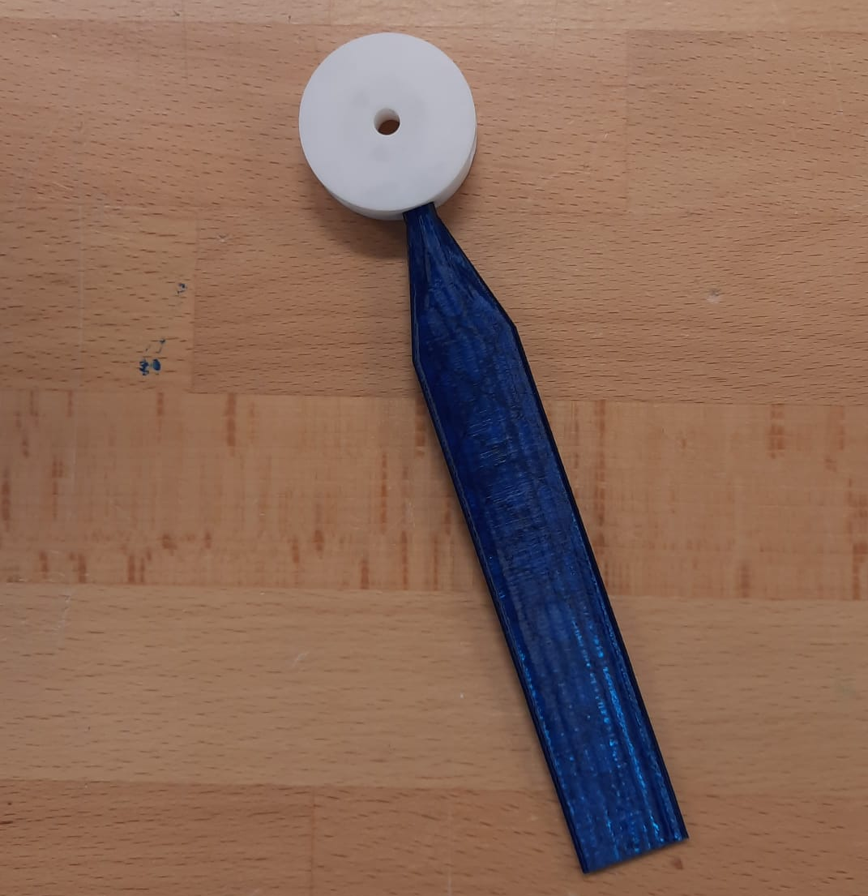
Number of blades | Wind strength | Voltage mV (AC)
1 blade, long size, really near to the fan | High | 600-1000 (volatile)
3 blades, long size, really near to the fan | High | 790
Exercise
Task 1
What did you observe?
The wind turbine with just one blade has a totally different movement dynamic.
It moves in a pulsating way, not continuously. The blade spins quickly at times, then stops for a short pause, and then spins quickly again. The movement looks like a pattern of fast spins followed by brief pauses, similar to a modified sine wave.

Slide 59
Task 2
Which blade number had a higher voltage at peak times?
The one-blade-wind-turbine has a higher voltage when it is a point in time to move.
Task 3
What happens to the stability of the wind turbine in both cases?
For the one-blade-wind-turbine, the system moves but is strongly unbalanced. You even need to hold it, because otherwise it moves.
This causes more stress on the system and it therefore not an optimal choice.
Task 4
What are possible explanations for your observation? And which system is better for wind energy generation in your opinion?
This happens because the forces acting on the single blade are uneven, causing the speed to change suddenly. Without other blades to counterbalance the weight, the turbine will move significantly different. This instability can increase vibrations, leading to different load points or even causing the turbine to break.
In summary
With a wind turbine with only one blade, the turbine still moves, but it rotates completely differently.
The single-blade wind turbine moves unbalanced. The speed can change suddenly.
Three blades are more balanced; have a good power output and are therefore the optimum number of blades.

Slide 60
Let’s test your knowledge on chapter 4!
Task 1
Fill in the blanks
The direction of wind has __________ (no/an) influence on the generation of wind.
To make the wind turbine face the wind, we attach a __________ (tail fin/rotor blade).
The pitch of the blade if it is optimal when it is ___________ (angled/flat).
The _________ (shorter/longer) the blade is, the power production increases.
If the blade is really heavy, the power will __________ (drop/increase).
To generate the optimal power output with a wind turbine and have a balanced wind turbine system, the number of blades should be ________ (one/two/three/six).
The turbine turns in an asymmetrical way if the number of blades is ________ (one/two/three/six).
Task 2
Write down at least three new things you have learned so far that you do not want to forget!

Slide 61
Task 3
Fill in the blanks
The Maximum Power Point (MPP) is the point where a wind turbine generates the _________ (lowest/highest/moderate) power output under given wind conditions.
To optimize energy capture, the blade angle (pitch) should be ________ (adjusted/fixed/ignored) according to wind speed.
Yaw control helps the turbine ________ (stay fixed/rotate towards/rotate away from) the wind direction for maximum efficiency.
Wind turbines use ________ (sensors/batteries/magnets) to monitor wind speed and adjust for MPP in real time.
Increasing rotor speed beyond MPP results in ________ (optimal performance/energy loss/increased efficiency).
Task 4
Are the following statements true or false? Correct the statements if they are false.
MPP ensures a wind turbine always operates at its maximum efficiency. False. Correction: MPP optimizes energy capture, but efficiency may vary based on wind conditions.
2. Blade pitch control is unnecessary for maintaining MPP. False. Correction: Blade pitch control adjusts the angle of the blades to optimize energy capture and maintain MPP.
3. Offshore wind farms use advanced control systems to optimize MPP in real-time. True.
4. Wind turbines naturally adjust to MPP without any external systems. False. Correction: Wind turbines require sensors and control systems to maintain MPP efficiently.
5. Dynamic wind conditions do not affect the Maximum Power Point. False. Correction: Changing wind conditions affect MPP, requiring constant adjustments for optimal performance.

Slide 62
Task 5
Match the terms in Column A to their corresponding definitions or functions in Column B.
Column A
1. MPP (c)
2. Yaw control (a)
3. Blade pitch control (b)
4. Sensors (d)
5. Wind speed variability (e)
Column B
a. Rotates the turbine to face the wind direction.
b. Adjusts blade angles for optimal energy capture.
c. Ensures the highest possible power output.
d. Monitors wind speed, direction and rotor performance.
e. Affects turbine efficiency and energy production.

Slide 63
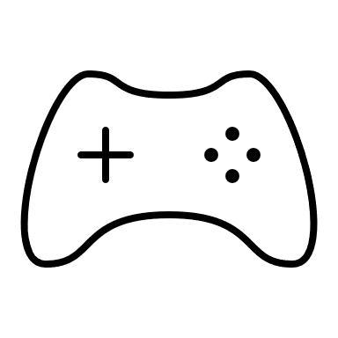
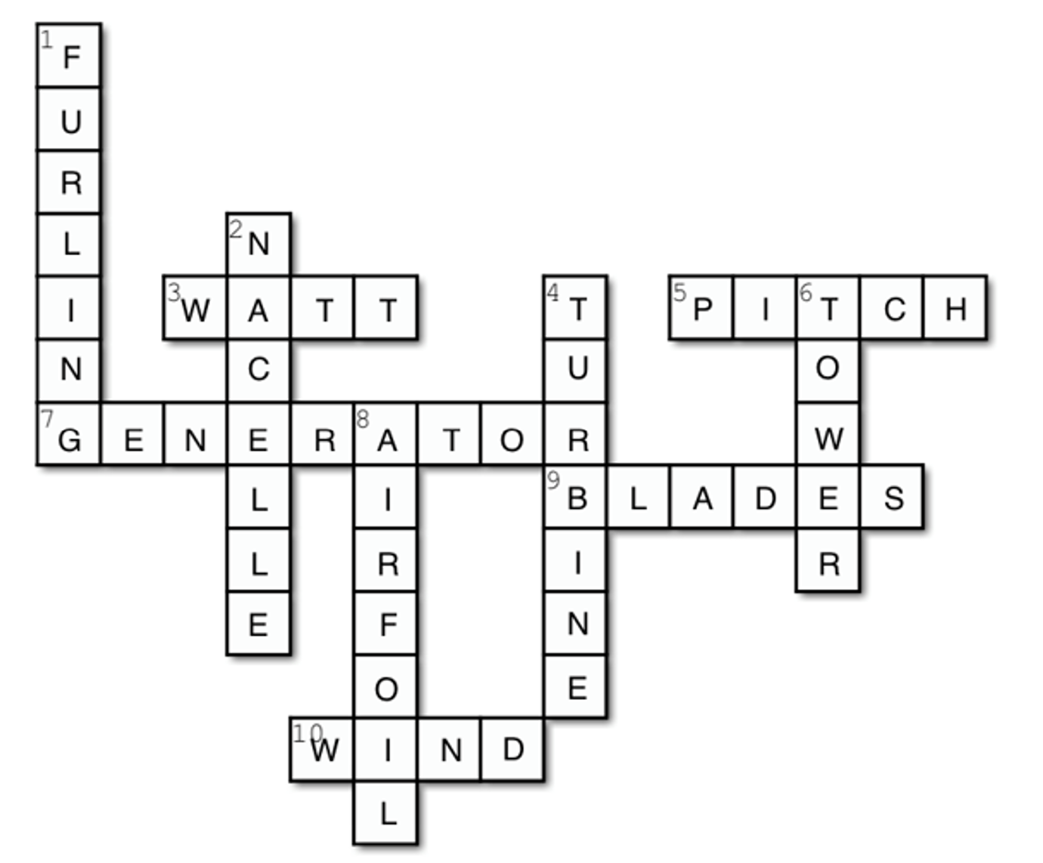
Playtime
Congratulations on completing this course on wind energy!
You've learned about how wind turbines work, the science behind wind power, and its role in renewable energy.
Now you can put your knowledge to the test with a fun wind energy crossword puzzle!
This puzzle challenges you with key terms related to wind energy - let's see how many you can get right! Get ready to have fun and reinforce what you've learned.
Across:
3. The unit of power
5. The angle into the wind
7. A machine that converts one form of energy into another
i.e. Mechanical energy into electrical energy
9. The part of the turbine that catches air current
10. Moving air
Down
1. Turning the blades away from the wind
2. Holds and protects the generator
4. Machine for collecting energy and converting energy for use as power
6. The part of the turbine that supports the nacelle
8. Cross-sectional shape of a blade

Slide 64

Well done!
Designed by Slidesgo und Freepik

