Slide 1
PV Education HUB
Connecting PV to a load and MPP
Chapter 2

Slide 2
Before diving into the session topic… what do you remember of last session?
1. Team up with 2-3 other students (not the same ones you teamed up with in the last session!) and give yourself a team name.
2. Imagine that your parents/some of their friends tells you that they are considering to install some PV panels on their rooftops/ in their farm, and they are asking your help to understand what they should consider. Write on a piece of paper what would you tell/ask them.
3. Now imagine that they have installed the PV system on their house rooftop, and they are asking your help to understand how they could increase the PV panels power output. Write on a piece of paper what would you ask/tell her/him
Help each other remember and understand better☺
Include everyone in the discussion, 3 heads are always better than 1 ☺
Notes:
At the end of the excercise the teacher can just ask the team to read/say what they wrote/discussed about.
It is important that although not everyone speak/answer, everyone understood therefore it should be a moment where the teacher understand the general understanding (not only of the students that are more extrovert/speak out) and in case there are still doubts, these are explained once more (using the slides/content provided for chapter 1.1 PV Basics). If the «smarter» students seems bored because the teacher is repeating something they already know the teacher can ask those students themselves to explain the concept.
The students can remain in their teams because these teams will be used for the later experiments

Slide 3
At the end of today you’ll be able to know
How to connect PV panels (in series and in parallel) and how this changes the performance of the PV panel
How to connect a PV panel to a fixed or changing load (or resistor) and how this changes the performance of the PV panel
What is the maximum power point (MPP) and how it changes based on changes in the load and in the local conditions

Slide 4
Our session’s agenda
01
02
03
Connecting PV to a load and MPP - Intro
Discover what is a load and an MPP and how they connect to PV panels
Experiments & Discussions
Work in your team, experiment and find out!
Summary and conclusions
Wrap-up what we’ve learned today and some surprises

Slide 5
01
Connecting PV to a load and MPP
Discover what is a load and an MPP and how they connect to PV panels

Slide 6
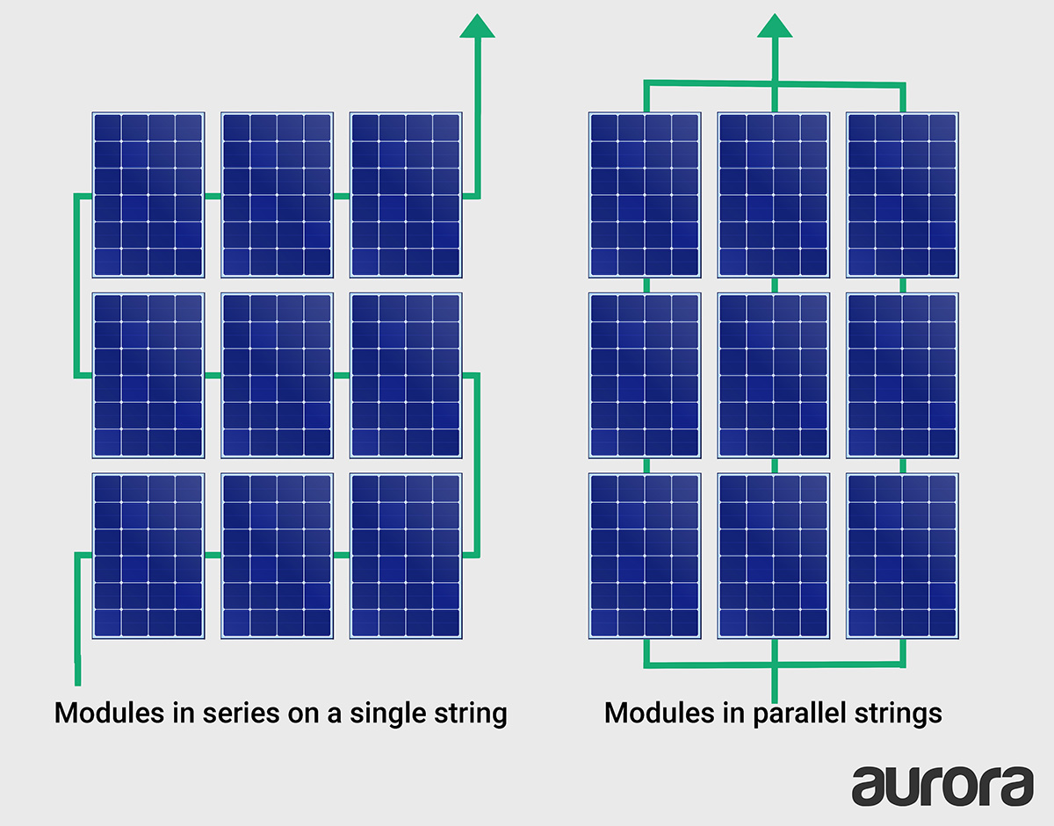

We only looked at one PV panel, but you usually see more of them....
How do you think they are connected? In how many ways you can connect PV panels?
Why would you need to
connect more PV panels?
What do you think it happens to the current and voltage when connecting more PV panels?

Slide 7


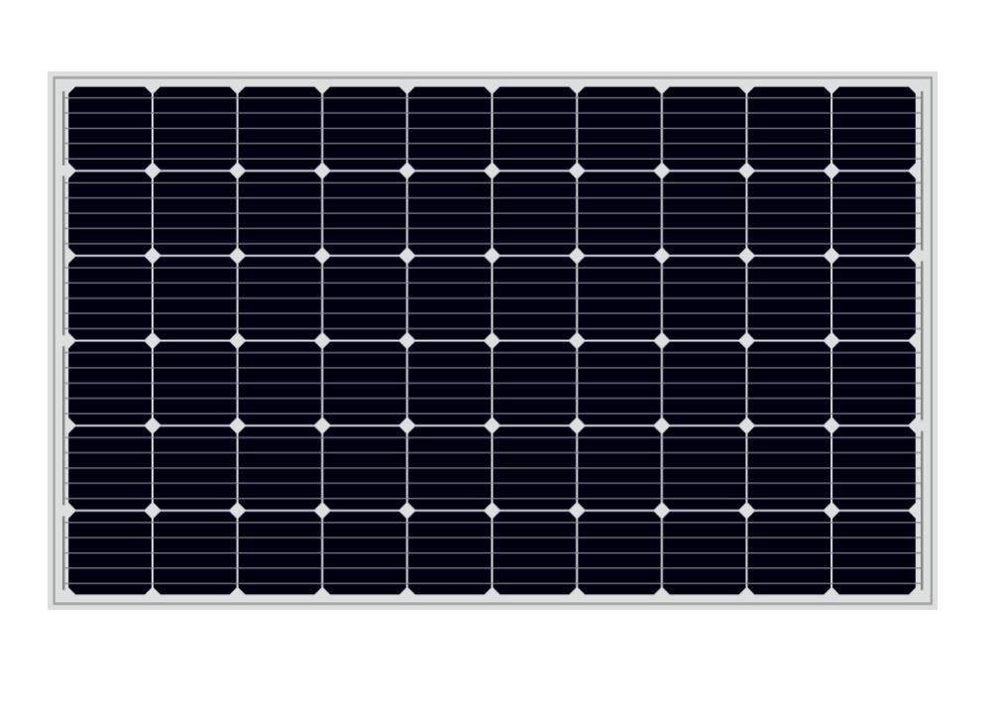
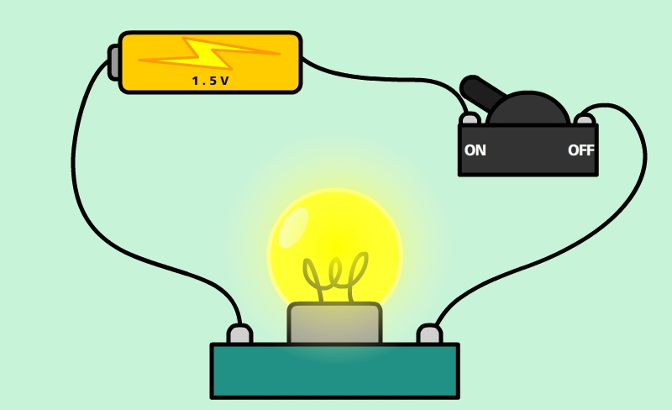
We also only saw just the PV panel, what happens when connecting it with a load?
What is a load?
What do you think it happens to the current and voltage when connecting PV panels to a load?
What do you think is the MPP (max power point)? From what do you think it depends?

Slide 8
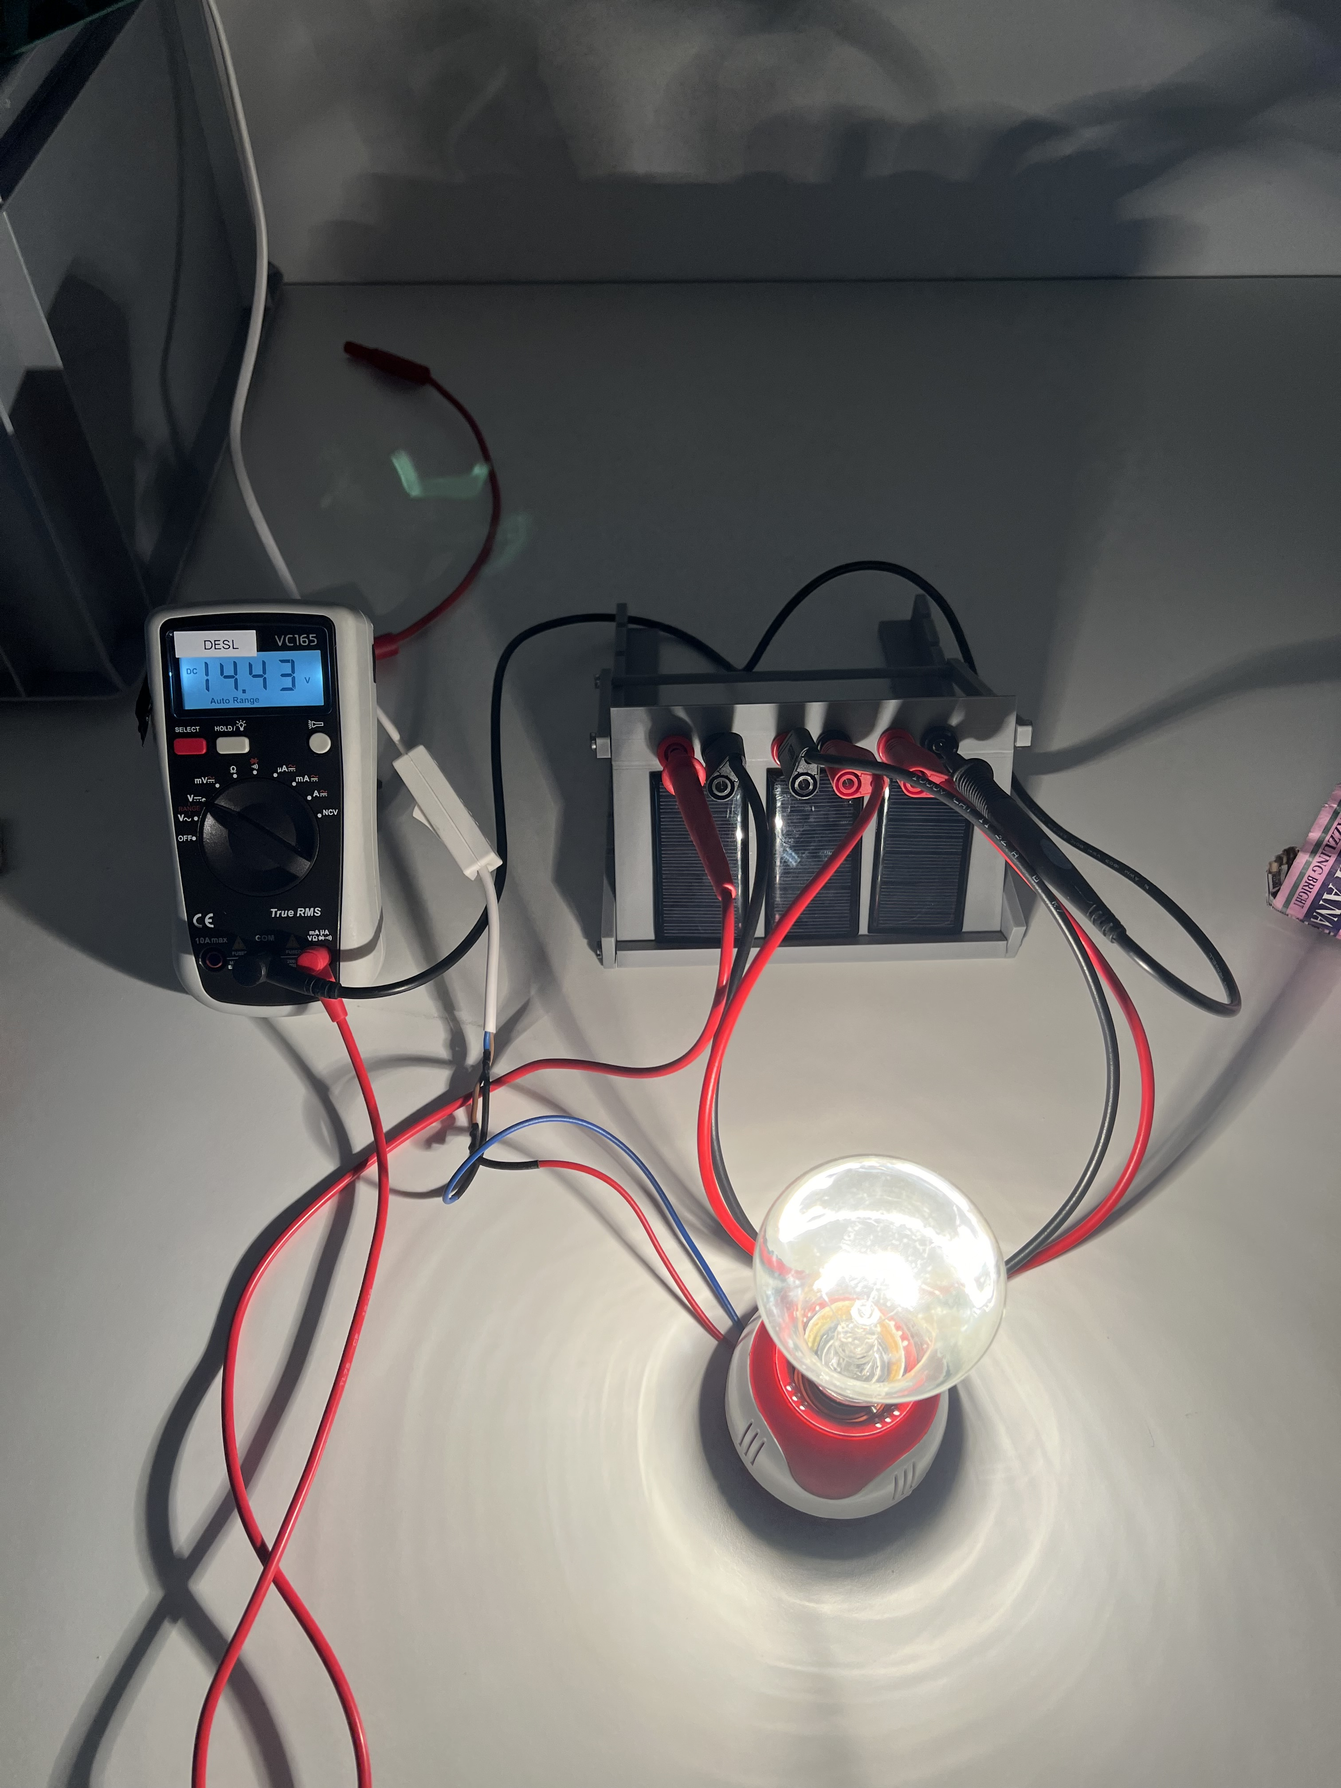
Let’s use our PV Kit to find out how to connect more PV panels, hot connect with a load and what happens to their performance!
If you haven’t already, take one PV kit (for each team)!

Slide 9
We are going to perform 6 experiments to answer those questions!
01
PV panels in series
03
Fixed
load
Local Conditions
and load changes
05
Connect PV panel in series
Connect the PV to a fixed load/resistor
Change local conditions and connect the PV to a changing load
PV panels in parallel
02
Changing load
04
Connect PV panel in parallel
Connect the PV to a changing load/ variable resistor

Slide 10
02
Experiments & Discussions
Work in your team, experiment and find out!

Slide 11
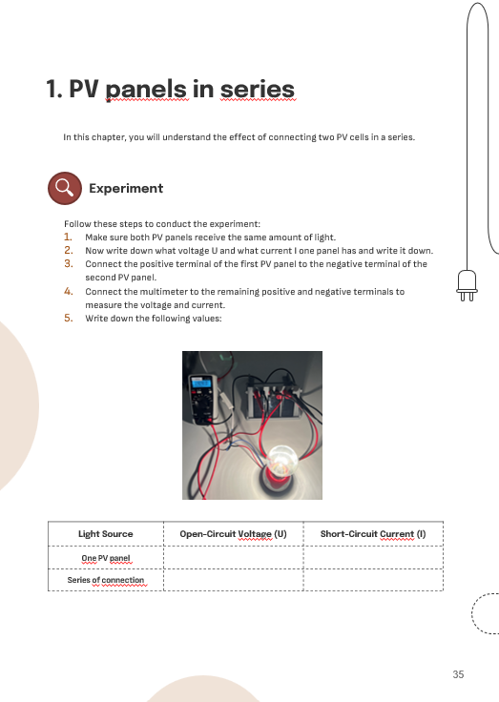
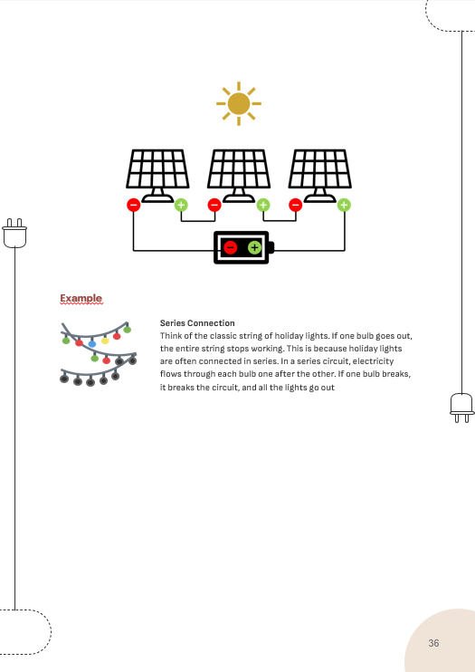
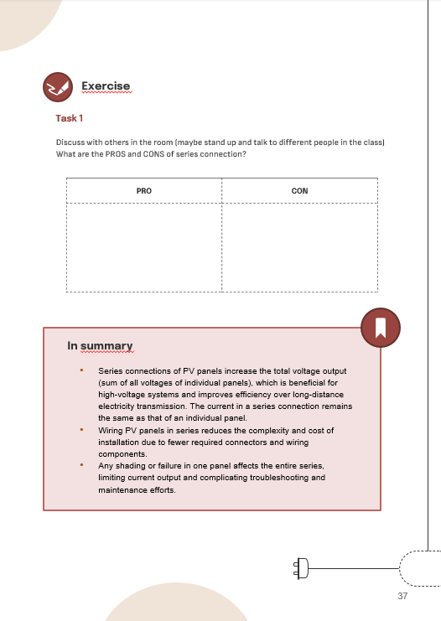
Work together with your team and fill out the worksheet for each experiment
Notes:
The teacher ask the student to open the handbook at page xx (they should already know the structure, always the same of previous experiments)
Every student should fill out its worksheet even though they work all together!

Slide 12
Ask ANY questions!
Help each other ☺
Notes:
Write Note!

Slide 13
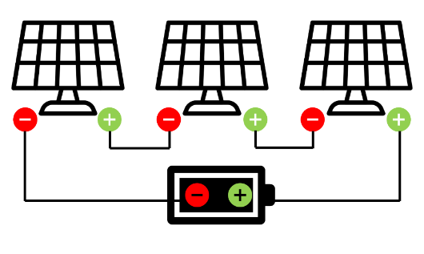
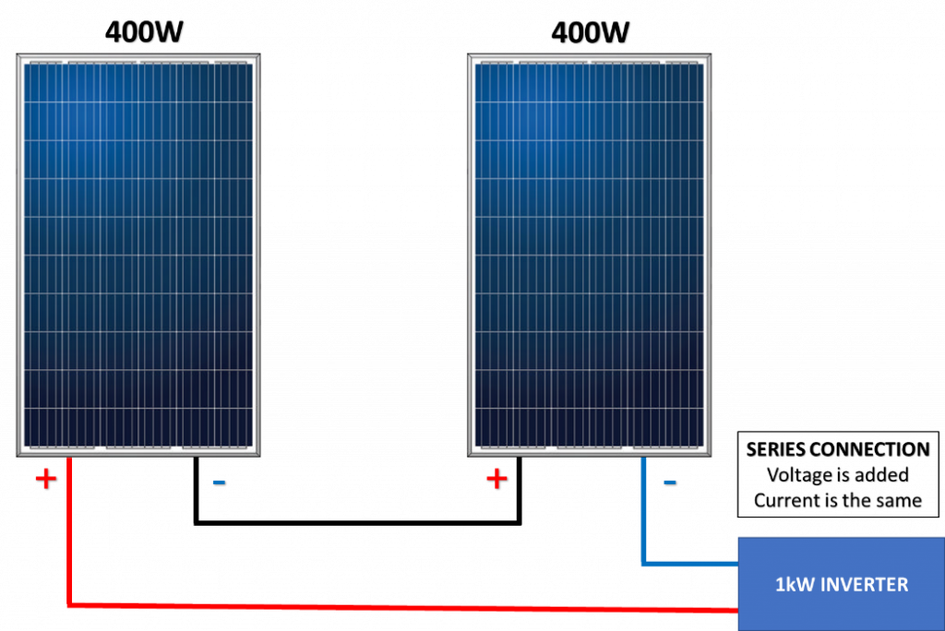
1. PV panels in series
Find out how connecting PV panels in series influence the performance of the PV system
You have 10 min to do the experiment before we collect the results

Slide 14
Conduct the experiment following the instructions on your worksheet (pg. 40-41)
Help each other in the team, ask questions to the teacher if you are stuck or have any doubt
If you finish before the other teams, try to do the other tasks (together!) then wait!
Notes:
This image will reamain during the time of the experiment

Slide 15

Time for confronting results and observations with the other teams!
Scan the QR Code, write the name of your team and answer the question on the experiment you just concluded!

Slide 16
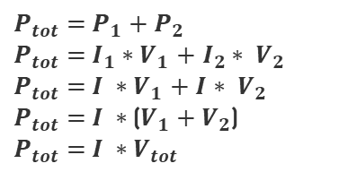

The total power output of PV panels in series increases because voltage increases!
When connecting PV panels in series you have PV panels connected to each other and only one circuit where current flow. This is the reason why the currents that are generated in the PV panels must be the same while the voltages can add up.
Calculation of the total power
Higher voltage and higher power generated in the system
$P_{tot}=$ $P_{1}{+ P}_{2}$
$P_{tot}=$ $I_{1}∗$ $V_{1}$ $+ I_{2}$ ${∗ V}_{2}$
$P_{tot}=$ $I ∗$ $V_{1}$ $+ I{∗ V}_{2}$
$P_{tot}=$ $I ∗$ ($V_{1}{+ V}_{2}$)
$P_{tot}=$ $I ∗$ $V_{tot}$
Try it first yourself!
Increased resistance, no/lower current in the system when any part is affected (e.g., shade), difficult to find the failure point
Advantages
Disadvantages, compared to single PV panel

Slide 17
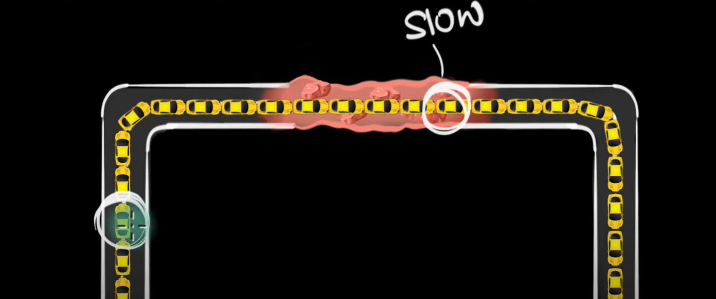
Let’s try to better understand why the current must be the same in a circuit
Look at this video to understand the concept behind why the current must be the same in a circuit although “the obstruction” (in the video is the resistance but in our example it as our shade or our “underperforming PV panel”) is just in one point!
Notes:
Introduction to circuits (what is current and what is voltage if you are not familiar with it) and a metaphor: https://www.youtube.com/watch?v=F_vLWkkOETI&list=PLSQl0a2vh4HC5-axG5RybD-FZ4lcgSlVY
Cells in series: https://www.youtube.com/watch?v=AzWvg3ZiBNQ&t=190s

Slide 18
What are commonalities and differences between PV panels and batteries?
Not sure where to put this one in the flow
Commonalities
- Booth are power sources! That is, if you draw a circuit, the role of the battery is the same of PV panel one: providing electricity!
Differences:
- Batteries are used for storing electricity in a chemical form while PV panels are used for generating electricity from sunlight
- Batteries provide always the same amount of power, voltage and current while PV panels will provide variable powers, currents and voltages based on the conditions
VS
PV panels and batteries are complementary rather than supplementary technologies with batteries compensating when PV panels are not generating the required voltage or current.

Slide 19
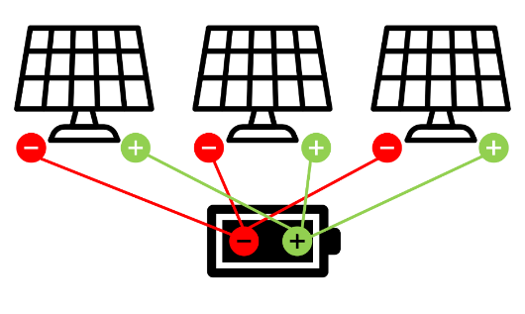
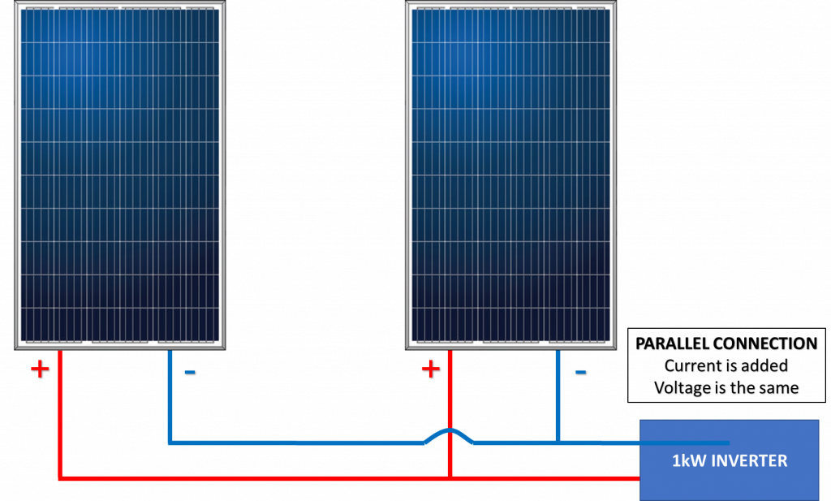
2. PV panels in parallel
Find out how connecting PV panels in parallel influence the performance of the PV system
You have 10 min to do the experiment before we collect the results

Slide 20
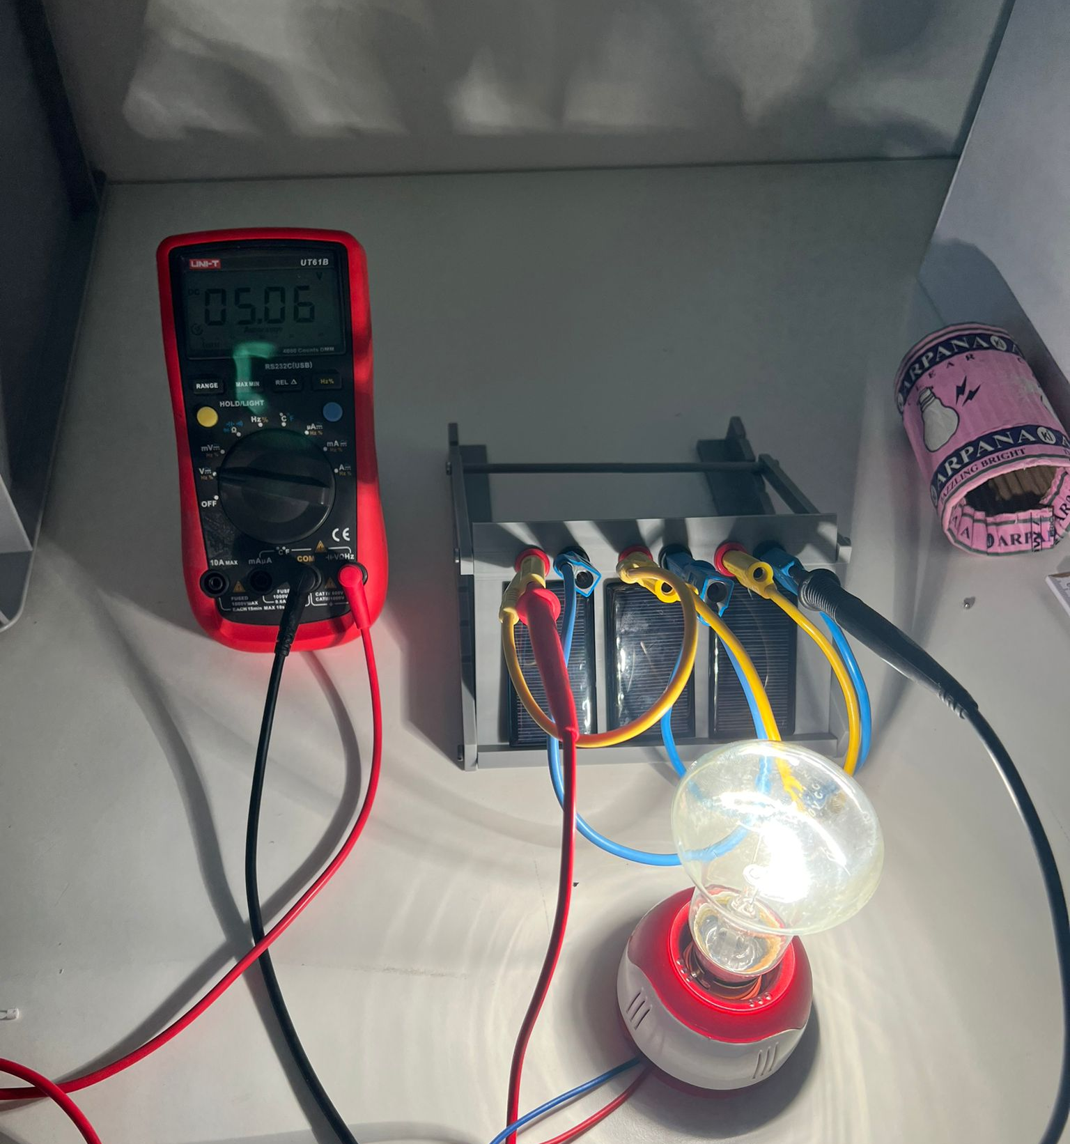
Conduct the experiment following the instructions on your worksheet (pg. 43-44)
Help each other in the team, ask questions to the teacher if you are stuck or have any doubt
If you finish before the other teams, try to do the other tasks (together!) then wait!
Notes:
This image will reamain during the time of the experiment

Slide 21

Time for confronting results and observations with the other teams!
Scan the QR Code, write the name of your team and answer the question on the experiment you just concluded!

Slide 22

The total power output of PV panels in parallel increases because current increases!
When connecting PV panels in parallel you have each PV panel connected to the inverter (PV panels are NOT connected to each other) therefore you will have several circuits connected to the same inverter. This is the reason why the currents that are generated by the two PV panels can adds up while the voltages must be the same.
Higher current generated, no affected system when a single part is affected, failure point easy to find, varying sunlight conditions
Calculation of the total power
$P_{tot}=$ $P_{1}{+ P}_{2}$
$P_{tot}=$ $I_{1}∗$ $V_{1}+I_{2}$ ${∗ V}_{2}$
$P_{tot}=$ $I_{1}∗$ $V$ $+$ $I_{2} ∗V$
$P_{tot}=$ $V ∗$ ($I_{1}{+ I}_{2}$)
$P_{tot}=$ $V∗$ $I_{tot}$
Try it first yourself!
Lower voltage, longer wires needed (try yourself to measure it!) and therefore higher resistance
Advantages
Disadvantages, compared to PV panel in series

Slide 23
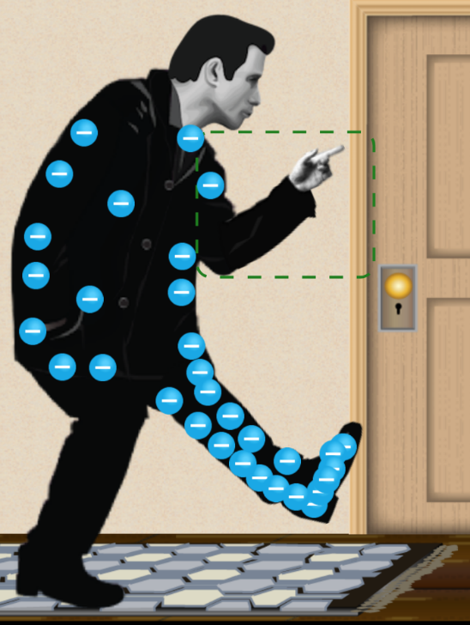
Why voltage must be the same when connecting in parallel?
Let’s ask it to:
John Travoltage!
Look at this video
Still not very clear to me but would be nice to explain it!
Notes:
More detailed video: https://www.youtube.com/watch?v=HWaNf1utfto

Slide 24
So, how should I decide whatever to connect PV panels in series or in parallel?
1. Understand what voltage and what current the system must provide (i.e., do you need higher voltage or higher current?)
2. Understand the location you are installing the PV system. For example:
    Is shade an issue?
    Are the sunlight conditions equal among the different panels?
    Wait but….this doesn’t have also in series PV panels? True!!! Indeed, you can also use a combination of both series and parallel connections to optimize the performance!
If no high voltage is required and the panels are not spread on long distances, a parallel configuration is preferable as it is easier to maintain and it is more flexible, therefore giving higher performance overall. But installation will be more complex and expensive!

Slide 25
70-80%
    But wait…didn’t we say that except some cases…parallel connection were preferrable?
Estimated PV systems installed around the world are connected in series (leaving only 20-30% connected in parallel)
Why do you think that is the case?
Notes:
There could be several answers, but the most important fact is that as of today the majority of PV systems are connected to the grid (due to incentives, ease of installation, ability to sell excess power back to the grid, and the fact that they are installed in urban/suburban areas with established infrastructures) and the connection to the grid requires higher voltage inputs.
Therefore, we understand that another important factor that we will take into consideration is if the PV system is connected to the grid or not → something important to consider especially in Africa where the idea is to bring clean electricity in areas where it is lacking!

Slide 26
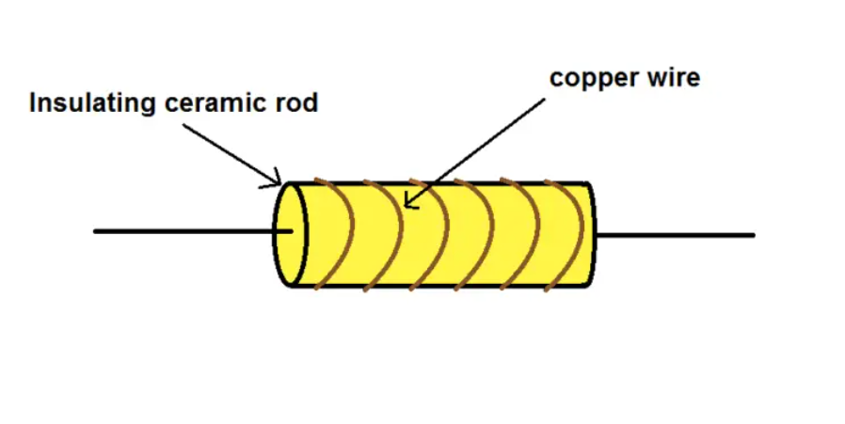
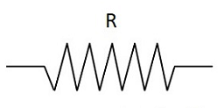
3. Fixed load (or resistor)
Find out how connecting a PV panel to a fixed load (or resistor R) influences its performance
You have 10 min to do the experiment before we collect the results

Slide 27
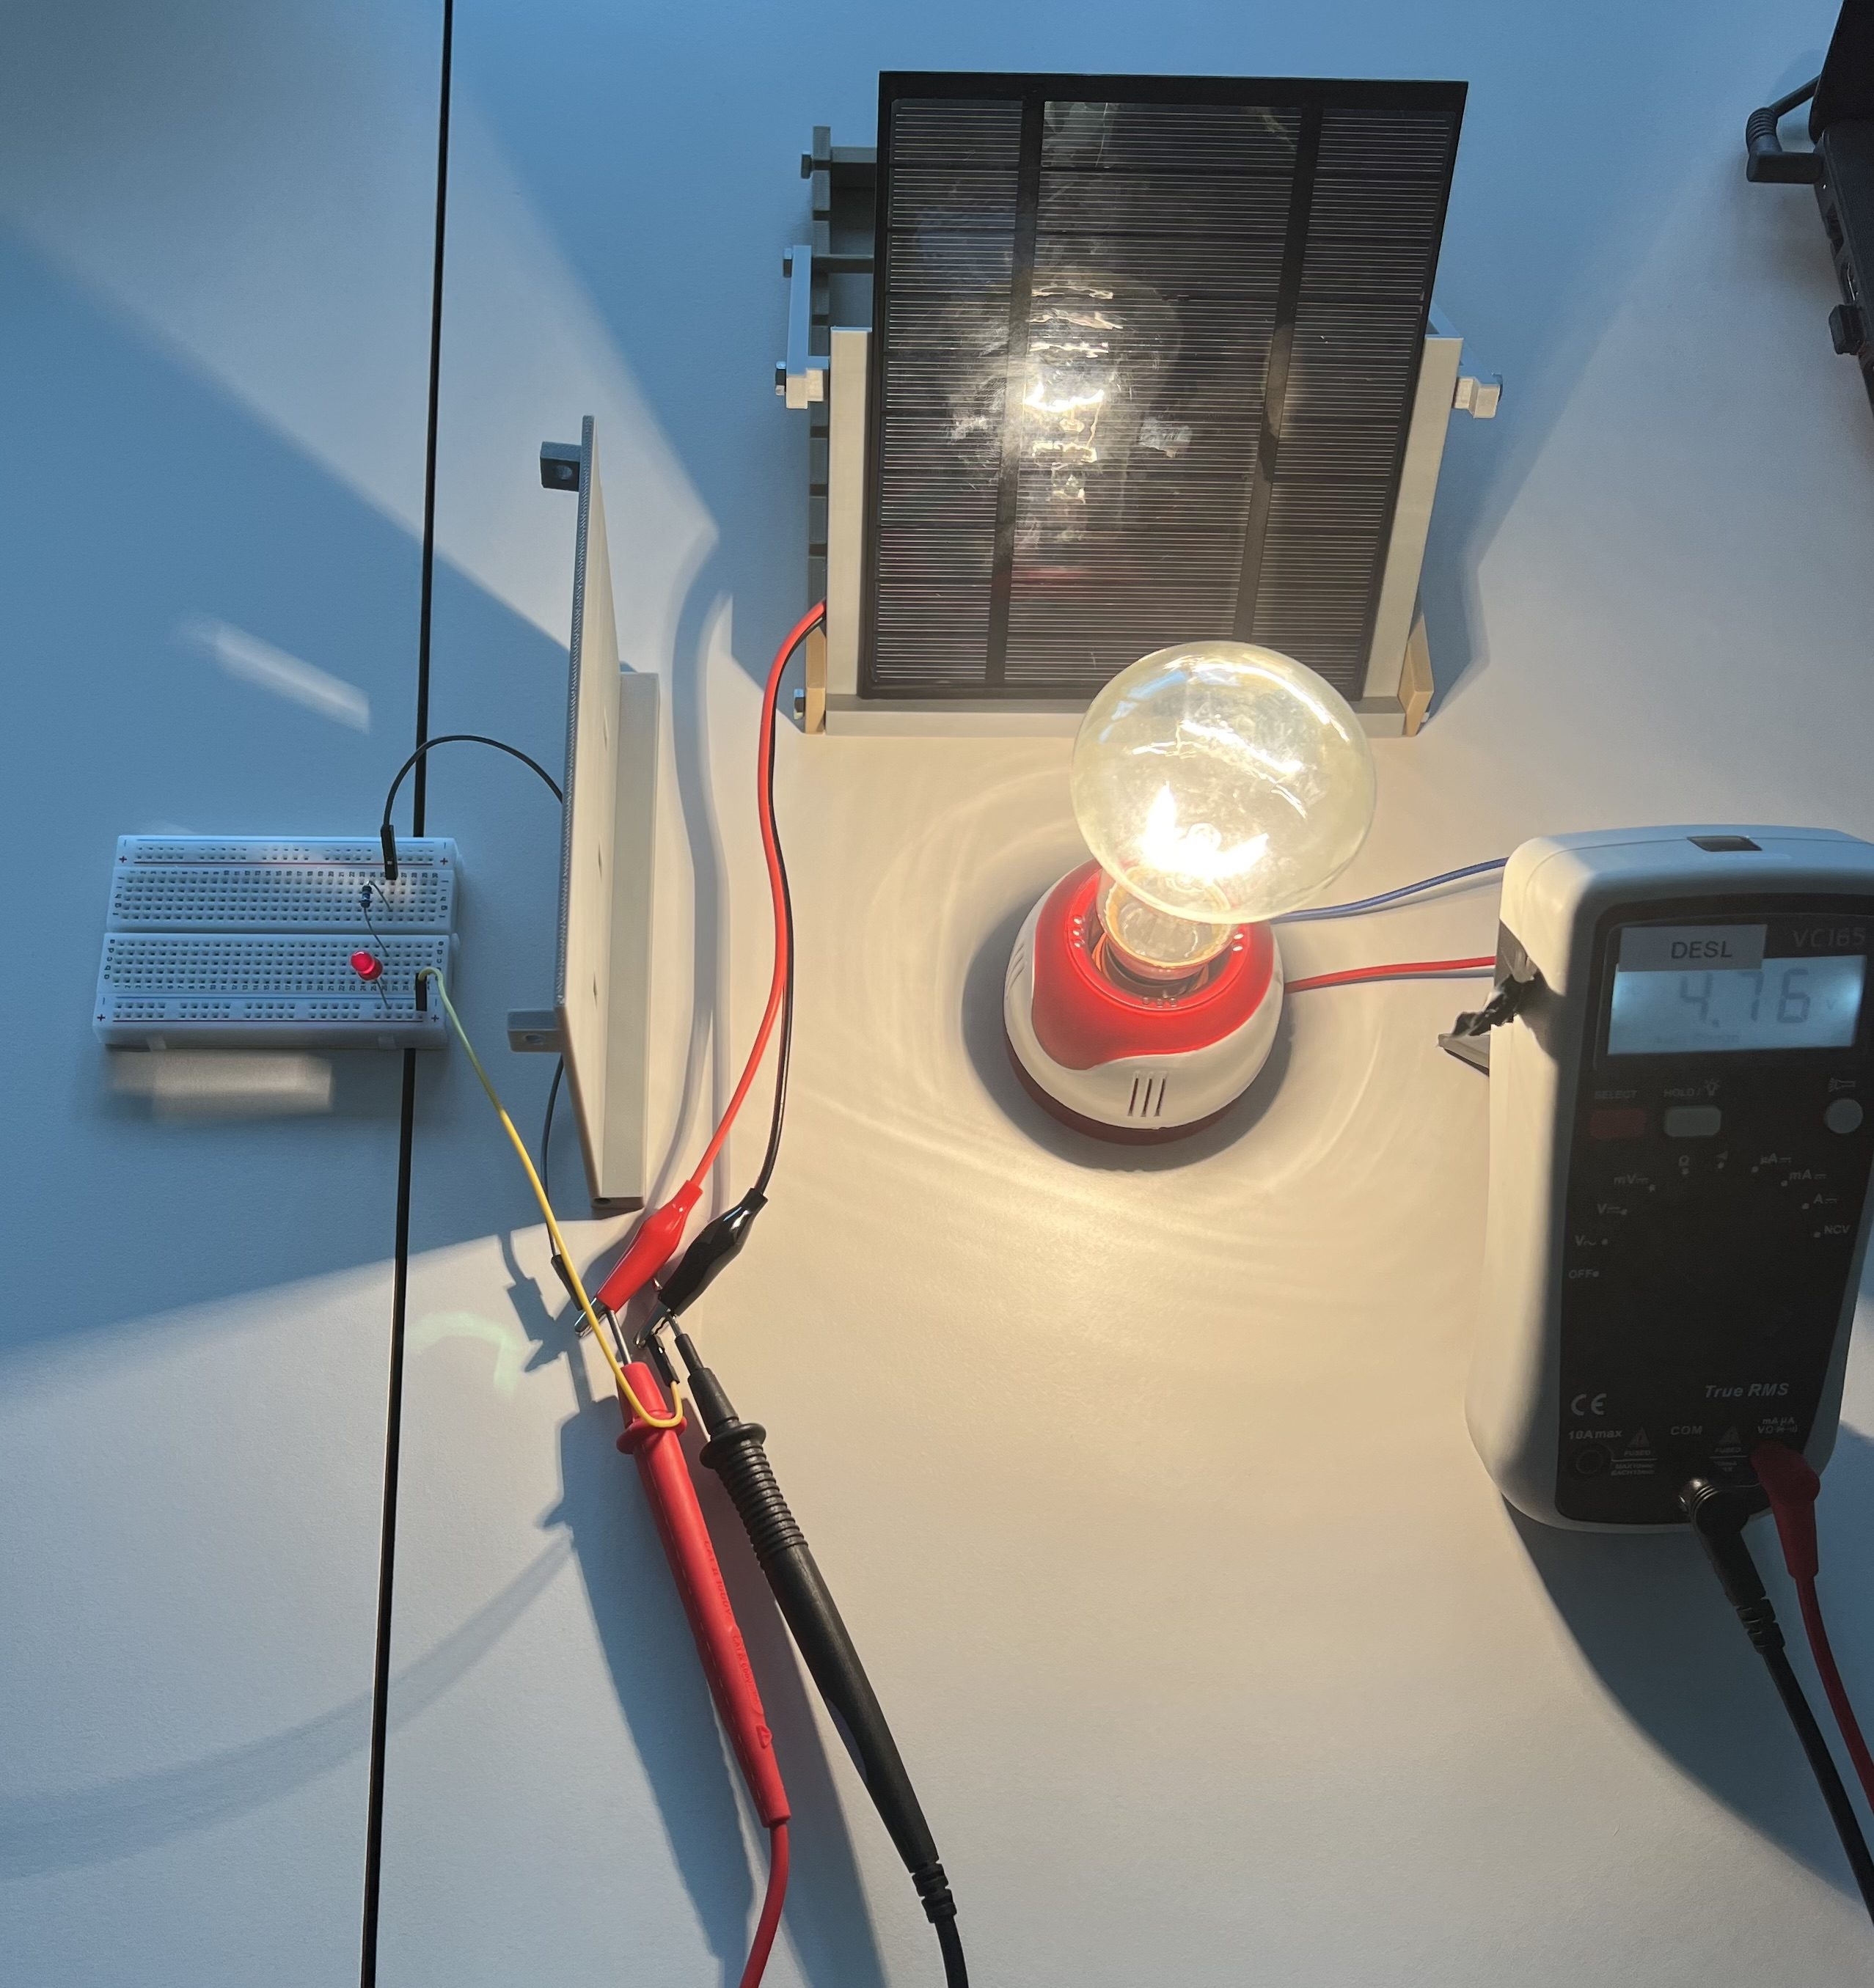
Picture of the experiment set-up @KIT TEAM
Conduct the experiment and do task 1 following the instructions on your worksheet (pg. 47-48)
The little light turned on!!
Help each other in the team, ask questions to the teacher if you are stuck or have any doubt
If you finish before the other teams, try to do the other tasks (together!) then wait!
Notes:
This image will reamain during the time of the experiment

Slide 28

Time for confronting results and observations with the other teams!
Scan the QR Code, write the name of your team and answer the question on the experiment you just concluded!

Slide 29

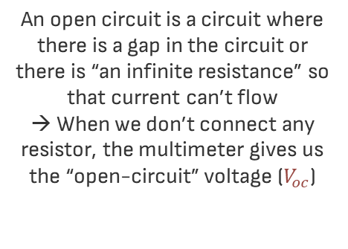


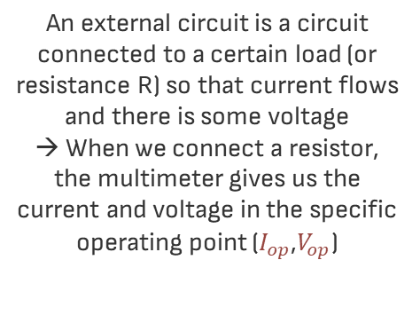

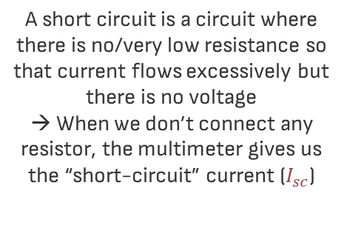

In our experiments we saw 3 “types” of circuits and their I-V characteristics
$$V_{oc}$$
$$V_{op}$$
$$I_{sc}$$
$$I_{op}$$
$$R$$
Open circuit
Short circuit
External circuit
An open circuit is a circuit where there is a gap in the circuit or there is “an infinite resistance” so that current can’t flow
→ When we don’t connect any resistor, the multimeter gives us the “open-circuit” voltage ($V_{oc}$)
A short circuit is a circuit where there is no/very low resistance so that current flows excessively but there is no voltage
→ When we don’t connect any resistor, the multimeter gives us the “short-circuit” current ($I_{sc}$)
An external circuit is a circuit connected to a certain load (or resistance R) so that current flows and there is some voltage
→ When we connect a resistor, the multimeter gives us the current and voltage in the specific operating point ($I_{op}$,$V_{op}$)
Notes:
The teacher can explain exactly in this way by drawing on the board: https://www.youtube.com/watch?v=9IGAEKzdJ_k
And then use this and the following slides as a support to repeat and leave written what was said

Slide 30




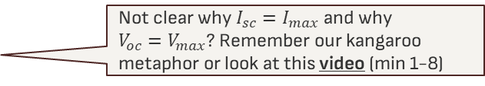





So now that we know these three points, let’s plot them on the IV diagram!
$$I$$
$${(I_{op},V}_{op}) with$$
$$a certain R$$
«Open circuit» ($R→∞$)
$I_{oc}=0$, ${V=V}_{oc}{=V}_{max}$
$$I_{sc}$$
Not clear why $I_{sc}{=I}_{max}$ and why $V_{oc}{=V}_{max}$? Remember our kangaroo metaphor or look at this video (min 1-8)
«Short circuit» ($R=0$)
${I=I}_{sc}{=I}_{max}$, $V_{sc}=0$
$$V_{oc}$$
$$V$$
Operating Point when connected to a resistor $R>0$
${(I_{op},V}_{op})$ ${, with 0<I_{op}<I}_{sc}$, $0<{V_{op}<V}_{oc}$
Why both current and voltage decrease when there is a certain resistance R>0? What is the relationship between R and V? and between R and I?
Notes:
From just these three points they should be able to observe that:
The higher is R, the higher is the voltage (indeed voltage is max with R “infinite”) → directly proportional → when R>0 , R decreased compared to R infinite therefore also voltage decrease!
The lower is R, the higher is the current (indeed current is max with R=0) → inversely proportional → when R>0, R increased compared to R=0 therefore current decrease!

Slide 31
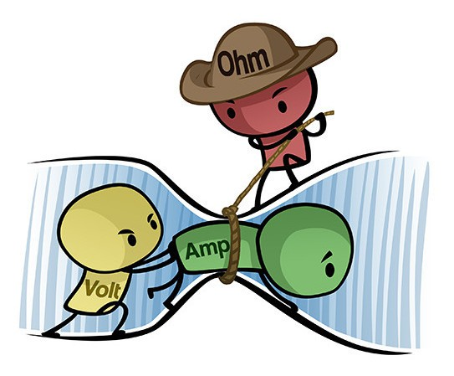

The complete relationship between R, V, and I is described in Ohm’s law!
Given the same current I, the higher is the resistance R, the higher is the voltage V
$V=R∗I$ ,
or
$$I=\frac{V}{R}$$
given the same voltage V, the higher is the resistance R, the lower is the current I
To have an intuitive understanding of what is the resistance and the Ohm’s low let’s look at this short video
As you can see, your observations are confirmed by the law!
Notes:
The teacher could conclude by saying that now we are going to confirm this further by experimenting a changing load

Slide 32
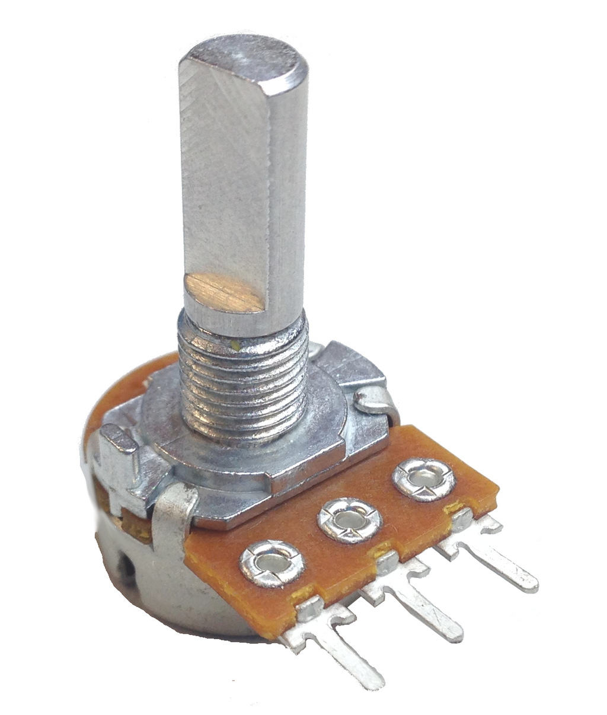
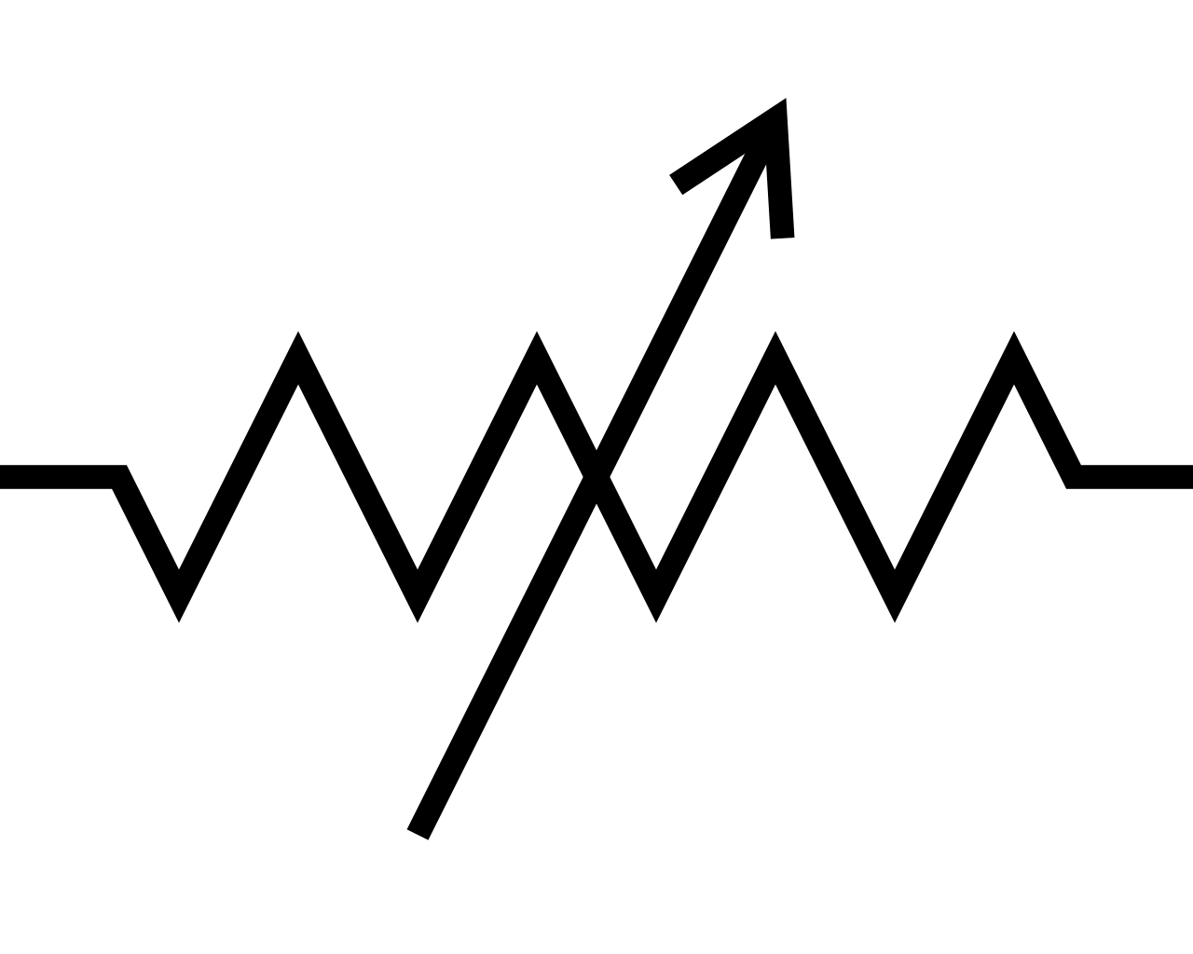
4. Changing load
Find out how connecting a PV panel to a changing load (or adjustable resistor) influences its performance
You have 10 min to do the experiment before we collect the results

Slide 33
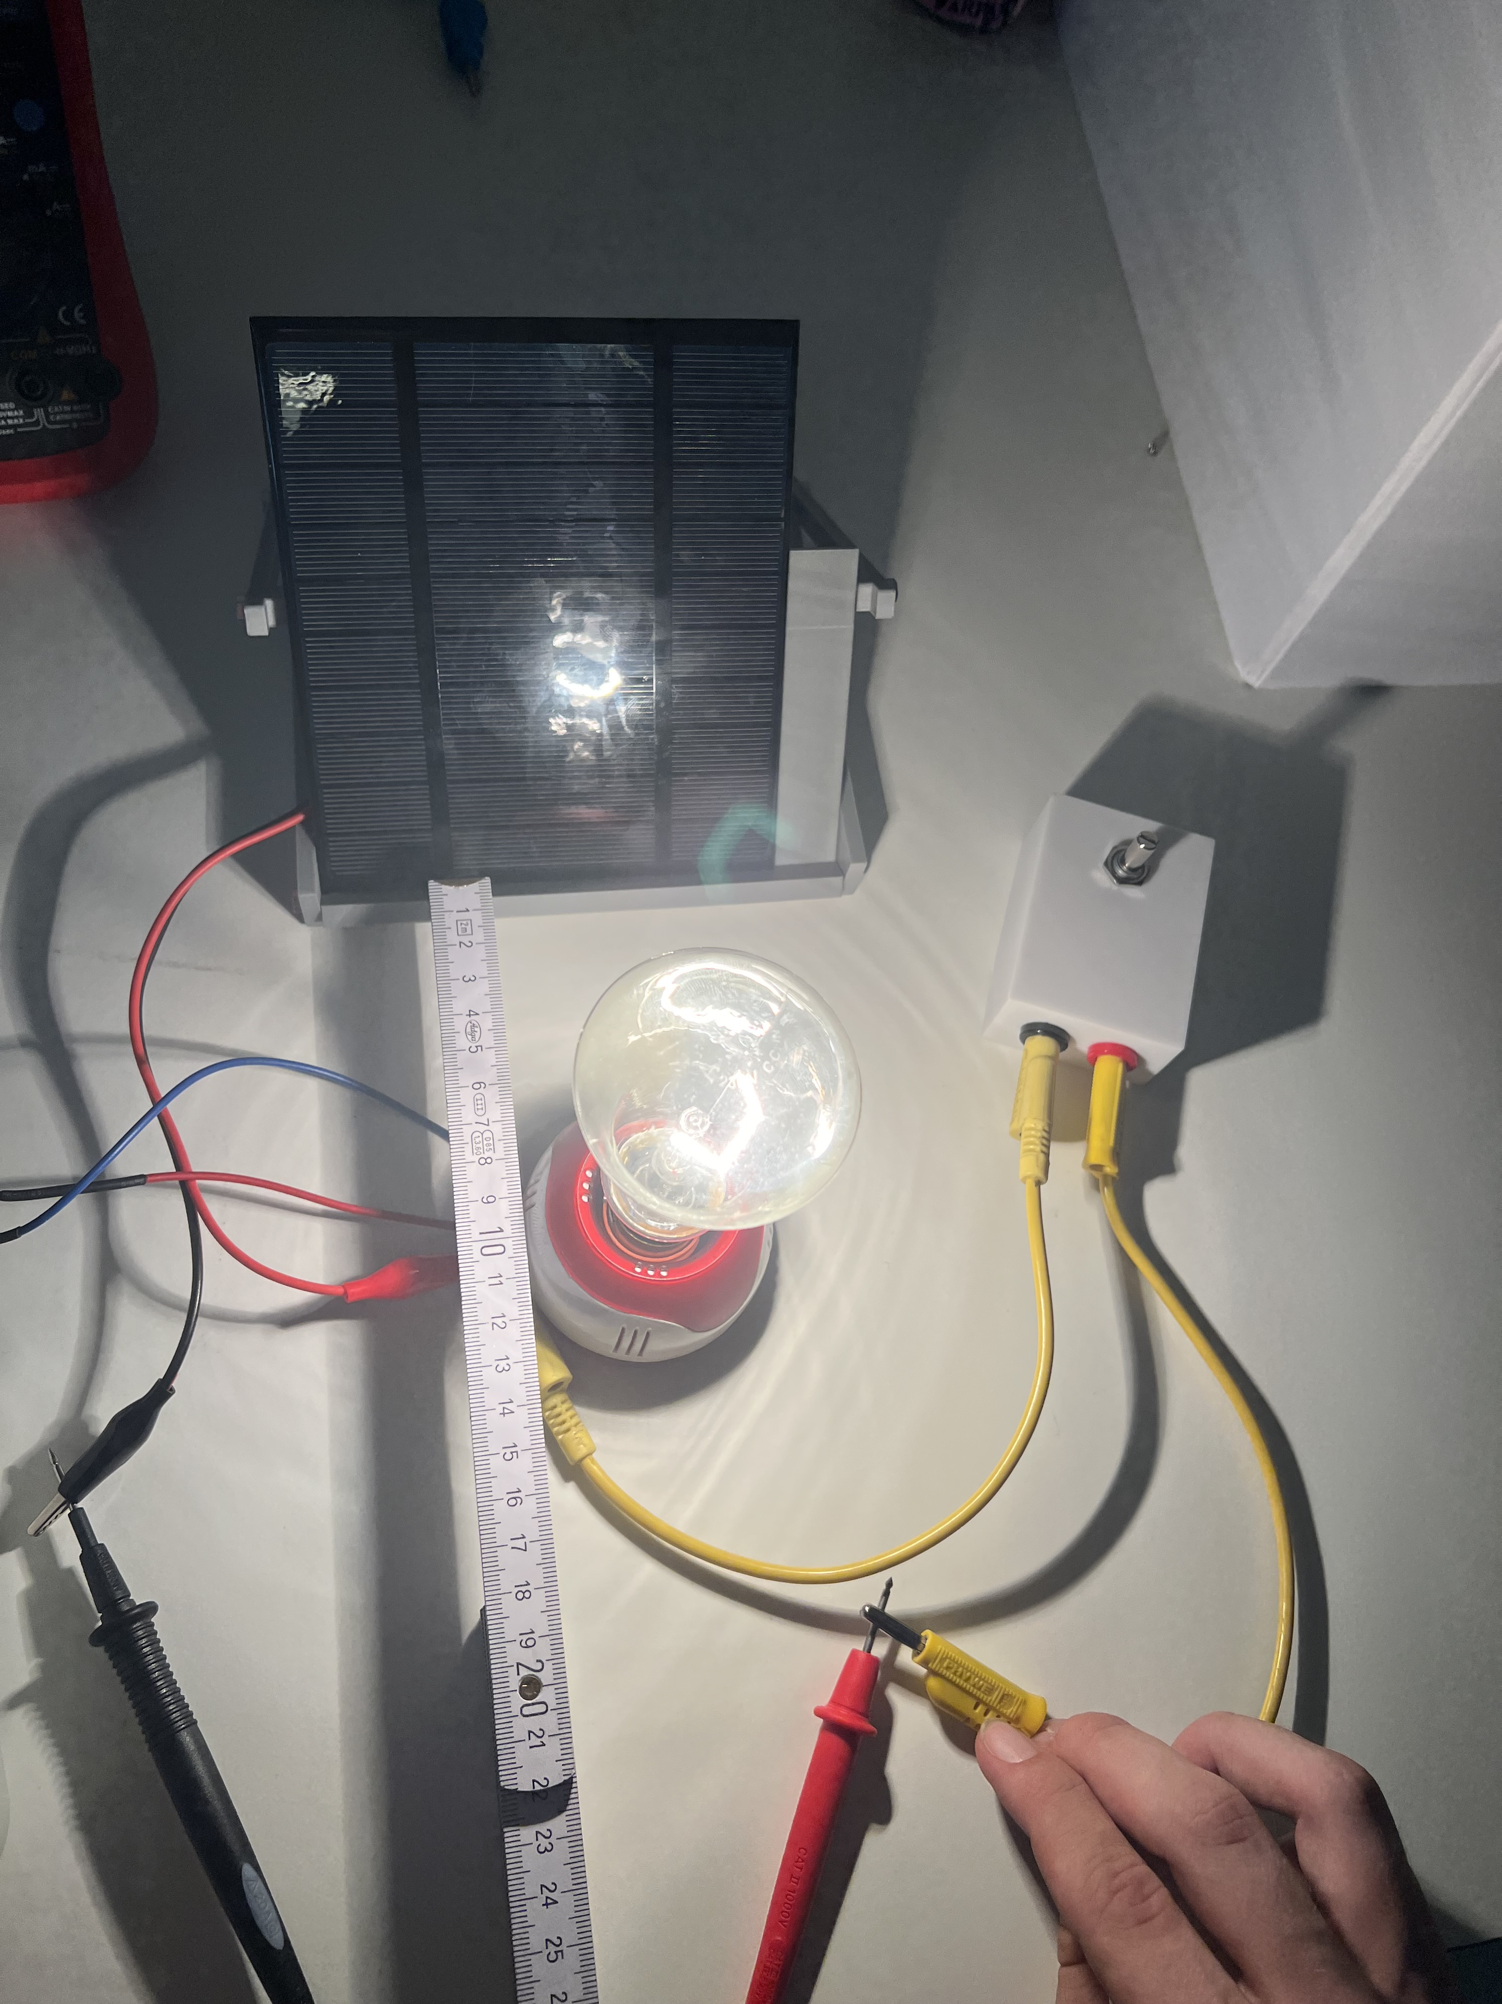
Picture of the experiment set-up @KIT TEAM
Conduct the experiment and do task 1 following the instructions on your worksheet (pg. 50-51)
Help each other in the team, ask questions to the teacher if you are stuck or have any doubt
If you finish before the other teams, try to do the other tasks (together!) then wait!
Notes:
This image will reamain during the time of the experiment

Slide 34

Time for confronting results and observations with the other teams!
Scan the QR Code, write the name of your team and answer the question on the experiment you just concluded!

Slide 35















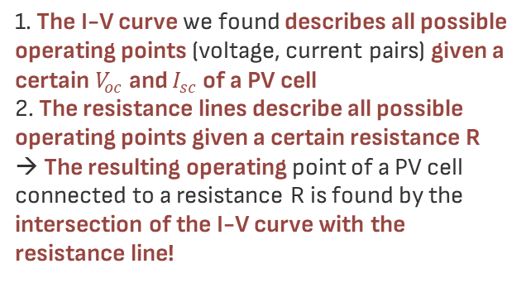





Let’s plot the different operating points and draw the I-V curve!
I-V curve
Observation
$$I$$
$$R_{5}$$
$$R_{4}$$
$$R$$
As the resistance increase, the voltage increase proportionally while the current decrease very slightly and then significantly drop!
$$R_{3}$$
$${I_{5}≈I_{4}≈I_{3}≈I}_{sc}$$
$$R_{2}$$
$$I_{2}$$
$$I_{1}$$
$$R_{1}$$
$$V$$
Learnings
$$V_{5}$$
$$V_{4}$$
$$V_{3}$$
$$V_{2}$$
$$V_{1}$$
1. The I-V curve we found describes all possible operating points (voltage, current pairs) given a certain $V_{oc}$ and $I_{sc}$ of a PV cell
2. The resistance lines describe all possible operating points given a certain resistance R
→ The resulting operating point of a PV cell connected to a resistance R is found by the intersection of the I-V curve with the resistance line!
$$V_{oc}$$
Resistance lines, described by Ohm’s law
$$I=\frac{1}{R}∗V$$
1/R represent the angle of the line, so the higher is R, the smaller the angle (or the other way around)!

Slide 36





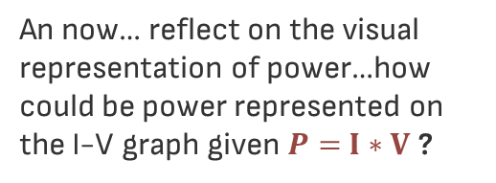



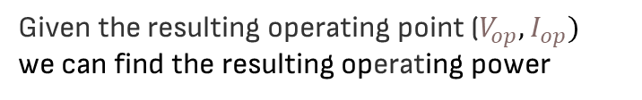
Ok but what about the resulting power?
$P=$ $I∗V$
Well, we know that:
An now… reflect on the visual representation of power…how could be power represented on the I-V graph given $P=$ $I∗V$ ?
Given the resulting operating point ($V_{op},I_{op})$
we can find the resulting operating power
${P_{op}=I}_{op}∗$ $V_{op}$
$$I$$
$$I=\frac{V}{R}$$
$$I_{sc}$$
And we also know that:
$$I_{2}$$
$$I_{1}$$
So we could also find the operting power as
$$V$$
$$V_{2}$$
$$V_{1}$$
$$V_{oc}$$
$$P_{op}{{= V}_{op}∗\frac{V_{op}}{R}=V}_{op}∗(\frac{1}{R}+1)$$

Slide 37
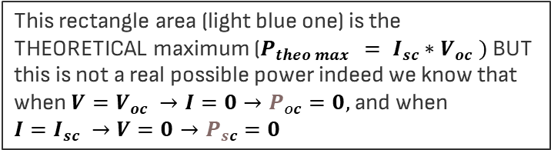



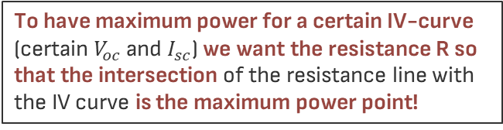



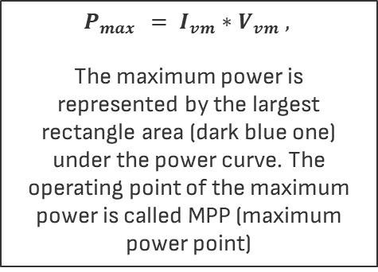


Power is the area of the rectangle! So now we can find the maximum power point!
To have maximum power for a certain IV-curve (certain $V_{oc}$ and $I_{sc}$) we want the resistance R so that the intersection of the resistance line with the IV curve is the maximum power point!
$$P_{\max{ }}= I_{vm}∗V_{vm} ,$$
The maximum power is represented by the largest rectangle area (dark blue one) under the power curve. The operating point of the maximum power is called MPP (maximum power point)
$$with 0<{V_{vm}<V}_{oc}$$
$$I$$
R
$$I_{sc}$$
$${(I_{vm},V}_{vm})$$
$$I_{vm}$$
MPP=
$$V$$
$$V_{vm}$$
$$V_{oc}$$
This rectangle area (light blue one) is the THEORETICAL maximum ($P_{theo max{ }}= I_{sc}∗V_{oc} )$ BUT this is not a real possible power indeed we know that when ${V=V}_{oc} →I=0→P_{oc}=0,$and when ${I=I}_{sc} →V=0→P_{sc}=0$

Slide 38
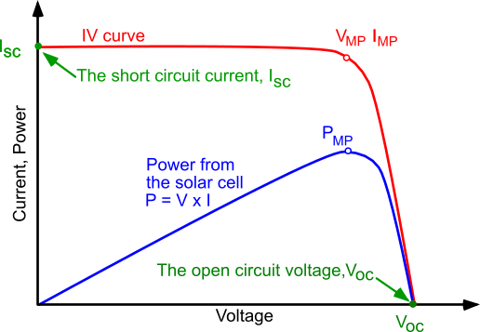
What do you think is the blue curve?
Try first to reflect within your team and then check the answer!
The power curve is the translation of the areas we just found and describes the power obtained for each possible operating point under the IV curve

Slide 39
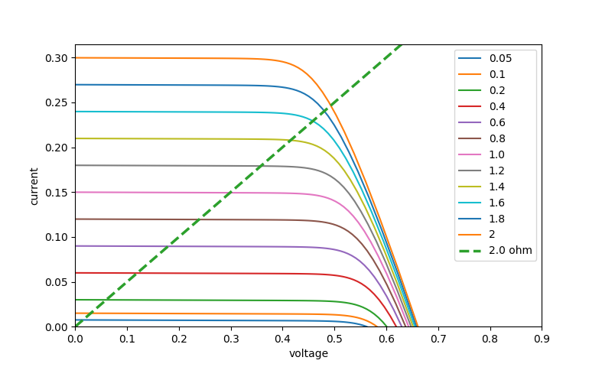
5. Local Conditions and load changes
Find out how local conditions (e.g., heat, shade, pollution, light intensity) and load changes affects the MPP
You have 10 min to do the experiment before we collect the results

Slide 40
Conduct the experiment and do task 1 following the instructions on your worksheet (pg. 54-55)
Help each other in the team, ask questions to the teacher if you are stuck or have any doubt
If you finish before the other teams, try to do the other tasks (together!) then wait!
Notes:
This image will reamain during the time of the experiment

Slide 41

Time for confronting results and observations with the other teams!
Scan the QR Code, write the name of your team and answer the question on the experiment you just concluded!

Slide 42







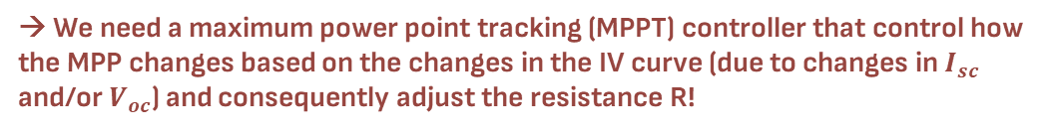


Let’s plot the new I-V curve with a decreased light intensity!
Voltage and current drops of OP and MPP’ compared to MPP
As the light intensity decrease, $V_{oc}$almost does not change while $I_{sc}$decrease
Previous I-V curve
$$I$$
New I-V curve (decreased light intensity)
Not clear why? Go back to our kangaroo metaphor or look at this video (min 1-8)
R
$$I_{sc}$$
MPP
R’
$$I_{vm}$$
OP
$${{I′}_{op}≈I′}_{sc}$$
The changed IV curve results in a change in the maximum power point MPP’ vs MPP → the new maximum power has decreased (and we could expect that has the maximum current decreased) but the important thing we understand here is that
$${I′}_{vm}$$
MPP’
$$V$$
$${V′}_{op}$$
$${\begin{aligned}{V′}_{vm} \\ ≈V\end{aligned}}_{vm}$$
$${V′}_{oc}≈V_{oc}$$
if we don’t adjust the resistance to R’ to fit the new MPP’ (i.e., if we operate in point OP) we would lose a lot of voltage and even more power! To see this visually look at the different rectangles (yellow vs blue vs green one)!
→ We need a maximum power point tracking (MPPT) controller that control how the MPP changes based on the changes in the IV curve (due to changes in $I_{sc}$ and/or $V_{oc}$) and consequently adjust the resistance R!

Slide 43
03
Summary and conclusions
Wrap-up what we’ve learned today and some surprises

Slide 44
Summary
This slide is purposefully left not filled, as the teacher will decide what activity is best to do based on the time left, the mood of the class.
Some options:
Go back to the learning objectives and repeat the main learnings/ask if there is any question
Give some exercises that require to use the knowledge acquired in the different experiments (examples proposed in the next slides)
Watch the chapter summary videos (slide 50) they should watch later at home

Slide 45
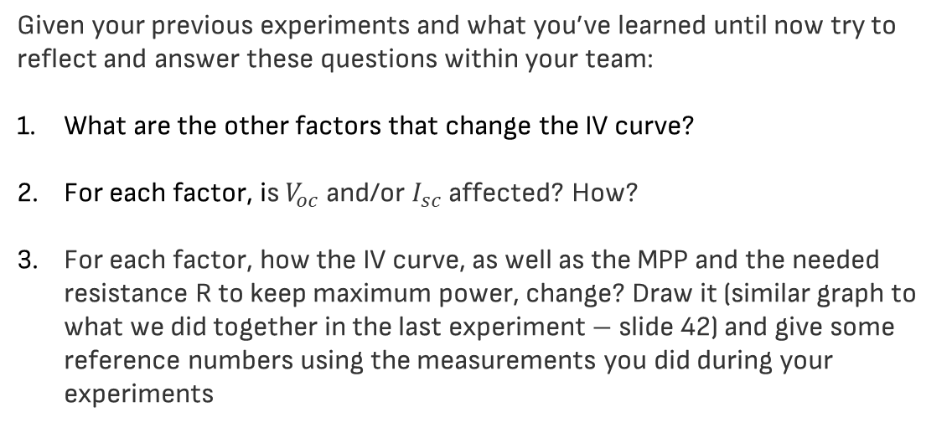
Summary exercise 1: Does the IV curve change only based on light intensity?
Given your previous experiments and what you’ve learned until now try to reflect and answer these questions within your team:
What are the other factors that change the IV curve?
For each factor, is $V_{oc}$ and/or $I_{sc}$affected? How?
For each factor, how the IV curve, as well as the MPP and the needed resistance R to keep maximum power, change? Draw it (similar graph to what we did together in the last experiment – slide 42) and give some reference numbers using the measurements you did during your experiments

Slide 46
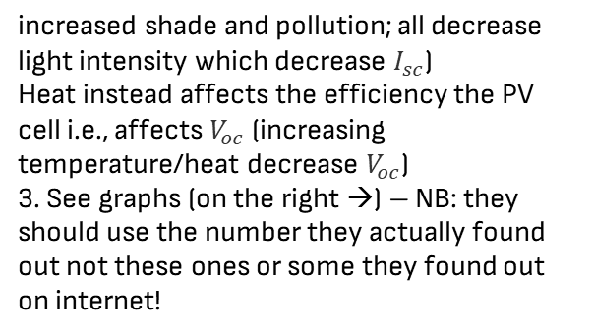
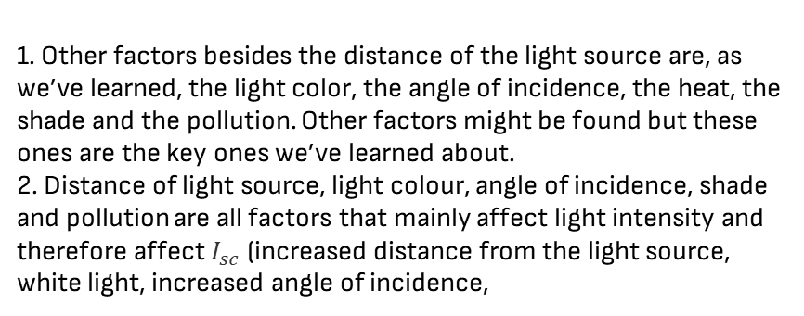
Summary exercise 1 answer
1. Other factors besides the distance of the light source are, as we’ve learned, the light color, the angle of incidence, the heat, the shade and the pollution. Other factors might be found but these ones are the key ones we’ve learned about.
2. Distance of light source, light colour, angle of incidence, shade and pollution are all factors that mainly affect light intensity and therefore affect $I_{sc}$ (increased distance from the light source, white light, increased angle of incidence,
Temperature changes
increased shade and pollution; all decrease light intensity which decrease $I_{sc}$)
Heat instead affects the efficiency the PV cell i.e., affects $V_{oc}$ (increasing temperature/heat decrease $V_{oc}$)
3. See graphs (on the right →) – NB: they should use the number they actually found out not these ones or some they found out on internet!
Light intensity changes
IV curve
MPP
R

Slide 47
Summary exercise 2: IV curve and MPP of single PV panel, PV in series and in parallel
Reflect upon todays experiments (on how to connect different PV panels and its effects on the PV system as well as on the IV curve and the MPP) and try to do the following task within your team:
Assume there are no changes in PV cells efficiency nor in sunlight conditions, draw and compare on the same IV diagram the IV curves as well as the MPP for: a) a single PV panel, b) 2 identical PV panels connected in series, c) 2 identical PV panels connected in parallel. Give some reference numbers using the measurements you did during your experiments.
Compare the 3 scenarios: How does the MPP change? How does the maximum power output change?
Compare the 2 scenarios of PV in series and in parallel: Which scenario would give you the actual maximum power output if you know that there is a risk of shading?

Slide 48
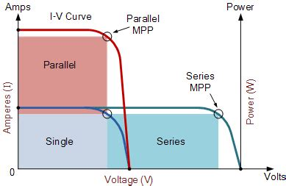
Summary exercise 2 answer
See graph (on the left) NB: they should add some reference number as requested using the ones they actually measured
The MPP change greatly together with the resistance needed: for PV panels in series a much higher resistance is needed compared to PV panels in parallel to get the same power output. The power output of PV in series and in parallel is ideally the same.
PV panels in parallel!

Slide 49
Conclusions
Thanks to what you have learned today about connecting PV panels, and connecting them with a load/resistor you’ll be able to:
Design the connection of your PV panels in a PV system
Ensure you always get the maximum power
Understand the components needed in a PV system besides the PV panels (e.g., wires and MPPT controller)

Slide 50
Thank you and see you next time to learn more about PV panels!

Slide 51
If you need to review the content of this lesson, look at our summary video here!

Slide 52
Icon pack

Slide 53
Alternative resources
Here’s an assortment of alternative resources whose style fits that of this template:
Electricity icon flat

Slide 54
...and our sets of editable icons
You can resize these icons without losing quality.
You can change the stroke and fill color; just select the icon and click on the paint bucket/pen.
In Google Slides, you can also use Flaticon’s extension, allowing you to customize and add even more icons.

Slide 55
Educational Icons
Medical Icons

Slide 56
Business Icons
Teamwork Icons

Slide 57
Help & Support Icons
Avatar Icons

Slide 58
Creative Process Icons
Performing Arts Icons

Slide 59
Nature Icons

Slide 60
SEO & Marketing Icons

