Slide 1


PV Education HUB
PV Basics
Chapter 1
Renewable energy workshop
xx.xx.2024, xx

Slide 2
At the end of today you’ll be able to...
Describe the main characteristics of the most important renewable energy technology for GHANA (Solar PV)
Know how a PV panel works and what are the key factors you should consider when evaluating/designing such technology
Use a multimeter and measure the current and the voltage in a PV panel
Notes:
The teacher here should take a moment to describe

Slide 3
Our session’s agenda
01
02
03
04
PV
introduction
PV Basics
introduction
Learn about Solar PV technology and its potential in Ghana
Discover the basic criteria/factors you should consider in PV technology
Experiments & Discussions
Summary and conclusions
Work in your team, experiment and find out!
Wrap-up what we’ve learned today and some surprises

Slide 4
01
PV introduction
Learn about Solar PV technology and its potential in Ghana

Slide 5
What can fill a room but takes up no space?
Notes:
Answer: light
The idea is to introduce the source of energy used in PV panels technology: (sun)light

Slide 6
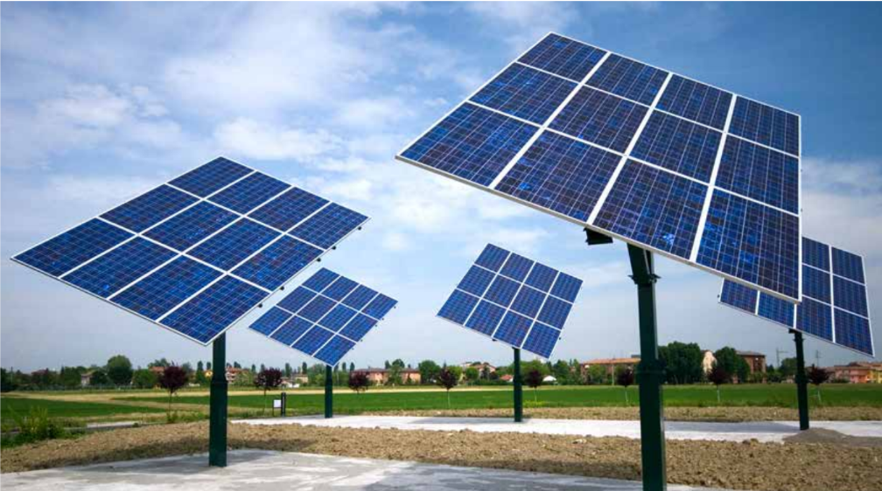
What do you know about PV panels?
Team up with 2-3 other students. Take a piece of paper and write down what you know about PV panels.
What PV stands for? What do PV panels do?
What kind of energy they have as input? and as output? How do they do so?
If you saw them, where did you see them? How they looked like? Are they all similar?
Why do you think PV panels are important for GHANA transition?
Be CREATIVE - write, draw, sketch whatever you know about them!
Notes:
As a first step the teacher ask the student to get involved and brainstorm all they know about PV panels
At the end of the excercise the teacher can use 5-10 minutes to get the answer from the various groups asking the questions in the slide. Also, when the students give a partial answer, the teacher could ask further question to stimulate the students to think on their own.
The teacher could write down on the board all the different answers (diregarding whatever they are wrong or correct) from the different groups to then refer visually to the student answers when going through the explenation in the next slides

Slide 7

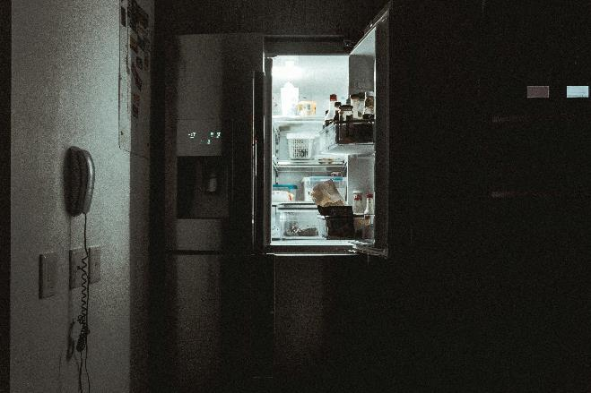
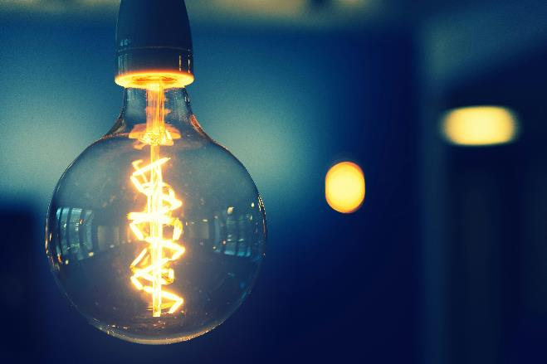
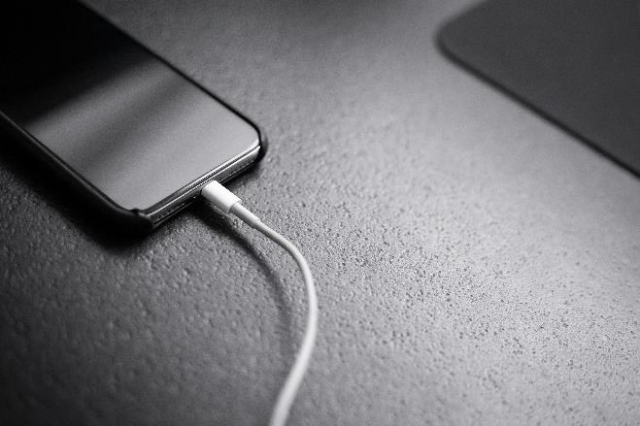
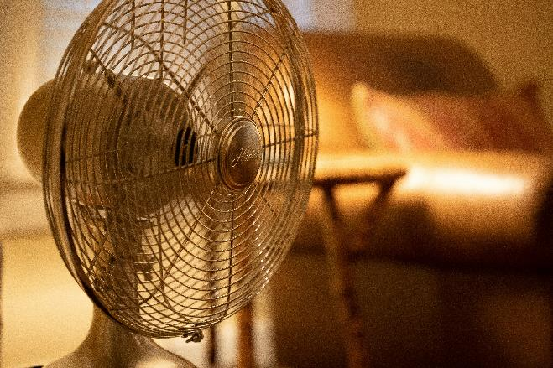
PV panels convert sunlight into electricity!
Some examples of how you use electricity…can you think about others?
PV stands for “Photo” which means light and “Voltaic” which refers to electricity
PV panels convert (sun)light - that you can (just) see and feel - into electricity that you can use! This process is called photovoltaic effect!
Because PV panels are used to harness solar energy, “PV” and “solar” are used interchangeably (e.g., PV panels or solar panels, PV cells or solar cells, …)
Notes:
After the active brainstorm of the students the teacher use the following slides to answer the questions and introduce PV panels
For what do you use electricity? Example of answers:
charge your devices/your computer in school
turn on the light in the evening
use the fridge
turn on the fan, …

Slide 8
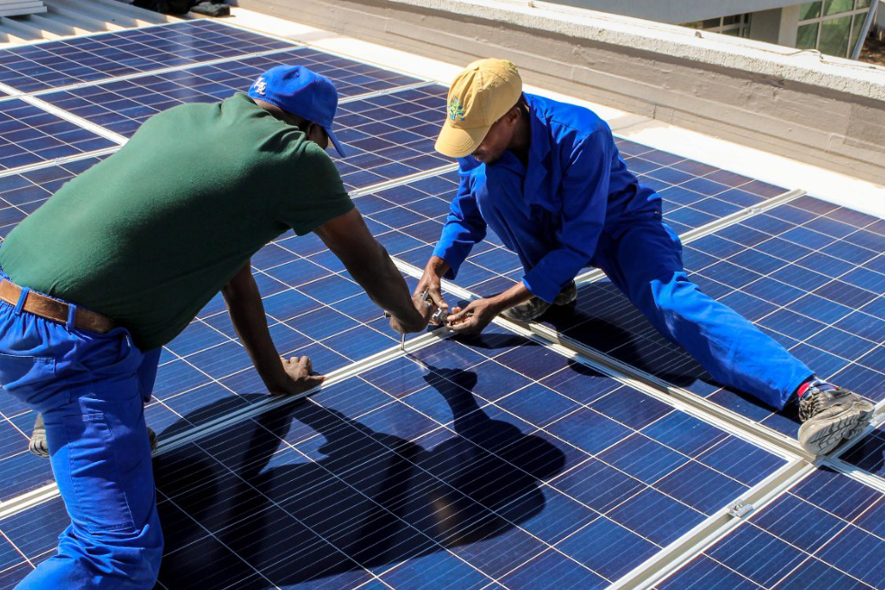
PV panels are composed by connected PV cells
PV Cell: A PV cell is the basic building block of the system capable of converting sunlight into electricity. It is made of a semiconductor material, today often silicon
PV panel: A PV panel is composed of multiple PV cells connected and encapsulated in a protective environment
PV system: A PV system consists of multiple PV panels connected to form a larger system
1 PV panel
1 PV cell
Notes:
PV Cells: Each small square (cell) generates a tiny amount of electricity.
PV panels: Groups of these cells are combined and protected to form modules/panels
PV system: These panels/modules are then assembled into system, which are installed on the roof to produce enough electricity to power a home.
In summary, the assemblage of multiple PV cells into panels and then multiple panels into systems allows for practical and efficient harnessing of solar energy on various scales.

Slide 9
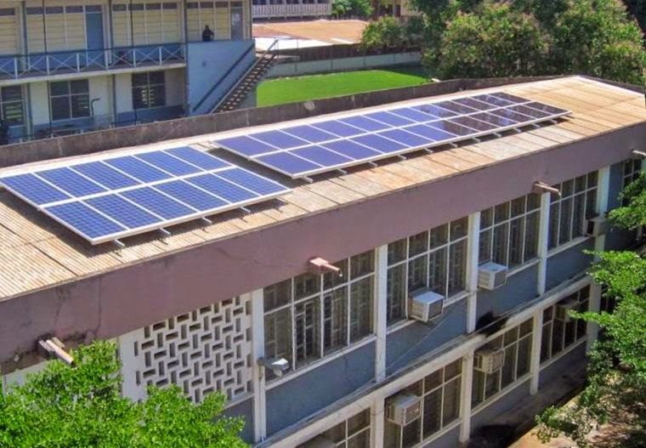
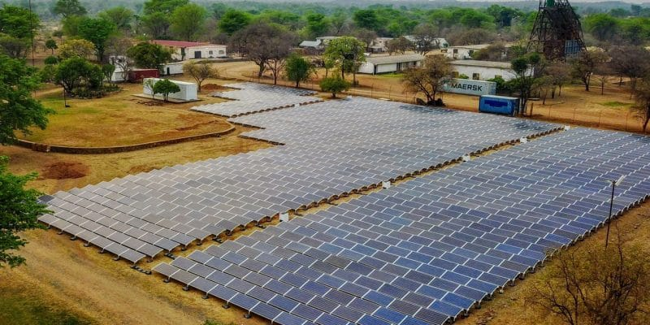
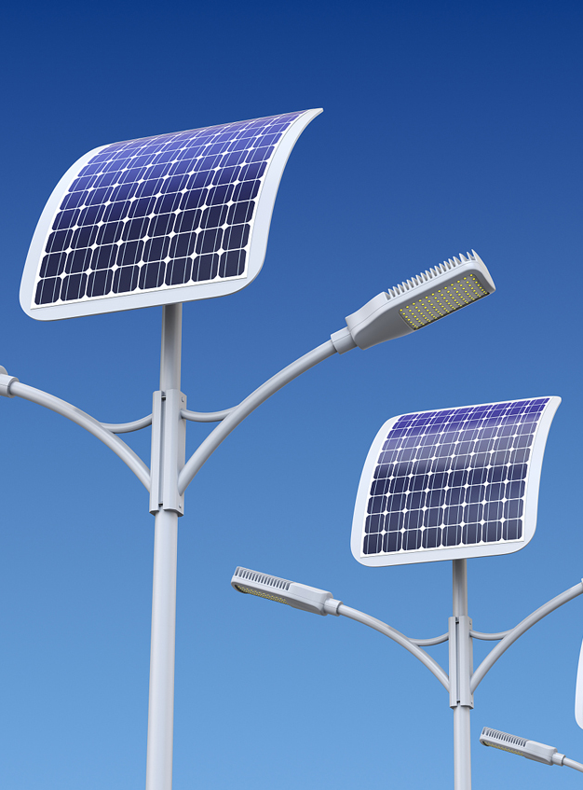
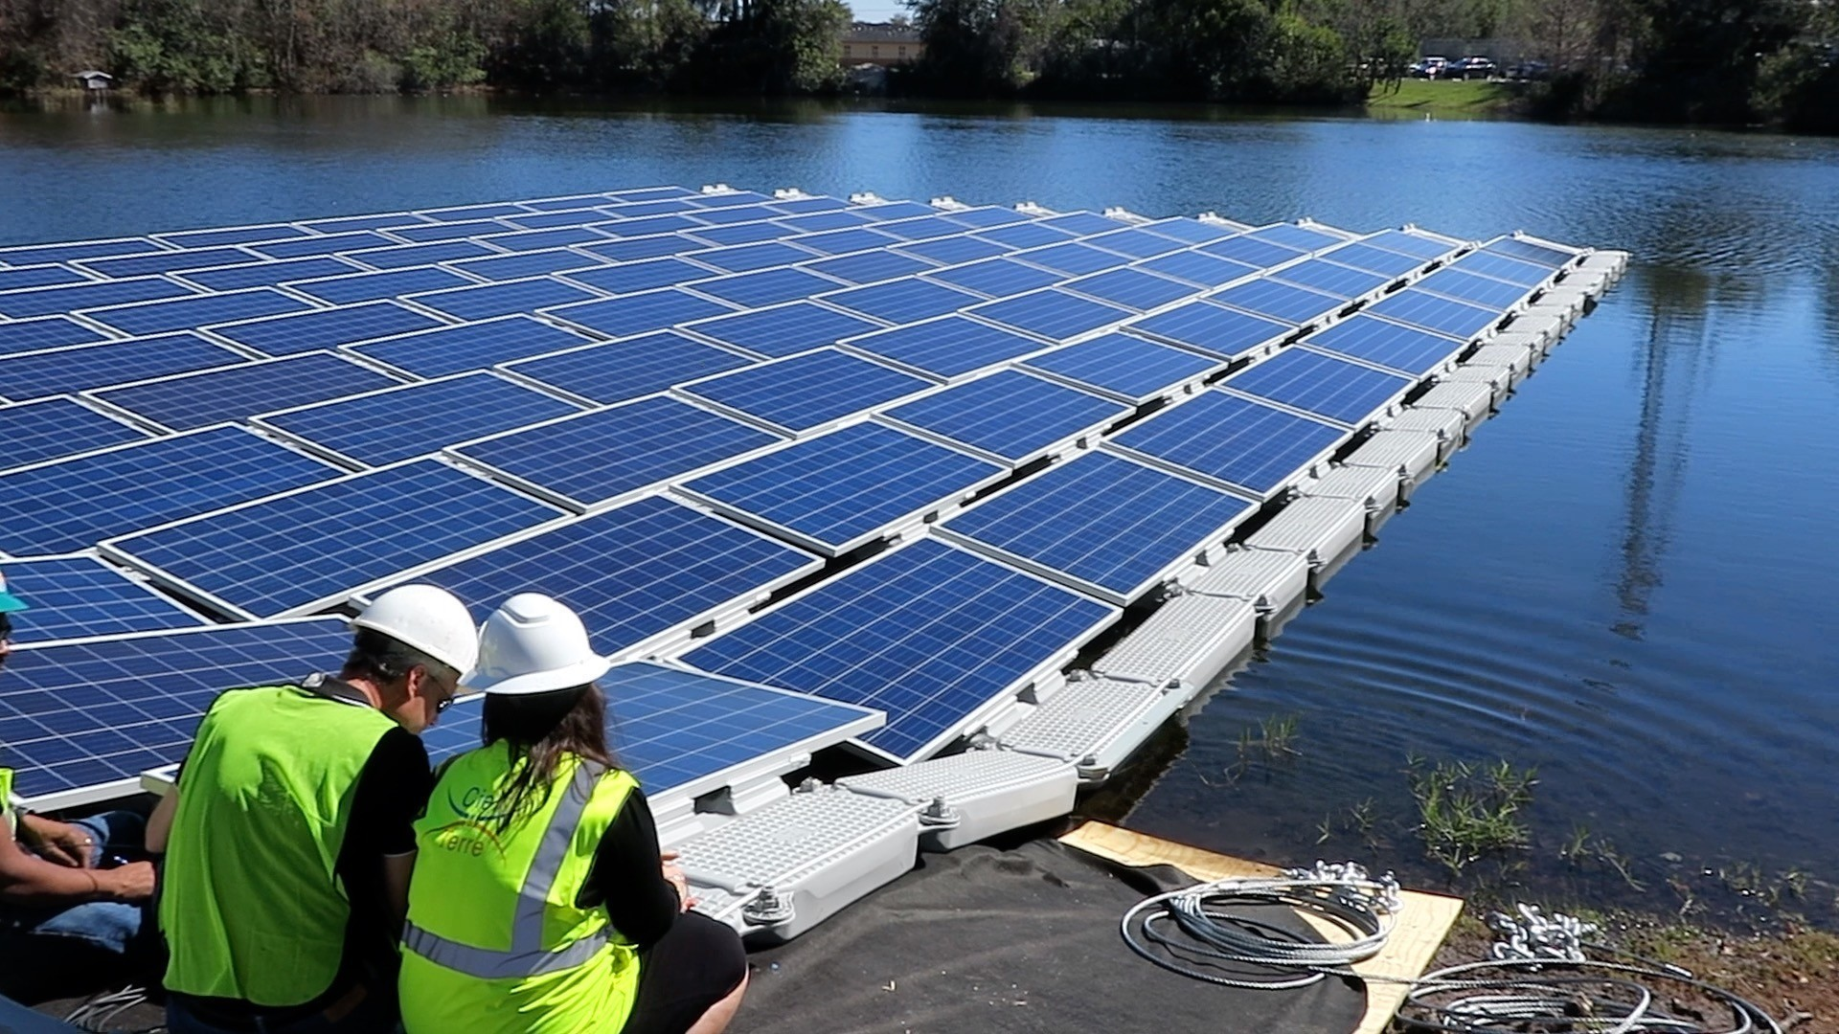
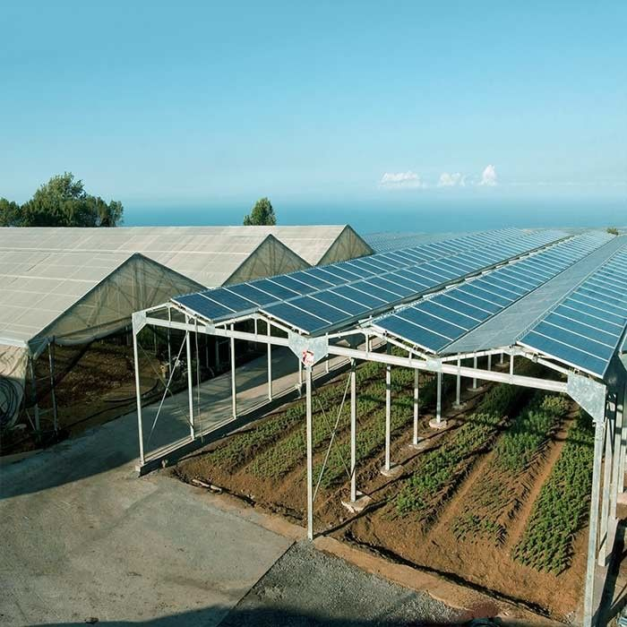
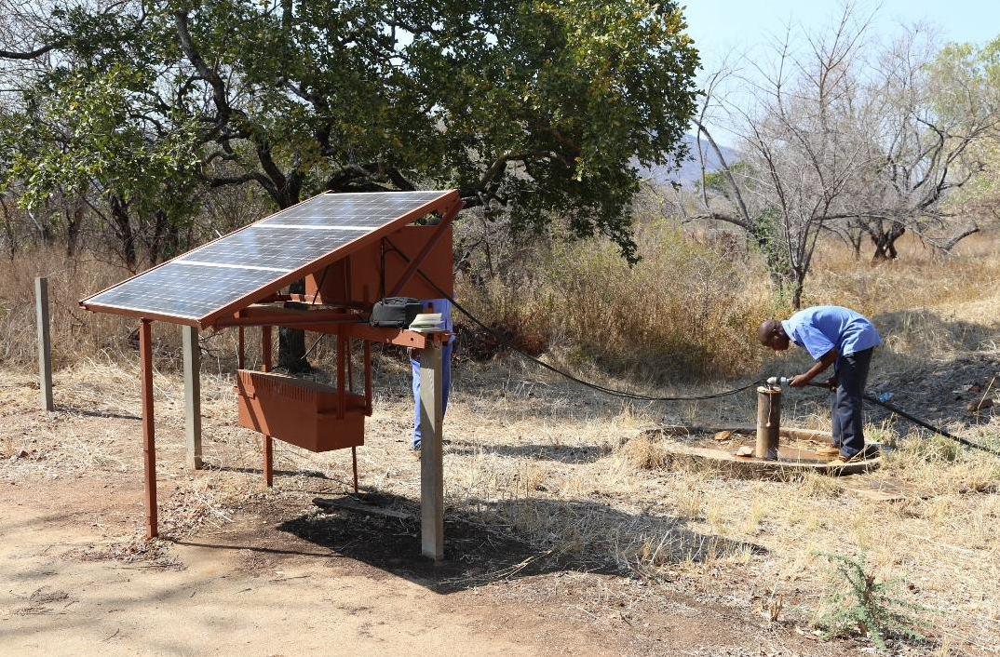
You might have seen PV panels on rooftops, farms, lakes, devices…
Notes:
By leveraging the flexibility of PV panel installations across different environments, it’s possible to harness solar energy efficiently and innovatively in each unique environment depending on the characteristics of the environment.
Factors that varies are for example installation and maintenance requirements.
For example, rooftop installations must consider roof integrity and orientation, while floating solar panels require suitable anchoring and water body management
More background information on each installation below.
1. Rooftops: PV panels can be installed on the rooftops of homes to generate electricity for household use or on the rooftop of businesses and industrial facilities (usually larger system). This installation reduces electricity costs, lowers carbon footprint, and can provide energy independence, especially in remote areas.
2. Solar Farms: Installation of PV panels spread over more or less extensive areas of land. This installation can generate electricity to satisfy the need of a local community and/or to fed into the power grid, supporting regional or national energy needs.
3. Portable Solar Chargers: Small PV panels integrated into chargers for electronic devices provides a renewable and portable power source for smartphones, tablets, and other small electronics, especially useful in remote or off-grid locations.
4. Solar-Powered Gadgets: Devices like solar-powered lights, fans, or Solar water pumps
5. Floating Solar Panels: PV panels mounted on floating platforms on lakes, reservoirs, and other water bodies can saves land space, reduces water evaporation, and can improve the efficiency of the panels due to the cooling effect of the water.
5. Greenhouses: Integration of PV panels with agricultural activities, such as installing panels on greenhouse roofs provides renewable energy for agricultural operations while also potentially enhancing crop growth by controlling sunlight exposure and temperature.

Slide 10
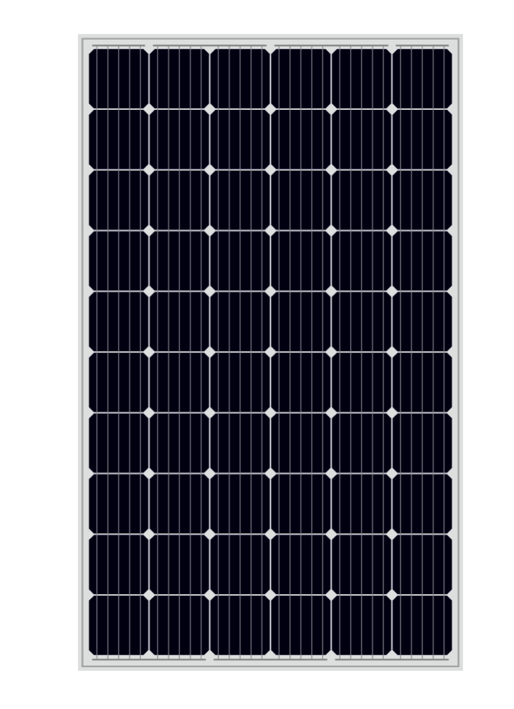
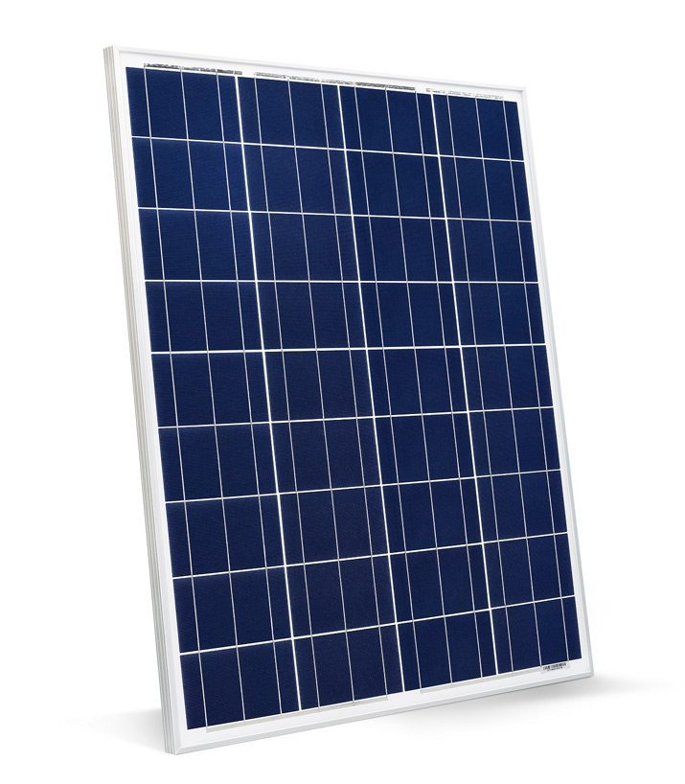
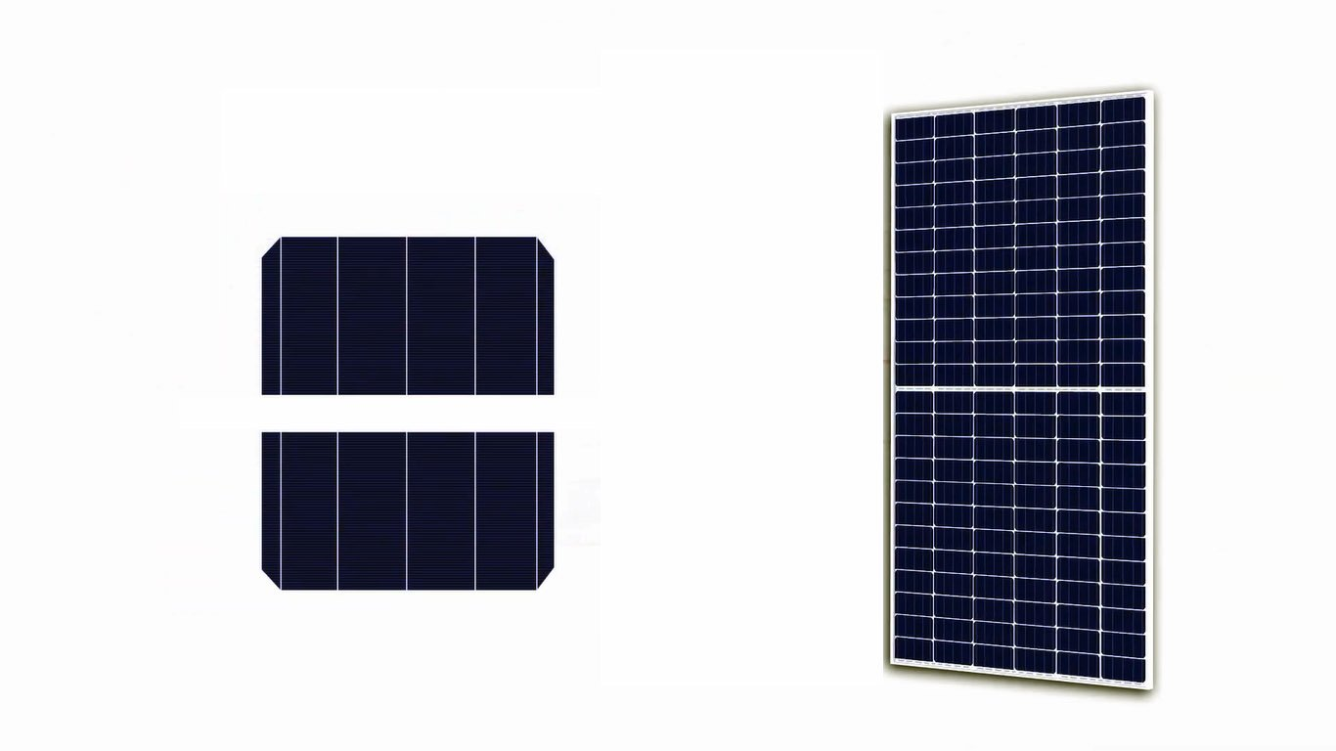
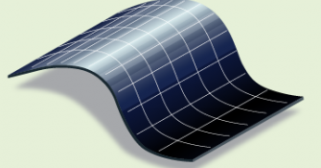
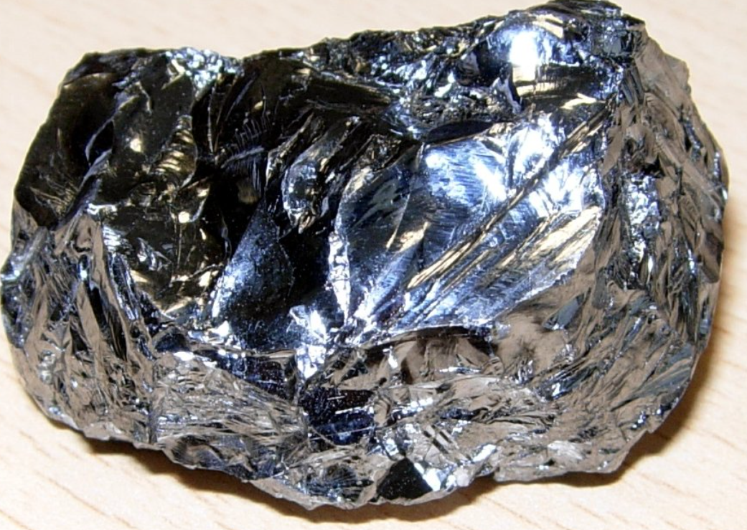
And you might have seen them of different shapes and colours!
Monocrystalline
Polycrystalline
Thin-Film
Half-cut
Recognizable from the dark and uniform colour, these PV cells are made of single (“mono”) large piece of silicon crystal
Recognizable from the bluish colour and the glittery appearance, these PV cells are made of multiple (“poly”) small silicon crystals pressed together
Recognizable from the particular flexible shape, these PV cells are made of a variety of different materials
Recognizable from the small “half” PV cells, these PV cells are just like traditional mono-poly crystalline cells, simply cut in half
second most abundant element on earth’s crust!
Notes:
Monocrystalline PV cells
These solar cells consist of a single large piece of silicon crystal.
They are often dark and have a uniform colour.
Advantages:
They are very efficient, which means they can convert a lot of sunlight into electricity (this can be explained by the colour of the panel!) → They take up less space to generate the same amount of electricity as other cells.
Disadvantages:
They are more expensive to produce.
Polycrystalline PV cells
These solar cells consist of many small silicon crystals that are pressed together.
They are usually bluish and have a glittery appearance because they are made up of many crystals.
Advantages:
manufacturing process is simpler → They are cheaper to produce and they produce less CO2 emissions
Disadvantages:
They are less efficient than monocrystalline cells, which means they take up more space to generate the same amount of electricity.
Thin-film
These panels are often flexible and lightweight, making them suitable for a variety of applications, including integration into building materials (like solar shingles) and portable solar devices.
Advantages:
Thin-film panels are typically cheaper to produce due to lower material costs and simpler manufacturing processes. This can result in lower initial installation costs and lower emissions
Their flexibility and lighter weight allow for a broader range of applications, including on curved surfaces and structures where traditional rigid panels would be impractical
Disadvantages:
Lower Efficiency: Thin-film panels generally have lower efficiency rates compared to monocrystalline (15-20%) and polycrystalline (13-16%) panels, meaning they require more space to produce the same amount of energy.
Lifespan and Degradation: Thin-film panels often have a shorter lifespan and higher degradation rates compared to crystalline silicon panels, which can affect long-term performance and return on investment.

Slide 11
These PV panels have different pros and cons
Monocrystalline
Polycrystalline
Thin-Film
Half-cut
Moderate
Low
High
Efficiency
Costs
Lifetime
CO2 emissions
Flexibility application
Notes:
The teacher can uses this slides if wanting to go more about the pros and cons
Monocrystalline PV cells
These solar cells consist of a single large piece of silicon crystal.
They are often dark and have a uniform colour.
Advantages:
They are very efficient, which means they can convert a lot of sunlight into electricity (this can be explained by the colour of the panel!) → They take up less space to generate the same amount of electricity as other cells.
Disadvantages:
They are more expensive to produce.
Polycrystalline PV cells
These solar cells consist of many small silicon crystals that are pressed together.
They are usually bluish and have a glittery appearance because they are made up of many crystals.
Advantages:
manufacturing process is simpler → They are cheaper to produce and they produce less CO2 emissions
Disadvantages:
They are less efficient than monocrystalline cells, which means they take up more space to generate the same amount of electricity.
Thin-film
These panels are often flexible and lightweight, making them suitable for a variety of applications, including integration into building materials (like solar shingles) and portable solar devices.
Advantages:
Thin-film panels are typically cheaper to produce due to lower material costs and simpler manufacturing processes. This can result in lower initial installation costs and lower emissions
Their flexibility and lighter weight allow for a broader range of applications, including on curved surfaces and structures where traditional rigid panels would be impractical
Disadvantages:
Lower Efficiency: Thin-film panels generally have lower efficiency rates compared to monocrystalline (15-20%) and polycrystalline (13-16%) panels, meaning they require more space to produce the same amount of energy.
Lifespan and Degradation: Thin-film panels often have a shorter lifespan and higher degradation rates compared to crystalline silicon panels, which can affect long-term performance and return on investment.

Slide 12
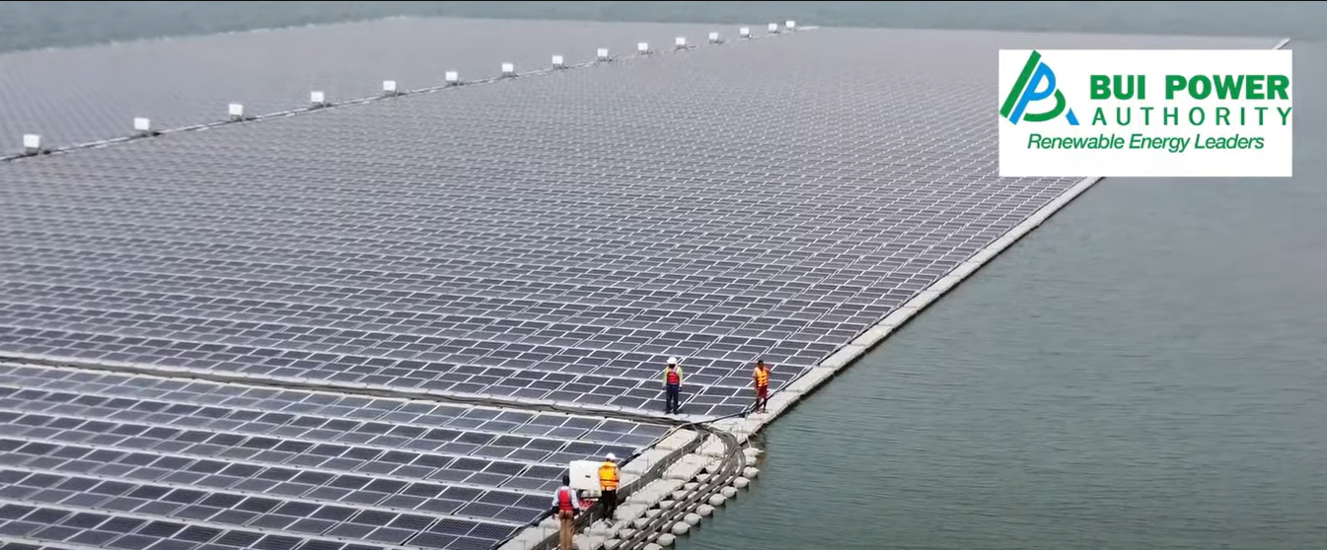
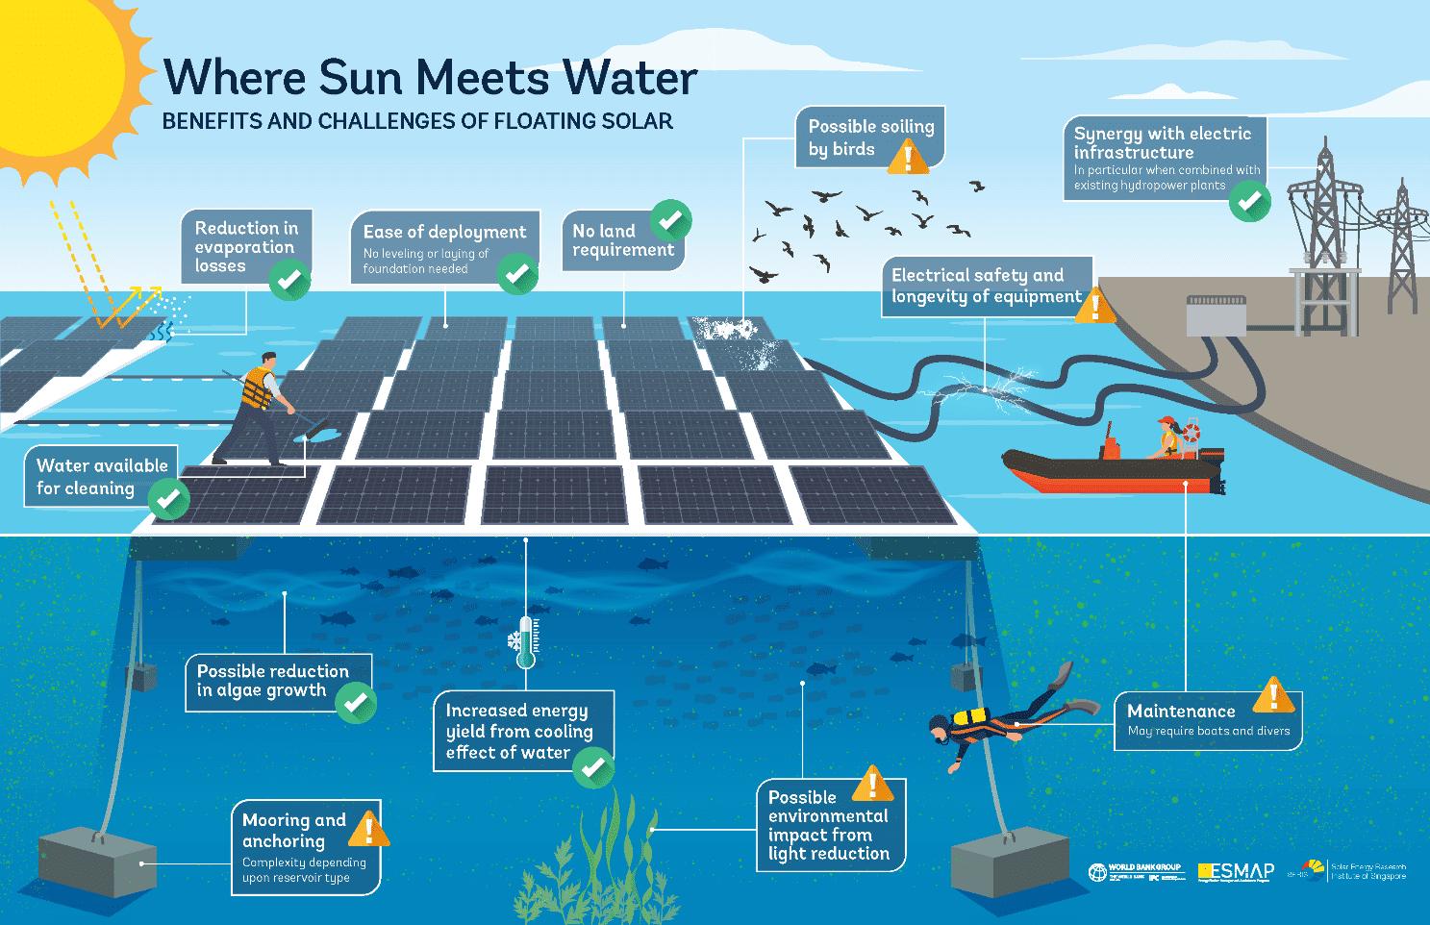
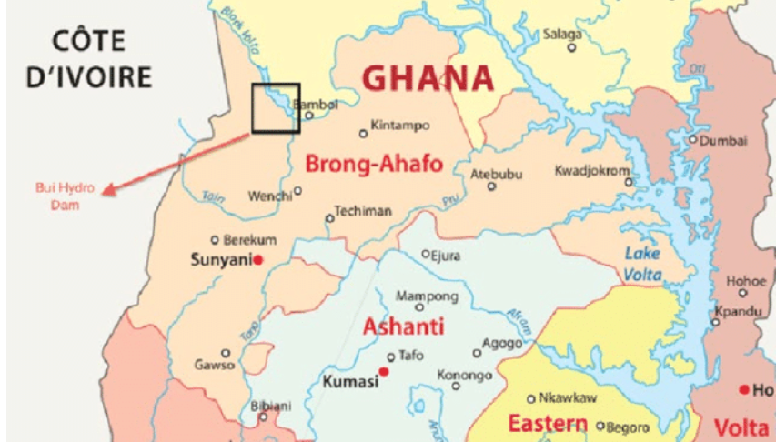
In Ghana there is the largest floating Solar PV system in whole Africa!
Look at the video: Largest Floating Solar Plant In Africa
Click here if you want to learn more about the about the 5MWp Floating Solar PV System.
Notes:
If there is time it is really nice to look at the video (also watching just the first 2 min)
Then you can look at some of the advantages and disadvantages briefly showned in the picture on the right. More background information below.
Major advantages:
When existing water reservoirs are used, valuable land is freed up for other purposes such as for agriculture/ residential developments
A power plant on the surface of a water body results in reduced evaporation, which can be vital in areas where water is a scarce resource.
The combination of hydropower and solar power plants is a cost-effective strategy for allocating new PV plants, increasing the capacity factor of a hydropower plant by 50- 100%.
A floating solar power plant can generate more electricity than traditional ground-mounted and rooftop systems, because the water has a cooling effect, which reduces the operating temperature and increases the solar panel efficiency.
Major challenges:
Environmental Impact: FPV systems can affect aquatic life, including changes in water temperature, light penetration, and gas exchange. This could impact the flora and fauna beneath the panels. Potential contamination from materials used in the FPV systems (e.g., plastics, metals) can degrade water quality over time. The anchoring systems can also disrupt the lake or reservoir bed and bring ecological damage.
Design complexities: FPV systems must withstand various water conditions, including waves, currents, and fluctuating water levels. Designing structures that can handle these dynamics is complex. They must also be resistant to extreme weather events such as storms, high winds, and heavy rainfall, which can damage the panels and supporting structures.
Installation and Maintenance: Installing FPV systems is more complex than ground-mounted systems. It requires specialized equipment and expertise to deploy and secure the floating platforms. Routine maintenance and repairs can be more challenging and costly due to the difficulty of accessing the panels on water.
Anchoring and Mooring: Ensuring that the FPV systems remain stable and properly anchored is critical. This requires robust mooring systems that can adapt to changing water levels and conditions.
Cost and Financial Viability: The initial cost of FPV systems is generally higher than ground-mounted systems due to the complexity of installation and the need for specialized components.
Maintenance Costs: Long-term maintenance costs can also be higher due to the challenges of working on water.
Energy Transmission: Transmitting the generated electricity from water-based systems to the grid involves underwater cabling, which adds complexity and potential points of failure.
Degradation and Efficiency: Exposure to constant moisture and UV radiation can accelerate the degradation of materials used in FPV systems, potentially reducing their lifespan. The cooling effect of water can enhance efficiency, but issues like algae growth on panels can reduce the efficiency if not properly managed.

Slide 13
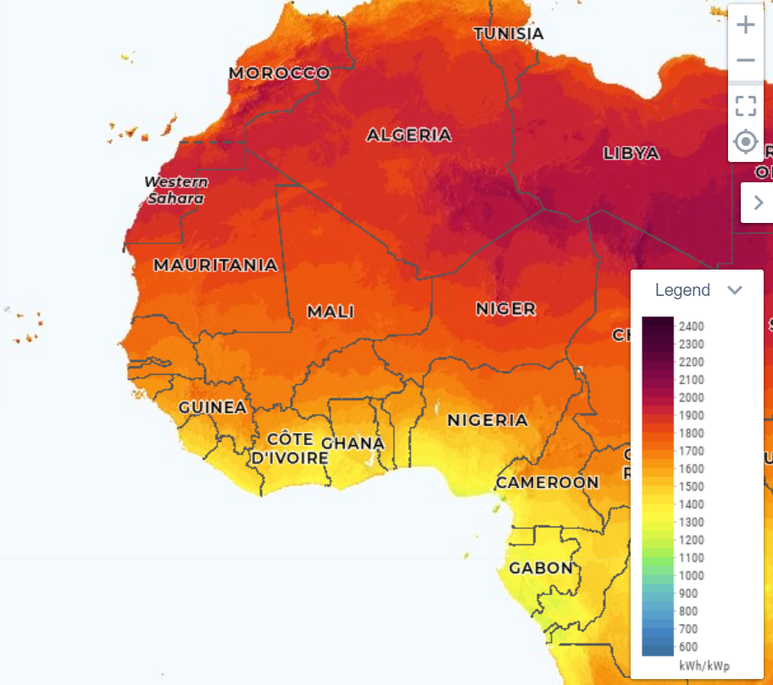
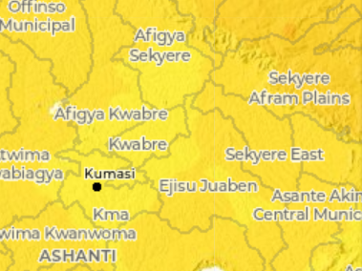
Ghana has a medium-high PV potential !
Check again the map by yourself Global solar atlas - PV power output and find:
One country that has higher potential compared to GHANA and one that has lower potential
One town that has higher potential compared to Kumasi and one that has lower potential
What is the region with highest potential in GHANA? And the one with lowest potential?
Very high potential
Very low potential
Notes:
The point here is to look at the website and see the different potentials, for example some students may come from another region and may be interested to look at the specific are where they grow up and compare it to other areas or countries!
The exercise can be done in class if there is time or can be required to do at home and asked about it in the next session.
Sample of answers:
Country that has higher potential compared to GHANA: Mali
Country that has lower potential compared to GHANA: Gabon
Town that has higher potential compared to Kumasi: Tamale
Town that has lower potential compared to Kumasi: Nkawkaw
Region with highest potential in GHANA: Upper West-East regions
Region with lowest potential in GHANA: Western-central region
To check other towns, countries, areas and their potential.
To check other towns, select “Site” in the menu on the left of the map then point the town you want to know about with the arrow and read the specific photovoltaic power output
To check other countries, select “Region” in the menu on the left of the map and then write the name of the country you want to know about in the “select country” tab on the right and read the specific photovoltaic power output
To check other areas, select “area” (either the rectangular one or the one to create other shapes) in the menu on the left of the map and then draw the area you want to know about in the map and read the specific photovoltaic power output

Slide 14
135 Mwh
The potential power output in 1 year generated by 100kWp installed on a medium size commercial rooftop in Kumasi
Simple CALCULATIONS: An average household consumes about 200 kWh per month, how many households could be powered then by installing 100KW in Kumasi?
Notes:
Answer: 56 households
Calculation:
1. Calculate the Annual Energy Consumption per Household:
Average household consumption: 200 kWh per month.
Annual consumption per household: 200 kWh/month×12 months/year=2400 kWh/year
2. Determine the Number of Households Powered:
Divide the annual energy output by the annual energy consumption per household: 135044 kWh/year/ 2400 kWh/year =56 households

Slide 15
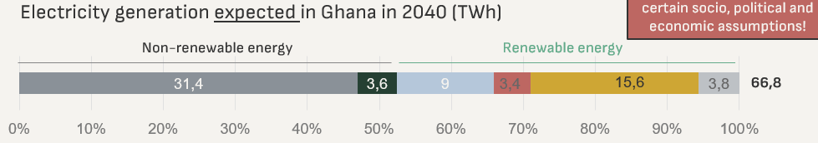
23%
PV panels are expected to be the main renewable technology in Ghana!
Remember from last session?
Expected electricity generated from PV panels in Ghana in 2040

Slide 16
02
PV Basics introduction
Discover the basic criteria/factors you should consider in PV technology

Slide 17
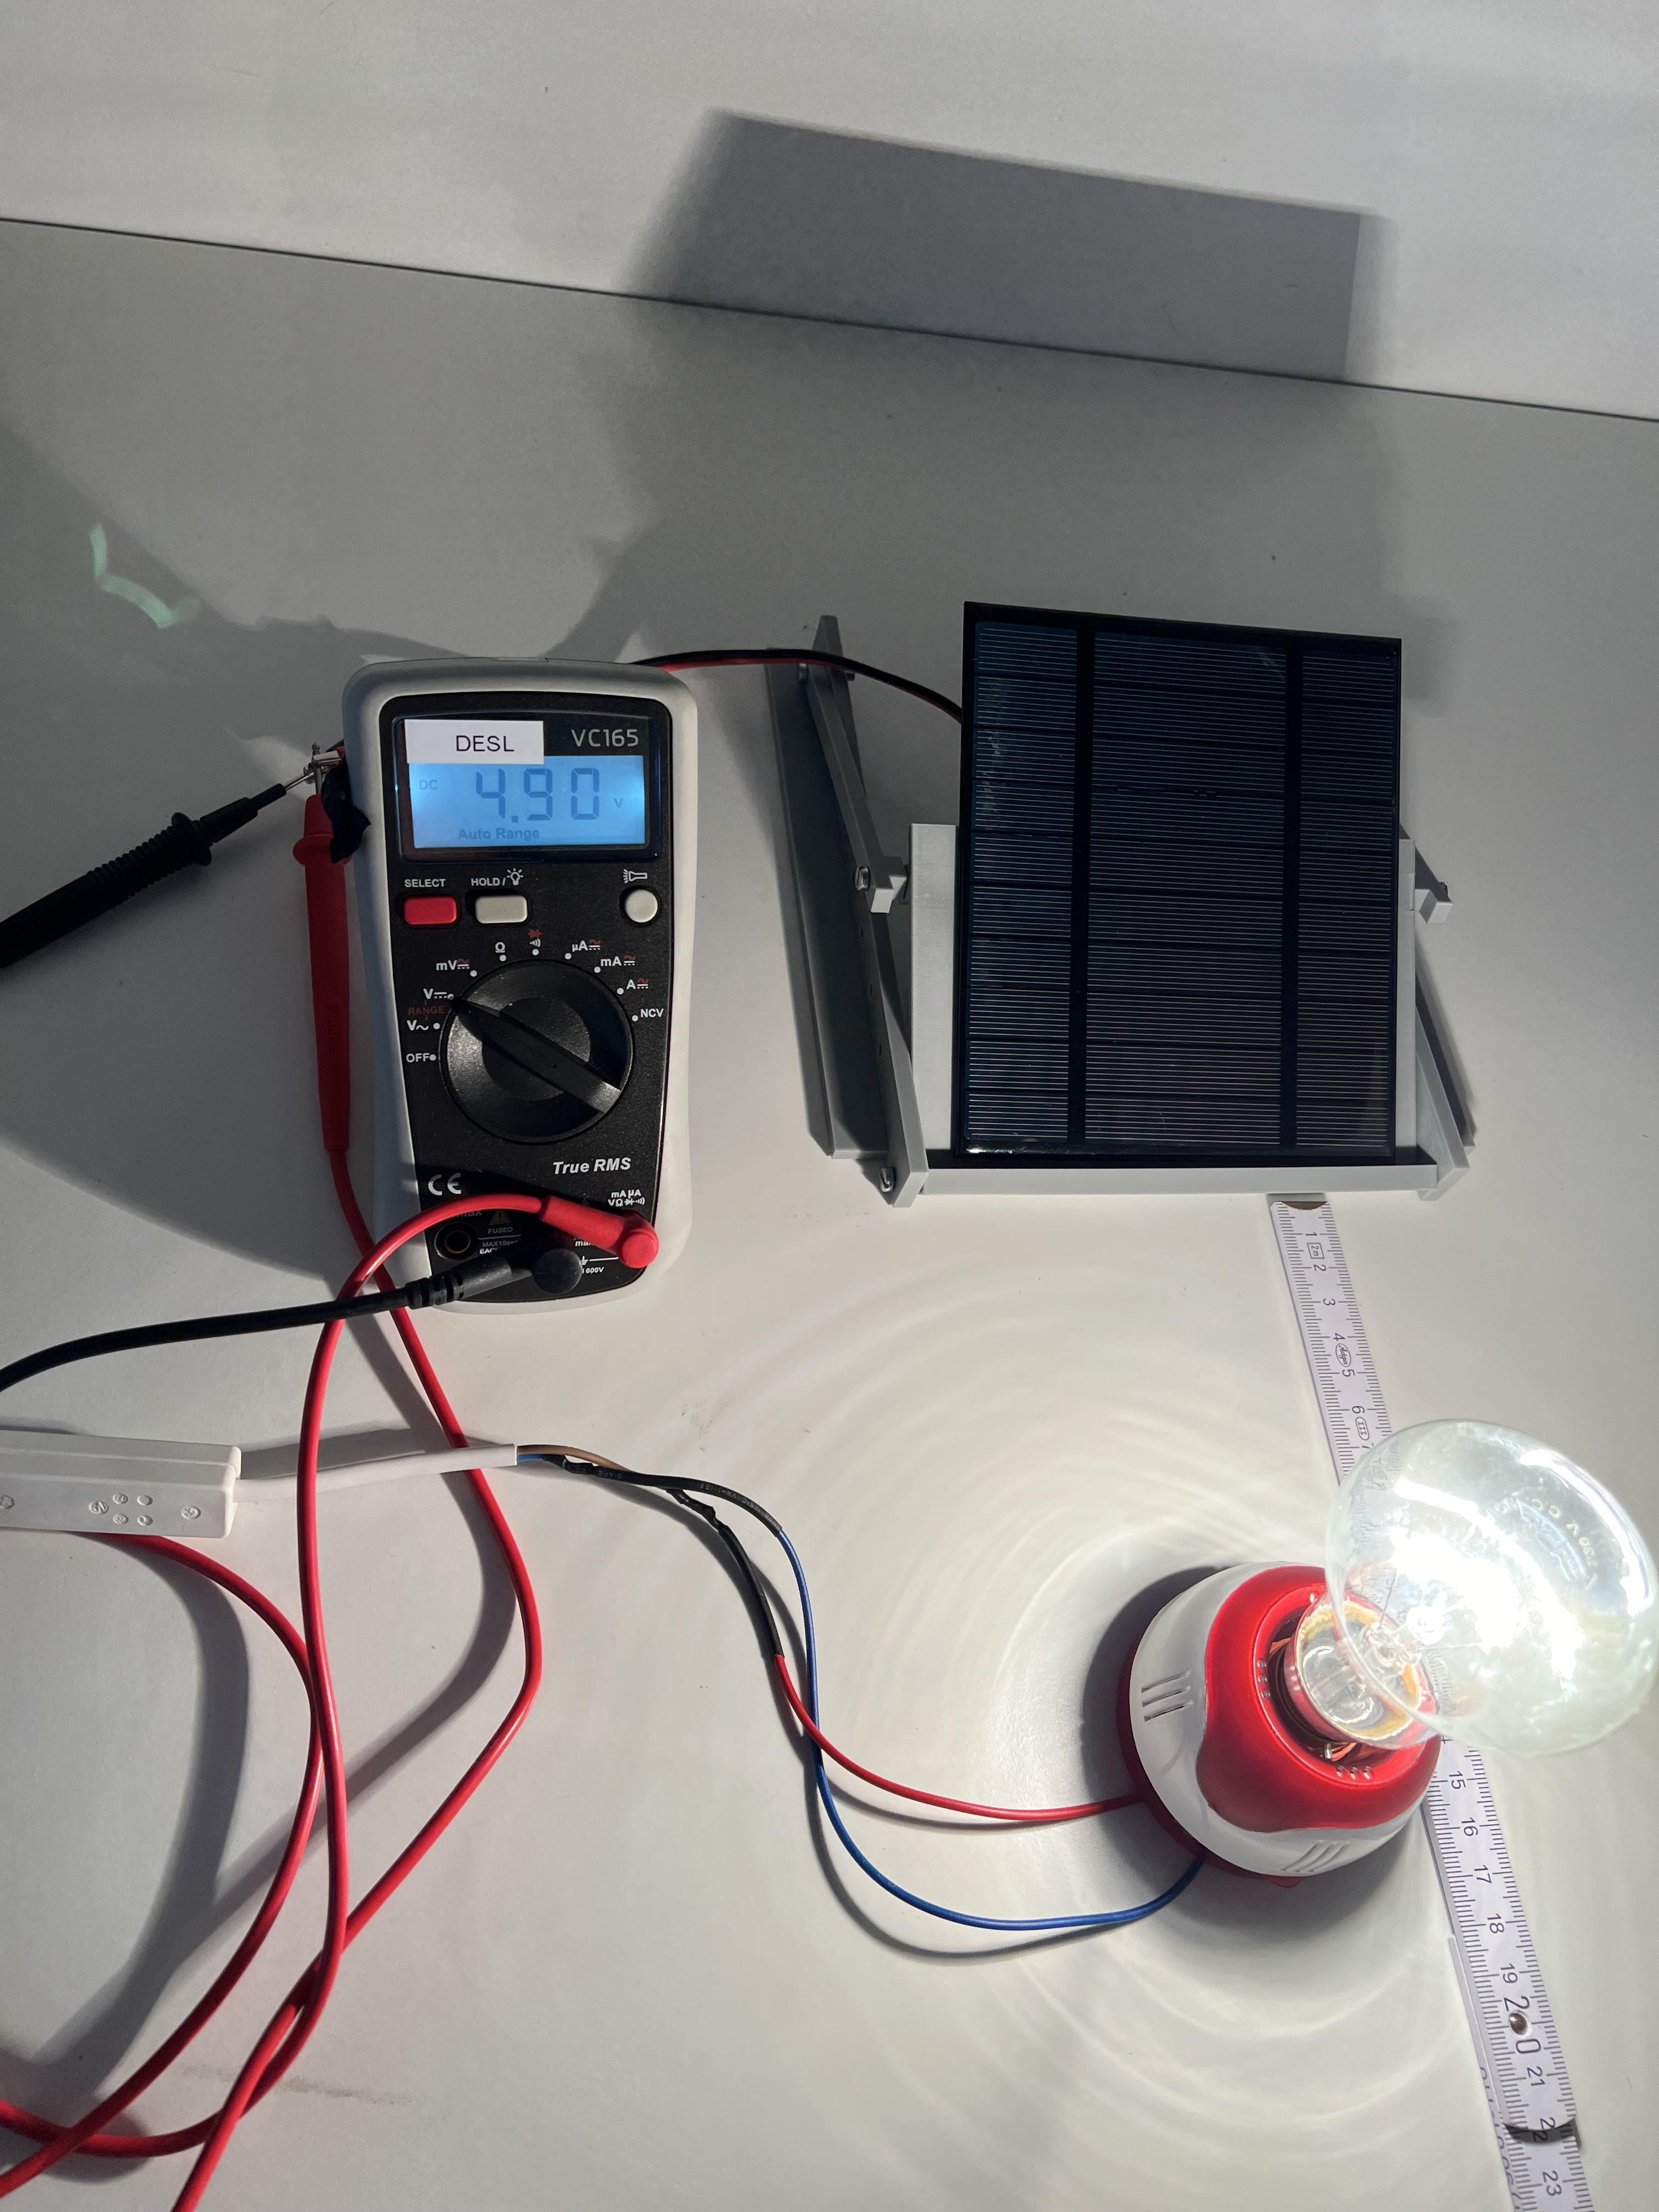
And now, let’s use our PV Kit to find out how a PV panel works and what are the key factors influencing their functioning!

Slide 18

Let‘s get started!
Team up with 2-3 other students. Give yourself a fun team name!
Take one PV kit per team and start to familiarize yourself with its components.
Scan the QR code and try to answer the questions
What could be some external factors influencing the functioning of a PV panel?
How do you think they influence the PV performance?
Notes:
This slide is meant for students to introduce the topic of the key factors affecting the functioning of a PV panel that they will discover durig the experiments

Slide 19
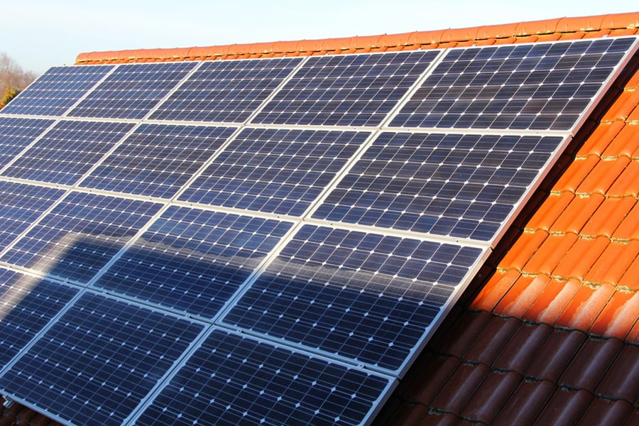
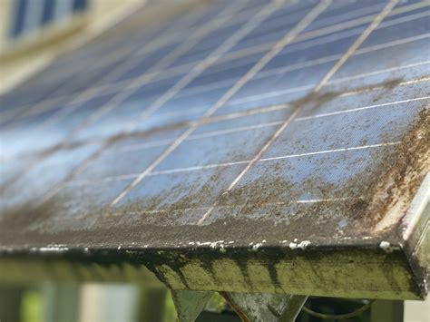
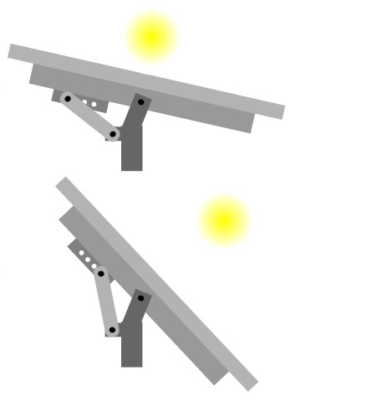
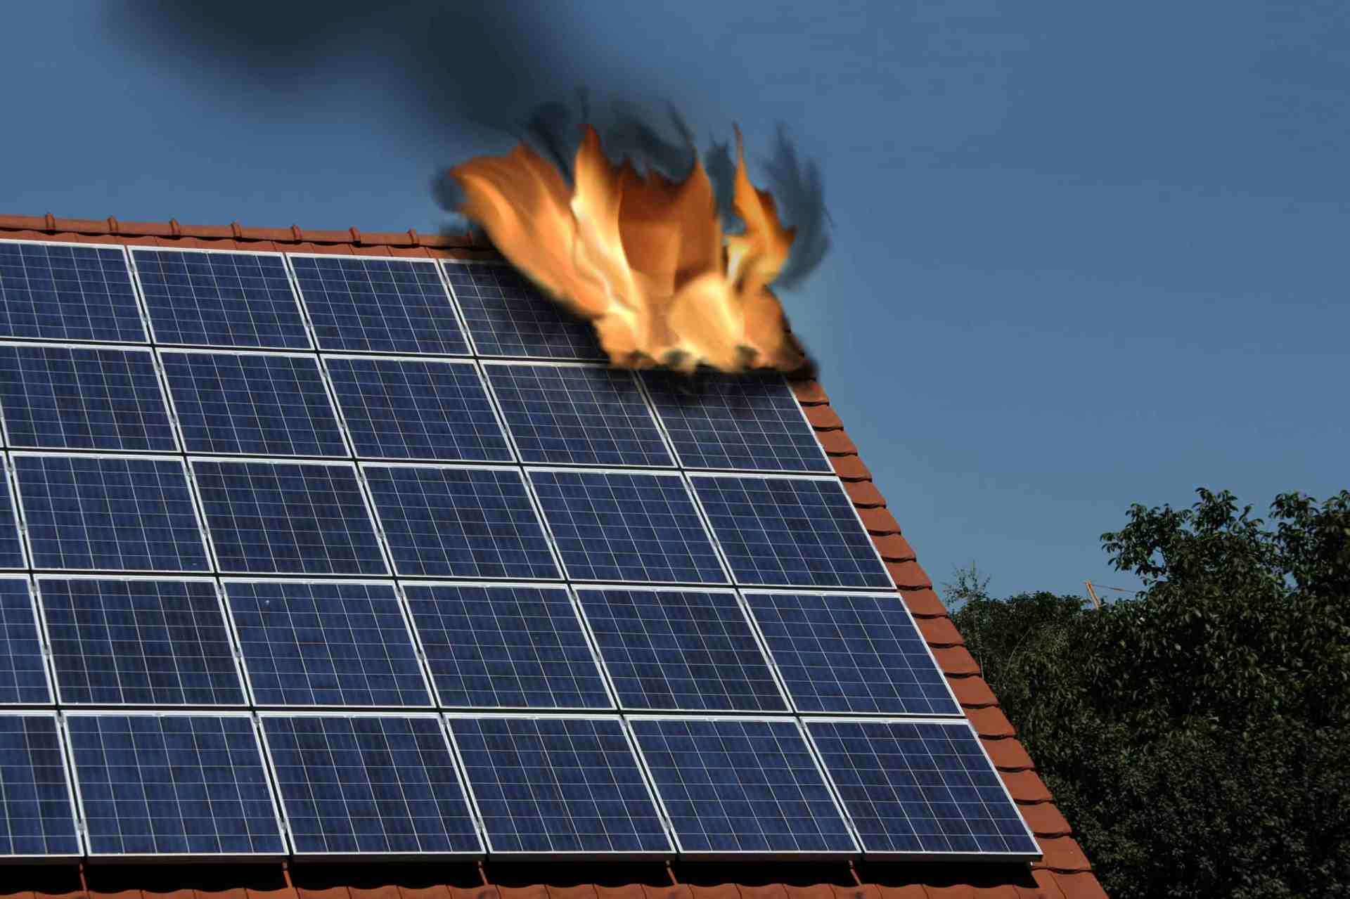
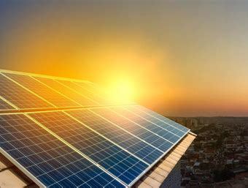
You can get inspired by looking at these pictures

Slide 20
03
Experiments & Discussions
Work in your team, experiment and find out!

Slide 21
We’ll conduct 6 experiments to see how key factors affect the PV cell performance
01
Light colours
Light intensity
Pollution
03
05
Yellow vs. white light
Distance to the light source
Pollution on the PV panel (e.g., dirt, dust)
Angle of incidence
02
Heat
04
Shade
06
PV Panel temperature
Shade on the
PV panel
PV panel inclination
Notes:
The teacher introduce the 6 factors briefly saying that we will learn more about these factors and how they affect a PV panel in the experiments.

Slide 22
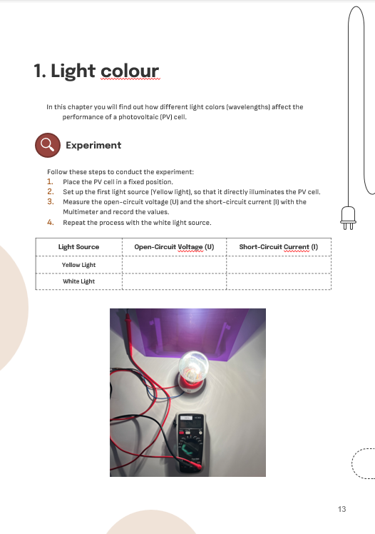
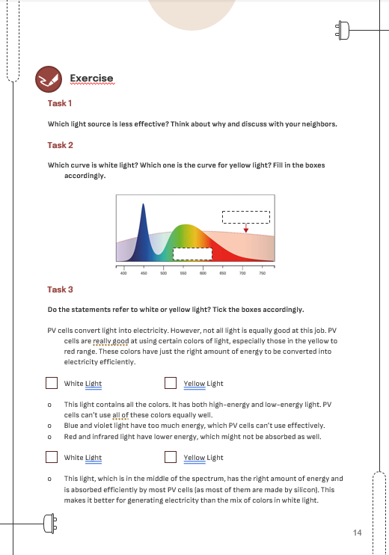
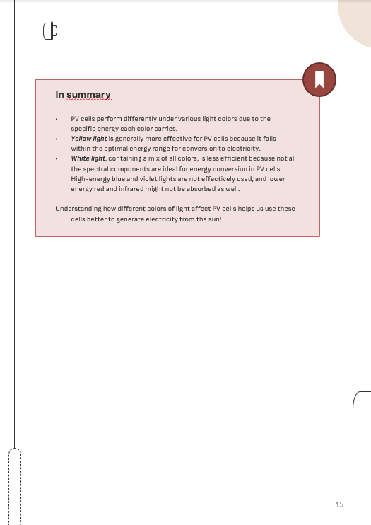
Work together with your team and fill out the worksheet for each experiment
Notes:
The teacher ask the student to open the handbook at page xx and explain a bit the structure of the worksheet
Every student should fill out its worksheet even though they work all together!

Slide 23
Ask ANY questions!
Help each other ☺
Notes:
Write Note!

Slide 24

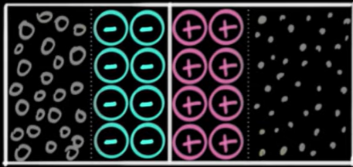



Before starting…lets try to understand a PV cell with a metaphor
photons
Electron
Hole
P-type
N-type
PN junction
Imagine….
Kangaroos= Electrons, bottom=holes
2 steps= PN Junction (lowest step where the kangaroo jump at first= N-type, highest step where they jump doing some work= P-type)
Falling sugar cubes of different sizes and colours= Photons of different wavelength/energy/colour
Medium between the 2 steps (e.g., air, void, rocks)= Resistance
Resistance

Slide 25


What is voltage? What is current? What is power?
1. Kangaroos usually stay at the bottom
2. Every kangaroo at the bottom that gets a sugar cube, eats it, get some energy and jump to the lowest step.
Voltage (V) is the potential energy/work that can be done by the kangaroo at the lowest step when jumping to the highest step → the higher is the number of kangaroos on the lowest step, the higher is the voltage!
3. Every kangaroo at the lowest step try to jump to the highest step then the fall back at the bottom
Current (I) is the number of kangaroos that we see in the air while jumping to the highest step in a given unit of time t. Power (P) is the energy/work that is done by the kangaroo when jumping to the highest step in a given unit of time t.
Try to derive the formula for power (P) as a function of voltage (V) and current (I) with your teammates!

Slide 26
What is open-circuit voltage?
Now imagine that, between the lowest and the highest step you have a very thick and dense medium (instead of air) that works like an infinite resistance to the kangaroo that wants to jump.
What will happen?
1. Every kangaroo eating a sugar cube will jump to the lowest step but then it will stop there because the very thick medium does not allow it to jump further
→ many kangaroos at the lowest step but no kangaroo in the air → high voltage but no current and no power (because although the high potential energy, none of this energy is used to do work!)
2. At some point it will be reached a point where kangaroos don’t fit anymore in the lowest step and any kangaroo that will try to jump will be pushed back by the kangaroos standing there already → a maximum voltage is reached
The “open-circuit” voltage is the maximum voltage that can be reached (when you have “infinite resistance”) and it depends on the design of the PN junction!

Slide 27

What is short-circuit current?
Now imagine that, between the lowest and the highest step you have the void (instead of air) that works like zero resistance to the kangaroo that wants to jump.
What will happen?
1. Every kangaroo eating a sugar cube will jump to the lowest step and then immediately to the highest step because the void makes zero resistance to the kangaroos that want to jump further.
→ Many kangaroos in the air but no kangaroo at the lowest step → high current but no voltage and no power (because the kangaroos don’t do any work to jump at the highest step – no resistance)!
2. The maximum number of kangaroo we’ll see in the air depends on how many and what kind of sugar cubes will reach the kangaroos
The “short-circuit” current is the maximum current that can be reached (when you have “no resistance”), and it depends on sunlight!

Slide 28
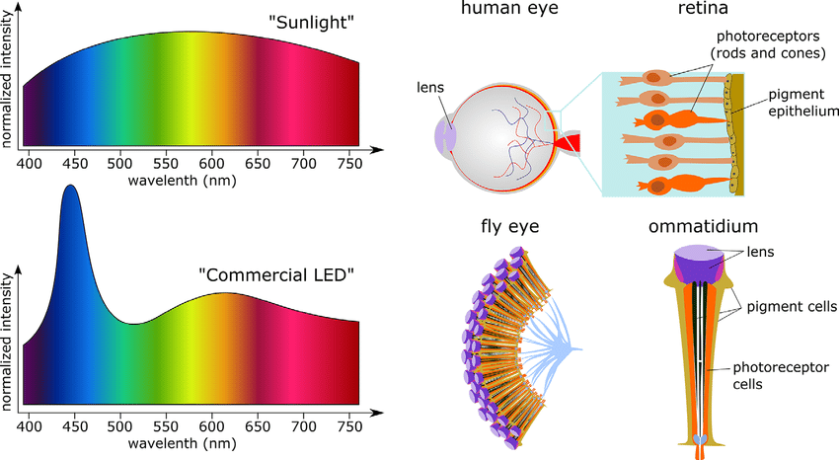
1. Light colours
Find out how different light colours (wavelengths) affect the performance of a PV cell
You have 10 min to do the experiment before we collect the results

Slide 29
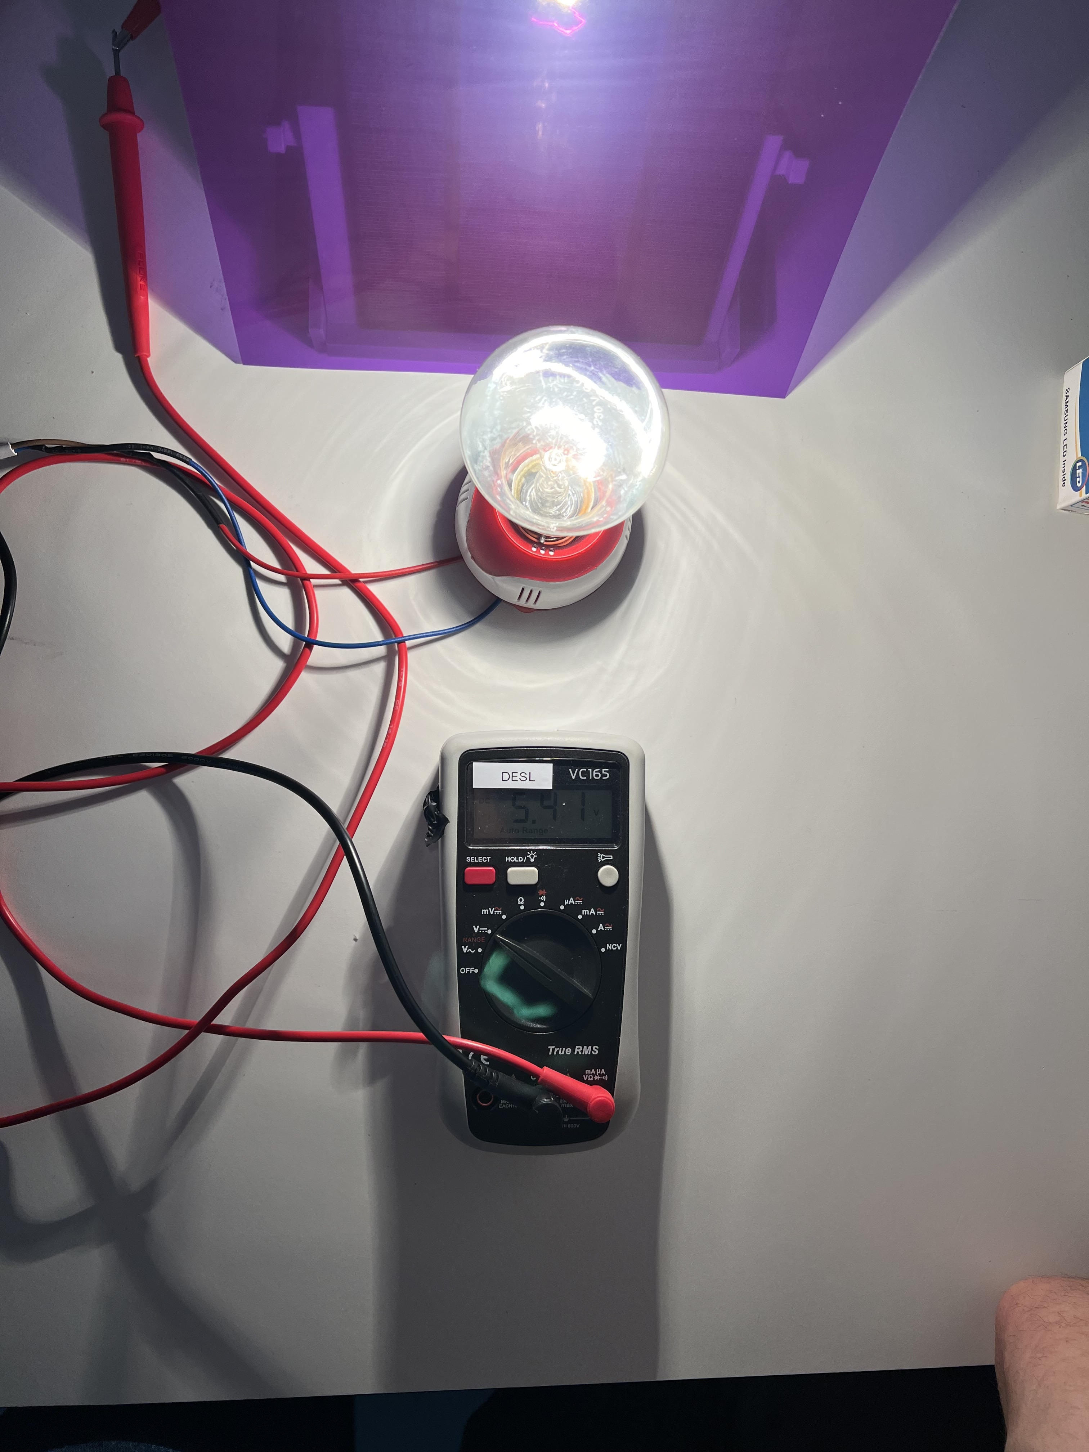
Conduct the experiment and do task 1,2 following the instructions on your worksheet (pg. 16-17)
Help each other in the team, ask questions to the teacher if you are stuck or have any doubt
If you finish before the other teams, try to do the other tasks (together!) then wait!
Notes:
This image will reamain during the time of the experiment

Slide 30

Time for confronting results and observations with the other teams!
Scan the QR Code, write the name of your team and answer the question on the experiment you just concluded!

Slide 31
PV cells are optimized to have highest efficiency with sunlight (not with white light!)
Wavelength (energy) spectrum
Violet-blue lights (short wavelengths) have exceeding amount of energy that PV cells CANNOT convert into electricity
Yellow-red lights (medium wavelengths) have the designed amount of energy, which PV cells CAN fully convert into electricity
Red-infrared lights (long wavelengths) have too low energy, which PV cells CANNOT convert at all into electricity
of White (LED) light
of Sunlight
Wavelengths
Light colours/wavelengths that have the designed amount of energy that can be fully converted into electricity by PV cells
Sunlight is more efficiently converted into electricity compared to white (LED) light because has a higher quantity of medium wavelength/yellow-red light photons that have the designed amount of energy that can be fully converted into electricity by PV cells.
Notes:
The point is to understand that light is not uniform but is composed of photons that have different wavelengths/colors/amounts of energy and that this amount of energy cannot be all equally absorbed and converted into electricity by PV cells
PV cells (as were born with the aim to harvest sunlight) has been designed based on the wavelength spectrum of sunlight (not with white light!) and therefore have highest efficiency with sunlight (and not white light!).

Slide 32


Why is the optimal energy, PV cells can convert, contained in yellow-red light?
If the kangaroo eats a blue cube, it will jump higher than needed and then fall back on the highest step (some energy is lost!)
If the kangaroo eats a yellow cube, it will jump exactly at the height of the highest step (all energy is used!)
If the kangaroo eats a red cube, it will jump too low, falling back on the lowest step (all energy is lost!)
Because only with yellow cubes (yellow-red light) alle energy is used (converted into electricity) by the PV cell!
Notes:
The teacher can use the following metaphor to explain the concept.
Imagine:
electrons as kangroo
PV cells as 2 steps (the lowest step from where the kangaroo start and the highest step where he/she must jump)
Photons as falling sugar cubes of different sizes (wavel/sugar content/colour
The designed amount of energy that can be fully converted into electricity by PV cells as the right amount of sugar that can be fully used by the kangaroo to jump exactly the height difference between the two steps
Now,
If the kangaroo eats a sugar cube with too high amount of sugar (blue cube), it will get an exceeding amount of energy and will jump higher than needed, falling back on the highest step (useful work has been done but the sugar energy has been only partly used, the exceeding amount being lost).
If the kangaroo eats a sugar cube with the designed amount of sugar (yellow cube), it will get the right amount of energy needed and will jump exactly at the height of the highest step (the sugar energy has been fully converted into useful work).
If the kangaroo eats a sugar cube with too low amount of sugar (red cube), it will not get enough energy and will jump too low, falling back on the lowest step (the sugar energy has been completely lost, no work has been done).
To see if the students understood the concept the teacher could ask:
What can we change in PV cells to maximize the efficiency? Answer: “the designed light colours/wavelengths/energy range that can be fully converted into electricity by PV cells” , in the metaphor words: “the difference height between the 2 stairs”
What do we have to understand about a certain kind of light to maximize the efficiency for that light? Answer: “the wavelength spectrum”, in the metaphor words “the probability to have a blue/yellow or red sugar cube”
Which light would more efficiently converted if a PV cell would be designed to fully convert violet-blue light instead of yellow-red light? Answer: “White (LED) light indeed we can see from the wavelength spectrum of white led light that this light has a higher quantity of short wavelength/violet-blue light photons compared to sunlight. In the metaphor words “if you increase the heigh difference between the two steps, the blue sugar cubes could be more efficiently used”
Further background information:
Current PV technologies, based on PN junction can convert only the photons with a certain amount of energy, which is the exact amount needed by the electrons in the semiconductor material (of which the PV cell is made of) to jump from the valence band to the conduction band (to jump the band gap). If the amount of energy is lower than the bandgap, the energy is lost (it is dissipated in the form of heat) because this energy is not enough for the electrons to jump in the conduction band. If the amount of energy is higher than the bandgap, only the amount of energy of the bandgap can be converted, while the exceeding one is also lost.

Slide 33
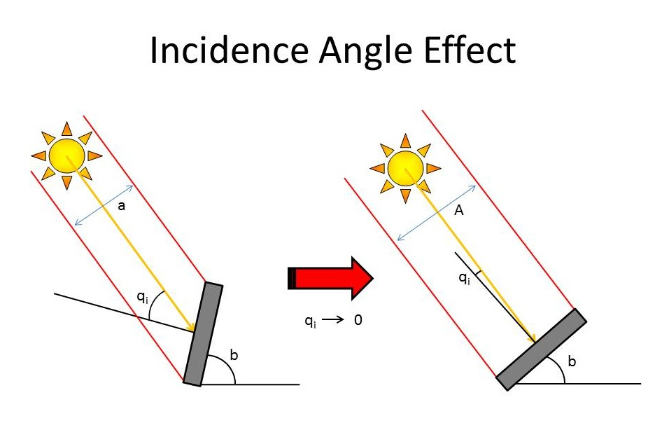
2. Angle of incidence
Find out how changing the angle of incidence (the inclination of a PV cell) affects its power output
You have 10 min to do the experiment before we collect the results

Slide 34
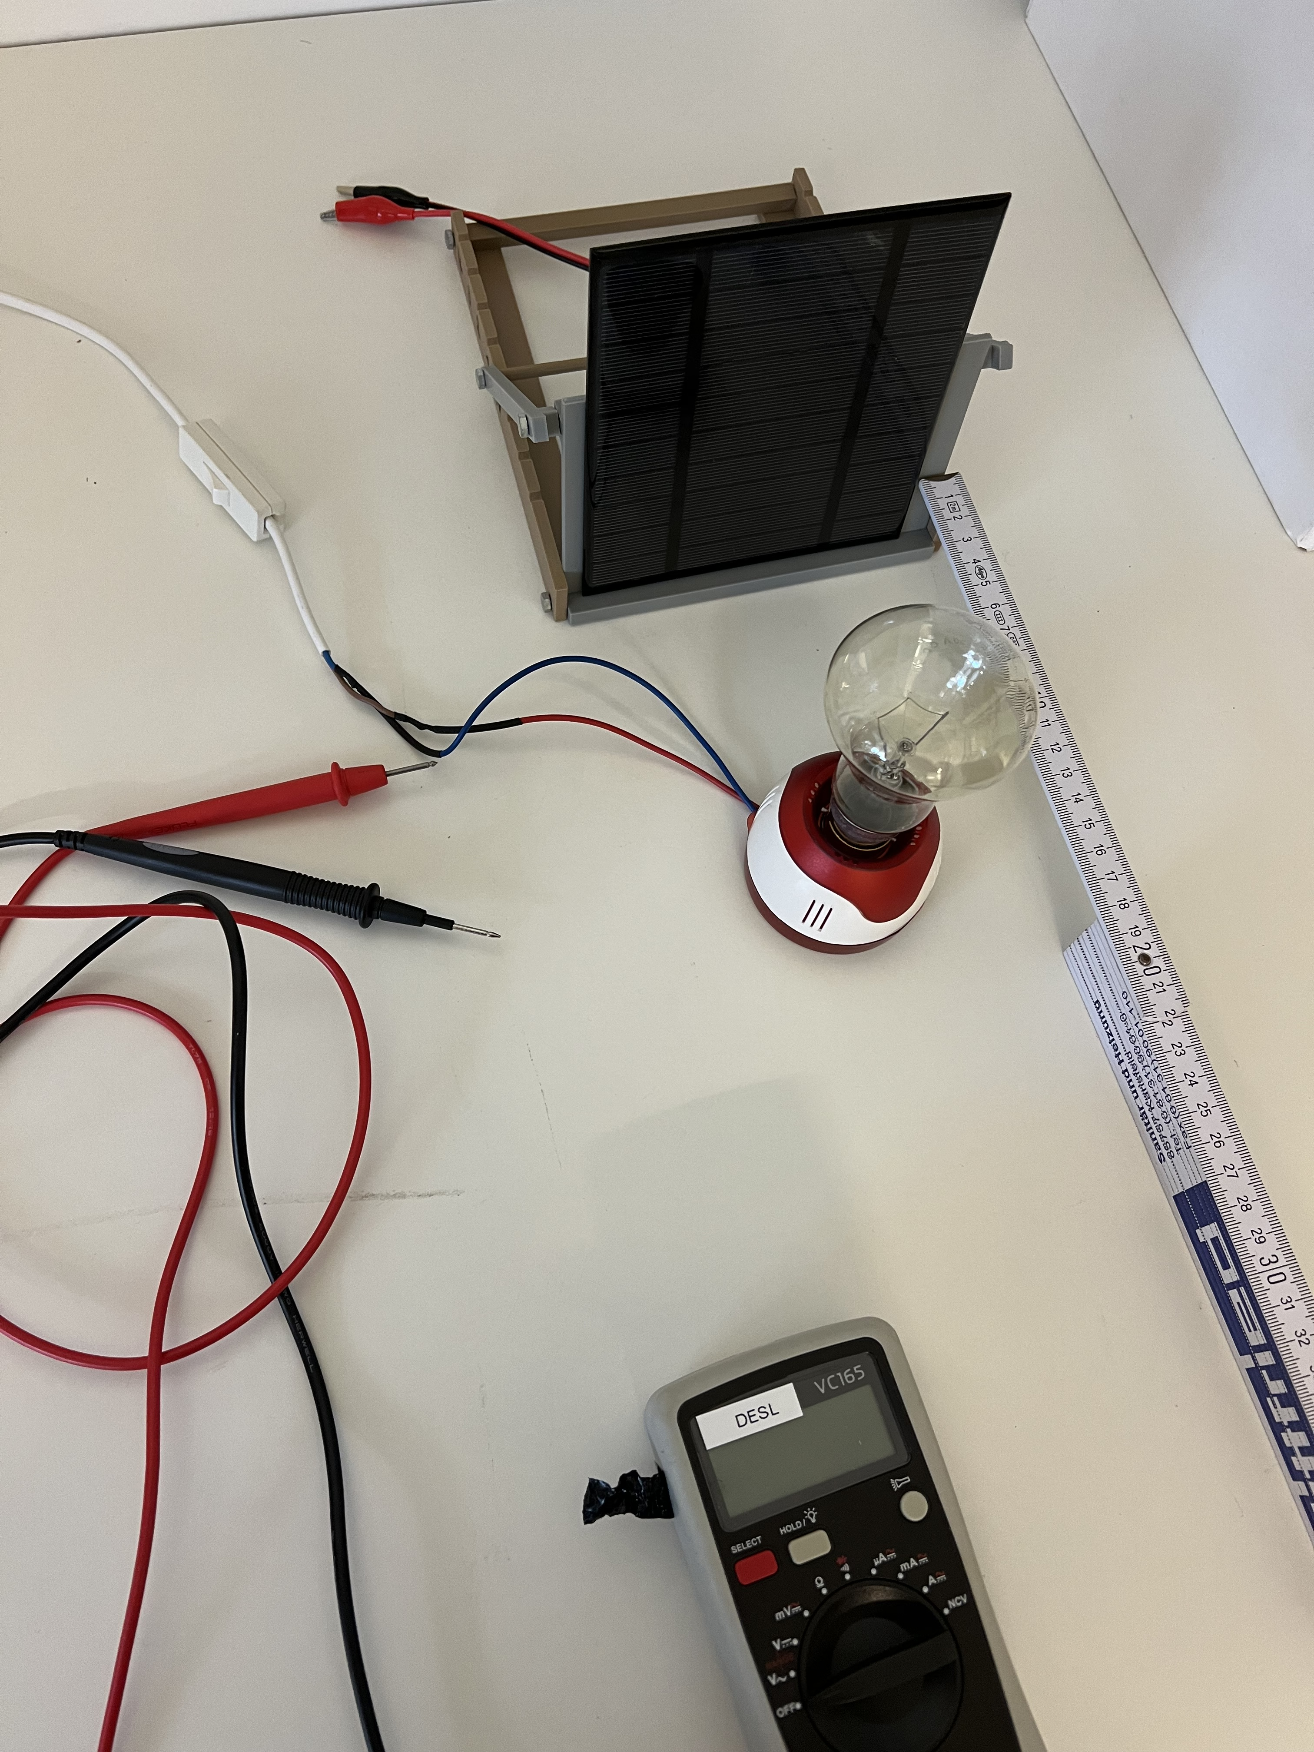
Conduct the experiment and do task 1, 2 following the instructions on your worksheet (pg. 19-20)
Help each other in the team, ask questions to the teacher if you are stuck or have any doubt
If you finish before the other teams, try to do the other tasks (together!) then wait ☺
Notes:
This image will reamain during the time of the experiment
The students will do the exepriement and tasks 1 and 2 themselves
Task 3 (formula) will be done together with the teacher (next slide)
Calculations can then be done alone again

Slide 35

Time for confronting results and observations with the other teams!
Scan the QR Code, write the name of your team and answer the question on the experiment you just concluded!

Slide 36
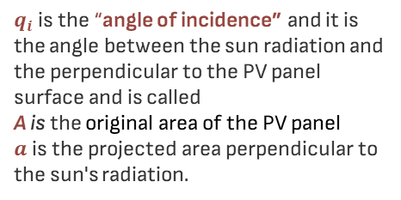
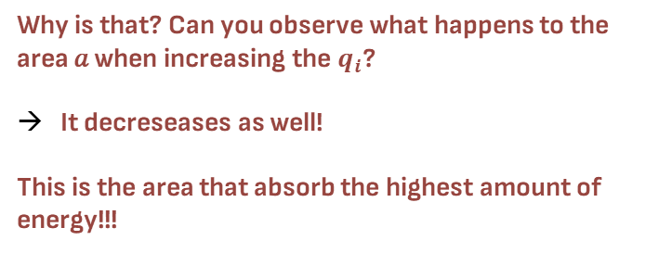
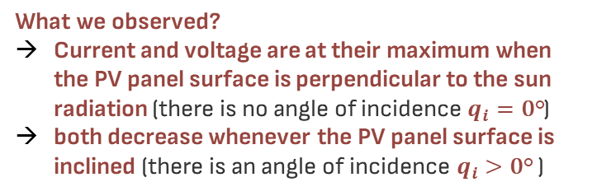


The PV panel absorbs the highest amount of energy when perpendicular to the sun radiation!
What we observed?
Current and voltage are at their maximum when the PV panel surface is perpendicular to the sun radiation (there is no angle of incidence $q_{i}=\text{0}\text{°}$)
both decrease whenever the PV panel surface is inclined (there is an angle of incidence $q_{i}>\text{0}\text{°}$ )
$$a$$
$$a$$
A
A
Why is that? Can you observe what happens to the area 𝑎 when increasing the $q_{i}$?
It decreseases as well!
This is the area that absorb the highest amount of energy!!!
$q_{i}$is the “angle of incidence” and it is the angle between the sun radiation and the perpendicular to the PV panel surface and is called
A is the original area of the PV panel
$a$is the projected area perpendicular to the sun's radiation$.$
Notes:
The teacher can use this slide after the experiment and mentimeter to repeat and confirm the main observation the students should have done in doing the experiment as well as in answering possible students questions
Also in this slide the teacher “explain” the reason behind the observation

Slide 37
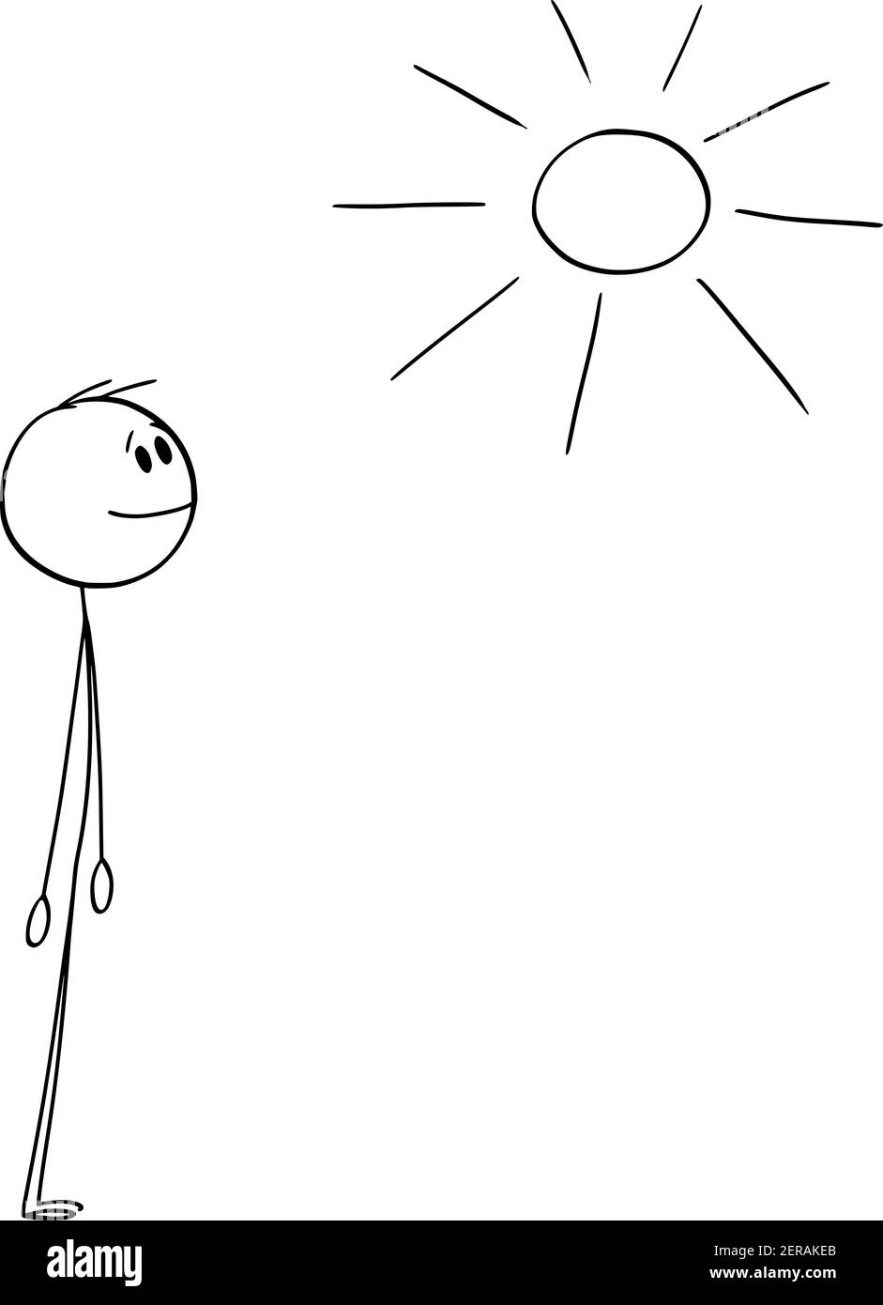
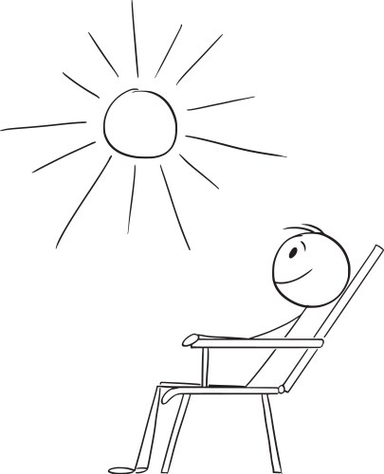
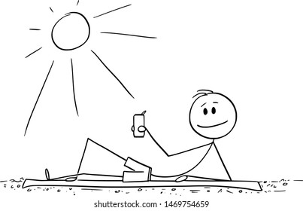
It is the same principle of when you are in the sun….
Who do you think is absorbing the highest amount of sun radiation? And in which part of the body?
Notes:
The teacher can use this metaphor to make more familiar the explanation about the concept of the perpendicular area as the one absorbing the most. The point is to link the concept to their personal experience!
(although our body is not a flat surface, still you can imagine it as such!)

Slide 38


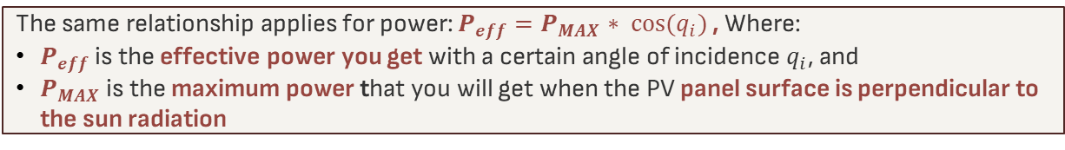

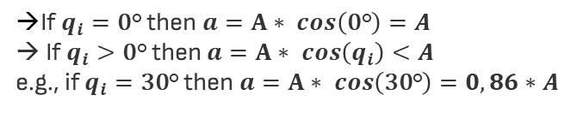


And now…let’s derive the formula with some geometry!
$$a$$
$$q_{i}$$
$$q_{i}$$
A
First let’s zoom in and look at this triangle….
How can we find $a$ as a function of A and $q_{i}$?
$$a$$
From geometry class we derive that$a=$ $A∗cos{(q_{i})}$
A
If $q_{i}=\text{0}\text{°}$ then $a=A∗ cos\left(\text{0}\text{°}\right)=A$
→ If $q_{i}>\text{0}\text{°}$ then $a=A∗ cos\left(q_{i}\right)<A$
e.g., if $q_{i}=\text{30}\text{°}$ then $a=A∗ cos\left(\text{3}\text{0}\text{°}\right)=0,86∗A$
The same relationship applies for power: $P_{eff}=P_{MAX}∗ \cos{(q_{i})}$ , Where:
$P_{eff}$ is the effective power you get with a certain angle of incidence $q_{i}$, and
$P_{MAX}$ is the maximum power that you will get when the PV panel surface is perpendicular to the sun radiation
Now, try to do task 4 (pg.21) on your worksheet together with your teammates!
Notes:
The teacher can use this slide after the formula has been derived in class using the black board ☺ doing step by step all the passages

Slide 39

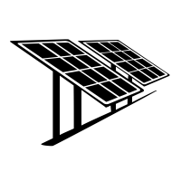
…ok all clear, I’ll put my PV panel so that is ALWAYS perpendicular to the sun!!
…wait a minute, but the sun moves around all the time!!!!
or perhaps I should better say, WE move around the sun all the time!
What time is it?
What day of year?
Where am I?
The sun changes its position not only during the day, but you might have noticed it also change throughout the year*. Furthermore, it changes its position also based on where you are…
*If you have never noticed it, find a place from where you can see the sunrise/sunset and take a picture/draw it on Dicember 21° and on June 21° and then compare!
Notes:
The teacher can use this slide to make the students think about the concept a bit further introducing other interesting daily life facts as understanding how the sun position will change based on the time and place
This should help student understand that an analysis of the position of the sun along the year in the specific place the PV panel is intended to be installed is needed!

Slide 40
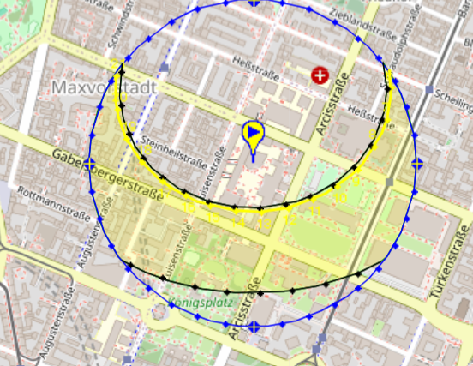
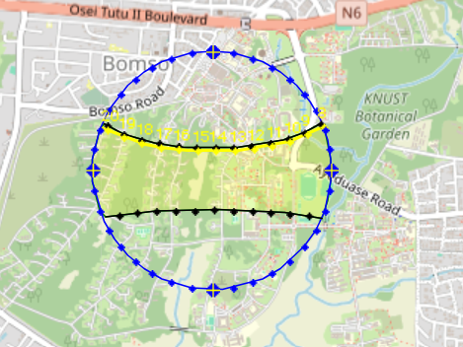
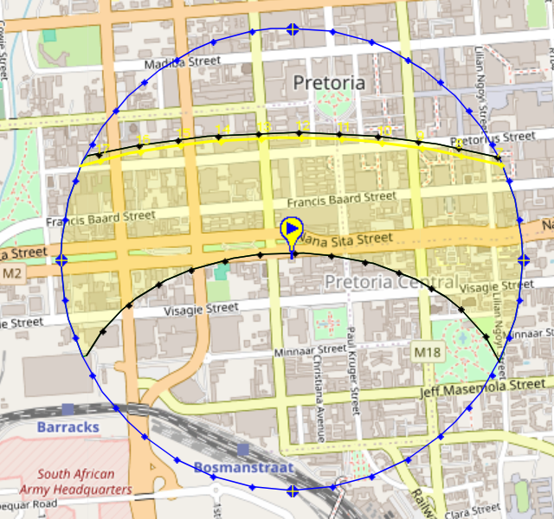
Let’s check the position of the sun in different locations…
These are the sun paths in 3 technical universities: Technical University of Munich (TUM), Kwame Nkrumah University of Science and Technology (KNUST) and Tshwane University of Technology
TUT (Johannesburg, South Africa
Can you guess which one is which picture? Why? What is the location of the universities?
TUM (Munich, Germany)
KNUST (Kumasi, GHANA)
North
East
West
At home you can further explore the sun map, for example looking for the location where you have the most north or south positions of the sun!
South
Notes:
The teacher can use this slide as a simple engaging game to check whatever they understood, linking to the exercise they made in the student worksheet (It is important to talk about places familiar to them or that might be interesting for them!)
The teacher can use this website to see the sun position in other areas: https://www.sunearthtools.com/dp/tools/pos_sun.php?lang=it
Before going to the next slide, the teacher could ask to the student if, after all said about the sun changing its position, they have any idea on how then they should put the PV panels

Slide 41
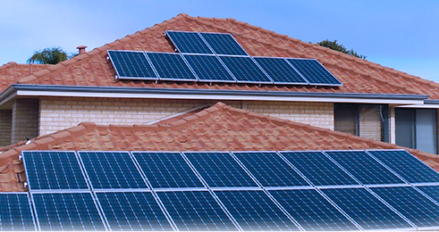


So, how should I put my PV panels if the sun position is continuously changing?
Some examples
Putting my PV panels in the position such as they face directly the sun at the at the time of the day/year:
there is the highest light intensity (we’ll discover more about light intensity in the next experiment!)
it is needed the most (e.g., school?, private house?)
Or placing a Solar Tracking Systems (even without GPS!) so that I don’t need to worry about anything…the system will move the PV panels according to the sun position!
And/or putting my PV panels in different positions!
Notes:
The point here is to understand that there is not one solution, but multiple ones!
Based for example on:
the number of PV panels
The type of PV panels (e.g., thin film are flexible and have different position toward the sun)
the location you can place them (e.g., am In putting them on already existent roofs with a certain inclination and position toward the sun or am I placing them on a solar farm?)
the possibility to store energy in a battery
the possibility to connect to the grid or to share the energy with someone else
The purpose/load (e.g., you could face it to maximize the energy output during the day if you are in a school, in the evening if you are in a private home, or perhaps you want to maximize it only in a certain season when you use it only for agriculture purposes or perhaps you want to maximize the overall energy output throughout the year)
….

Slide 42



3. Light intensity
Find out how light intensity influences the performance of a PV module
You have 10 min to do the experiment before we collect the results

Slide 43

Conduct the experiment and do task 1,2 following the instructions on your worksheet (pg. 23-24)
Help each other in the team, ask questions to the teacher if you are stuck or have any doubt
If you finish before the other teams, try to do the other tasks (together!) then wait!
Notes:
This image will reamain during the time of the experiment

Slide 44

Time for confronting results and observations with the other teams!
Scan the QR Code, write the name of your team and answer the question on the experiment you just concluded!

Slide 45



The light intensity is higher closer to the radiation source!
The light intensity is the sun radiation energy that hits $a$ (the projected PV panel surface area perpendicular to the sun radiation) in a unit of time $t$.
When the projected area is closer to the radiation source, the light intensity increase because more radiant energy hits the surface!
Still not clear ? Turn of the light in the room and put your hand closer and further away from the lamp. How does the illuminated area on your palm change? And how about the heat you feel?

Slide 46


Light intensity is higher at the equator (very close to Ghana)!
Wait, but… is sun closer to the earth at the equator?
Yes and no! Although it is true the equator is closer to the sun, this difference is negligible given the sun's distance from the earth! Rather, the reason why light intensity is higher at the equator is due to:
Ghana
1. The lower angle of incidence
→ you should already know what this means
2. The lower distance travelled by sunlight in the atmosphere
Equator
→ many solar radiation are “lost” in the atmosphere never reaching the earth due to particles absorbing and scattering the radiations!
Look at the first minute of this video to visualize it: Why is equator hot

Slide 47

For you: Why do you think the sun is red at sunset/sunrise time?
Notes:
The colour of the light is red because only the long wavelengths/ red reach different because at the sunset and sunrise time the angle of incidence is higher and the distance the sunlight has

Slide 48

4. Heat
Find out how heat affects the performance of PV modules
You have 10 min to do the experiment before we collect the results

Slide 49

Conduct the experiment and do task 1 following the instructions on your worksheet (pg. 26-27)
Help each other in the team, ask questions to the teacher if you are stuck or have any doubt
If you finish before the other teams, try to do the other tasks (together!) then wait!
Notes:
This image will reamain during the time of the experiment

Slide 50

Time for confronting results and observations with the other teams!
Scan the QR Code, write the name of your team and answer the question on the experiment you just concluded!

Slide 51

When temperature increase, the PV panel capacity to generate power decrease!
Why??
When temperature increase, the bandgap energy decrease because electrons get more excited and are freer to move. This results in:
+ slightly higher current (I) because more electrons have enough thermal energy to cross the bandgap
--- significant smaller voltage (V) because of the reduction in bandgap energy and more electrons falling back in the valence band
-- smaller power output (P = I x V) because the voltage decrease is higher than the current increase
PV panels like (sun)light but not heat (these are 2 very different forms of energy!)
Notes:
The teacher can use also this short simulation to show how electrons are increasingly moving with temperature increase: https://youtu.be/lbh5u05PzC4?si=-RqmPyXBFyGqgglz! Please note that in this video they show electrons moving in a conductor material while in PV cells we use a semiconductor material, but the concept is the same! The only difference is that there would be a little gap (the bandgap) between the valence and the conduction band.
If the teacher find it useful it could link it again to the metaphor of the kangaroo for example saying that temperature increase is like a new form of energy that increase the height of the lowest step so that the difference of height between the two steps decreased and therefore while more kangaroo can easily jump to the highest step (current increase), the potential energy/work that could be done by the kangaroo jumping to the highest step has decreased (voltage decrease).

Slide 52

Some “cooling solutions” examples to decrease the temperature
Putting PV panels on the water
Cleaning the PV panels!
Notes:
The teacher could ask the students to think about some solutions before showing the slide or perhaps questions around what they think could be other examples or what do they think are the pros and cons of each solution…

Slide 53



5. Pollution
Find out how pollution on PV modules affects their performance
You have 10 min to do the experiment before we collect the results

Slide 54

Conduct the experiment and do task 1,2 following the instructions on your worksheet (pg. 31-32)
Help each other in the team, ask questions to the teacher if you are stuck or have any doubt
If you finish before the other teams, try to do the other tasks (together!) then wait!
Notes:
This image will reamain during the time of the experiment

Slide 55

Time for confronting results and observations with the other teams!
Scan the QR Code, write the name of your team and answer the question on the experiment you just concluded!

Slide 56
Polluted PV panels generate less power and have shorter lifetime!
What are the possible pollutants?
Dust and dirt
Organic matter (e.g., leaves, algae, birds poop)
Chemical/mineral residues in the air/water
Why is power output reduced?
Pollutants can decrease the power output by reducing the light absorption (e.g., increasing the reflexivity of the surface) or by obstructing the light (e.g., through scattering)
Why is lifetime reduced?
Pollutants can decrease the panels lifetime through chemical degradation (e.g., substances that lead to corrosion) or through physical wear (e.g., through abrasion)

Slide 57




Air quality in Ghana seems to be reducing since 2024…
Some possible solutions:
Regular/automatic (water or without water) cleaning systems to remove dirt
anti-soiling coatings to reduce dirt adherence
Read the full article here

Slide 58



6. Shade
Find out how shade on PV modules affects their performance
You have 10 min to do the experiment before we collect the results

Slide 59

Conduct the experiment and do task 1 following the instructions on your worksheet (pg. 34-35)
Help each other in the team, ask questions to the teacher if you are stuck or have any doubt
If you finish before the other teams, try to do the other tasks (together!) then wait!
Notes:
This image will reamain during the time of the experiment

Slide 60

Time for confronting results and observations with the other teams!
Scan the QR Code, write the name of your team and answer the question on the experiment you just concluded!

Slide 61

Any shadow on your PV panel can reduce significantly the power output!
Even a small shadow on few PV cells could have the same effect of a big shadow on the entire PV panel!
The reason is that in a PV panel, PV cells are connected in series which means that the same current (I) must flow in every cell of the panel and therefore if only in one cell the current dscrease because of the shadow, in all cells the current is «forced» to decrease.
Remember this concept; it will help you in the experiment where we connect PV panels in series!
Shadows stop or reduce the amount of sunlight that reaches the PV cells, stopping or reducing both current and voltage (and therefore power!)
Notes:
To better explain the concept of PV cells in series

Slide 62



Some example solutions to avoid shadowing losses
Choose a good “shadow free” location to put your PV panels after having considered how shadow evolve over the day/year!
Use other technological solutions such as bypass diode to prevent partial shadow (e.g., on few PV cells) from limiting the current of the entire series on the PV panel
Look the video to better understand how Bypass diode works

Slide 63
04
Summary and conclusions
Wrap-up what we’ve learned today and some surprises

Slide 64
Summary
This slide is purposefully left not filled, as the teacher will decide what activity is best to do based on the time left, the mood of the class.
Some options:
Go back to the learning objectives and repeat the main learnings/ask if there is any question
Give a small exercise/story to do again in teams (e.g., there are two roofs in a house….where should I install my PV panels to maximize the efficiency?)
Watch the chapter summary video (slide 57)

Slide 65
Conclusions
Thanks to an accurate understanding and analysis of all the basics external factor we learned about today you’ll be able to:
(Better) design your PV panels system
Improve your PV panels power output and efficiency
Maintain your PV panels and increase their lifetime

Slide 66
Thank you and see you later to learn more about PV panels!

Slide 67
If you need to review the content of this lesson, look at our summary video here!

Slide 68
Icon pack

Slide 69
Alternative resources
Here’s an assortment of alternative resources whose style fits that of this template:
Electricity icon flat

Slide 70

…through the photovoltaic effects in PV cells!
Start by looking at the animation here...
Sunlight
Photons
Now let’s try to describe what we saw…
…and what is happening
1. Yellow balls hit the surface and enter the material
2. Red balls, accumulated at the bottom, start to move up creating white balls that are left at the bottom.
3. Red balls flows out in the circuit lighting up the bulb and then flow back at the bottom destroying white balls
1. Photons (of which sunlight is made of!) hit the PV cell surface and are absorbed by the PV cell semiconductor material
2. Electrons in the PV cell, that are in the P-type silicon (engineered material with extra holes-lower electrons), free themselves from atomic bonds and move in the N-type silicon (engineered material with extra electrons), leaving even more holes behind.
3. Electrons collected in the N-type silicon flow out of the cell into an external circuit, creating an electric current and then flow back in the P-Type silicon, falling back in the holes
What is the photovoltaic effect?
This is just the fancy name we use to call the process by which PV cells converts sunlight into electricity.
Notes:
The teacher can use also this video (min 1 to min 6) for a more detailed explanation: https://www.youtube.com/watch?v=YSRs3PuYT_k
As well as this set of videos for a refresher on semiconductors and PN junctions: https://www.khanacademy.org/science/in-in-class-12th-physics-india/in-in-semiconductors
Again, the process explained with a bit more details:
Absorption of Sunlight: Sunlight consists of particles of light called photons. When sunlight hits the surface of the PV cell, these photons are absorbed by the semiconductor material (usually silicon) of which PV cells are made of
Excitation of Electrons: The energy from the absorbed photons is transferred to the electrons in the semiconductor material. This energy boost excites the electrons, giving them enough energy to break free from their atomic bonds
Creation of an Electric Current: Once freed, these excited electrons are free to move within the material. This movement creates an electric current within the electric field of the PV cell. The electric field in the PV cell is created thorough a PN junction i.e., the junction of two types of silicon: a N-type silicon plate which has extra electrons (the blue plate in the picture) and a P-type silicon plate which has extra holes for electrons (the green one in the picture).
Current Flow: As electrons are pushed to the N-type silicon, they are collected by metal contacts and flow out of the cell into an external circuit, creating an electric current.

